Slide 1


Well come to our class!
Unit 11: What’s the matter
with you?
Lesson 2
Class : 5A4
Teacher : Nguyen Thi Nga

Slide 2
Unit 11: What’s the matter
with you?
Lesson 2

Slide 3

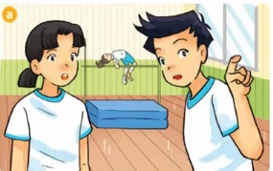
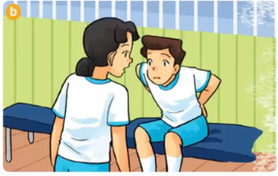
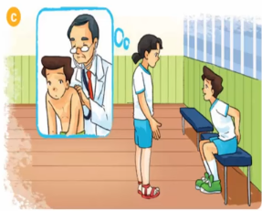
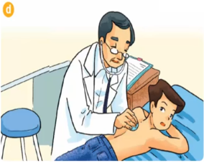
Where’s Nam? I can’t see him here.
Hi, Nam. Why aren’t you pactising karate?
Sorry to hear that.
I don’t feel well.
I have a backache.
He’s sitting over there, in the corner of the gym.
You should take a rest and shouldn’t phay sports for a few days.
You should go the doctor now, Nam.
OK, I will. Thanks, Mai.
Thank you, doctor.

Slide 4

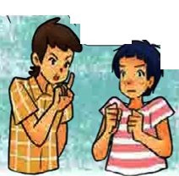



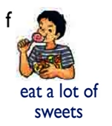
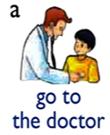
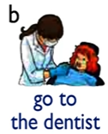
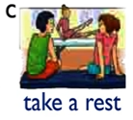
You should .
You shouldn’t .
go to the doctor
carry heavy things
Yes, I will. Thanks
OK, I won’t. Thanks

Slide 5

I have a/an .
You should .
Yes, . Thanks
You shouldn’t .
OK, . Thanks

Slide 6

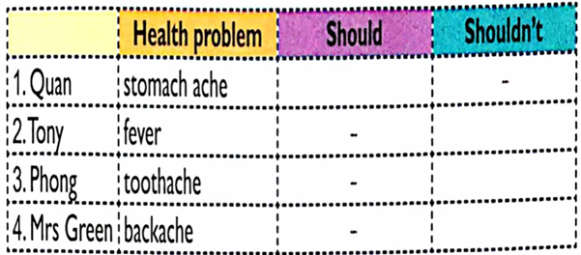
go to the doctor
go to the school
eat ice cream
carry heavy things

Slide 7
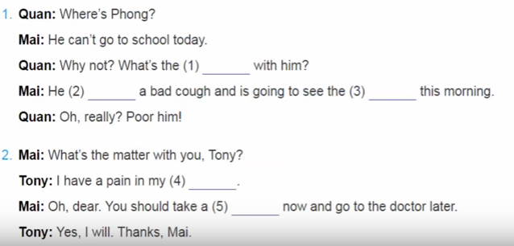
rest
stomach
matter
has
doctor

Slide 8
Homework
    - Chuẩn bị bài lesson 3.

Slide 9
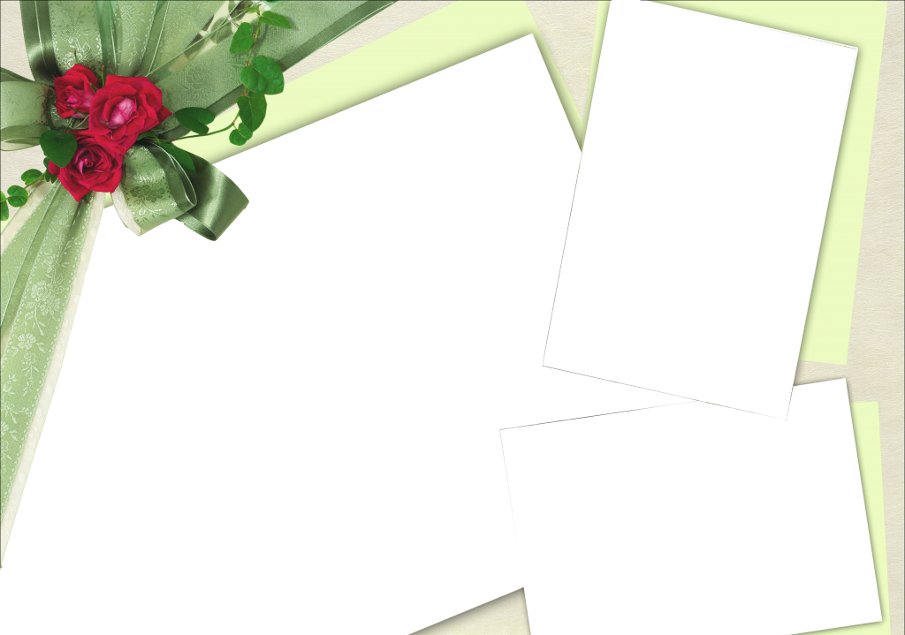

KÍNH CHÚCQUÝ THẦY CÔ SỨC KHỎE!

