Slide 1
Welcome to our class 4A2
Teacher: Ms Mai

Slide 2


WARM- UP

Slide 3











Slide 4
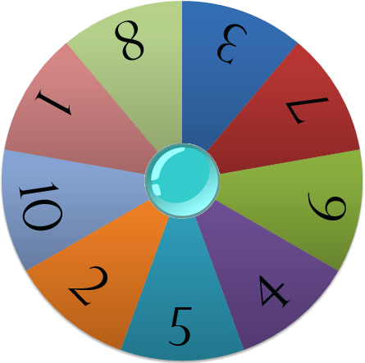
Lucky Wheel
RULES:
There are 6 numbers ( 5 questions and 1 Lucky number)
Choose the number & answer the question.
If the answer is right, the team will allow to spin the Wheel. If not, they will not allow to spin the Wheel.
The Team with the higher points is the Winner.
Play

Slide 5



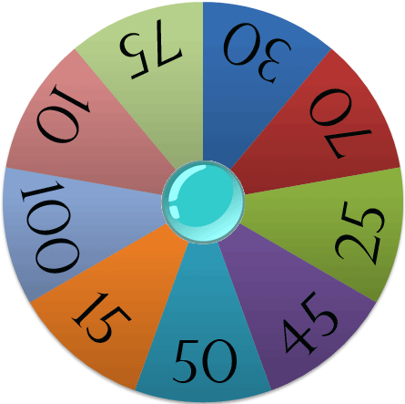




Choose a number
Spin
Points

Slide 6
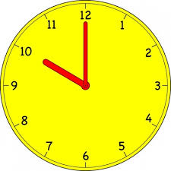

04
03
01
00
02
05
10.00
A
B
11.50
C
10.15

Slide 7
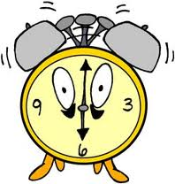

04
03
01
00
02
05
7.00
A
6.00
B
4.00
C

Slide 8
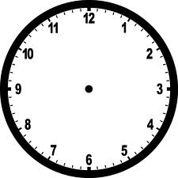
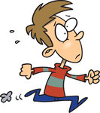
04
03
01
00
02
05
A
2.50
2. 45
B
1.45
C

Slide 9
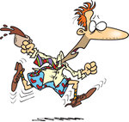
04
03
01
00
02
05
12:15
A
12:20
B
12:25
C

Slide 10
04
03
01
00
02
05
A
8:45
8:25
B
8:50
C

Slide 11
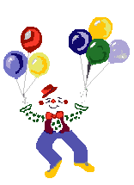






Slide 12
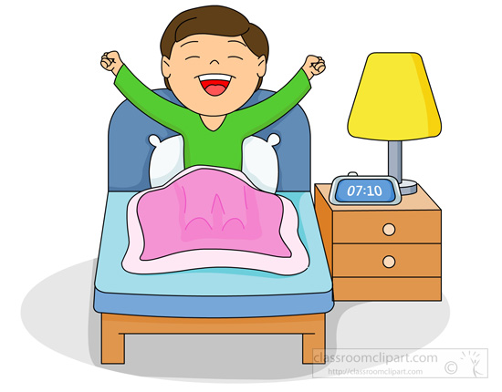

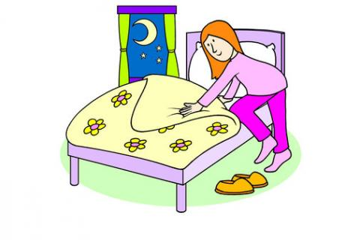
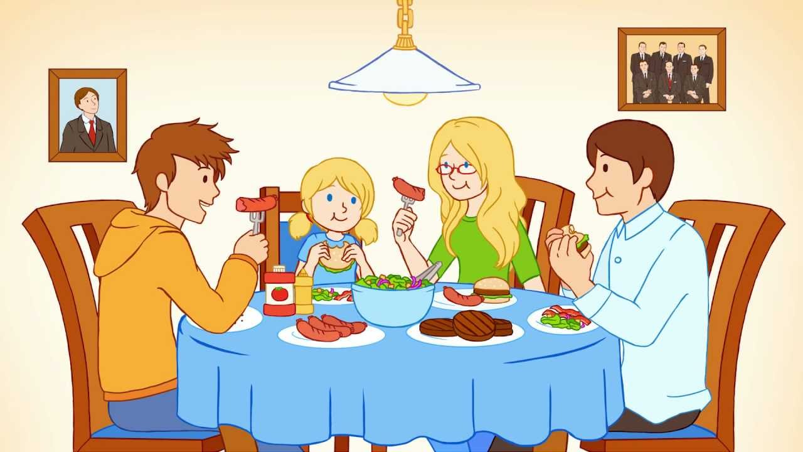
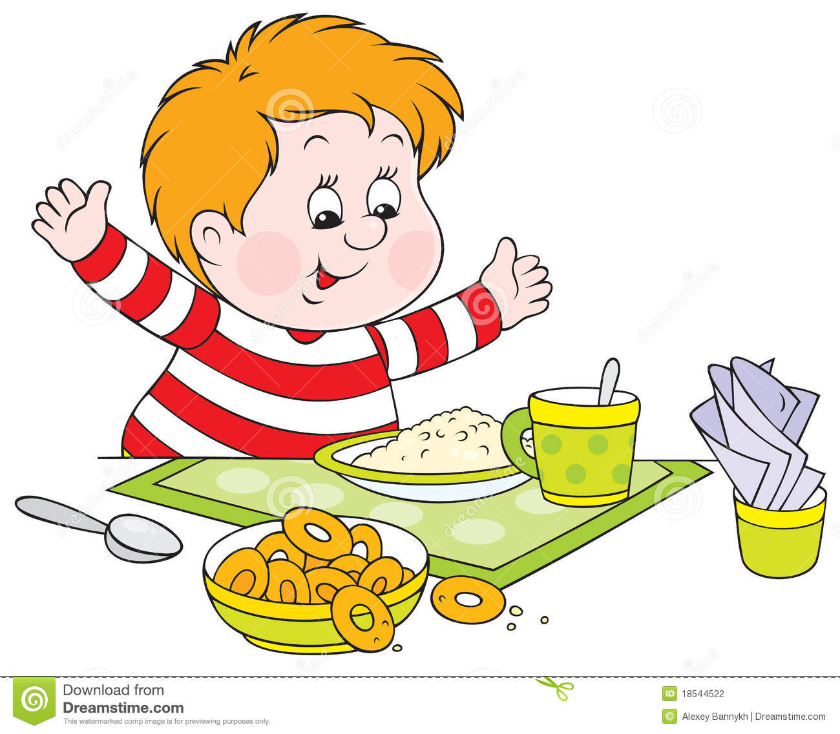
New Words
- Go to bed
- Have breakfast
- Go to school
- Have dinner
- Get up

Slide 13
Get up
Have breakfast
Have dinner
Go to School
Go to bed
Thức dậy
Ăn sáng
Ăn tối
Đến trường
Đi ngủ

Slide 14

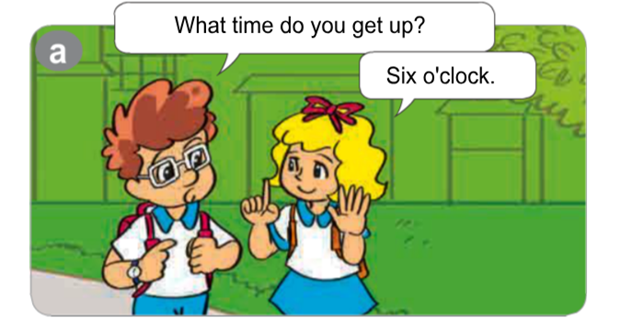

Unit 11: What time is it ?
Lesson 2

Slide 15
Unit 11: What time is it ?
Lesson 2

Slide 16
Unit 11: What time is it ?
Lesson 2

Slide 17
Sunday, January 13th 2019
Unit 11: What time is it ?
Lesson 2:1->6

Slide 18
*Structures:
Get up
What time do you …….......?
get up
6 o’clock
I ……… at …….……

Slide 19
Unit 11: What time is it ?
Lesson 2

Slide 20
Unit 11: What time is it ?
Lesson 2
It’s eight fifteen
I get up at six o’clock

Slide 21
Unit 11: What time is it ?
Lesson 2
Example:
a.7:00
b.7:30
c.8:15
d.8:00
e.9:00

Slide 22
Unit 11: What time is it ?
Lesson 2

Slide 23
Unit 11: What time is it ?
Lesson 2

Slide 24
THANK YOU !

