Slide 1


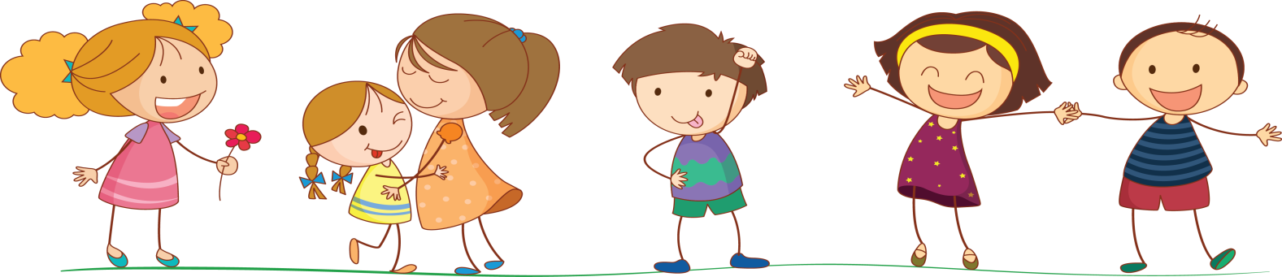
UNIT ̃ 8. WHAT SUBJECTS DO YOU HAVE TODAY?
LESSON 2

Slide 2
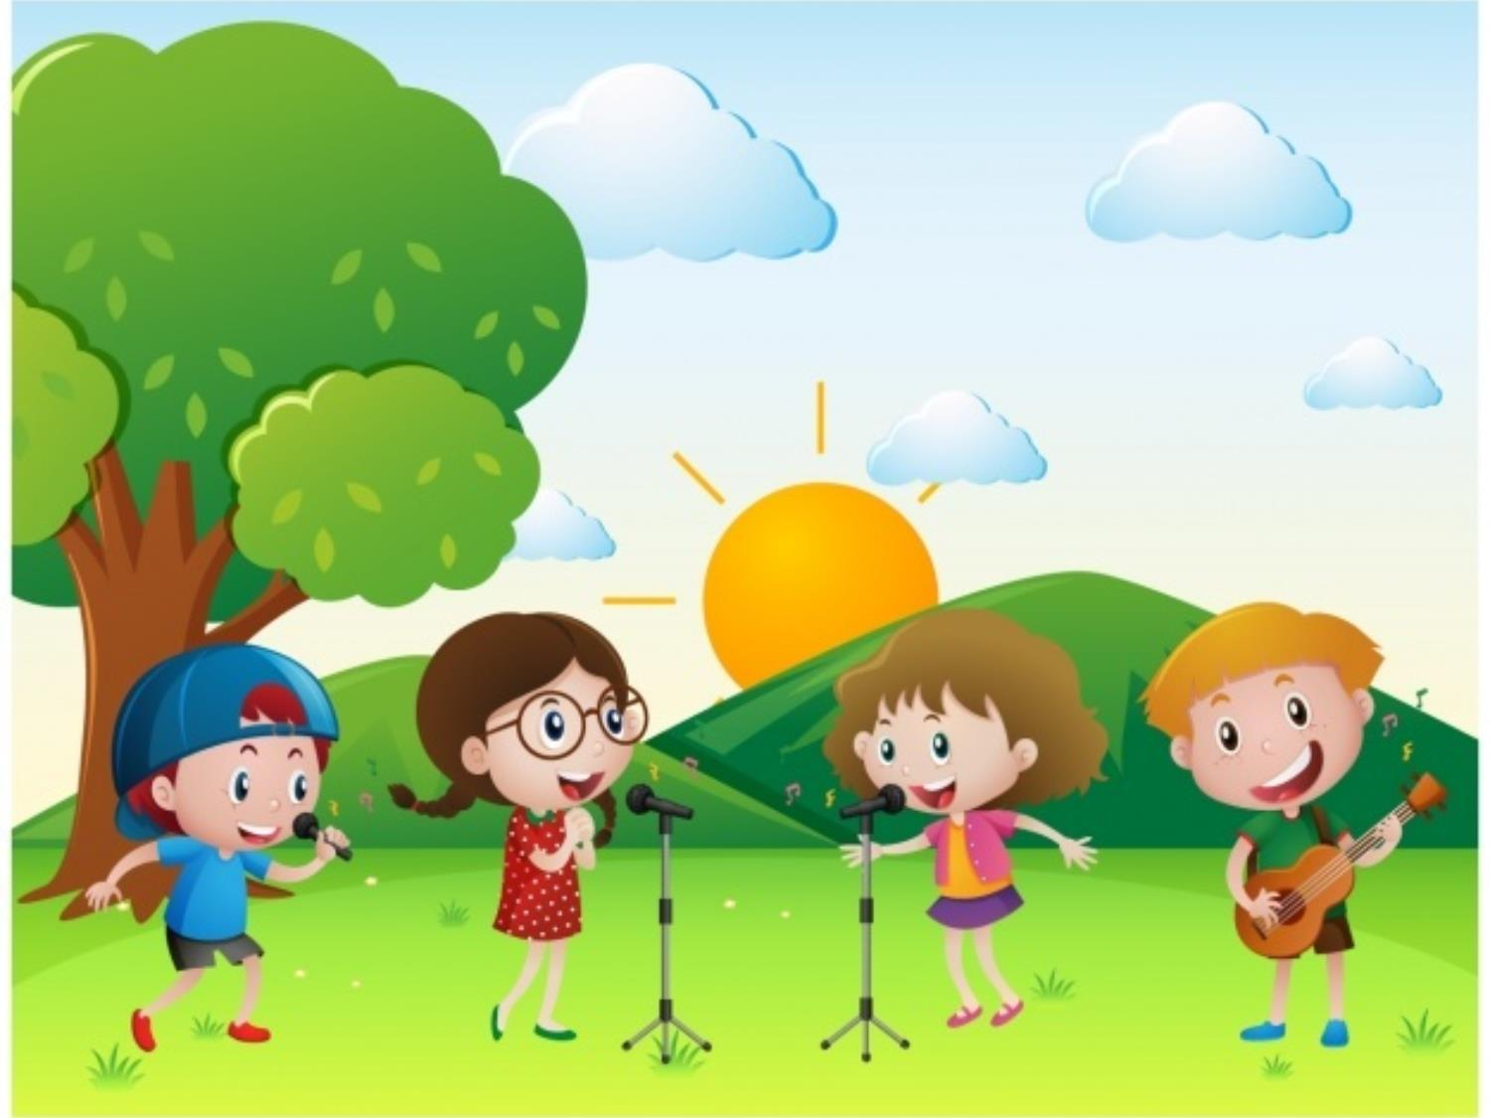

WARM UP

Slide 3



Slide 4
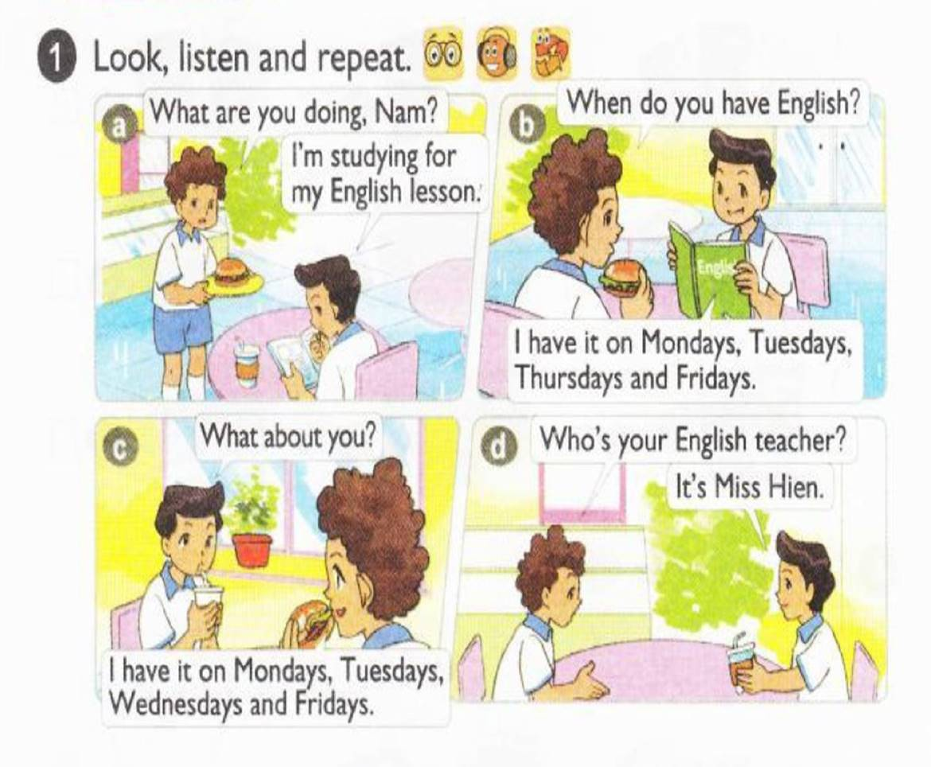




Slide 5
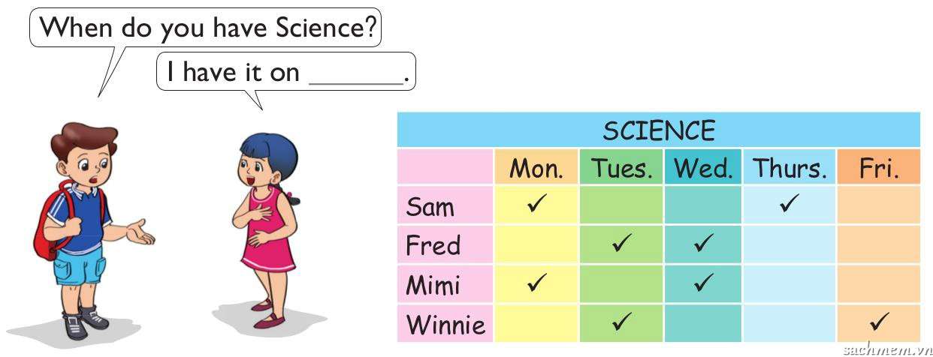


POINT & SAY

Slide 6



Model sentence
When do you have Science?
I have it on Mondays and Thursdays.
When do you have English?
I have it on Mondays, Tuesdays and Fridays.

Slide 7

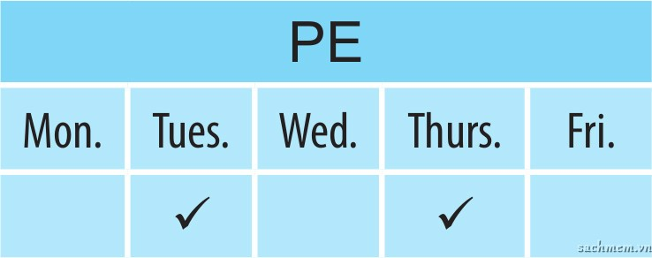
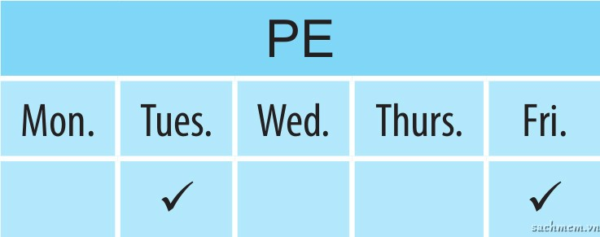
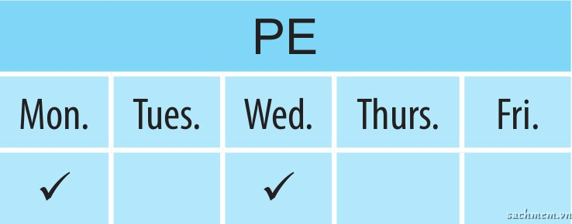
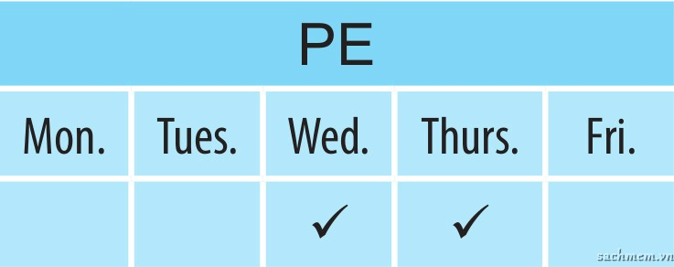
LISTEN AND NUMBER
1
3
4
2
3
1
2
4

Slide 8
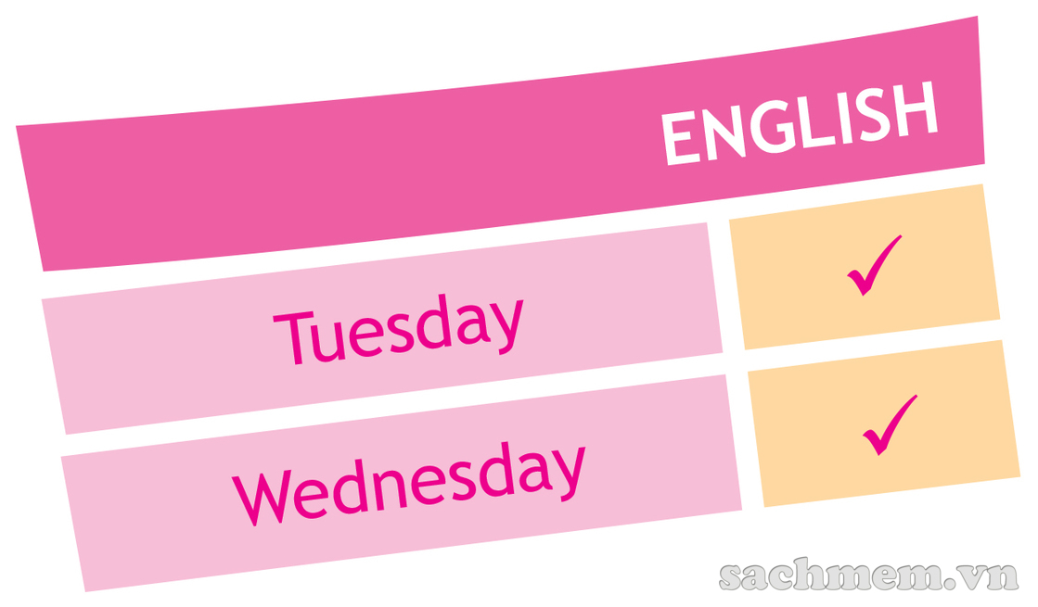
LOOK & WRITE
Today is . I have today. Tomorrow is I have English on too. When do you have English?
Tuesday
English
Wednesday
Wednesday

Slide 9
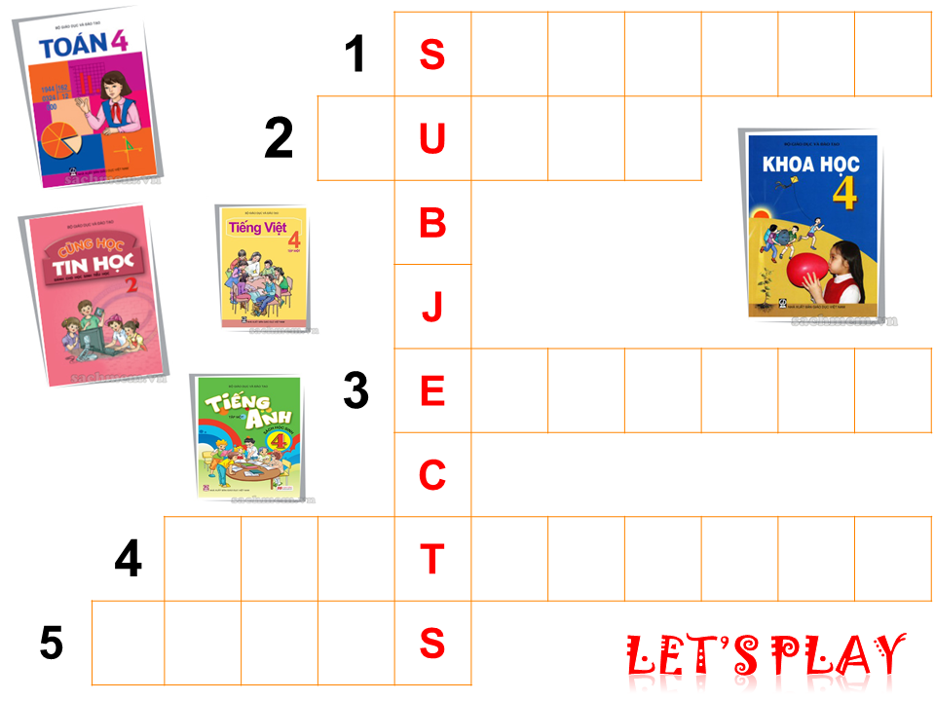
1
C
I
E
N
C
E
2
M
S
I
C
3
N
G
L
I
S
H
4
V
I
E
N
A
M
E
S
E
5
M
A
T
H

Slide 10


Slide 11
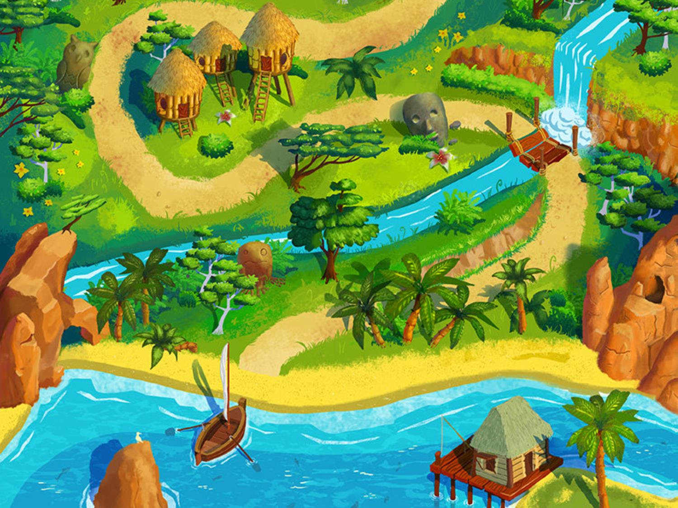


Honey Island

Slide 12





Slide 13
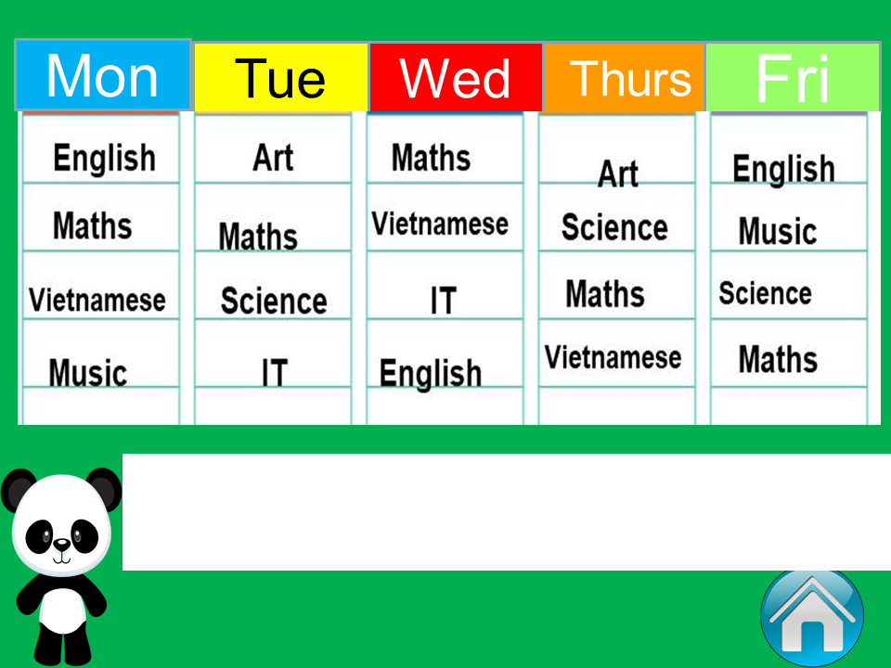

I have English, Maths, Vietnamese and Music on
Monday

Slide 14
I have Maths, Vietnamese, IT and English on
Wednesday

Slide 15
I have Art, Maths, Science and IT on
Tuesday

Slide 16
I have Art, Science, Maths and Vietnamese on
Thursday

Slide 17
I have English, Music, Science and Maths on
Friday

Slide 18
I have Maths on
Mondays, Tuesday
Thursdays and Fridays

Slide 19
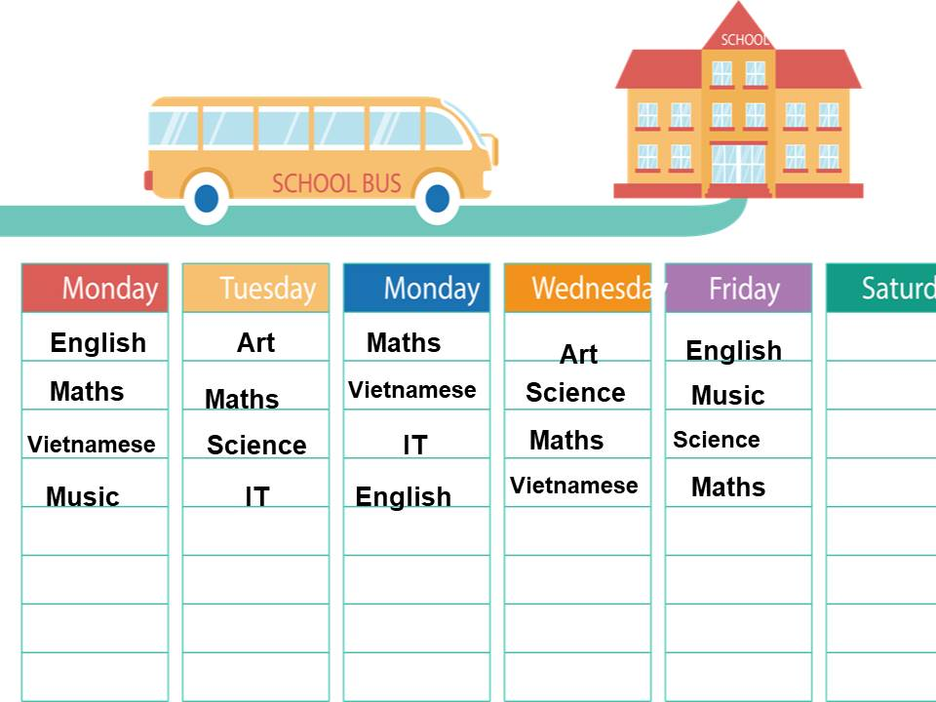
I have English on
Mondays, Wednesdays
and Friday

Slide 20
I Vietnamese on
Mondays, Wednesdays
and Thursdays

Slide 21
I have Science on
Tuesdays, Thursdays
and Fridays

Slide 22
I have IT on
Tuesdays and Wednesdays

Slide 23
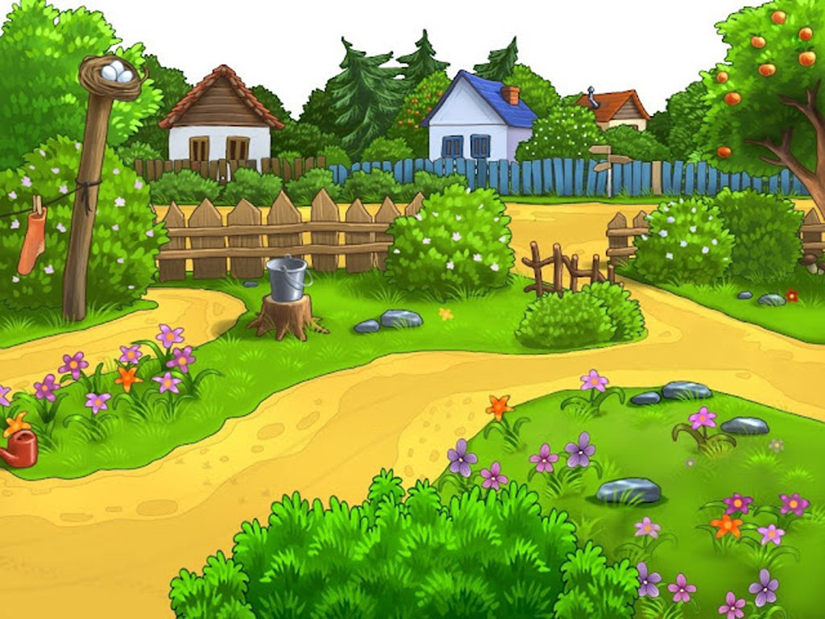
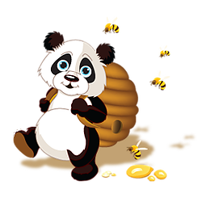

Slide 24


