Slide 1

Getting Started
Lesson 5
Page 9

Slide 2

WARM UP

Slide 3
1
4
6
1
SPIN
2
5
2
5
4
3
3
6
Next Part

Slide 4

What color is it?
Go back

Slide 5

Say and do.
Go back

Slide 6
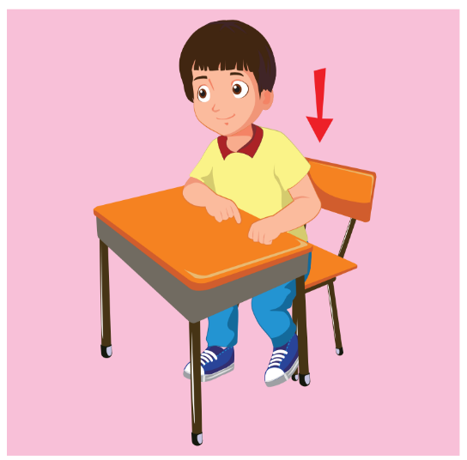
Say and do.
Go back

Slide 7

Say and do.
Go back

Slide 8

What’s your name?
Go back

Slide 9

What color is it?
Go back

Slide 10

It’s time to learn …

Slide 11

New words
red
yellow
blue
black
white

Slide 12

A
Listen and point. Repeat. (CD1 Track 10)
A
B
C
D
E
1
2
3
4
5
one
two
three
four
five
/wʌn/
số một
/tuː/
số hai
/θriː/
số ba
/fɔːr /
số bốn
/faɪv/
số năm
Click on each English word to hear the sound.

Slide 13
A
Listen and point. Repeat. (CD1 Track 10)
F
G
H
I
J
6
7
8
9
10
six
seven
eight
nine
ten
/sɪks/
số sáu
/ˈsevn/
số bảy
/eɪt/
số tám
/naɪn/
số chín
/ten/
số mười
Click on each English word to hear the sound.

Slide 14

Listen and choose.
6
10
1
8
4
Keys

Slide 15
Listen and choose.
4
7
5
9
2
Keys

Slide 16
Listen and choose.
1
4
8
3
10
Keys

Slide 17
Listen and choose.
3
6
2
7
1
Keys

Slide 18
Listen and choose.
3
9
2
8
10
Keys

Slide 19
Listen and choose.
2
6
5
1
9
Keys

Slide 20
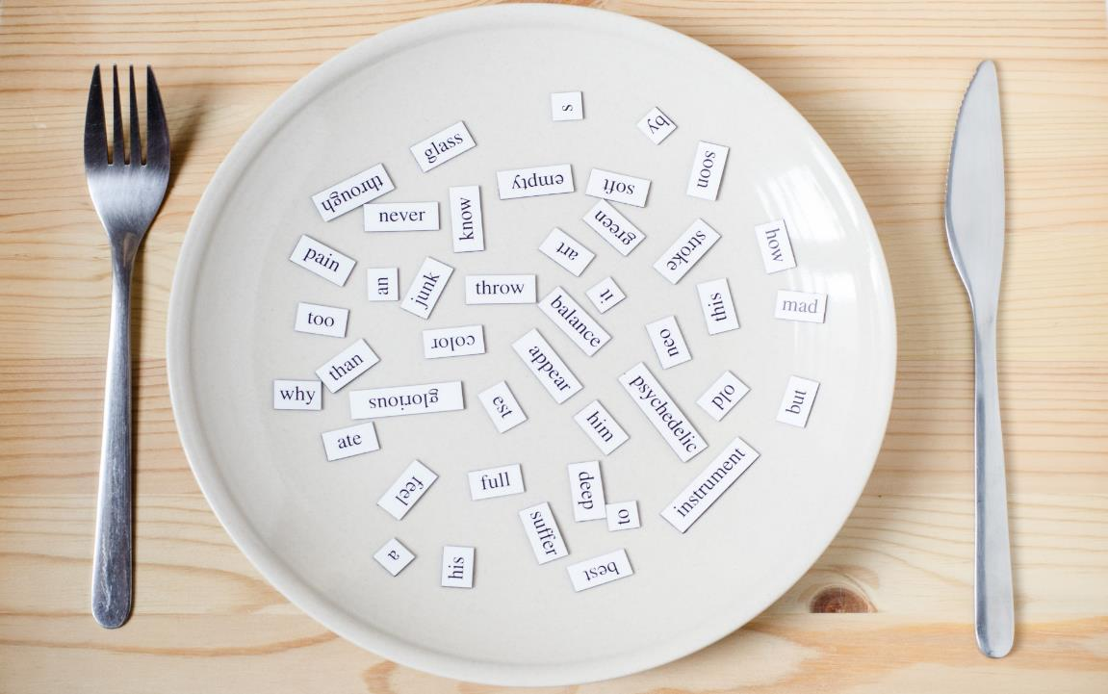
Structures
How old are you?
I’m eight.

Slide 21
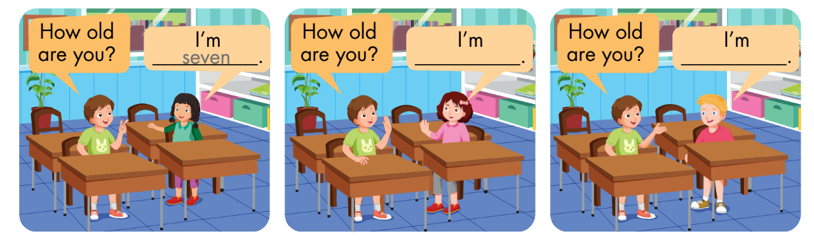
B
Listen and fill in the blanks. Repeat. Role-play. (CD1 Track 11)

Slide 22
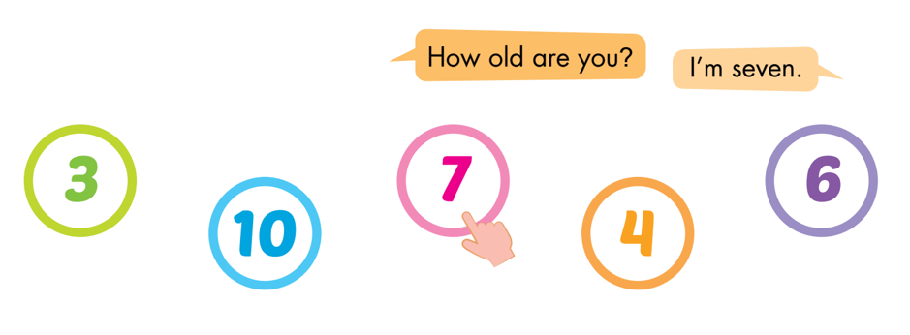
C
Point, ask, and answer.

Slide 23
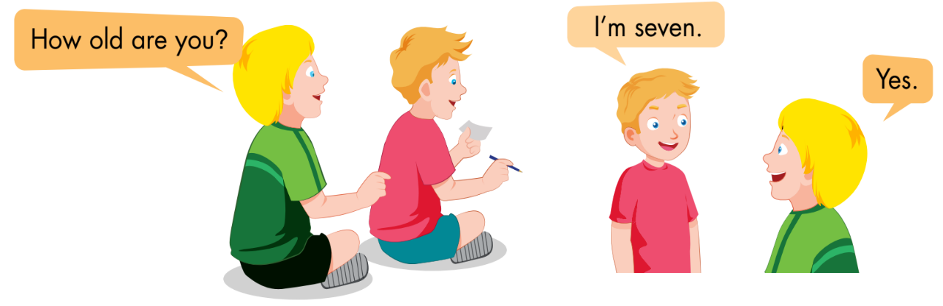
D
Play Magic finger.

Slide 24
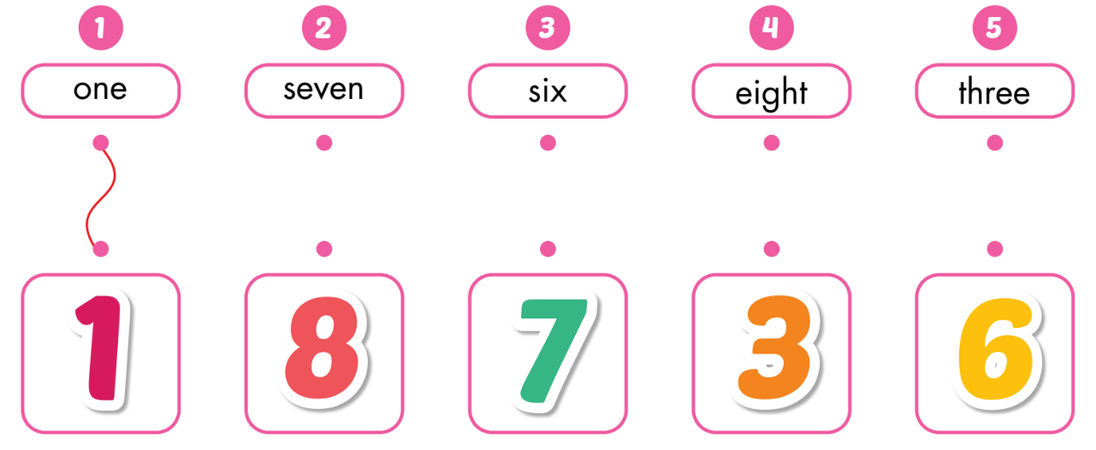
A
Draw lines.

Slide 25
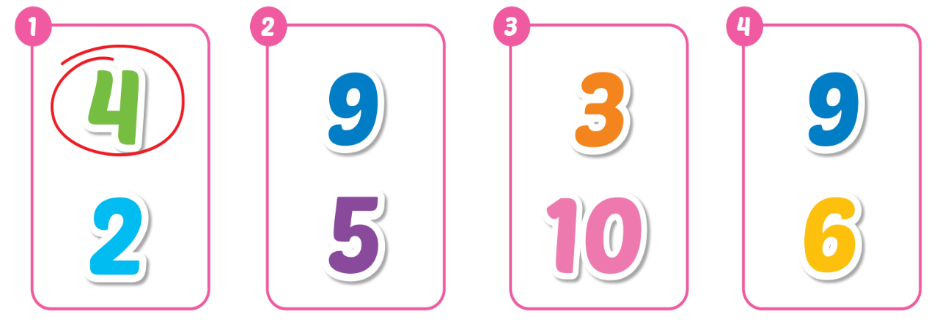
B
Listen and circle. (WB Track 06)
Keys

Slide 26
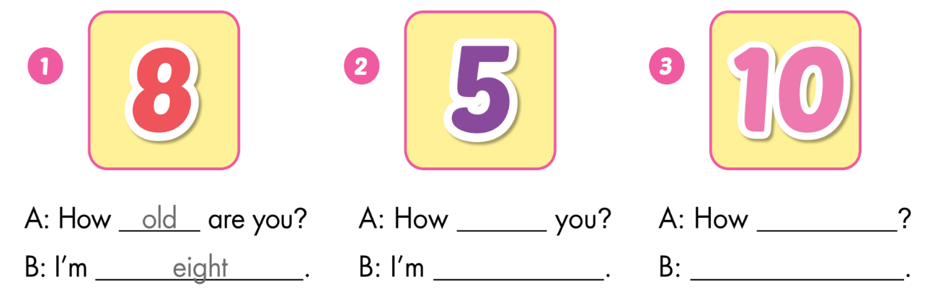
C
Look and write.
old are
old are you
five
I’m ten

Slide 27

WRAP-UP

Slide 28
Today’s lesson
Vocabulary:
one, two, three, four, five, six, seven, eight, nine, ten
Structures:
How old are you?
I’m eight.

Slide 29
Today’s lesson
Vocabulary:
one, two, three, four, five, six, seven, eight, nine, ten
Structures:
How old are you?
I’m eight.

Slide 30
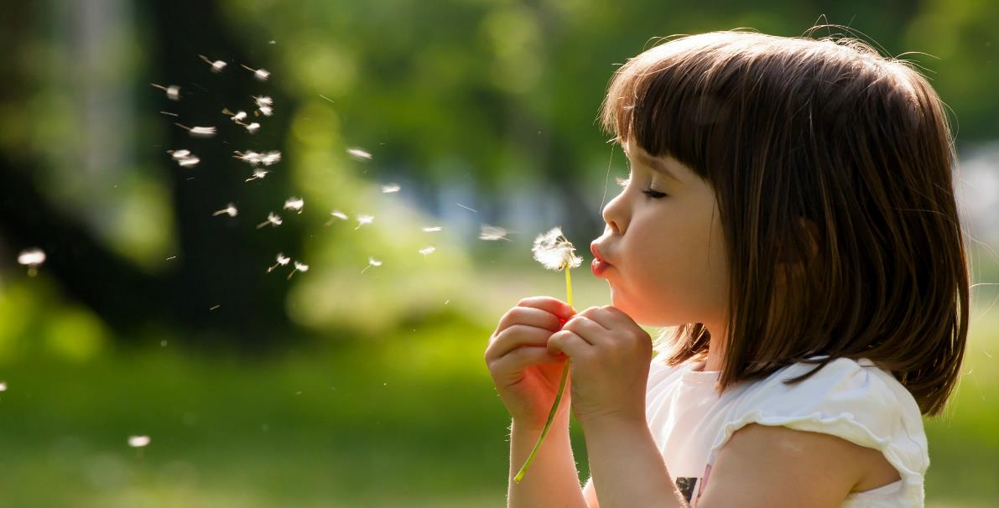
Enjoy your day!

