Slide 1

Getting Started
Lesson 4
Page 8

Slide 2

WARM UP

Slide 3



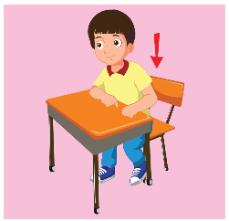
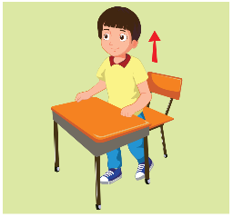



What’s missing?
1
2
3
4
5
6
7
8

Slide 4

It’s time to learn …

Slide 5

New words
red
yellow
blue
black
white

Slide 6






A
Listen and point. Repeat. (CD1 Track 08)
1
2
3
4
5
red
yellow
blue
black
white
/red/
màu đỏ
/ˈjeləʊ/
màu vàng
/bluː/
màu xanh dương
/blæk/
màu đen
/waɪt/
màu trắng
Click on each English word to hear the sound.

Slide 7

Listen and match.
1
2
3
4
5
a
b
c
d
e
Keys

Slide 8
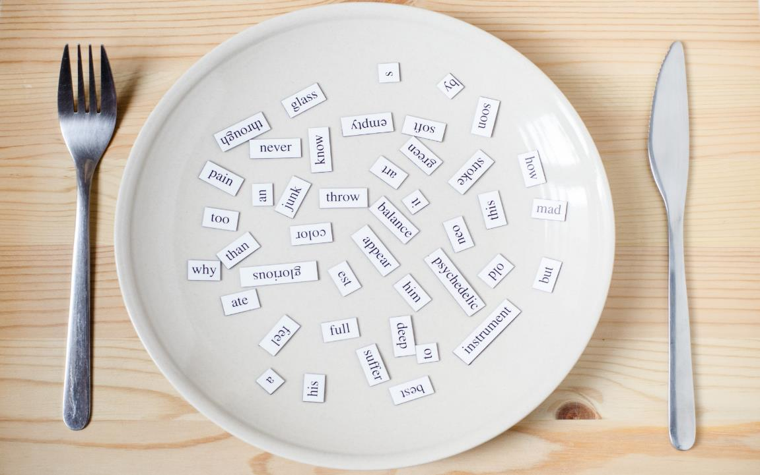
Structures
What color is it?
It’s yellow.

Slide 9
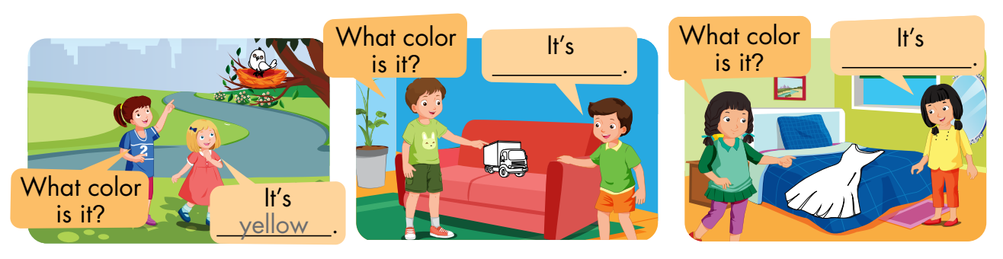
B
Listen and point. Repeat. Role-play. (CD1 Track 09)

Slide 10
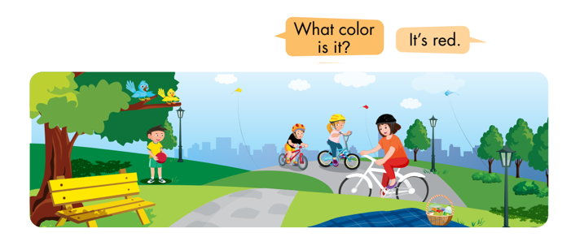
C
Point, ask, and answer.

Slide 11
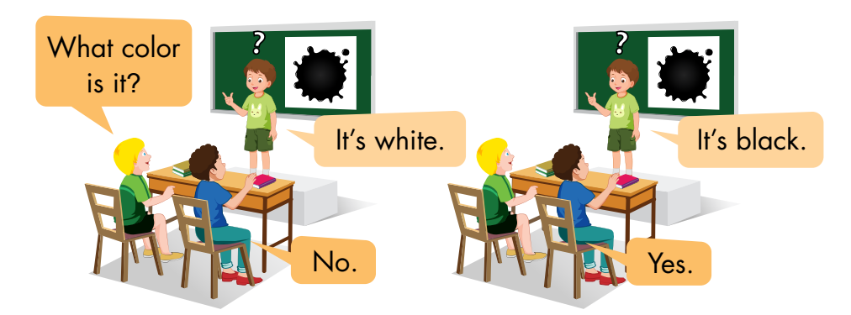
D
Play Guess the picture.

Slide 12
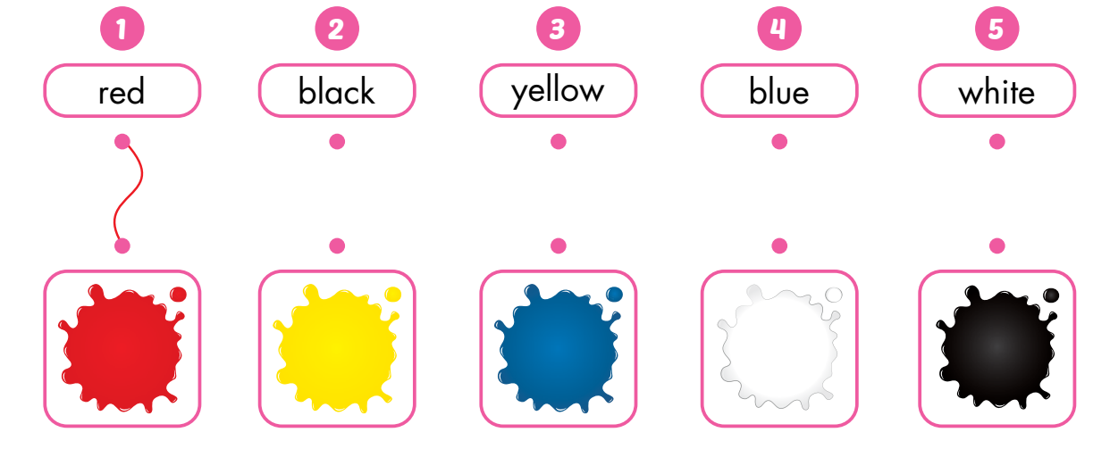
A
Draw lines.

Slide 13
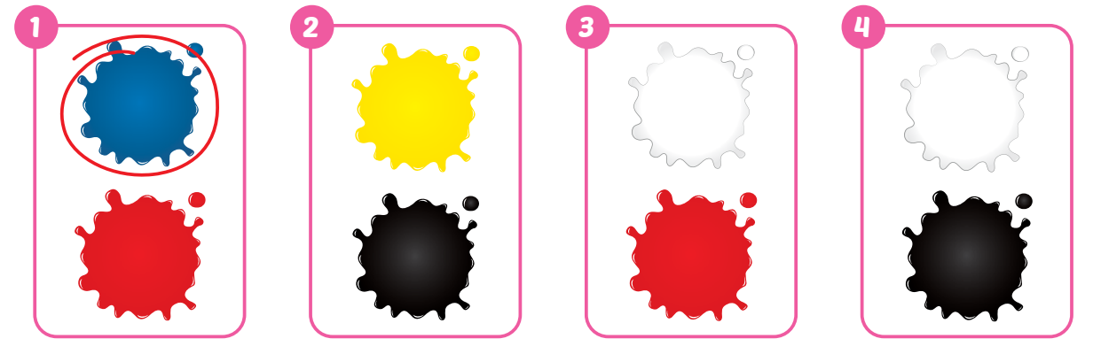
B
Listen and circle. (WB Track 05)

Slide 14
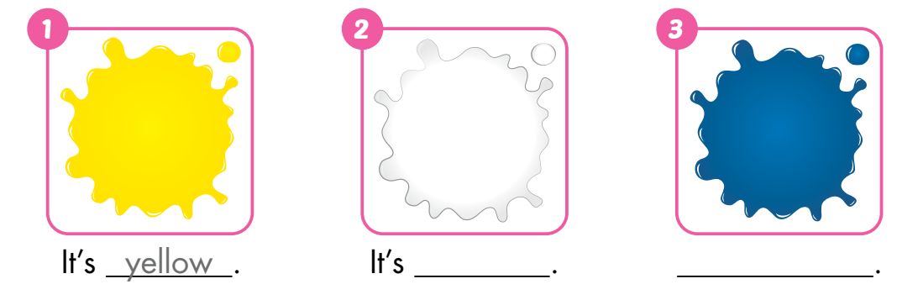
C
Look and write.
white
blue

Slide 15





Find something in… .

Slide 16

WRAP-UP

Slide 17
Today’s lesson
Vocabulary:
red, yellow, blue, black, white
Structures:
What color is it?
It’s yellow.

Slide 18
Homework
Practice vocabularies and structure. Make sentences using them.
Do the exercises in Tiếng Anh 3 i-Learn Smart Start Workbook (page 6).
Practice the vocabulary and structure in Tiếng Anh 3 i-Learn Smart Start Notebook (page 6).
Play the consolidation games in Tiếng Anh 3 i-Learn Smart Start DHA App on www.eduhome.com.vn
Prepare the next lesson (page 9).

Slide 19

Enjoy your day!

