Slide 1

Getting Started
Lesson 3
Page 7

Slide 2

WARM UP

Slide 3

Hello

Slide 4

It’s time to learn …

Slide 5

New words
Hello
Goodbye
Tom
Lucy

Slide 6





A
Listen and point. Repeat. (CD1 Track 06)
1
2
3
4
hello
goodbye
Tom
Lucy
/həˈləʊ/
xin chào
/ˌɡʊdˈbaɪ/
tạm biệt
/Tɑːm/
Tom
/ˈLuːsi/
Lucy
Click on each English word to hear the sound.

Slide 7
Decode
1
2
3
4
Well done!
1
4
1
2
1
2
3
1
2
2
3
2
2
3
4
1
2
4
3
2
1
3
4
4
1
4
1

Slide 8
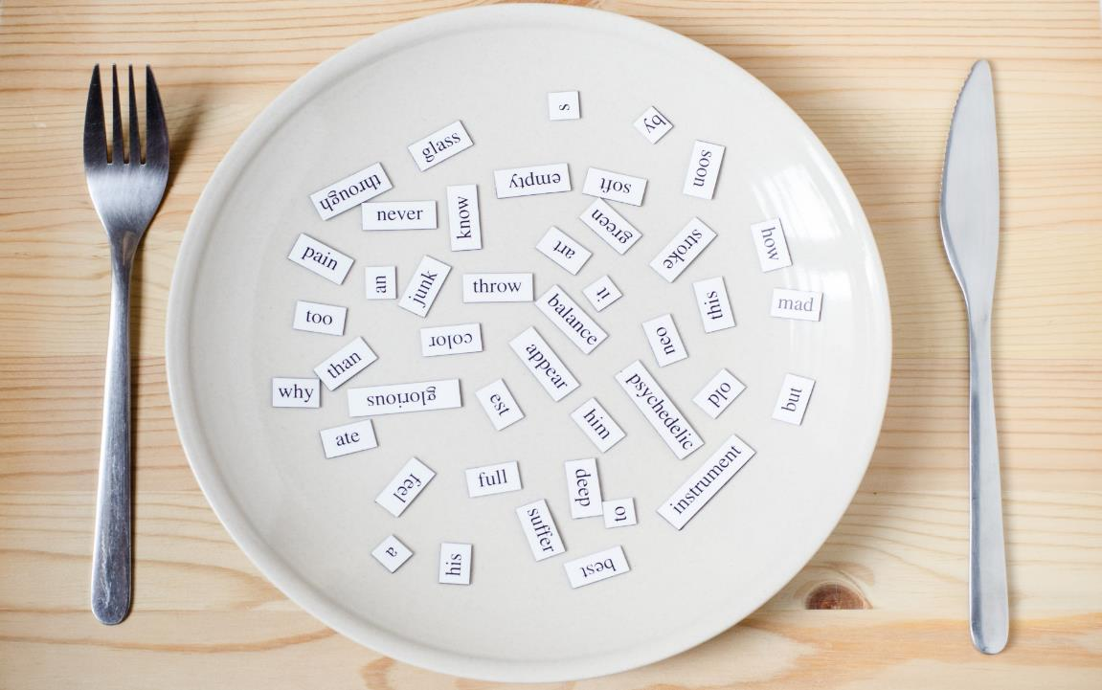
Structures
Hello, what’s your name?
My name’s Tom. Goodbye.

Slide 9
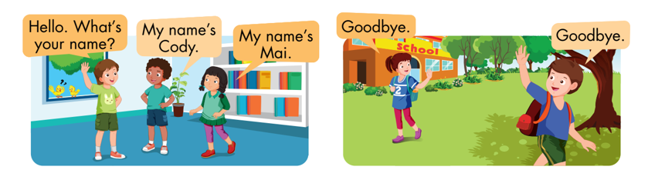
B
Listen and point. Repeat. Role-play. (CD1 Track 07)

Slide 10
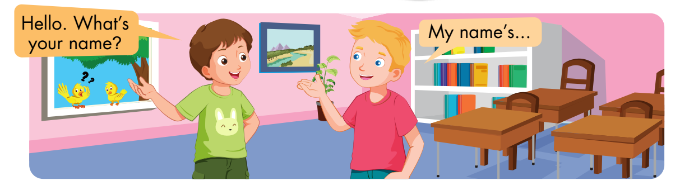
C
Practice with your friends.

Slide 11
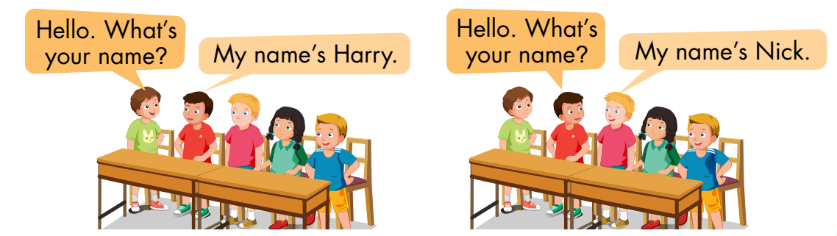
D
Play the Chain game.

Slide 12
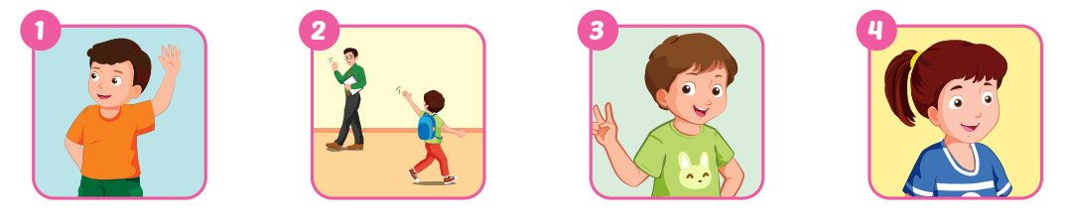
A
Complete the words.
hello
goodbye
Tom
Lucy

Slide 13
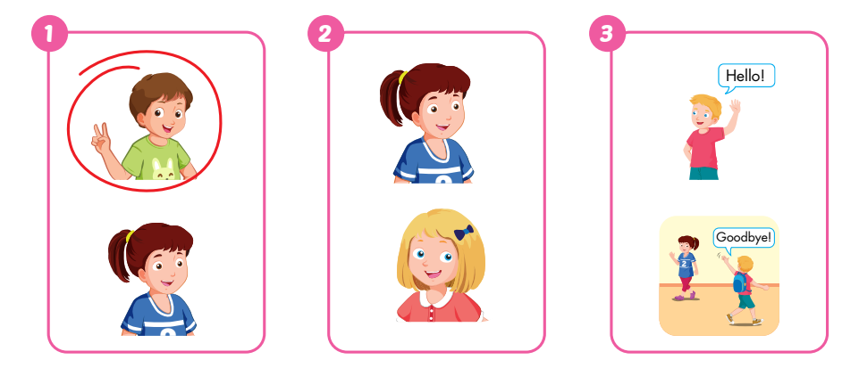
B
Listen and circle. (WB Track 04)

Slide 14
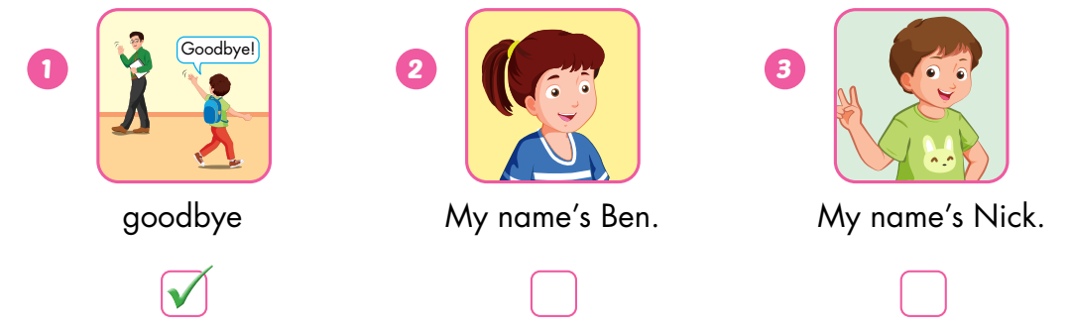
C
Look, read, and put a tick (✓) or a cross (✗).
✗
✗

Slide 15

Bye Bye

Slide 16

WRAP-UP

Slide 17
Today’s lesson
Vocabulary:
Hello, goodbye, Tom, Lucy
Structures:
Hello, what’s your name?/ My name’s Tom./ Goodbye.

Slide 18
Homework
Practice vocabularies and structure. Make sentences using them.
Do the exercises in Tiếng Anh 3 i-Learn Smart Start Workbook (page 5).
Practice the vocabulary and structure in Tiếng Anh 3 i-Learn Smart Start Notebook (page 5).
Play the consolidation games in Tiếng Anh 3 i-Learn Smart Start DHA App on www.eduhome.com.vn
Prepare the next lesson (page 8).

Slide 19

Enjoy your day!

