Slide 1

Getting Started
Lesson 2
Page 6

Slide 2

WARM UP

Slide 3


Look, guess, and spell.
h
a
n
d
s
u
p

Slide 4
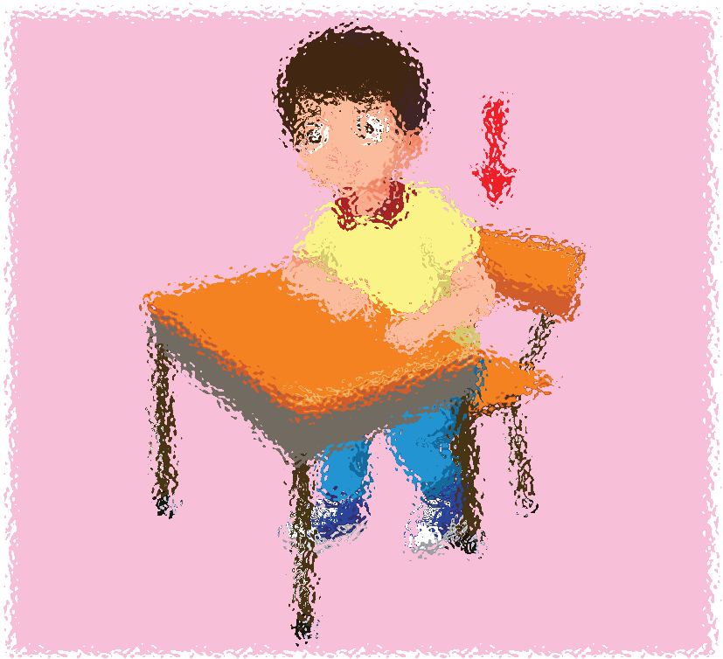
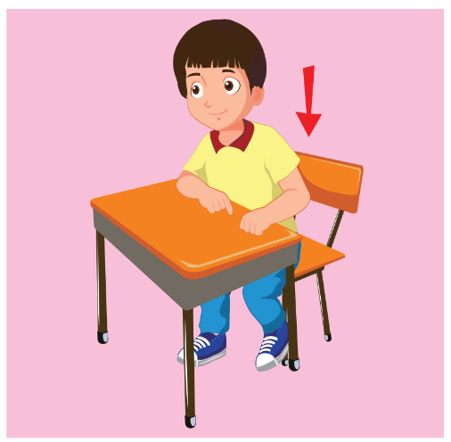
Look, guess, and spell.
s
i
t
d
o
w
n

Slide 5
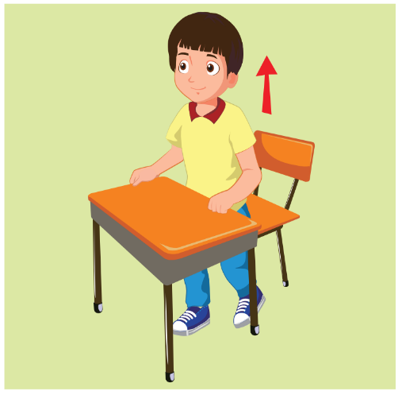

Look, guess, and spell.
s
t
a
n
d
u
p

Slide 6


Look, guess, and spell.
b
o
o
k

Slide 7

It’s time to learn …

Slide 8

New words
open your book close your book hands down

Slide 9




A
Listen and point. Repeat. (CD1 Track 04)
1
2
3
open your book
close your book
hands down
/ˈəʊpən jʊr bʊk/
mở sách ra
/kləʊz jʊr bʊk/
đóng sách lại
/hændz daʊn/
hạ tay xuống
Click on each English word to hear the sound.

Slide 10



Look at the vocabulary and do the action.
Perfect!
open your book
close your book
hands down
close your book
close your book
hands down
close your book
hands down
open your book
hands down
hands down
open your book
hands down
hands down
hands down
close your book
open your book
hands down
close your book
hands down
open your book
open your book
hands down
close your book
close your book
hands down
hands down
close your book
hands down
open your book
open your book
close your book

Slide 11

Structures
Close your book, please.
Open your book, please.
Hands down, please.

Slide 12
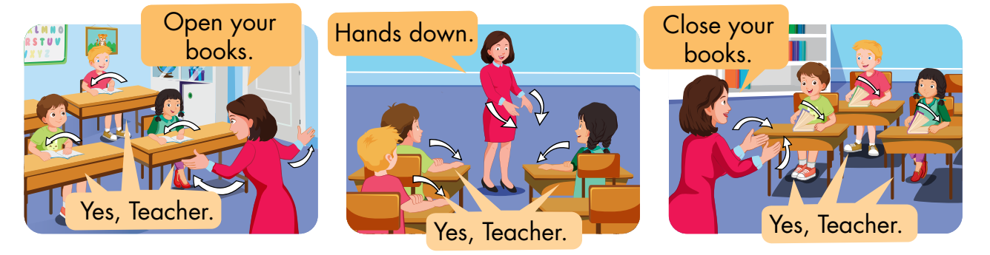
B
Listen and point. Repeat. Role-play. (CD1 Track 05)

Slide 13
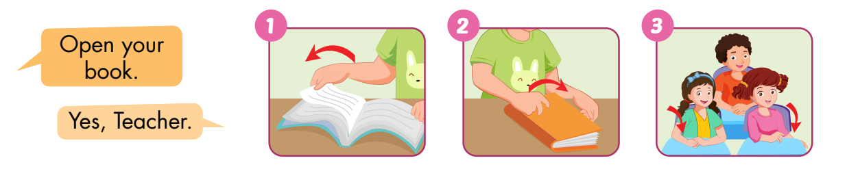
C
Point, say, and do.

Slide 14
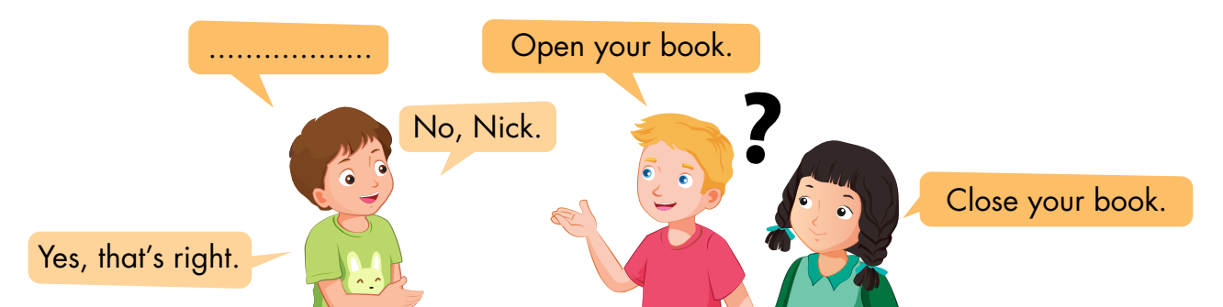
D
Play Read my lips.

Slide 15
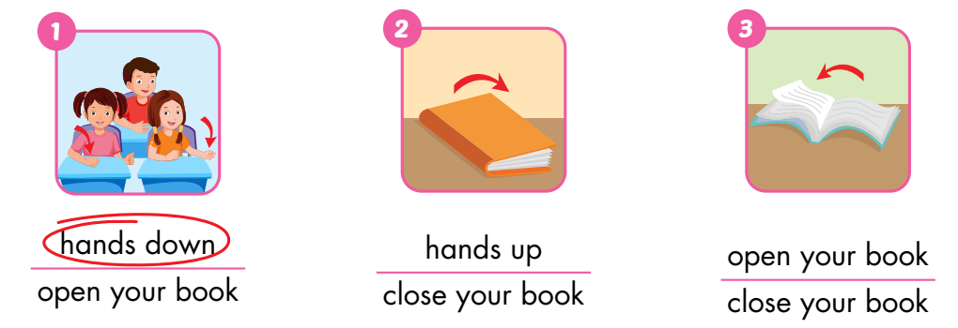
A
Look and circle.

Slide 16
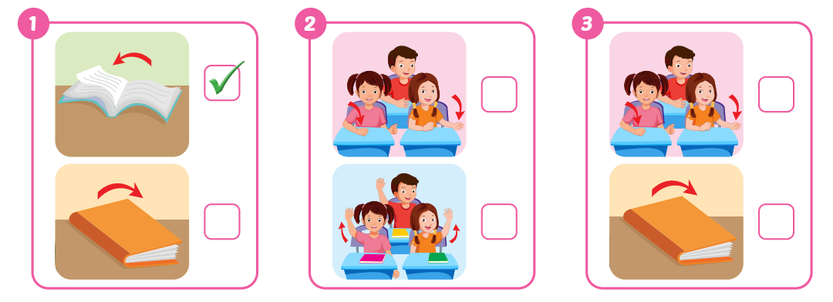
B
Listen and tick (✓) the box. (WB Track 03)
✓
✓

Slide 17
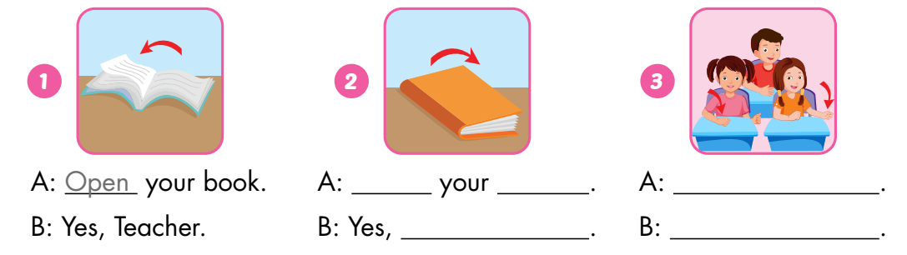
C
Look and write.
Close
book
Hands down
Teacher
Yes, Teacher

Slide 18
C
Look and write.
Close
book
Hands down
Teacher
Yes, Teacher

Slide 19
Today’s lesson
Vocabulary:
open your book, close your book, hands down
Structures:
Open your book./ Close your book./
Hands down./ Yes, Teacher.

Slide 20
Homework
Practice vocabularies and structure. Make sentences using them.
Do the exercises in Tiếng Anh 3 i-Learn Smart Start Workbook (page 4).
Practice the vocabulary and structure in Tiếng Anh 3 i-Learn Smart Start Notebook (page 4).
Play the consolidation games in Tiếng Anh 3 i-Learn Smart Start DHA App on www.eduhome.com.vn
Prepare the next lesson (page 7).

Slide 21

Have a nice day!

