Slide 1

Getting Started
Lesson 1
Page 5

Slide 2

WARM UP

Slide 3

Name Chain
Hello, my name is ______.
He/She is______.
Example:
Student 1: Hello, my name is Nina.
Student 2: Hello, my name is Lan.
She is Nina.

Slide 4

It’s time to learn …

Slide 5

New words
stand up
sit down
hands up

Slide 6
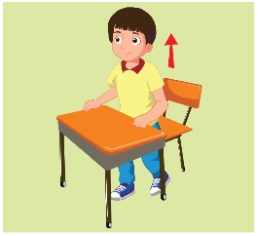
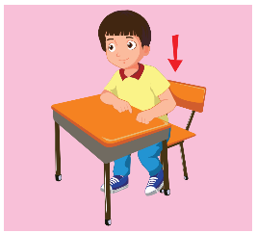


A
Listen and point. Repeat. (CD1 Track 02)
1
2
3
stand up
sit down
hands up
/stænd ʌp/
đứng lên
/sɪt daʊn/
ngồi xuống
/hændz ʌp/
giơ tay lên
Click on each English word to hear the sound.

Slide 7

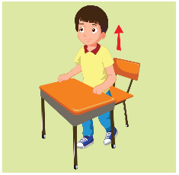


Look at the numbers and say the words.
2
1
3
2
3
1
1
2
3
1
1
2
3
3
2
1
1
3
2
3
2
3
2
1

Slide 8

Structures
Stand up, please.
Sit down, please.
Hands up, please.

Slide 9
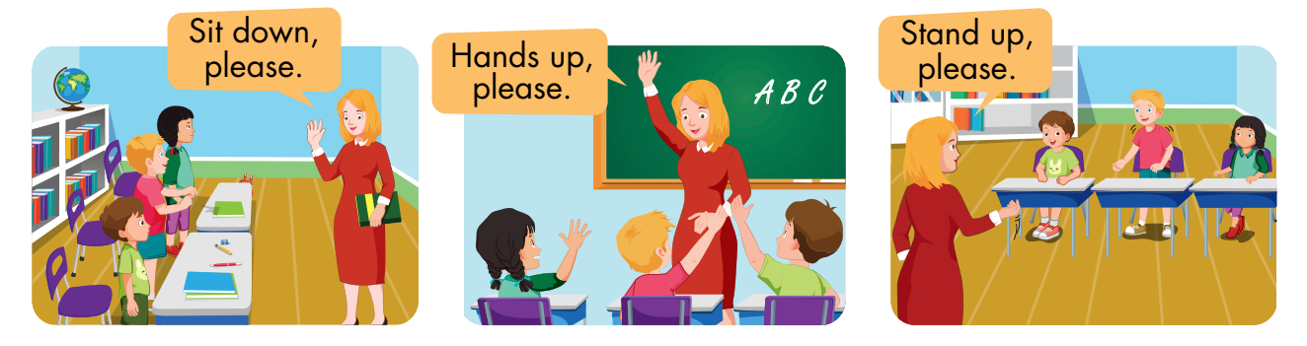
B
Listen and point. Repeat. Role-play. (CD1 Track 03)

Slide 10
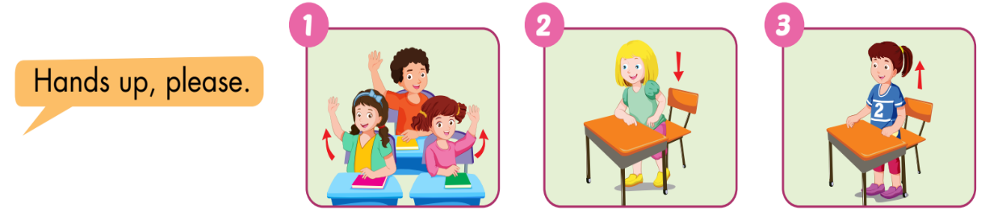
C
Point, say, and do.

Slide 11
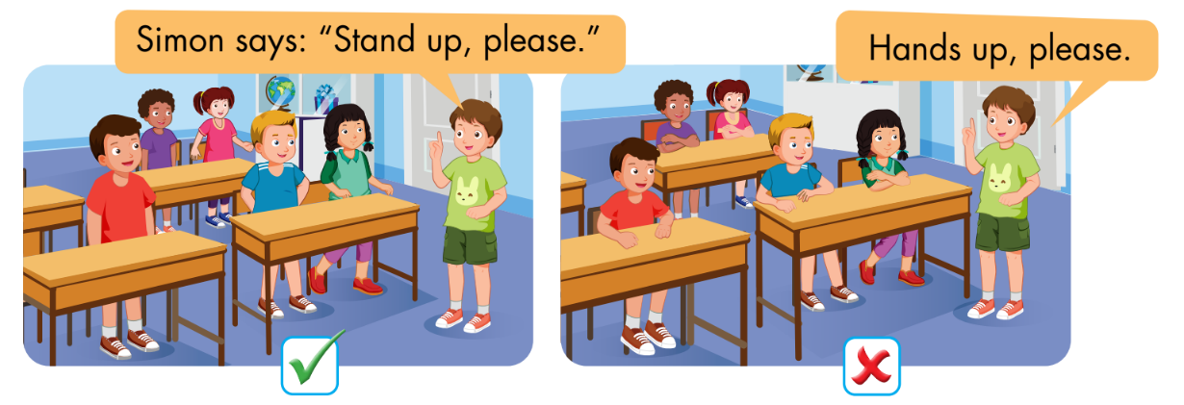
D
Play Simon says.

Slide 12
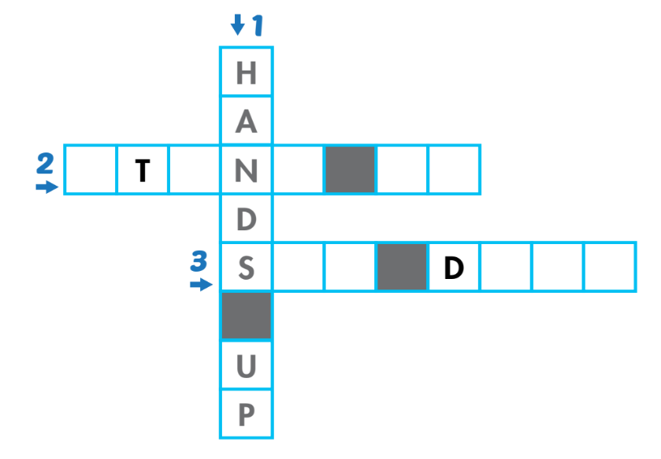
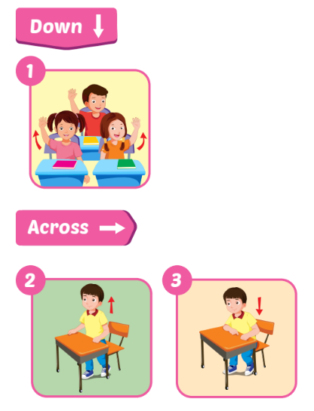
A
Look and write.
S
A
D
U
P
I
T
O
W
N

Slide 13
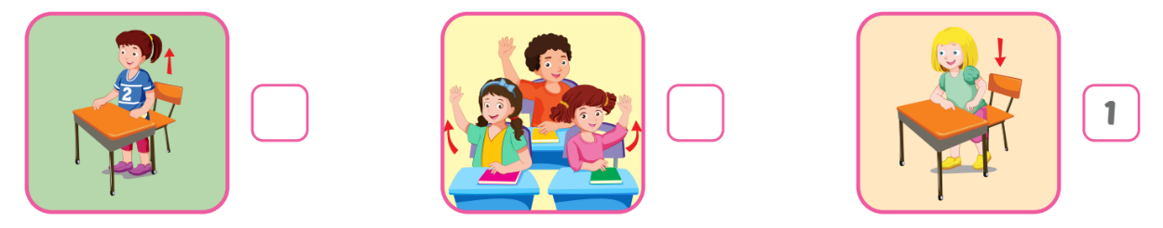
B
Listen and number. (WB Track 02)
3
2

Slide 14
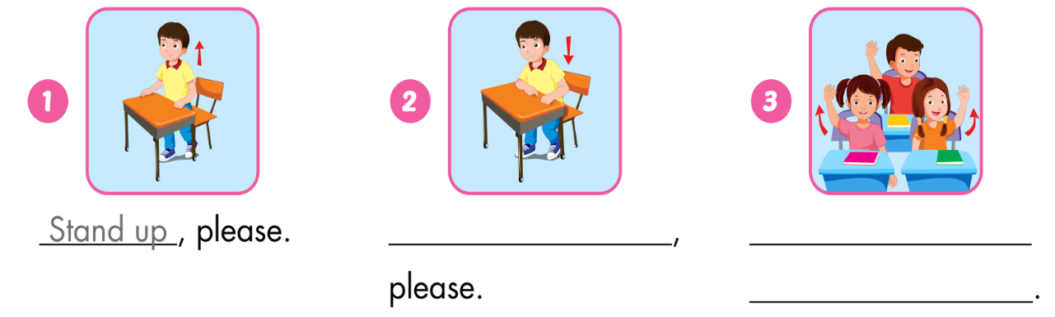
C
Look and write.
Sit down
Hands up,
please

Slide 15

WRAP-UP

Slide 16
Today’s lesson
Vocabulary:
stand up, sit down, hands up
Structures:
Stand up, please./ Sit down, please./ Hands up, please.

Slide 17
Homework
Practice vocabularies and structure. Make sentences using them.
Do the exercises in Tiếng Anh 3 i-Learn Smart Start Workbook (page 3).
Practice the vocabulary and structure in Tiếng Anh 3 i-Learn Smart Start Notebook (page 3).
Play the consolidation games in Tiếng Anh 3 i-Learn Smart Start DHA App on www.eduhome.com.vn
Prepare the next lesson (page 6).

Slide 18

Enjoy your day!

