Slide 1

UNIT 17. WHAT WOULD YOU LIKE TO EAT?
LESSON 2

Slide 2
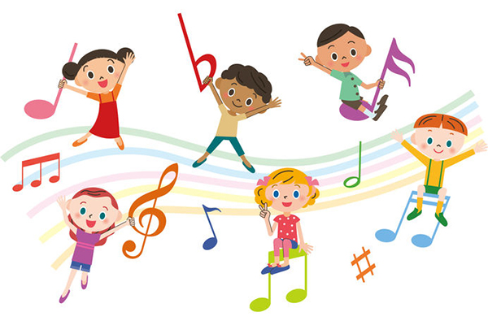


Slide 3
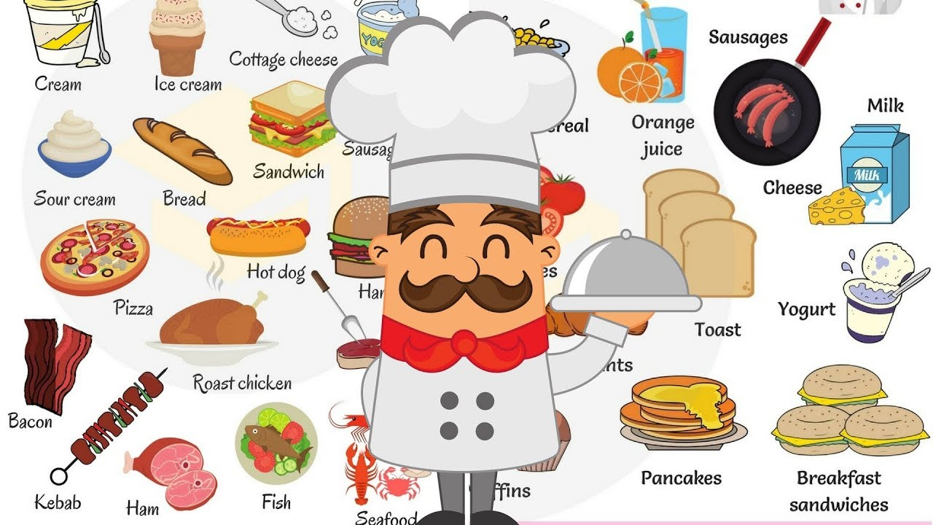

Slide 4
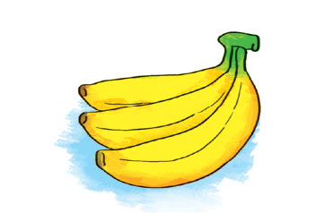
banana

Slide 5
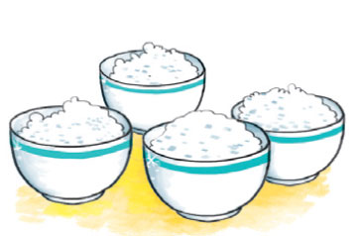
rice
Four bowls

Slide 6
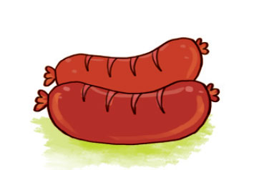
sausages

Slide 7
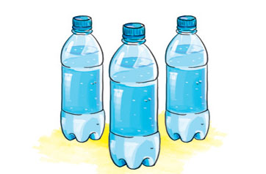
Three bottles

Slide 8
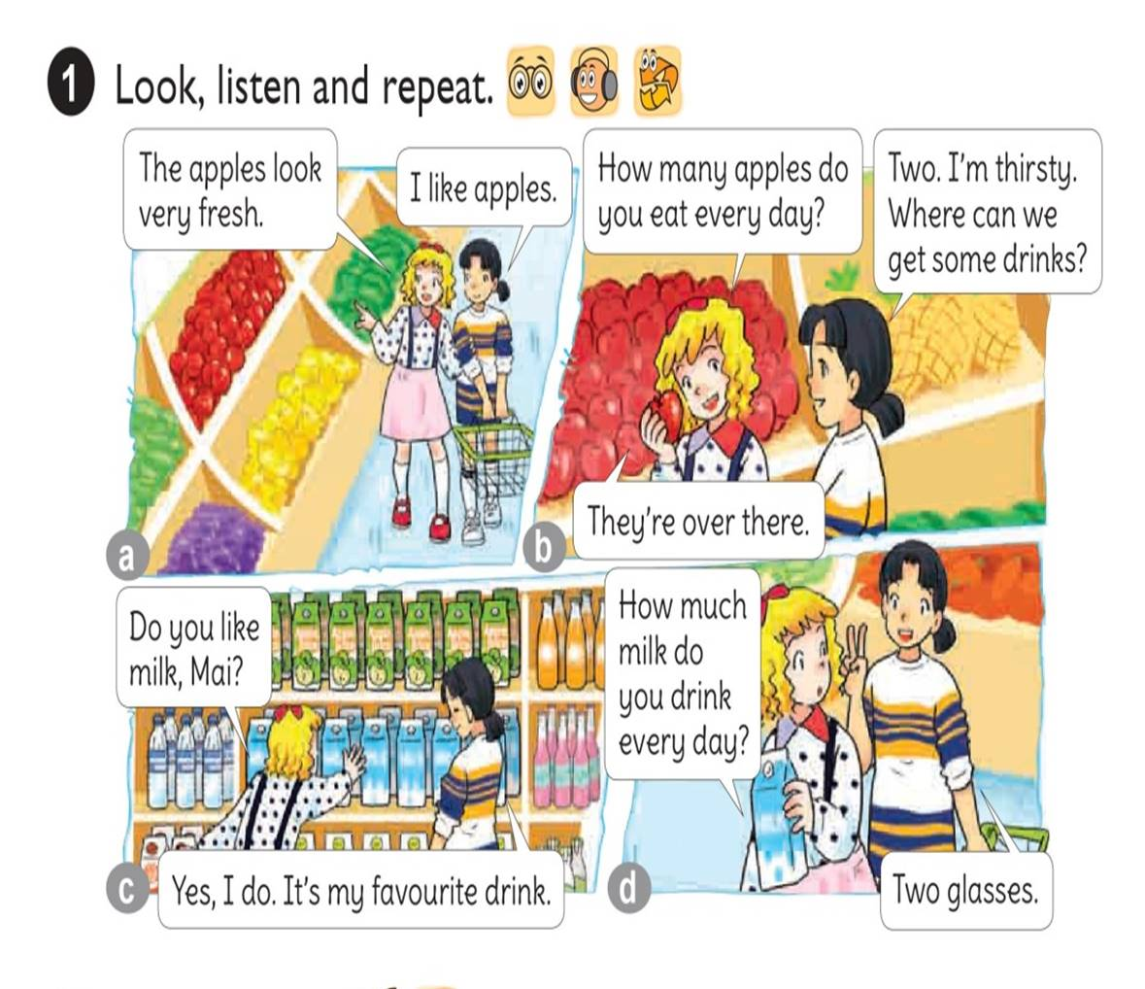




Slide 9
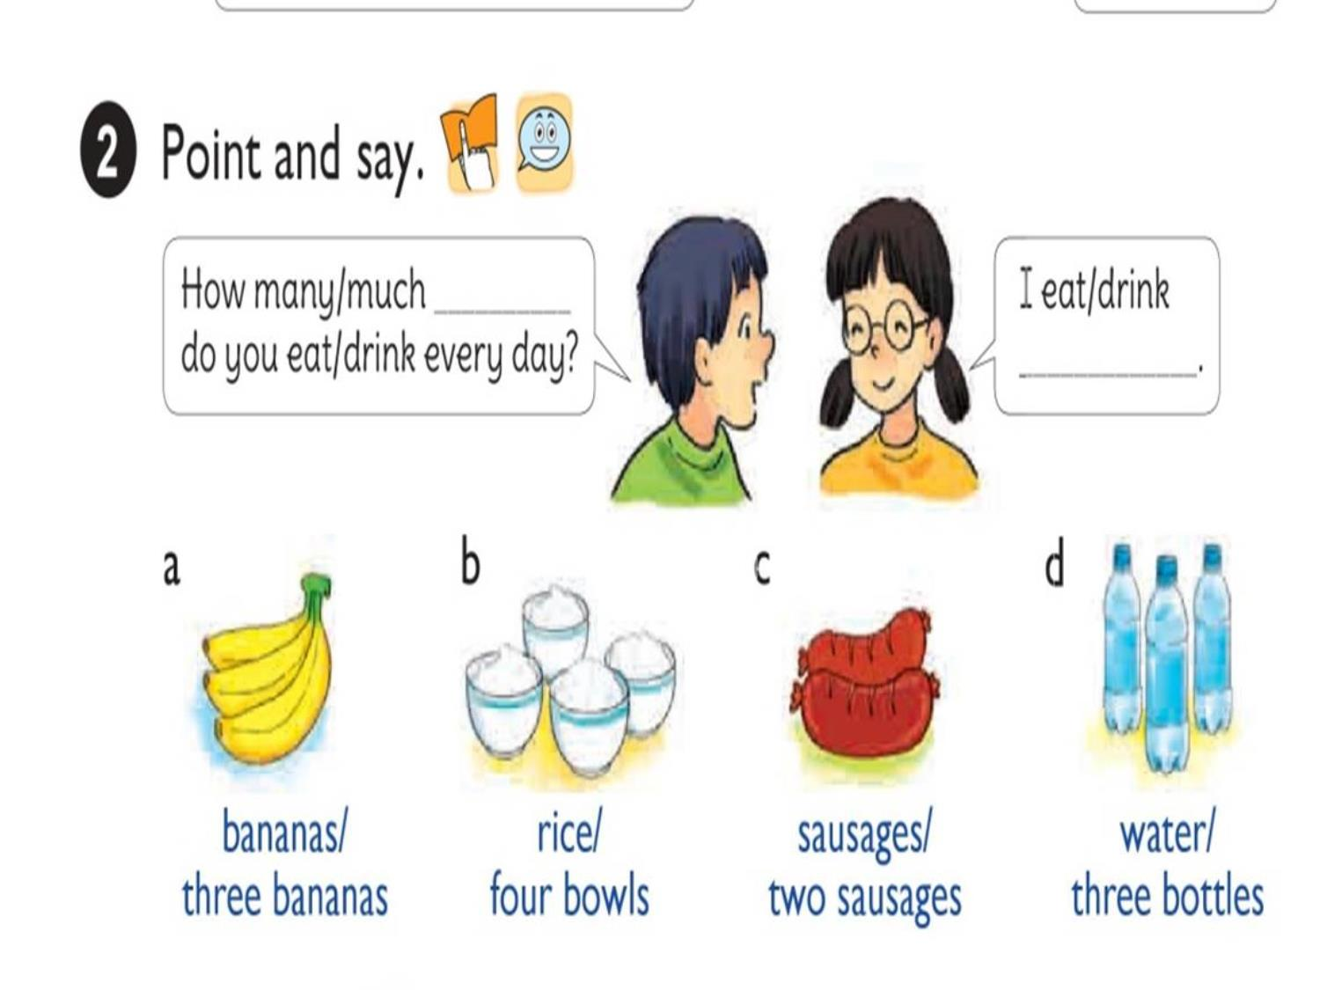

Slide 10

1. Vocabulary
- banana
- bowl
- sausages
- bottle
2. Model sentence
How many bananas do you eat everyday?
I eat four bananas.
How much water do you eat everyday?
I drink three bottles.

Slide 11
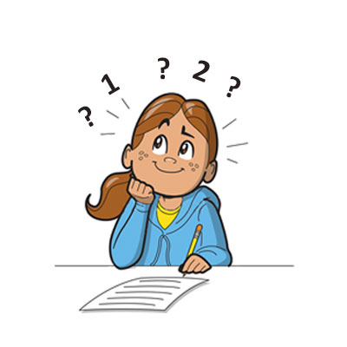
How many do you eat every day?
bananas
I eat
three bananas.

Slide 12
How much do you eat every day?
rice
I eat
four bowls of rice.

Slide 13
How many do you eat every day?
sausages
I eat
two sausages.

Slide 14
How much do you eat every day?
water
I drink
three bottles.

Slide 15


LISTEN AND circle
1
1.How many bananas does Tony eat every day?
a.One. b.Two. c.Three.
2.How much rice does Nam eat every day?
a.Two bowls. b.Three bowls. c.Four bowls.
3.How much water does Mai drink every day?
a.Three bottles. b.Four bottles. c.Five bottles.
4.How many sausages does Tom eat every day?
a.One. b.Two. c.Three.
2
3
4

Slide 16
READ AND COMPLETE
milk
How much
Shouldn’t
healthy
How many
Mai: What do you usually have for breakfast?
Tom: Some bread with butter, sausages, eggs, chocolate and milk.
Mai: (1) sausages and eggs do you have?
Tom: I usually have two sausages and one egg.
Mai: (2) chocolate do you eat?
Tom: One or two bars.
Mai: And how much (3) do you drink?
Tom: A big glass.
Mai: You (4) eat too many sausages and chocolate bars.
Tom: Why not?
Mai: Because they’re not very (5) !
How many
How much
milk
shouln’t
healthy

Slide 17
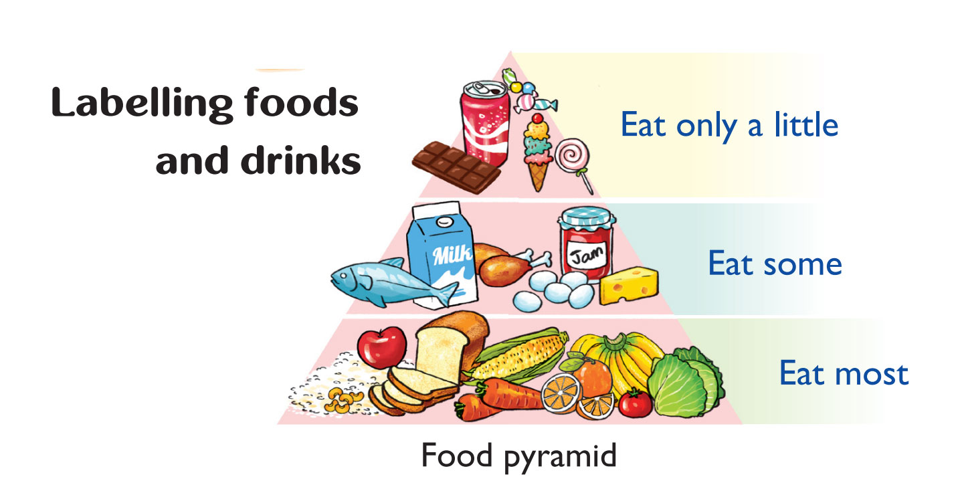
Labling food and drink

Slide 18


Slide 19



Slide 20












LUCKY STARS

Slide 21

+5

Slide 22

-5

Slide 23

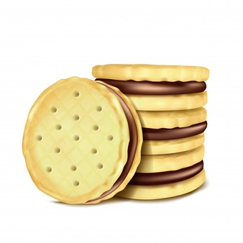
QUESTION 01
I’d like some … , please
fish
A
biscuits
B
chocolate
C
sweets
D

Slide 24

QUESTION 02
I’d like … , please
A glass of water
A
A dish of fish
B
A bar of chocolate
C
A packet of biscuits
D

Slide 25
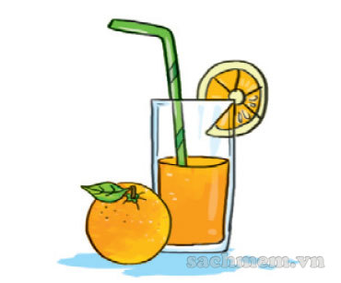
QUESTION 03
I’d like … , please
.
A glass of milk
A
A cup of tea
B
A glass of soda
C
A glass of orange juice
D

Slide 26
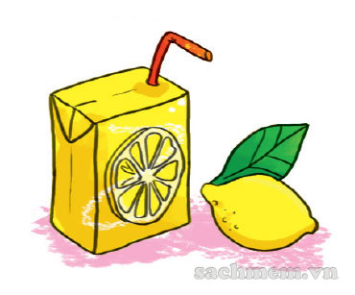
QUESTION 04
I’d like … , please
A carton of lemonade
A
A glass of milk
B
A cup of tea
C
A bottle of water
D

Slide 27
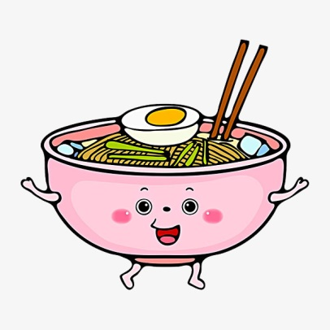
QUESTION 05
I’d like … , please
A bowl of rice
A
A bowl of noodles
B
A bowl of soup
C
A dish of beef
D

Slide 28
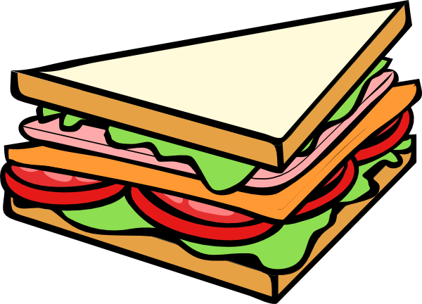
QUESTION 06
I’d like … , please
A piece of meat
A
A piece of bread
B
A piece of sandwich
C
A packet of biscuits
D

Slide 29
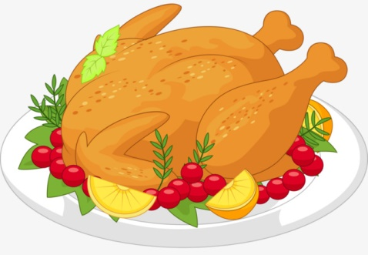
QUESTION 07
I’d like … , please
A dish of pork
A
A dish of fish
B
A dish of beef
C
A dish of chicken
D

Slide 30
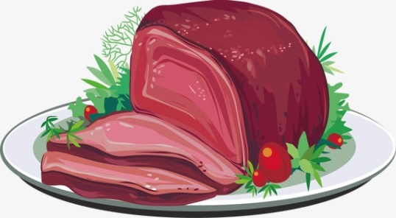
QUESTION 08
I’d like some … , please
A dish of chicken
A
A dish of pork
B
A dish of vegetables
C
A dish of fish
D

Slide 31




