Slide 1

UNIT 16. WHERE’S THE POST OFFICE?
LESSON 2

Slide 2



Slide 3


Slide 4
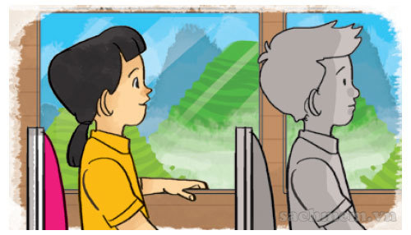
Take a coach

Slide 5
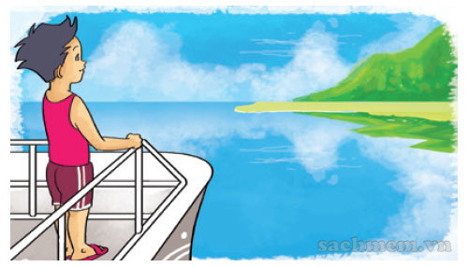
Take a boat

Slide 6
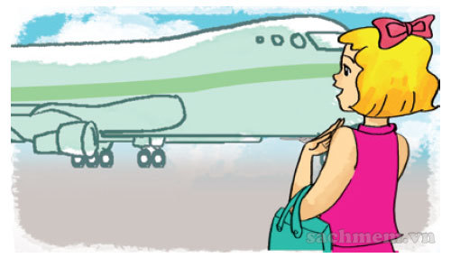
Go by plane

Slide 7
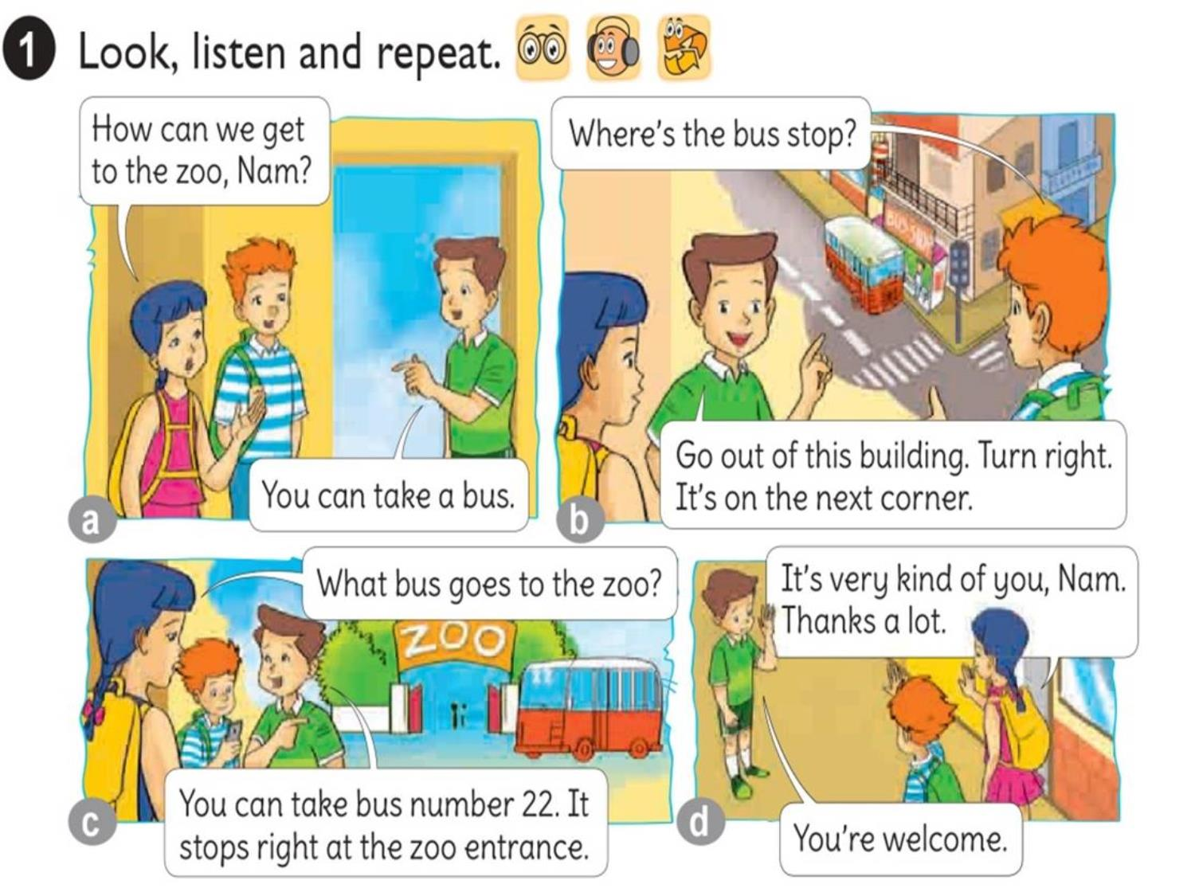




Slide 8
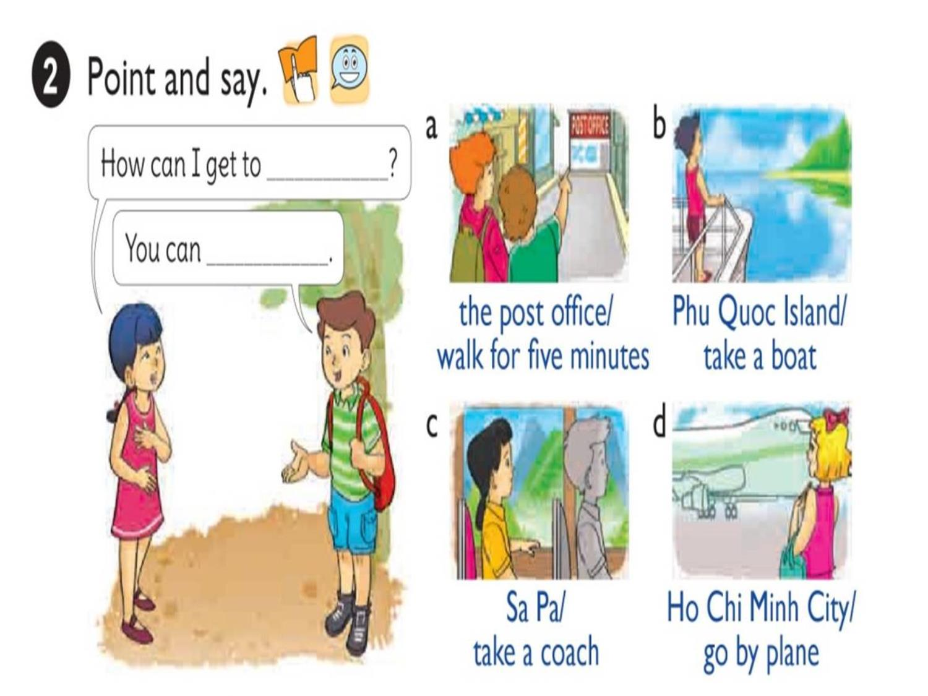

Slide 9

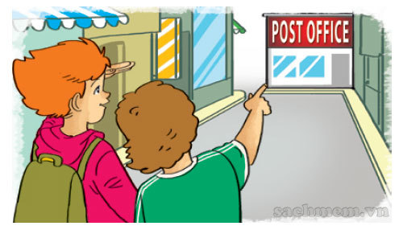
1. Vocabulary
- Take a coach
- Take a boat
- Go by plane
2. Model sentence
How can I get to the post office.
You can walk for five minutes.

Slide 10

How can I get to ?
the post office
You can
walk for five minutes.

Slide 11
How can I get to ?
Phu Quoc Island
You can
take a boat.

Slide 12
How can I get to ?
Sapa
You can
take a coach.

Slide 13
How can I get to ?
Ho Chi Minh city
You can
go by plane.

Slide 14
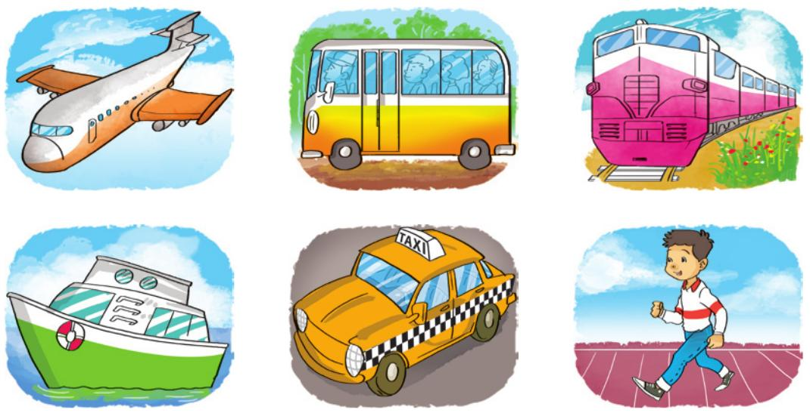
LISTEN AND WRITE
1
2
3
4
How can they get there? | By ...
1. Akiko
2. Tony
3. Mai
4. Linda
boat
taxi
coach
plane

Slide 15
Look, READ AND COMPLETE
Mai: We’re going to have a school (1) next weekend.
Akiko: Where are you going?
Mai: We’re going to the (2)
Akiko: Is it far from your school?
Mai: No, it isn’t.
Akiko: How are you going to get there?
Mai: On (3)
trip
how
zoo
welcome
foot
foot
Tony: I’ll go to Ho Chi Minh City tomorrow.
Mai: (4) are you going to get there?
Tony: By plane because I don’t have much time.
Mai: (5) a nice trip!
Tony: Thanks a lot, Mai.
Mai: You’re (6)
have
How
trip
Have
zoo
Welcome

Slide 16
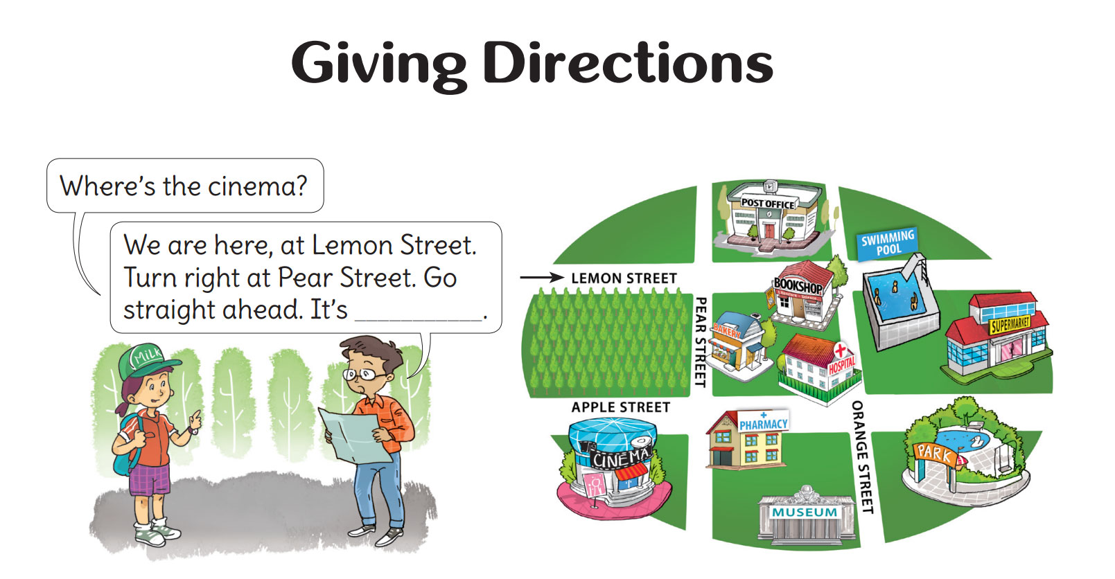


Slide 17


Slide 18



Slide 19












LUCKY STARS

Slide 20

+5

Slide 21

-5

Slide 22


QUESTION 01
Where’s the … ?
school
A
bus stop
B
museum
C
supermarket
D

Slide 23

QUESTION 02
Where’s the … ?
market
A
pharmacy
B
supermarket
C
museum
D

Slide 24

QUESTION 03
Where’s the … ?
.
stadium
A
Bus stop
B
school
C
museum
D

Slide 25

QUESTION 04
Where’s the … ?
Post office
A
Bus stop
B
Market
C
Supermarket
D

Slide 26

QUESTION 05
Where’s the … ?
museum
A
school
B
theatre
C
cinema
D

Slide 27
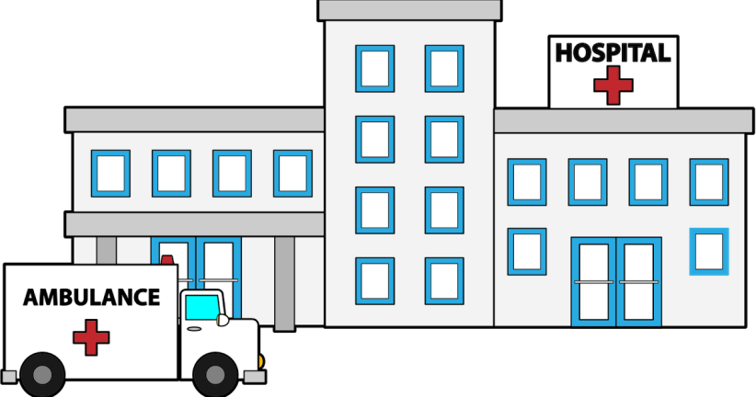
QUESTION 06
Where’s the … ?
museum
A
cimema
B
Hospital
C
theatre
D

Slide 28
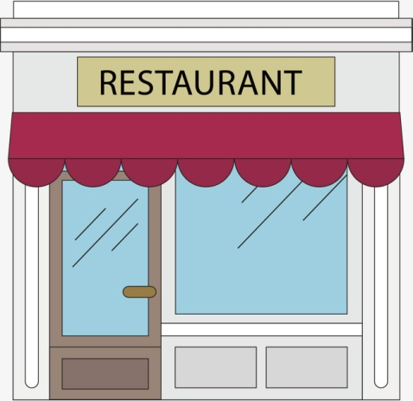
QUESTION 07
Where’s the … ?
Post office
A
bank
B
museum
C
restaurant
D

Slide 29

QUESTION 08
Where’s the … ?
stadium
A
cinema
B
restaurant
C
theatre
D

Slide 30




