Slide 1

UNIT 16. WHERE’S THE POST OFFICE?
LESSON 1

Slide 2



Slide 3
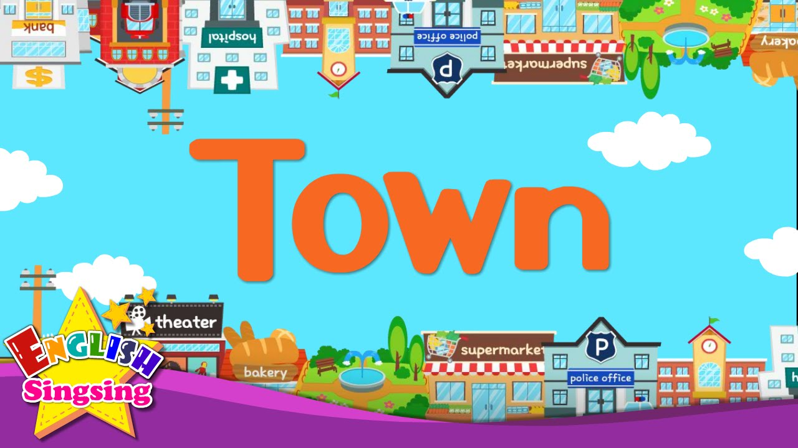

Slide 4
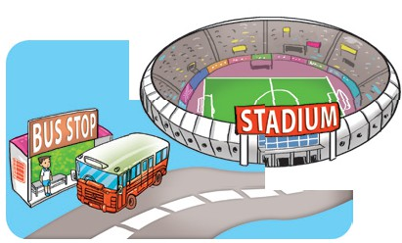
next to

Slide 5
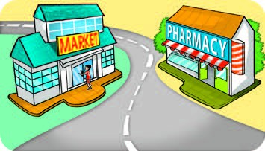
opposite

Slide 6
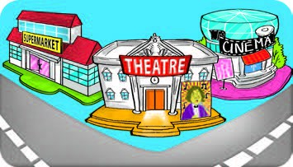
Theatre / between

Slide 7
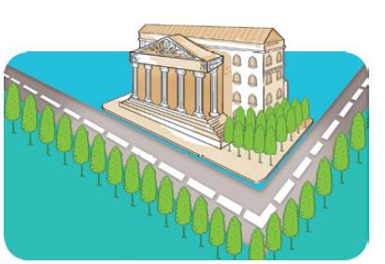
museum
On the corner of street

Slide 8
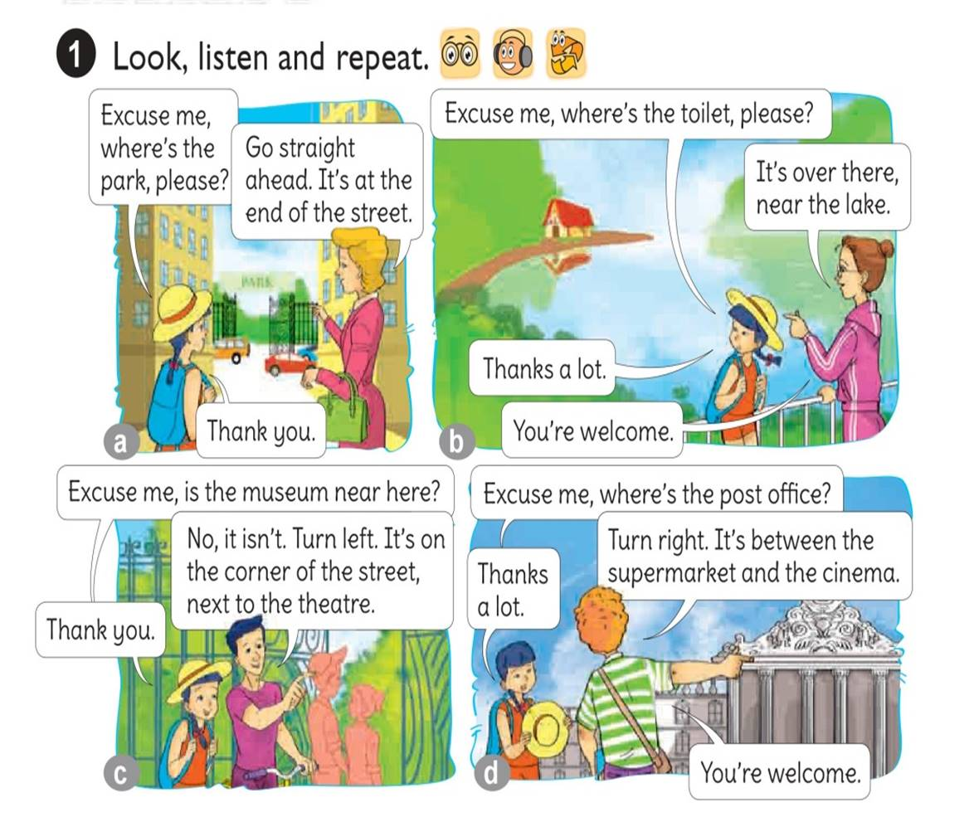




Slide 9
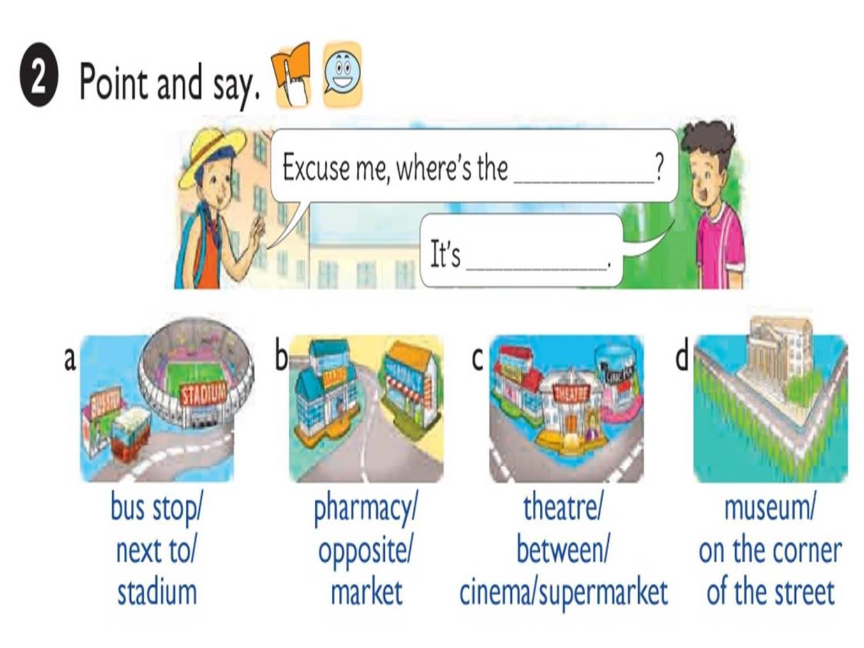

Slide 10

1. Vocabulary
- bus stop
- stadium
- market
- theatre
- museum
- opposite
- the coner
2. Model sentence
Where’s the bus stop?
It’s next to stadium.

Slide 11
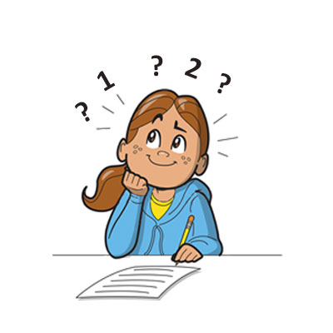
Where’s ?
the bus stop
It’s
next to the stadium.

Slide 12
Where’s ?
the pharmacy
It’s
opposite the market.

Slide 13
Where’s ?
the theatre
It’s
between the supermarket and the cinema.

Slide 14
Where’s ?
the museum
It’s
on the corner of street.

Slide 15




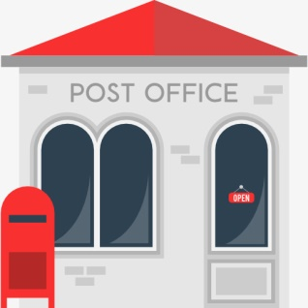

LISTEN AND TICK
Opposite the pharmacy
Between the supermarket and the cinema
Next to the stadium
Go along the street and turn left

Slide 16
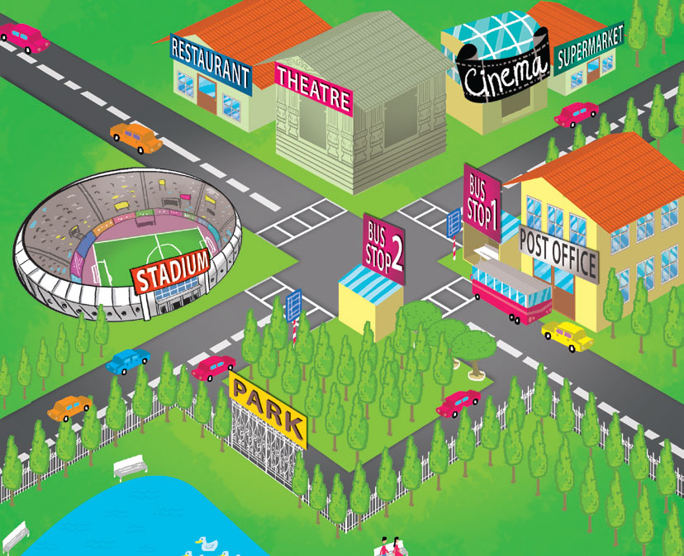
Look, READ AND COMPLETE
between
On the coner
opposite
Next to
1.The theatre is the stadium.
2.The cinema is the theatre and the supermarket.
3.The stadium is of the street.
4.Bus stop 1 is Bus stop 2.
5.The post office is Bus stop
opposite
between
on the coner
opposite
next to

Slide 17


Slide 18



Slide 19












LUCKY STARS

Slide 20

+5

Slide 21

-5

Slide 22


QUESTION 01
Where’s the … ?
school
A
bus stop
B
museum
C
supermarket
D

Slide 23

QUESTION 02
Where’s the … ?
market
A
pharmacy
B
supermarket
C
museum
D

Slide 24

QUESTION 03
Where’s the … ?
.
stadium
A
Bus stop
B
school
C
museum
D

Slide 25

QUESTION 04
Where’s the … ?
Post office
A
Bus stop
B
Market
C
Supermarket
D

Slide 26
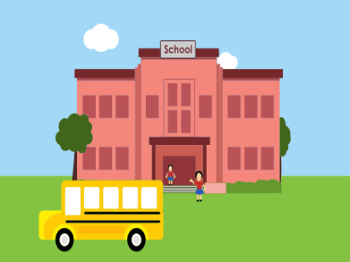
QUESTION 05
Where’s the … ?
museum
A
school
B
theatre
C
cinema
D

Slide 27
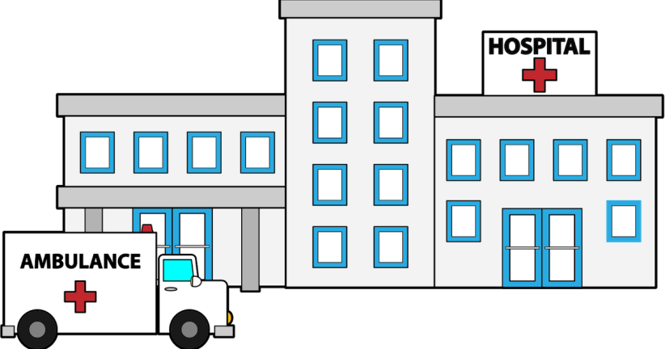
QUESTION 06
Where’s the … ?
museum
A
cimema
B
Hospital
C
theatre
D

Slide 28
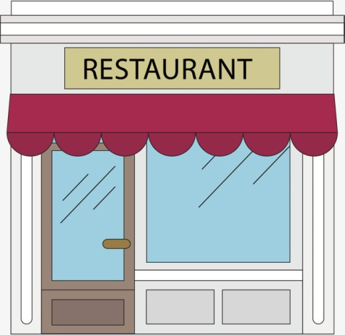
QUESTION 07
Where’s the … ?
Post office
A
bank
B
museum
C
restaurant
D

Slide 29

QUESTION 08
Where’s the … ?
stadium
A
cinema
B
restaurant
C
theatre
D

Slide 30




