Slide 1

UNIT 15. WHAT WOULD YOU LIKE
TO BE IN THE FUTURE?
LESSON 2

Slide 2



Slide 3

Fly a plane

Slide 4
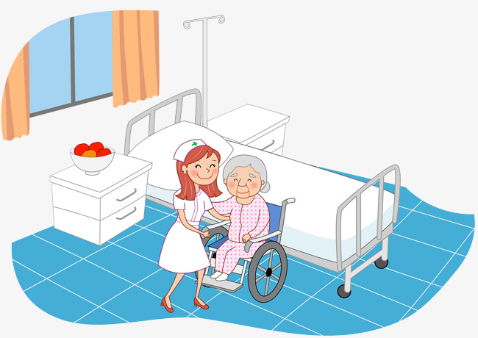
Look after patients

Slide 5

Design buildings

Slide 6

Write stories for children

Slide 7
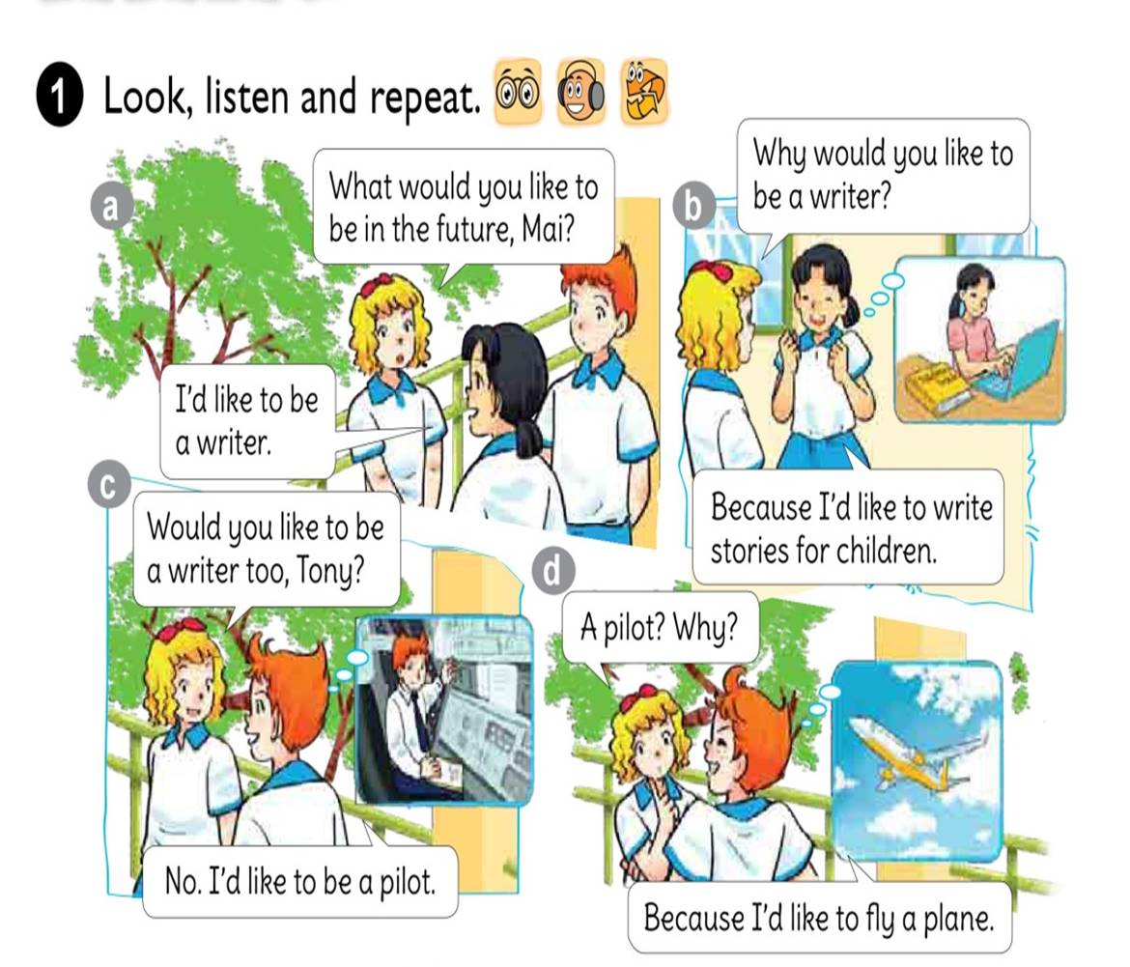




Slide 8
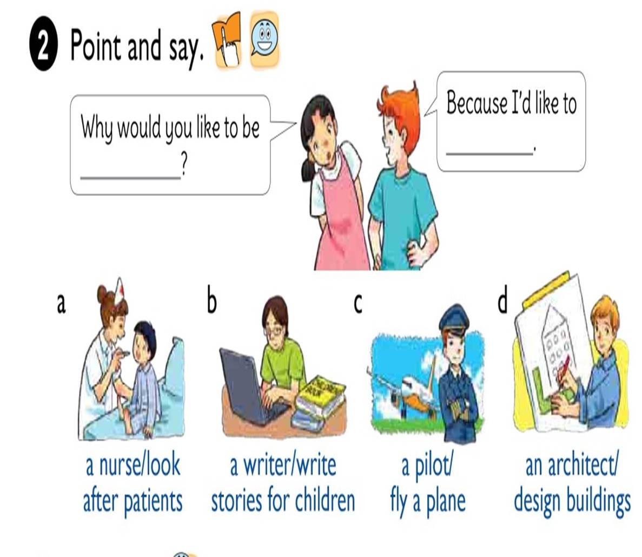

Slide 9


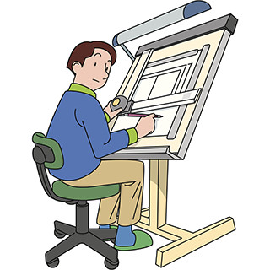


1. Vocabulary
- Look after patients
- Write stories for children
- Fly plane
- Design buildings
2. Model sentence
Why would you like to be a writer ?
Because I’d like to write stories for children.

Slide 10

Why would you like
to be
a nurse?
Because I’d like to
look after patients.

Slide 11
Why would you like
to be
a writer?
Because I’d like to
write stories for children.

Slide 12
Why would you like
to be
a pilot?
Because I’d like to
fly a plane

Slide 13
Why would you like
to be
an architect?
Because I’d like to
design buildings.

Slide 14





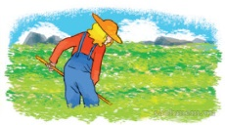
LISTEN AND TICK
1. Trung would like to be ___________.
a.an engineer b.an artist c.an architect
2.Mai would like to be ___________.
a.a nurse b.a teacher c.a singer
3.Tony would like to ___________.
a.drive a car b.fly a plane c.work in a factory
4.Tom would like to ___________.
a.grow vegetables b.look after flowers c.work on a farm
1
2
3
4

Slide 15
READ AND COMPLETE
do
nurse
Look after
write
hospital
A: What would you like to be in the future?
B: I’d like to be a (1)
A: Why?
B: Because I’d like to (2) patients.
A: Where would you like to work?
B: In a (3) in the countryside.
A: What would you like to (4) in your free time?
B: I’d like to (5) comic stories.
nurse
look after
hospital
do
write

Slide 16
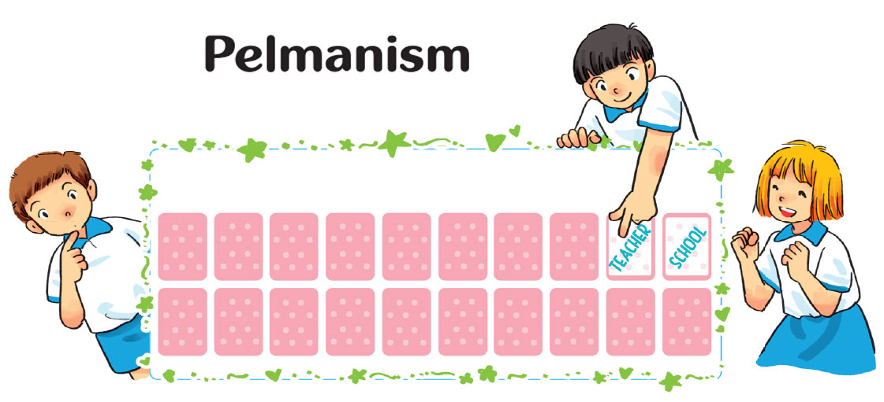

Slide 17


Slide 18



Slide 19












LUCKY STARS

Slide 20

+5

Slide 21


QUESTION 01
I’d like to be a/ an … in the future.
writer
A
pilot
B
doctor
C
nurse
D

Slide 22

QUESTION 02
I’d like to be a/ an … in the future.
doctor
A
nurse
B
architect
C
farmer
D

Slide 23
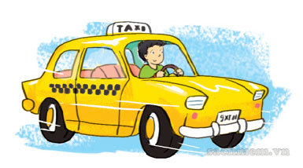
QUESTION 03
I’d like to be a/ an … in the future.
pilot
A
doctor
B
Football player
C
driver
D

Slide 24

-5

Slide 25

QUESTION 04
I’d like to be a/ an … in the future.
writer
A
doctor
B
farmer
C
teacher
D

Slide 26
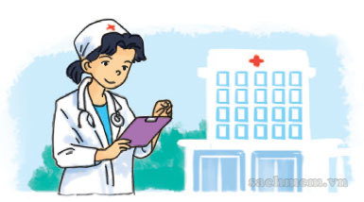
QUESTION 05
I’d like to be a/ an … in the future.
writer
A
nurse
B
teacher
C
teacher
D

Slide 27
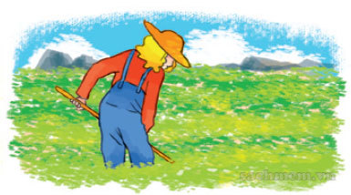
QUESTION 06
I’d like to be a/ an … in the future.
doctor
A
architect
B
farmer
C
writer
D

Slide 28
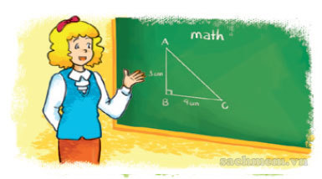
QUESTION 07
I’d like to be a/ an … in the future.
writer
A
doctor
B
farmer
C
teacher
D

Slide 29

QUESTION 08
I’d like to be a/ an … in the future.
teacher
A
writer
B
farmer
C
nurse
D

Slide 30




