Slide 1

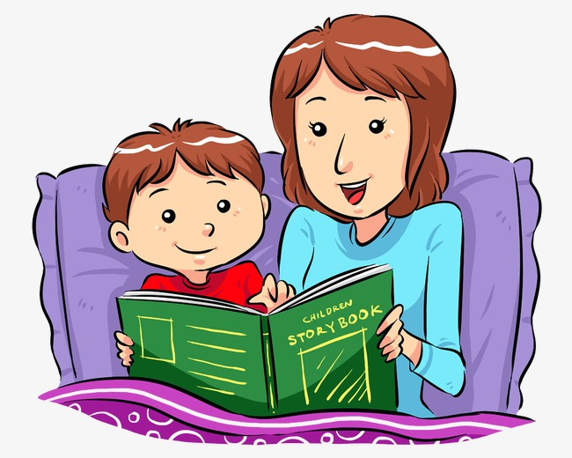
UNIT 14. WHAT HAPPEN
IN THE STORY?
LESSON 2

Slide 2
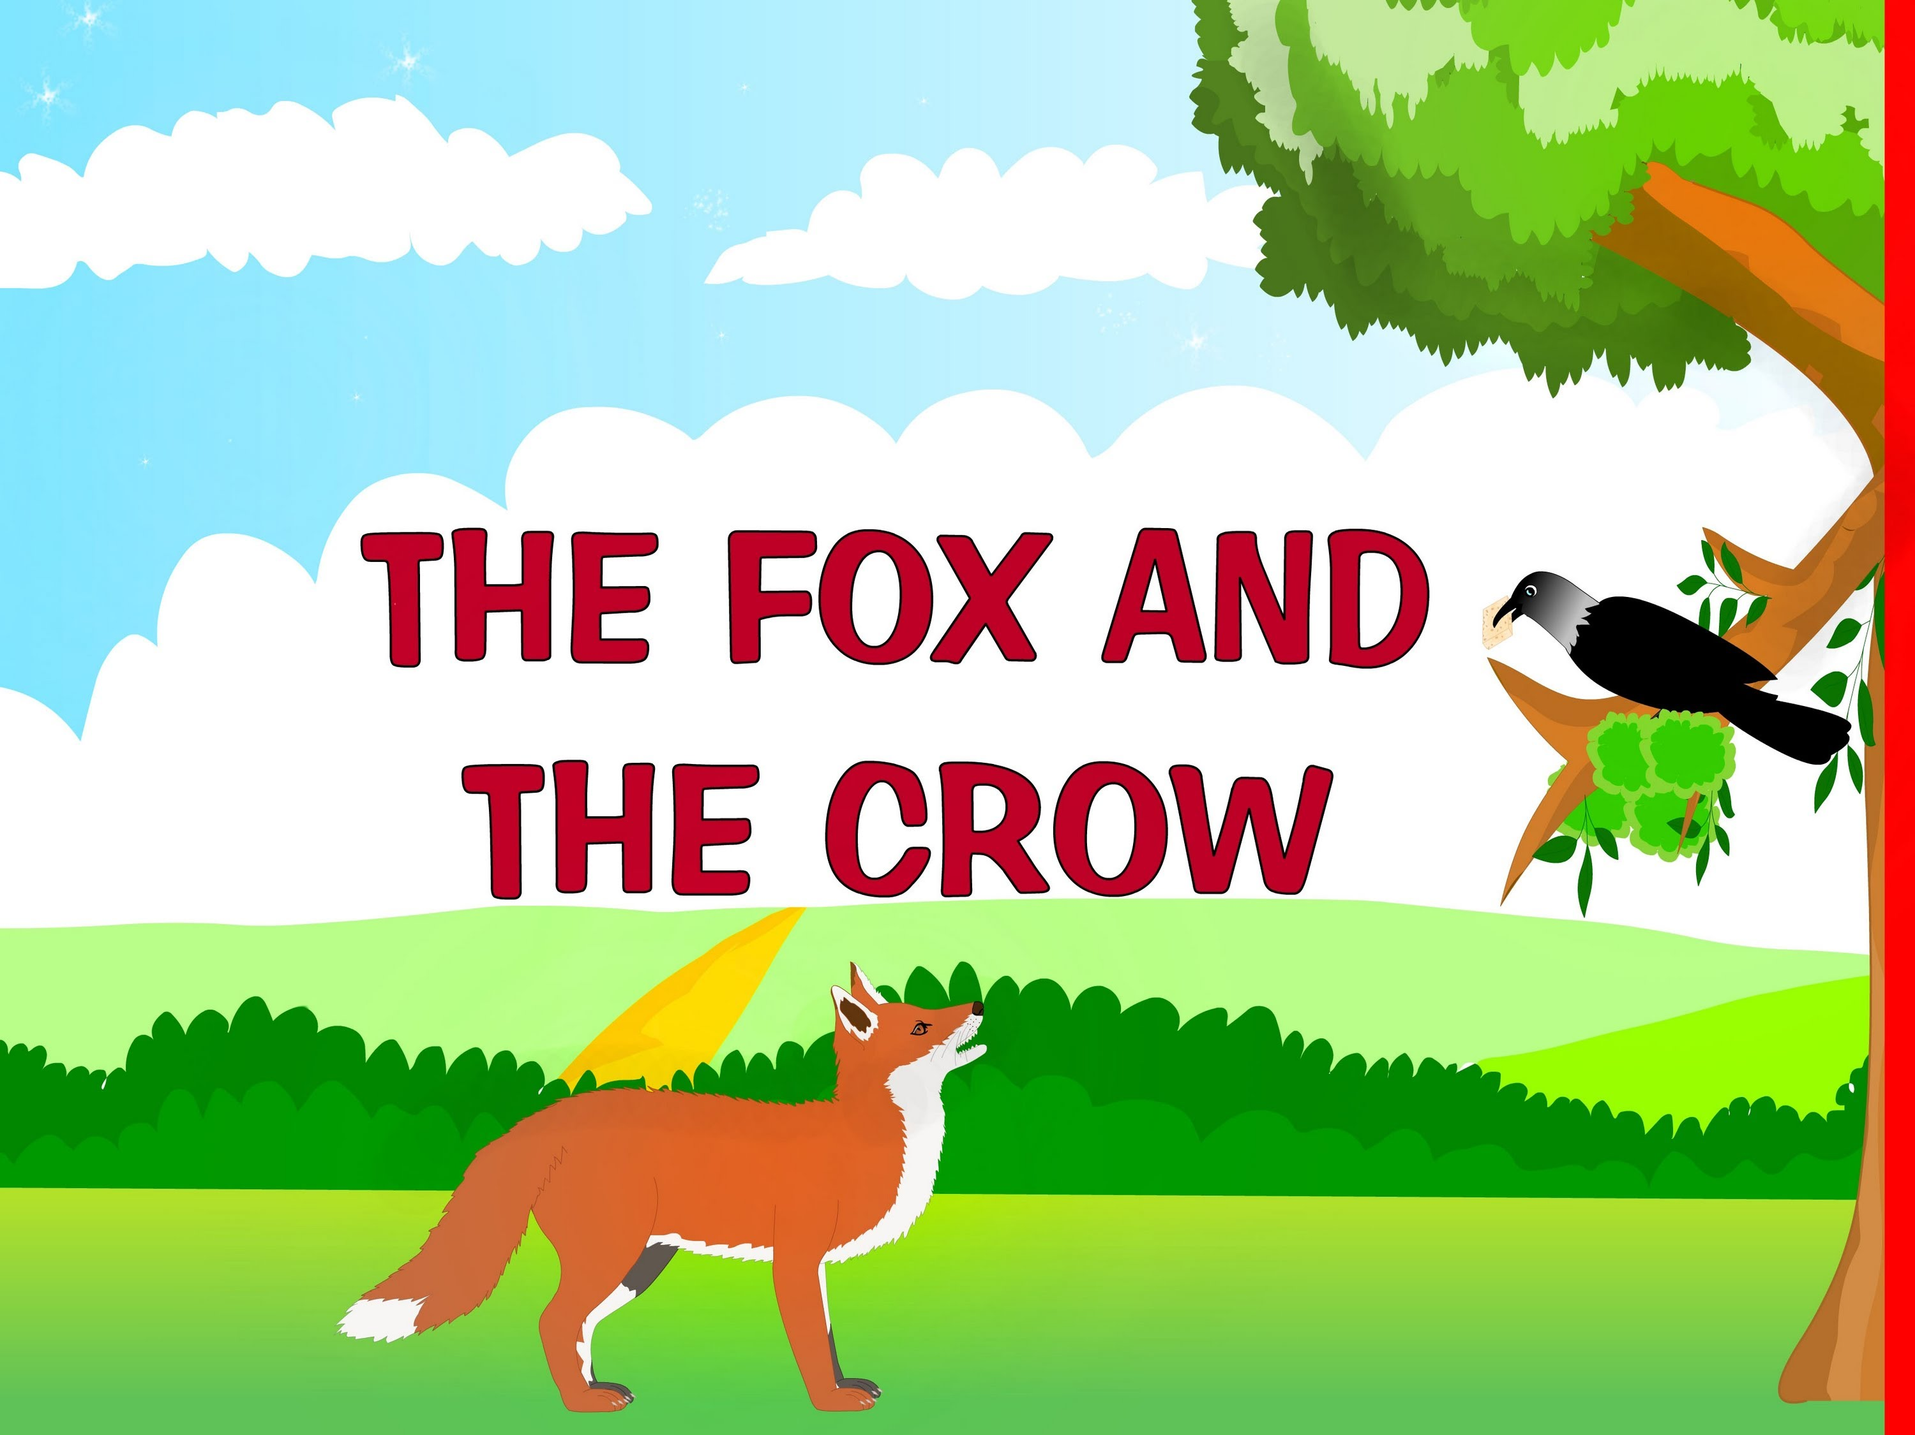


Slide 3
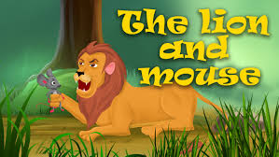
intelligent

Slide 4

hard - working

Slide 5

greedy

Slide 6
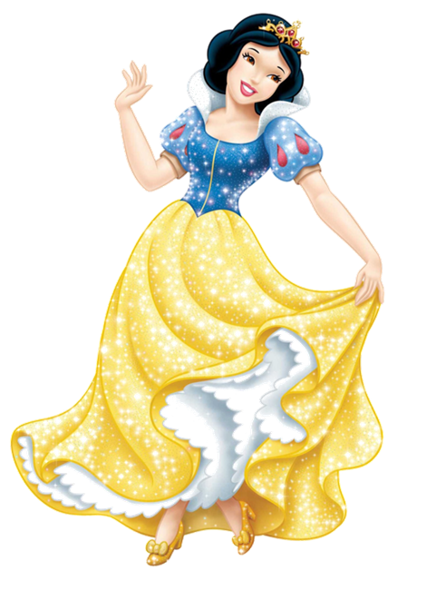
KIND

Slide 7
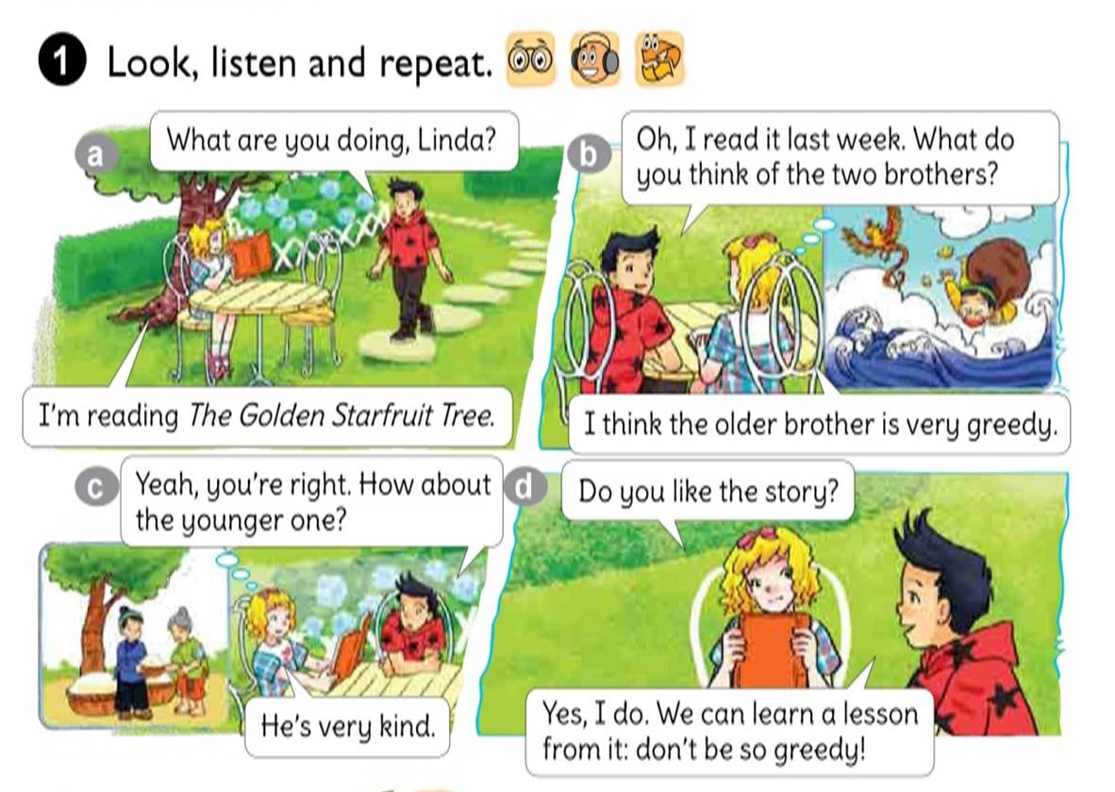


Slide 8
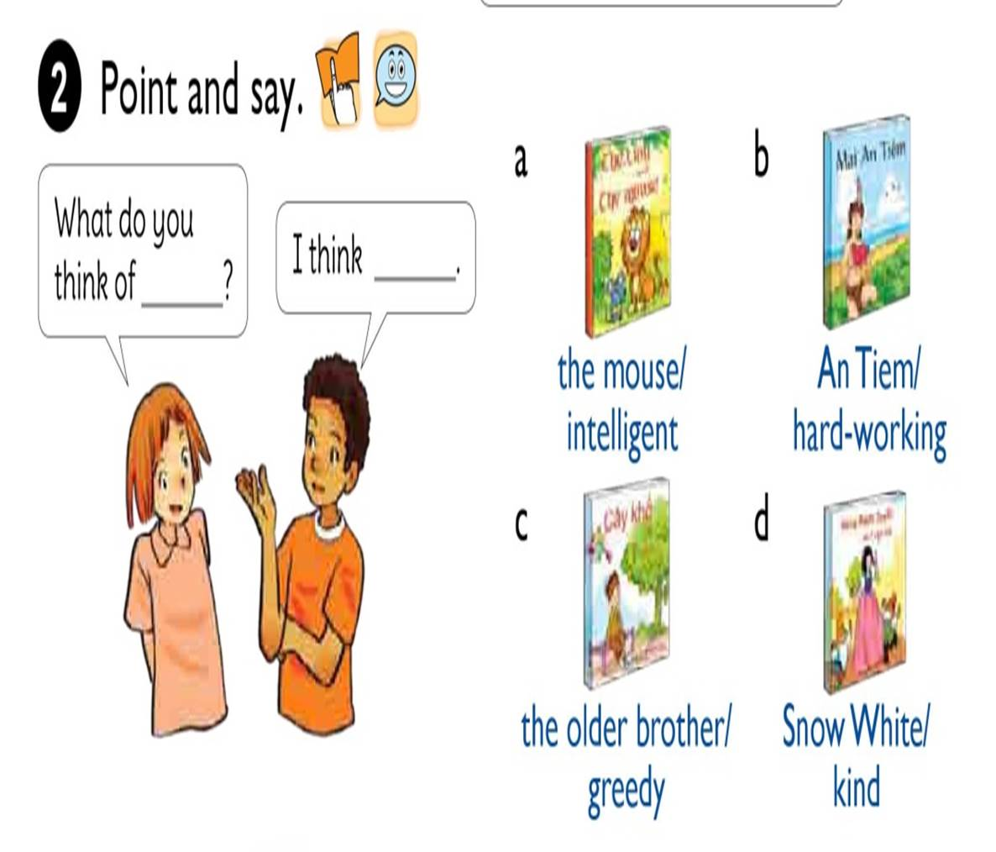

Slide 9

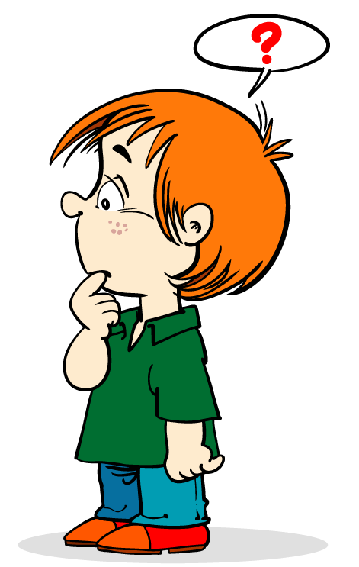
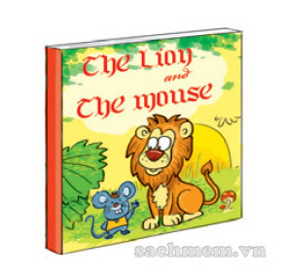
What do you think of ?
the mouse
I think
the mouse is intelligent.

Slide 10
What do you think of ?
An Tiem
I think
An Tiem is hard-working.

Slide 11
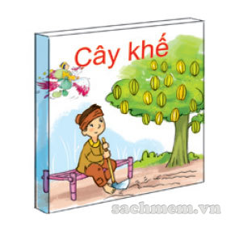
What do you think of ?
the older brother
I think
the older brother is greedy.

Slide 12
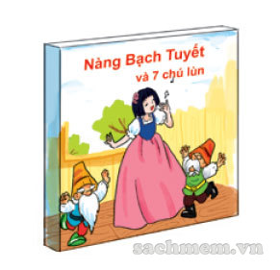
What do you think of ?
Snow White
I think
Snow White is kind.

Slide 13
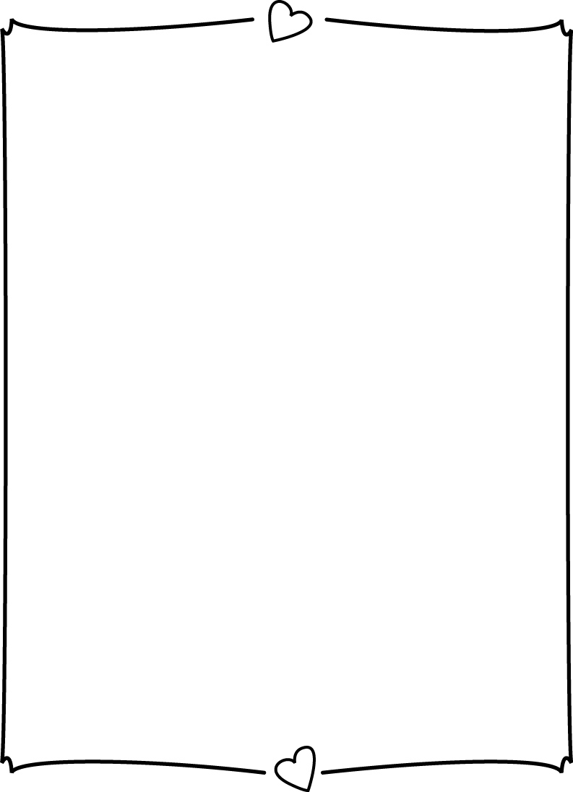
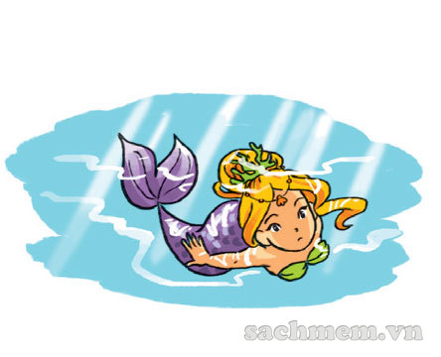
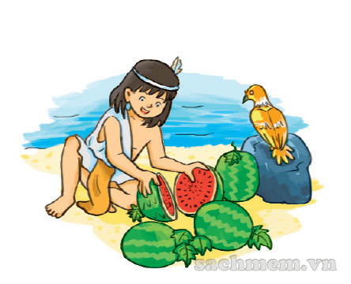
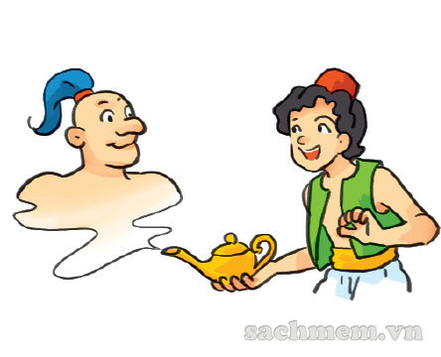

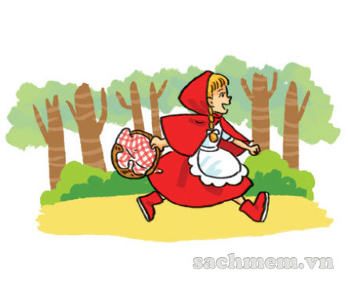
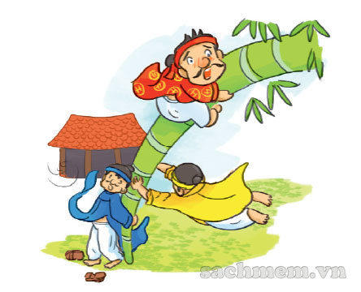
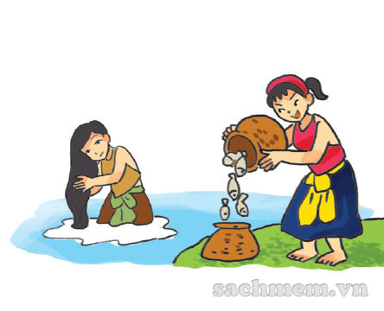
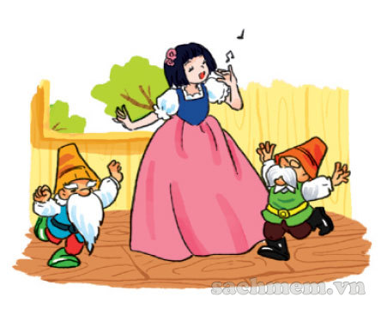
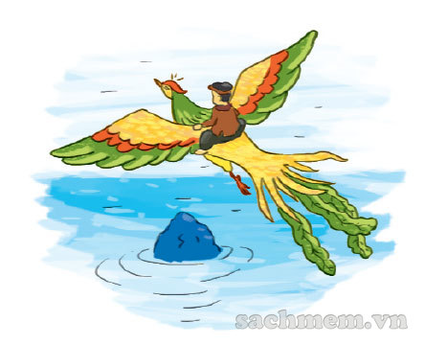
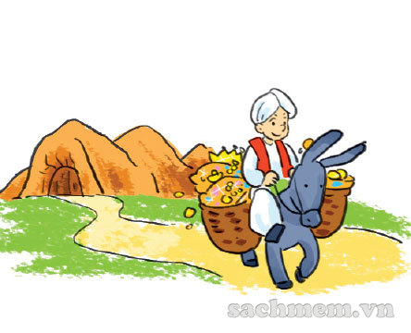
LISTEN AND TICK
1
2
3
a
a
a
b
b
b
c
c
c

Slide 14
WRITE ABOUT YOUR BOOK
1. What kinds of books do you like?
→
2. What is your favourite book?
→
3. Which character do you like best?
→
4. Which character don’t you like?
→
5. Why do you like this book?
→
I like folklores best.
My favourite book is “The Golden Star Fruit Tree”
I like the younger brother best.
I don’t like the older brother.
Because this story advises us to live honestly, not greedily since the greed brings unpredicted consequences to us.

Slide 15
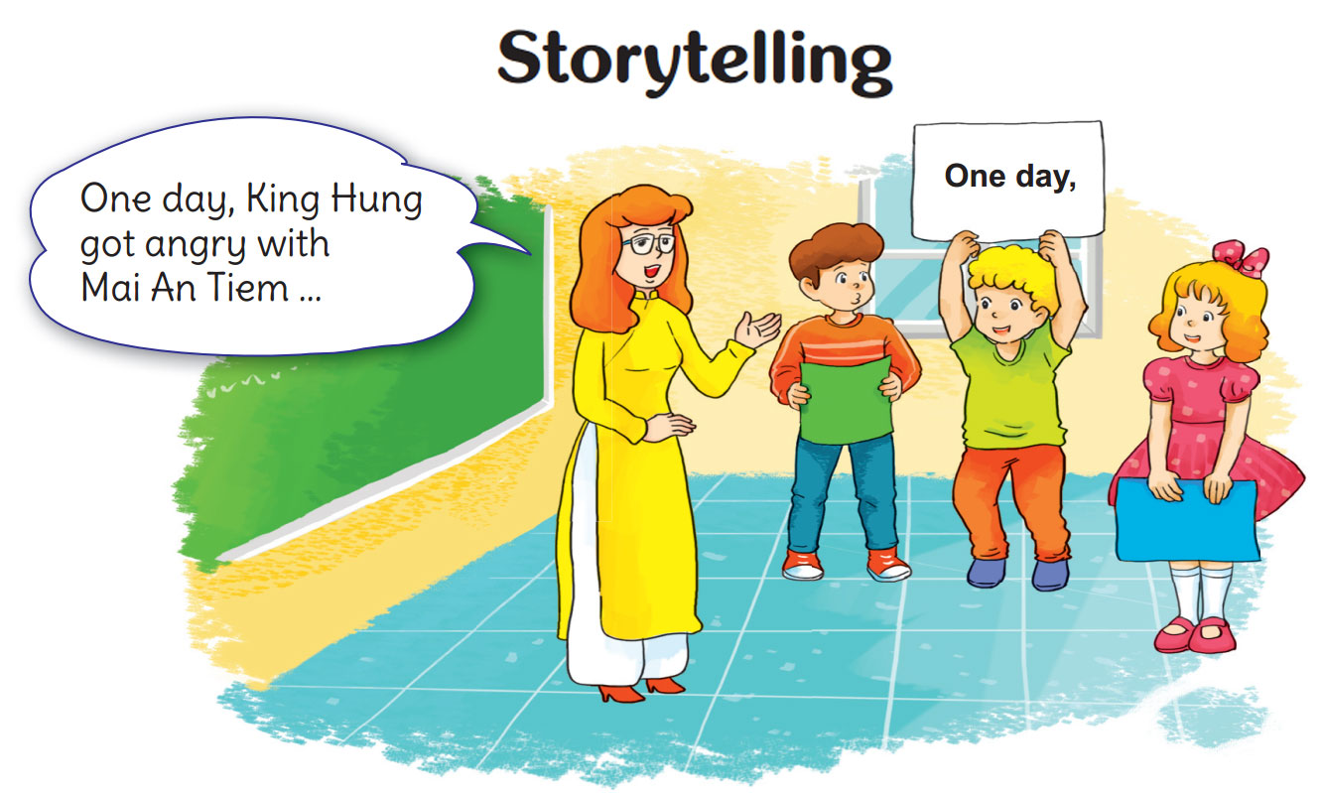

LET’S SING

Slide 16
