Slide 1

Unit 1: My friends
Lesson 2.1
Page 13

Slide 2

Vocab
the USA, the UK, Italy, India, Japan, Alpha

Slide 3


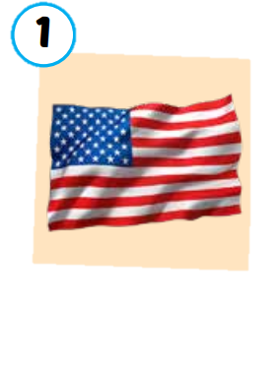
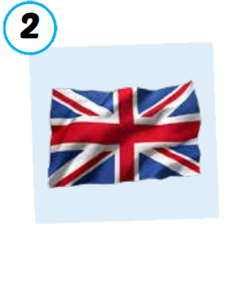
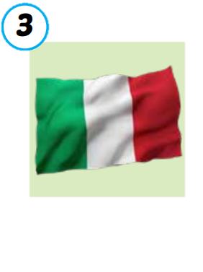
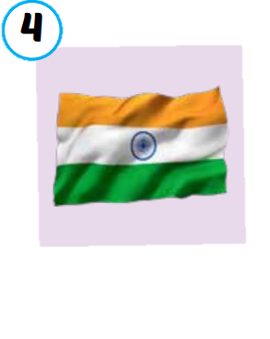
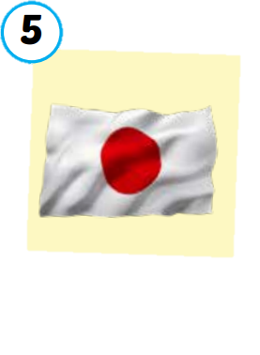
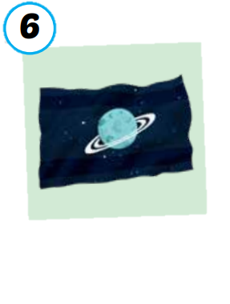
the USA
the UK
Italy
India
Japan
Alpha
/ðə ˌjuː es ˈeɪ/
nước Mỹ,
Hoa Kỳ
/ðə ˌjuː ˈkeɪ/
Vương quốc Anh
/ˈɪtəli/
nước Ý
/ˈɪndiə/
nước Ấn Độ
/dʒəˈpæn/
Nước Nhật
/ˈælfə/
Hành tinh Alpha

Slide 4

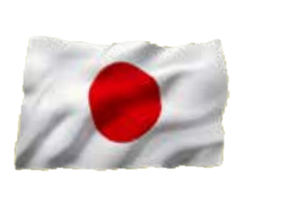



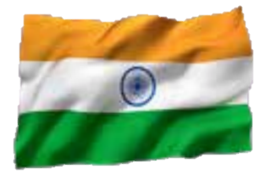
SLAP THE BOARD
Japan
The USA
The UK
Alpha
Italy
India

Slide 5


Listen and match.
a
b
c
d
e
f

Slide 6
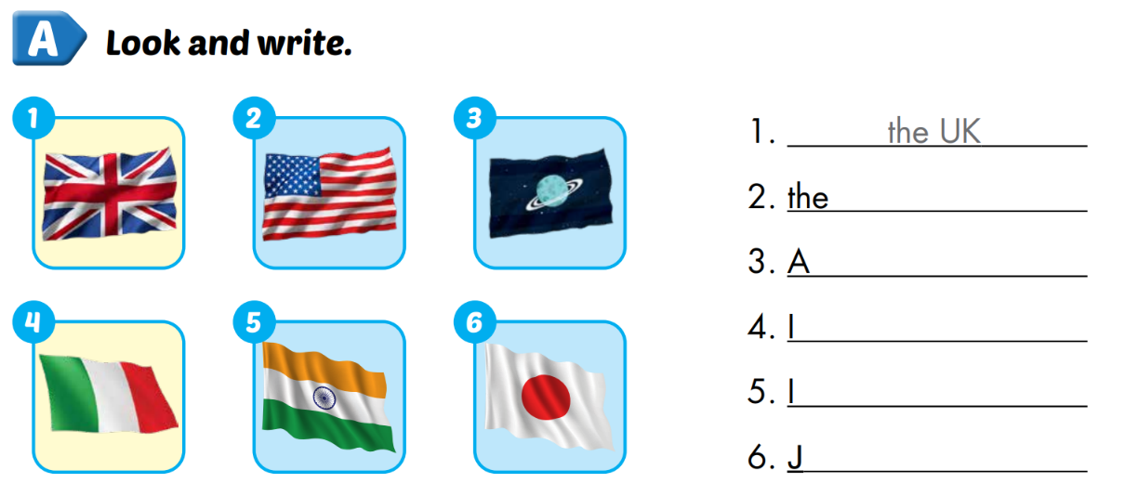
Extra 1 – WB P.10
USA
lpha
taly
ndia
apan

Slide 7
Structure
Where are you from?
I’m from ...

Slide 8









Slide 9

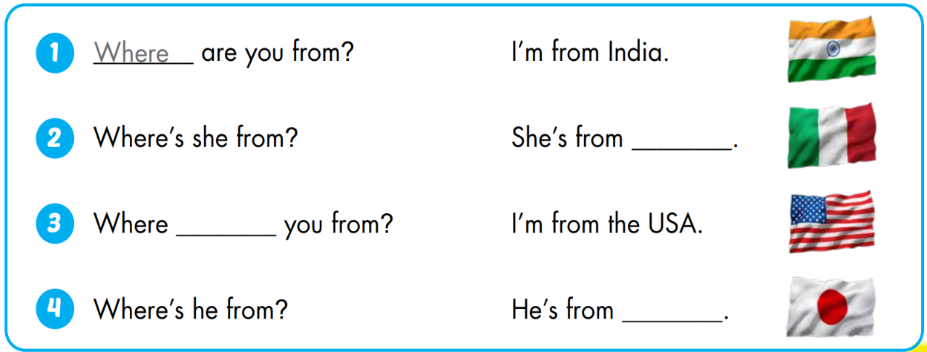
Italy
are
Japan

Slide 10
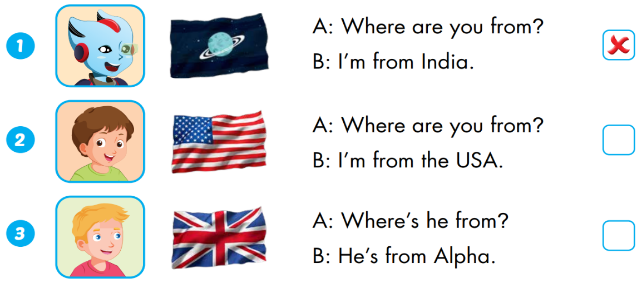


Extra 1 – WB P.10
Alpha
the UK

Slide 11

Enjoy your day!

