Slide 1

Unit 1: My friends
Lesson 1.2
Page 11

Slide 2

Phonics
/sp/

Slide 3


spell
space
Act1. Read and say YES
or NO Listen and check.
spider
spring
strong
speak
spider
spring
surprise
spicy
sport
speak
sport
star
spoil
spicy
spoil
spa
spa

Slide 4


sp
spell
space

Slide 5


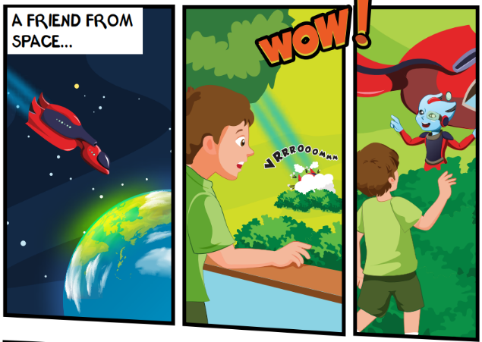
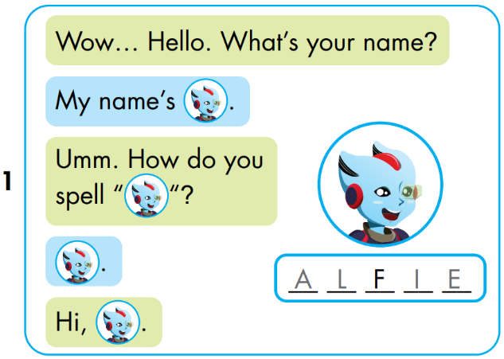


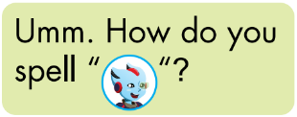


A
L
I
E

Slide 6
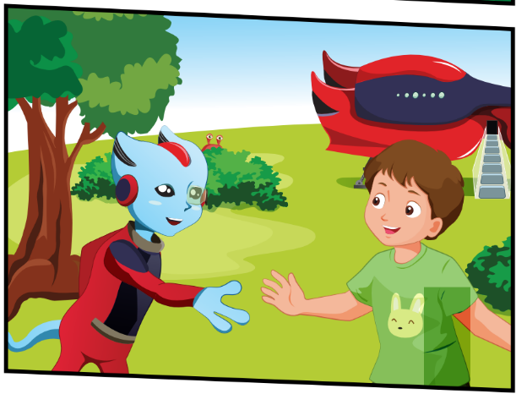
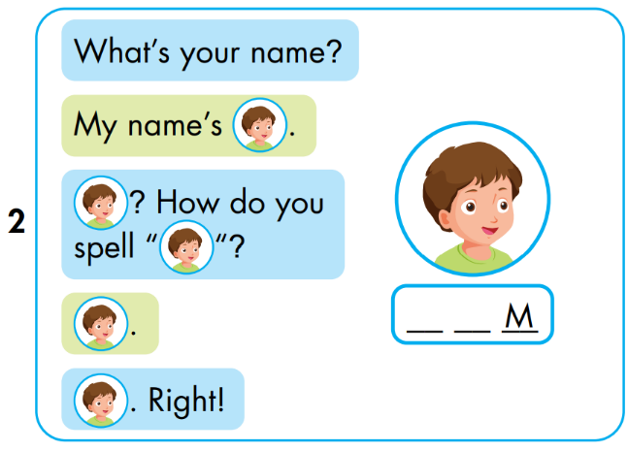


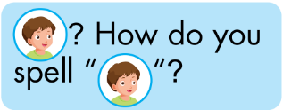


T
O

Slide 7
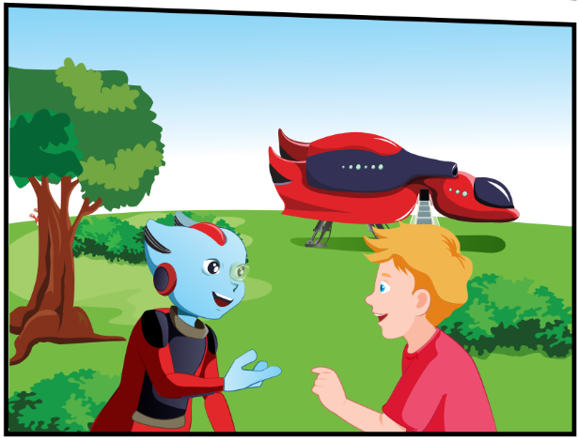
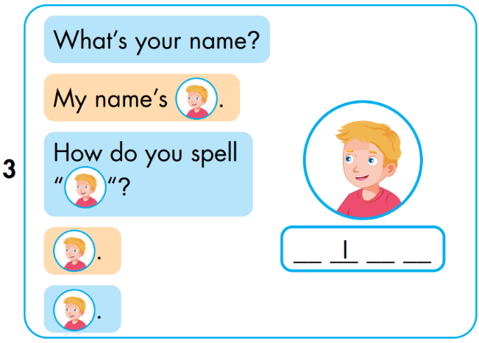


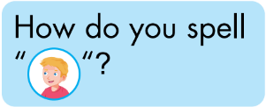


N
C
K

Slide 8
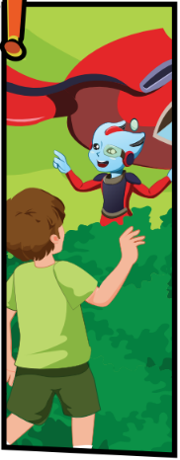
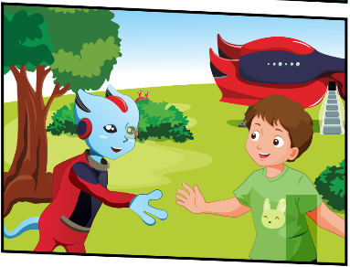





Slide 9

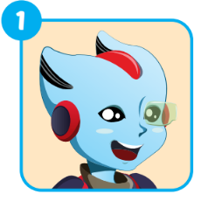
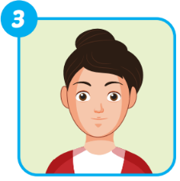
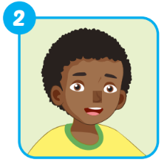
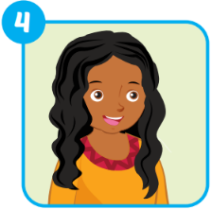
Extra 1 – WB p9
A _ _ _ _
ALFIE
_ _ _ _
MARY
_ _ _ _
HUGO
ELLA
_ _ _ _

Slide 10


Pop
-up
Enjoy your day!

