Slide 1

ENGLISH 3
SÁCH TIẾNG ANH 3
(Bộ Giáo dục và Đào tạo)

Slide 2

UNIT 14:
ARE THERE ANY POSTERS IN THE ROOM?
LESSON 1- P.24,25

Slide 3

WARM - UP
Let’s chant

Slide 4


Where's the book?
Where’s the book?
Where’s the ball?
Where are the posters?
Where are the pictures?
Here ! Here !
It’s here!
There! There!
It’s under the chair.
On the wall. On the wall.
They’re on the wall.
On the wall. On the wall.
They’re on the wall.

Slide 5

New words

Slide 6
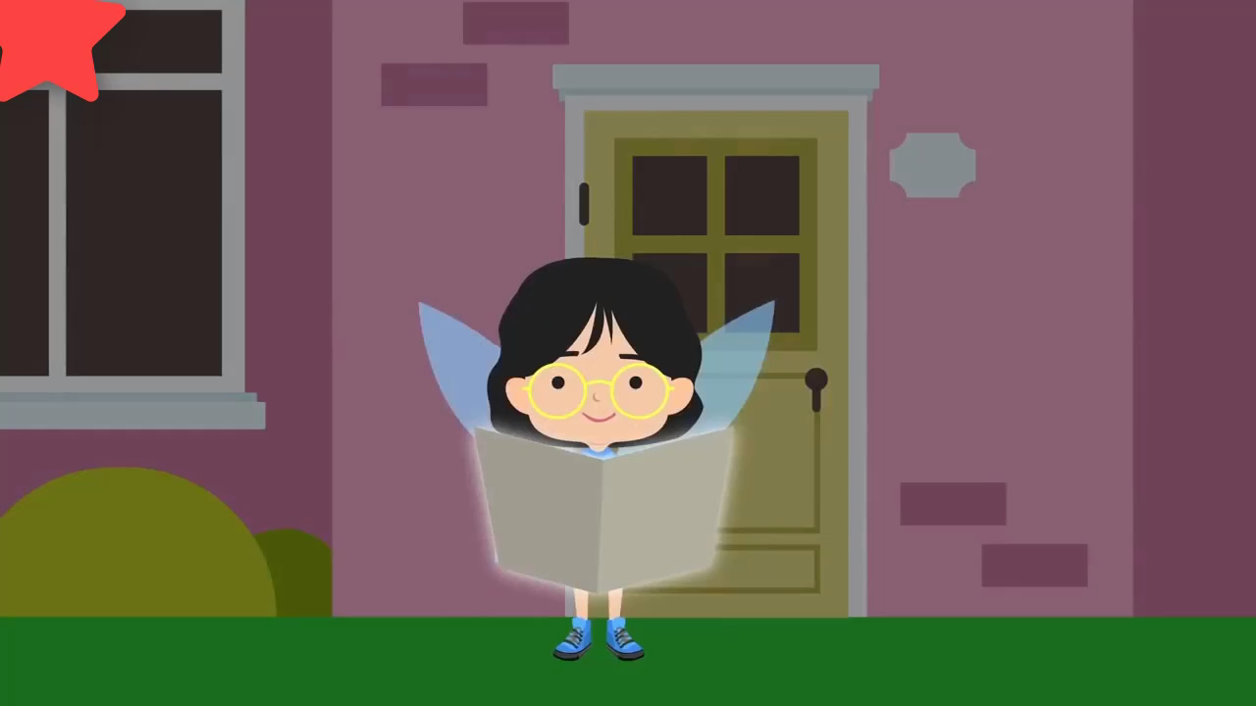
Các con chú ý xem và ghi nhớ các từ xuất hiện trong video nhé!

Slide 7
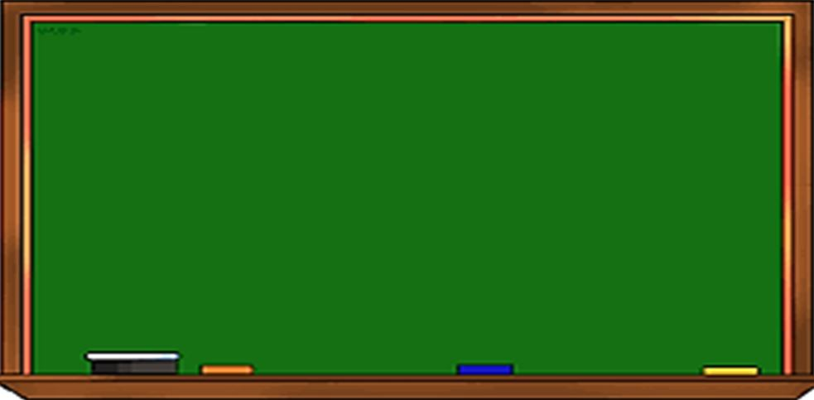


map
(bản đồ)

Slide 8
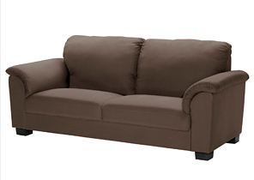
sofa
(ghế xô pha)

Slide 9
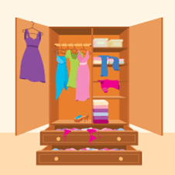
wardrobe
(tủ quần áo)

Slide 10
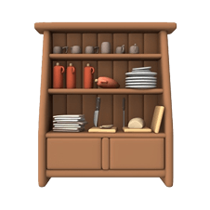
cupboard
(tủ chạn, tủ ly)

Slide 11
things in the room

Slide 12

Matching

Slide 13

1.
map
2.
sofa
3.
wardrobe
4. cupboard
5.
poster
Great job!
A
B
C
D
E

Slide 14

1. Look, listen
and repeat.

Slide 15
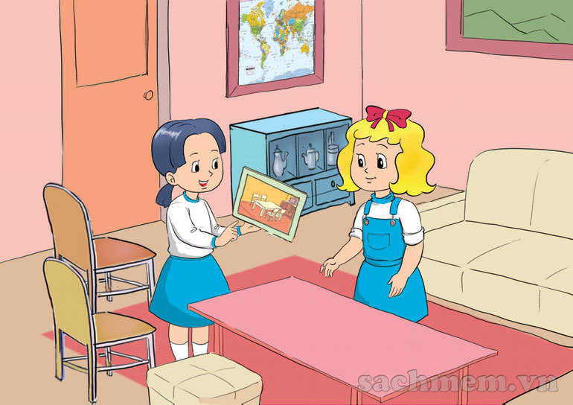
Linda
Mai

Slide 16
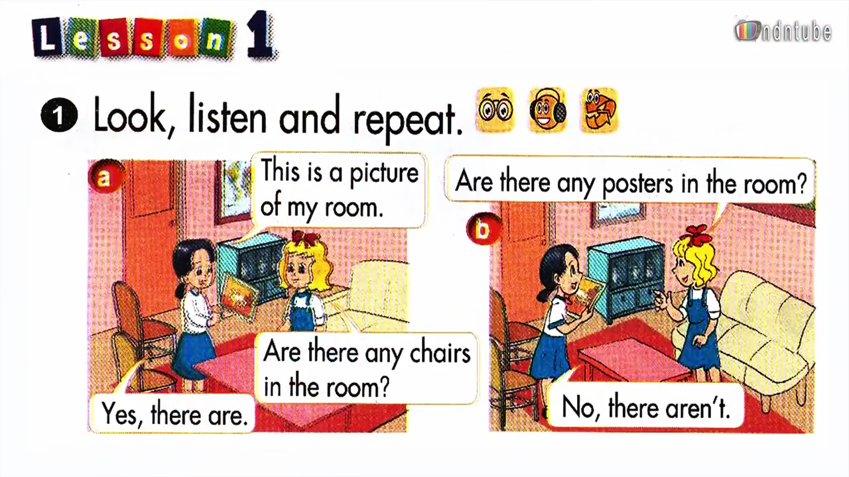

Slide 17
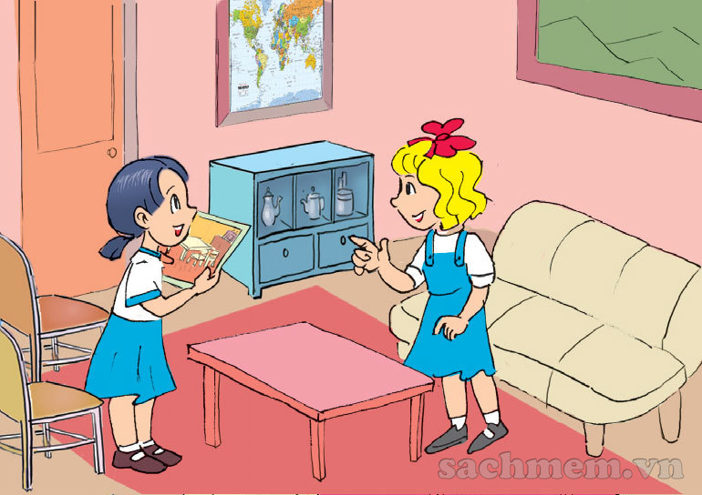
This is a picture of my room.
Are there any posters in the room?
Are there any chairs in the room?
No, there aren’t.
Yes, there are.

Slide 18
This is a picture of my room.
Are there any posters in the room?
Are there any chairs in the room?
No, there aren’t.
Yes, there are.

Slide 19
This is a picture of my room.
Are there any posters in the room?
Are there any chairs in the room?
No, there aren’t.
Yes, there are.

Slide 20
a
b
This is a picture of my room.
Are there any posters in the room?
Are there any chairs in the room?
No, there aren’t.
Yes, there are.

Slide 21
This is a picture of my room.
Are there any chairs in the room?
Yes, there are.

Slide 22
Are there any posters in the room?
No, there aren’t.

Slide 23
This is a picture of my room.
Are there any posters in the room?
Are there any chairs in the room?
No, there aren’t.
Yes, there are.

Slide 24



New sentences
Are there any in the room?
chairs
Yes, there are.
No, there aren’t. = No, there are not.

Slide 25
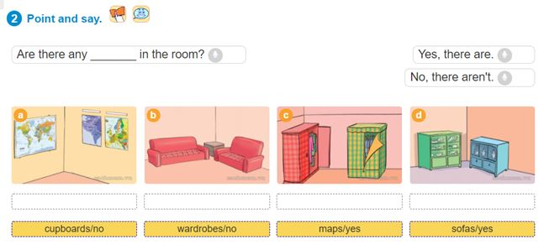
2. Point and say.

Slide 26
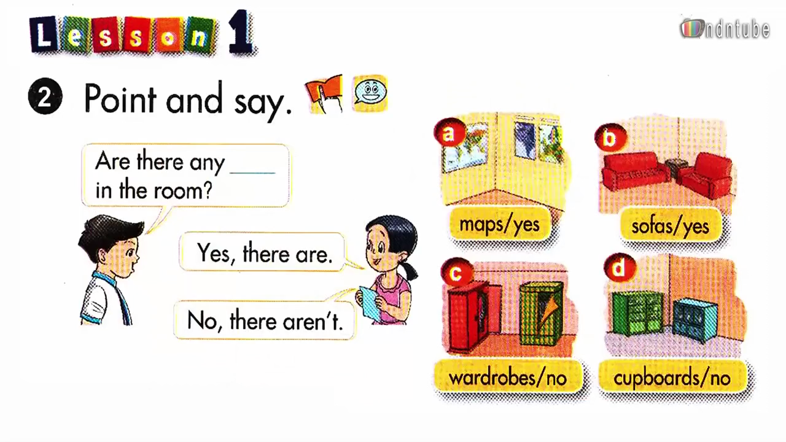

Slide 27

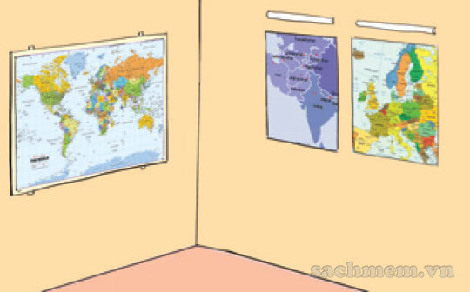

Are there any maps in the room ?
a
Yes, there are.

Slide 28
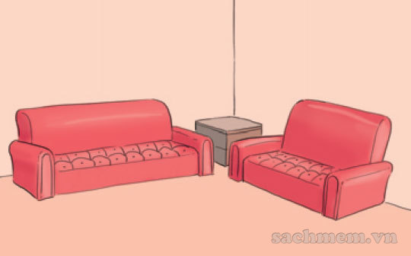
Are there any sofas in the room ?
b
Yes, there are.

Slide 29
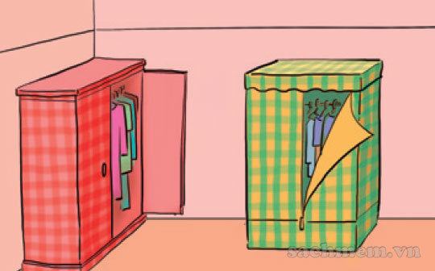
Are there any wardrobes in the room ?
c
No, there aren’t.

Slide 30
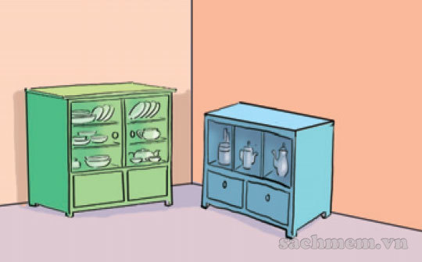
Are there any cupboards in the room ?
d
d
No, there aren’t.

Slide 31
3. Listen and tick

Slide 32


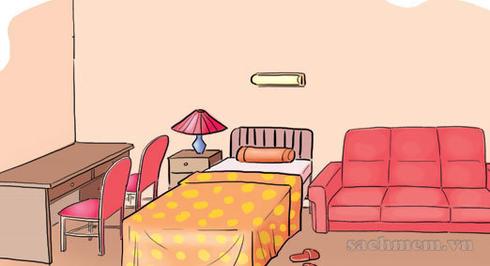
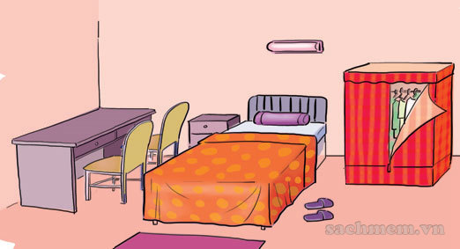
a
a
b
b
1.
b
a
b
2.
a

Slide 33
a
b
a
b
1.
a
a
b
b
2.

Slide 34
a
b
1.

2.
a
b


Slide 35
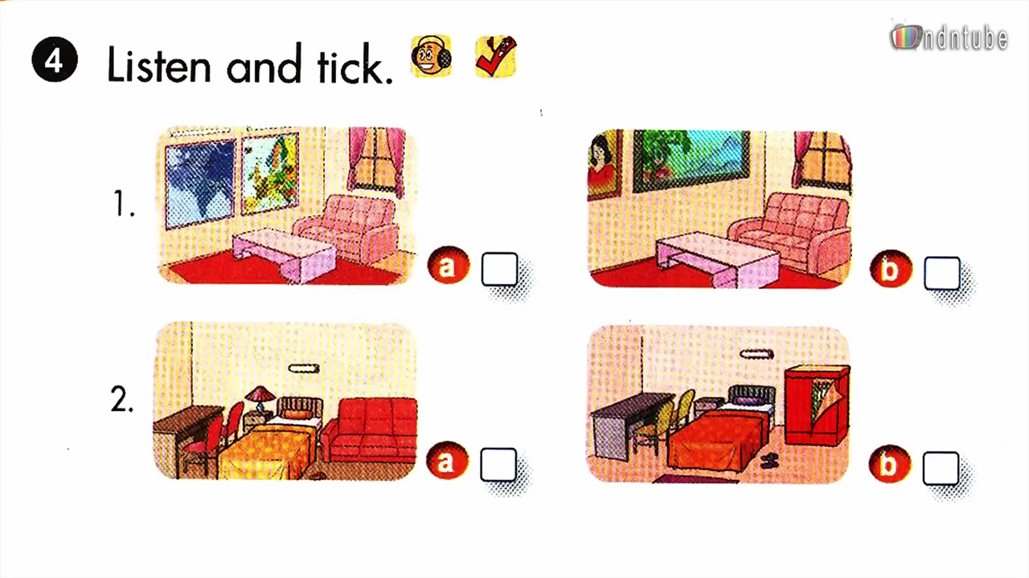

Slide 36
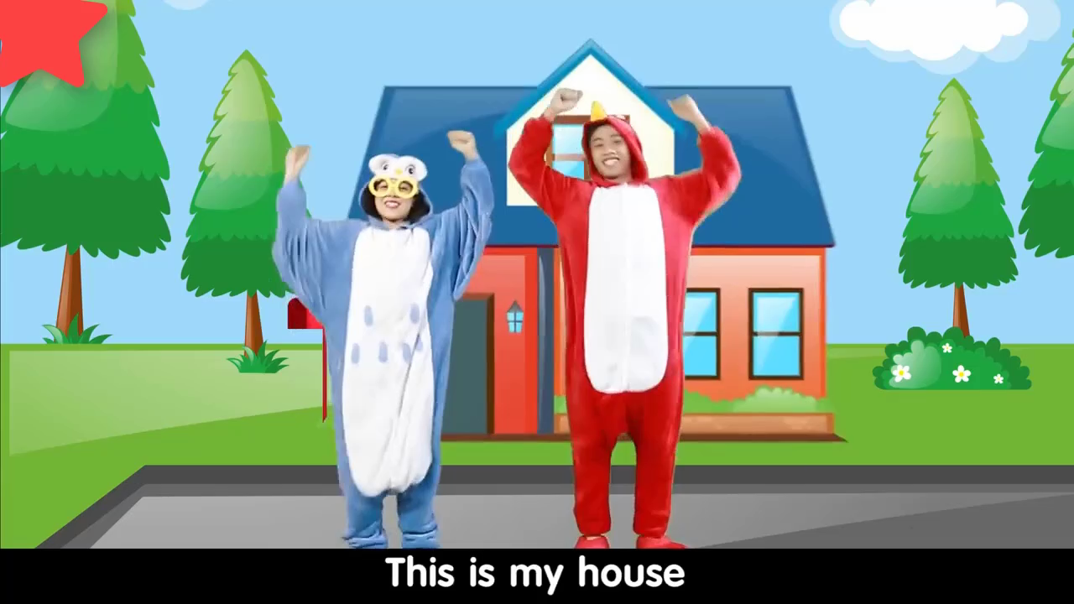
Các con chú ý xem và ghi nhớ các mẫu câu hôm nay học nhé!

Slide 37
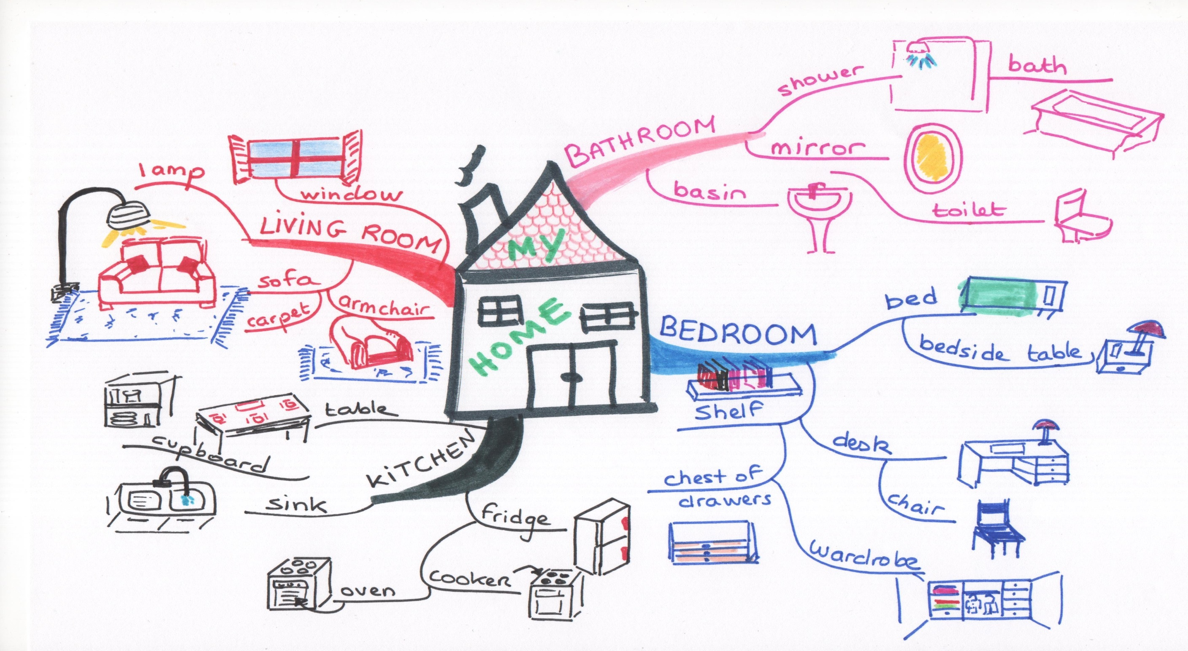

MIND MAP
map
sofa
LET’S SEE
HOUSE
cupboard
wardrobe

Slide 38



HOME-LINK
Vận dụng từ mới và mẫu câu vừa học:
Are there any ____ in the room ?
Yes, there are.
No, there aren’t. = No, there are not.
để hỏi và trả lời về các đồ vật trong phòng ở nhà mình.
2. Sáng tạo một Mind map tóm tắt nội dung bài học.

Slide 39
GOODBYE
SEE YOU NEXT TIME!

