Slide 1

UNIT 2. WHAT’S YOUR NAME?
LESSON 1

Slide 2



WARM UP

Slide 3
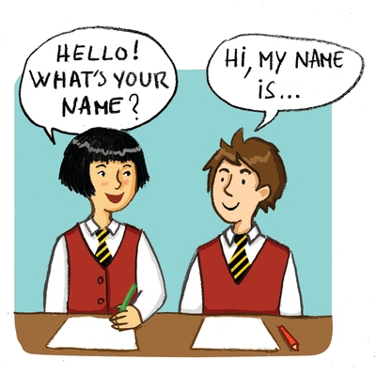


Slide 4
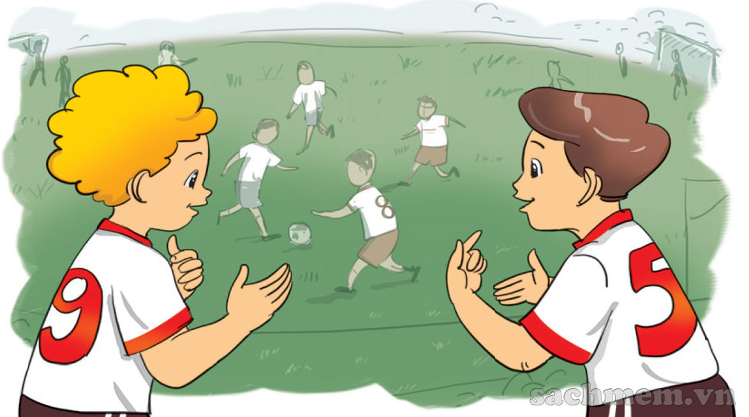
Hi, My name’s Peter
Hello, Peter. My name's Nam.

Slide 5
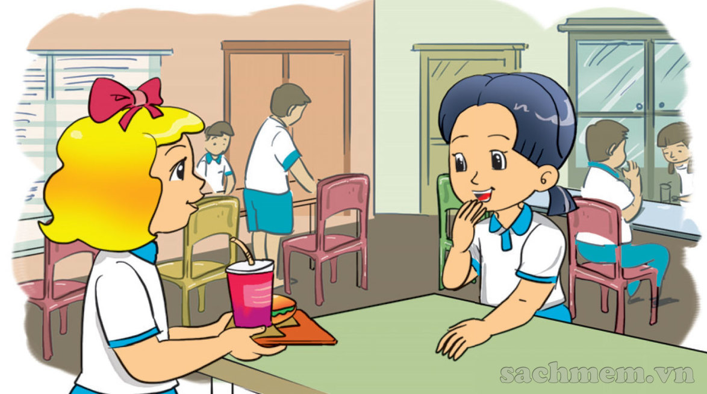
I'm Linda.
What's your name?
My name's Mai.

Slide 6

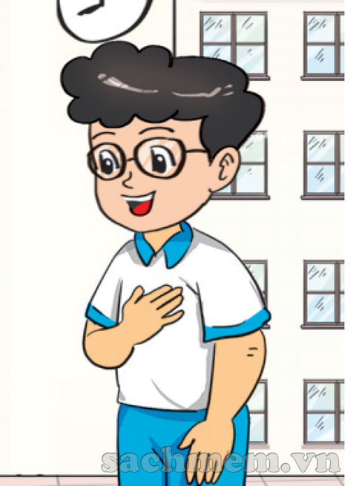

What’s your name?
My name’s
Phong

Slide 7
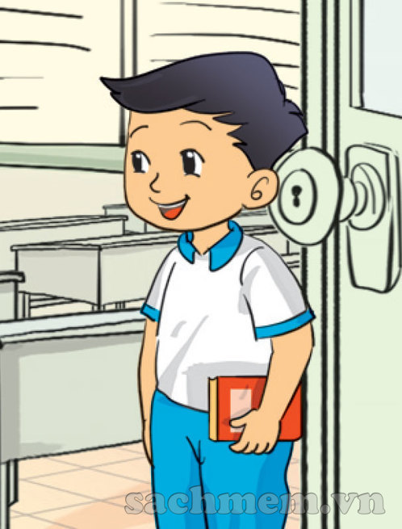
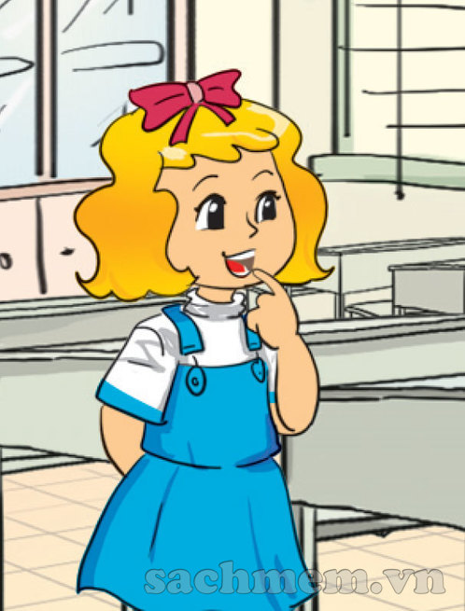
What’s your name?
My name’s
Quan

Slide 8


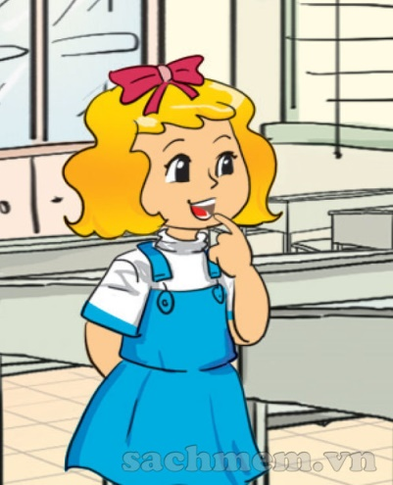
1. Vocabulary
- What?
- My
- Your
- name
2. Model sentence
What’s your name?
My name’s Phong.

Slide 9
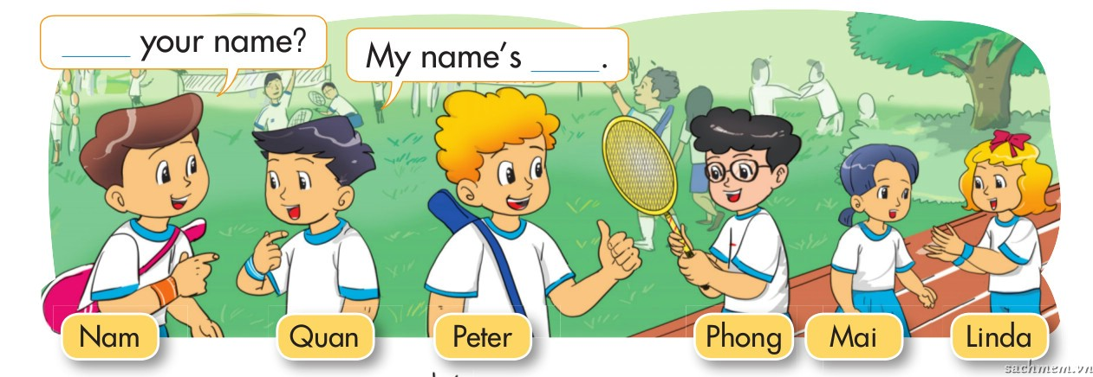

Gợi ý hoạt động: chia lớp thành 2 đội, chơi với bóng và thẻ nhân vật. 1đội truyền bóng, 1 đội truyền tranh, nhạc dừng, bóng và tranh ở tay ai thì bạn đó giới thiệu nhân vật trong tranh và đáp lại lời giới thiẹu theo mẫu câu.
By Jessica

Slide 10
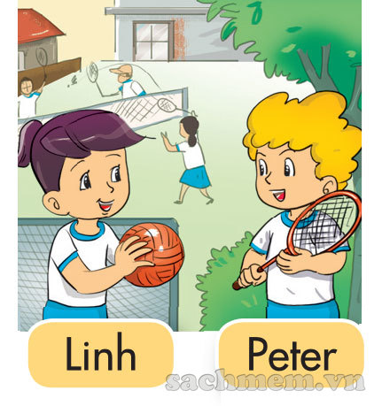
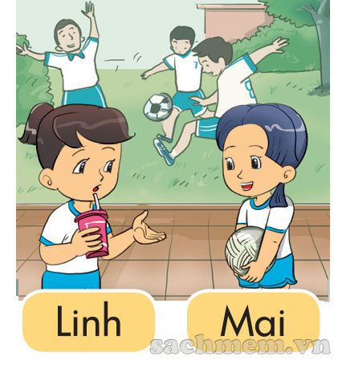

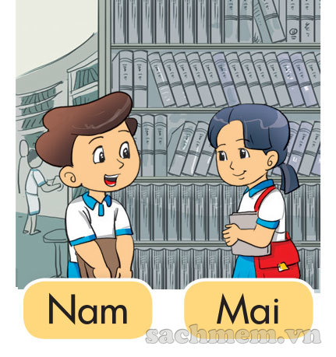
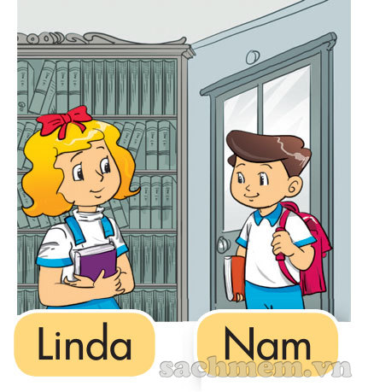
LISTEN AND TICK
1
a
b
2
a
b

Slide 11


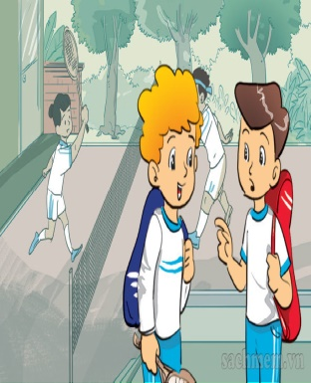
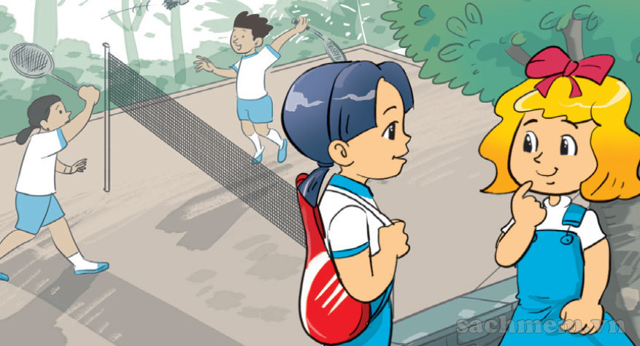
Look and write
1.A: What's your name?
B: Peter.
My name’s
2.A: I'm
What's your name?
B: Linda.
I’m
My name’s

Slide 12


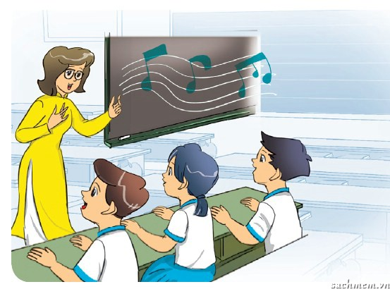
Let’s sing
The alphabet song
A B C D E F G
H I J K L M N O P
Q R S T U V
W X Y Z.
Now I know my ABCs.
Next time will you sing with me?

Slide 13

By Jessica

Slide 14






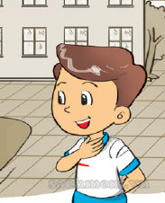


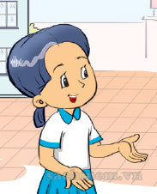

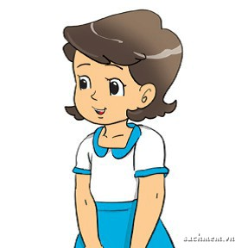
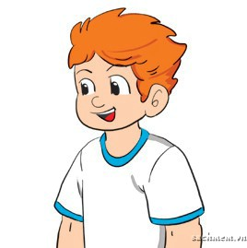
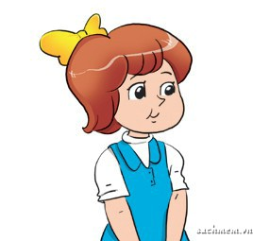
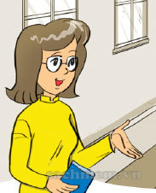

Slide 15






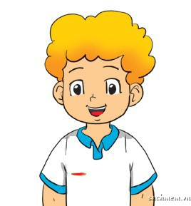

By Jessica

Slide 16
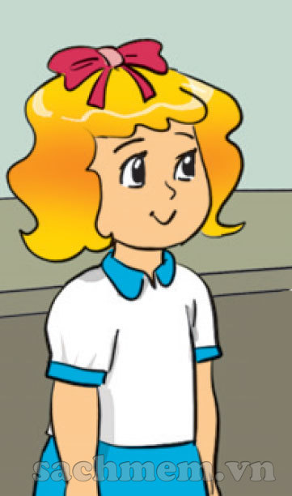

Linda
My name’s
CHECK
By Jessica

Slide 17


By Jessica

Slide 18
CHECK
Mai
My name’s
By Jessica

Slide 19

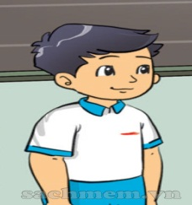
By Jessica

Slide 20
Hello, I’m
Miss Hien
CHECK
By Jessica

Slide 21


By Jessica

Slide 22
My name’s
Peter
CHECK
By Jessica

Slide 23


By Jessica

Slide 24
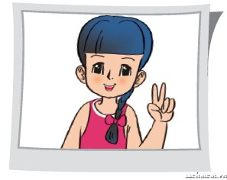
My name’s
Akiko
CHECK
By Jessica

Slide 25
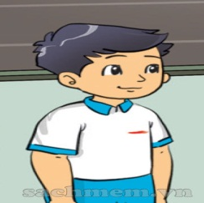

By Jessica

Slide 26
My names’s
Phong
CHECK
By Jessica

Slide 27


By Jessica

Slide 28

My name’s
Quan
CHECK
By Jessica

Slide 29

By Jessica

Slide 30
CHECK
My name’s
Tony

Slide 31




