Slide 1
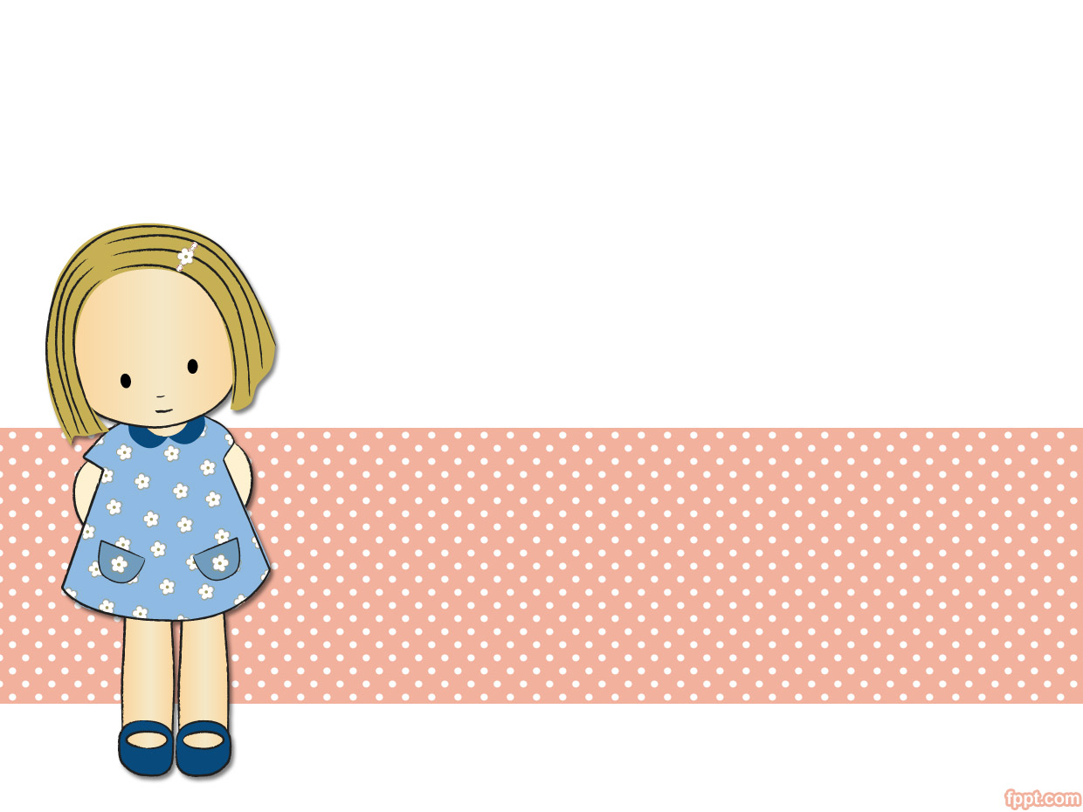
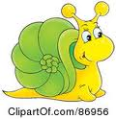
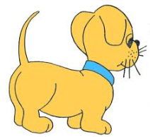

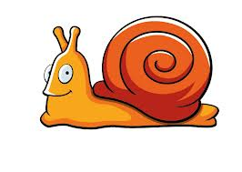

UNIT 1. NICE TO SEE YOU AGAIN
LESSON 1

Slide 2

WARM UP

Slide 3

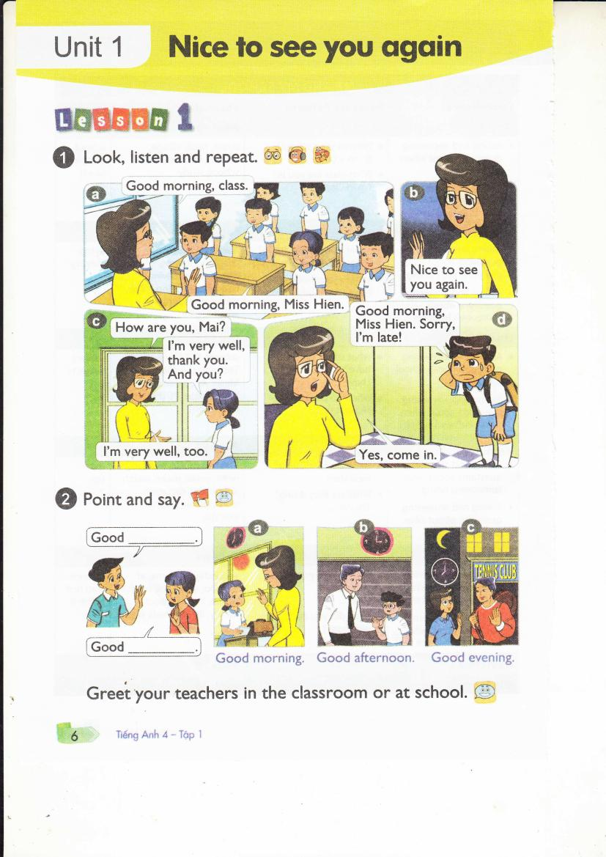
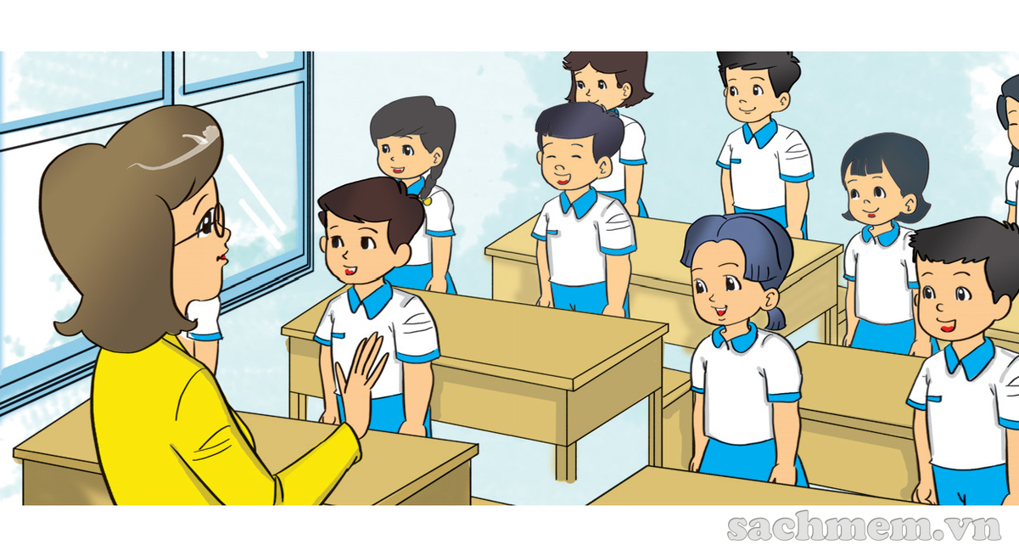

Slide 4
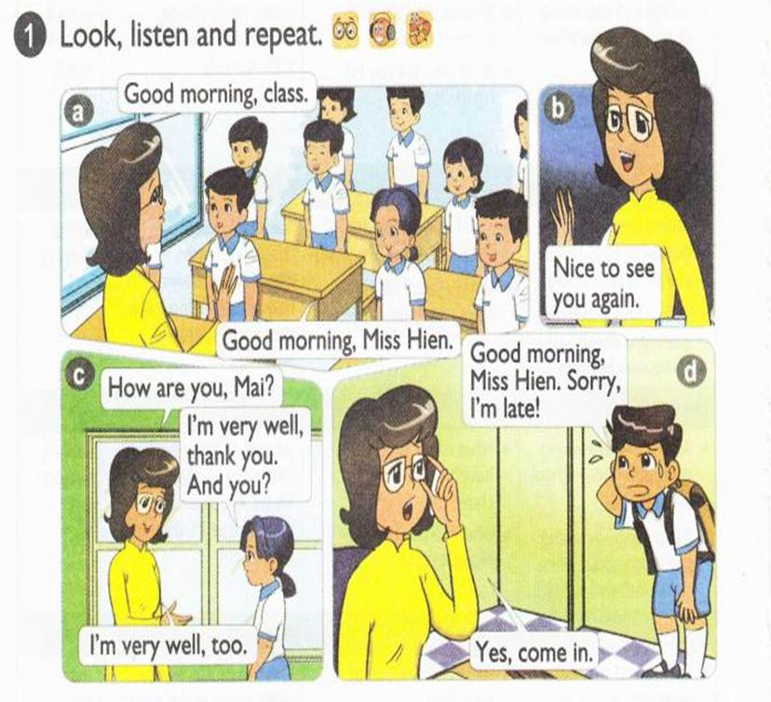


Slide 5
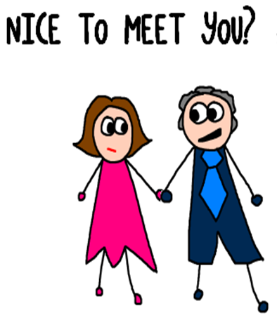

Slide 6
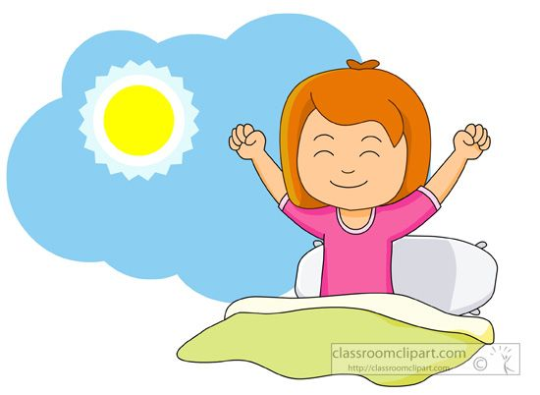
Good morning

Slide 7


Slide 8
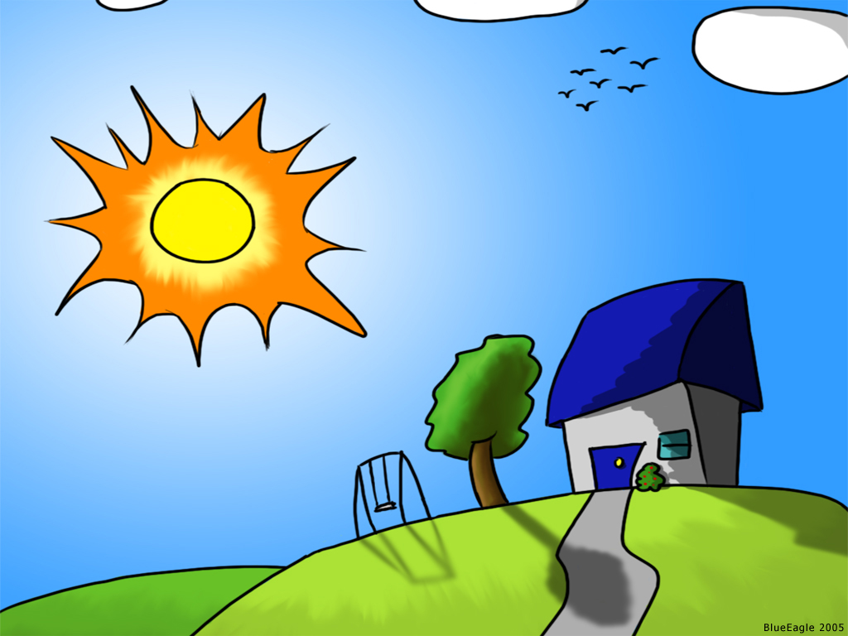
Good EVENING

Slide 9
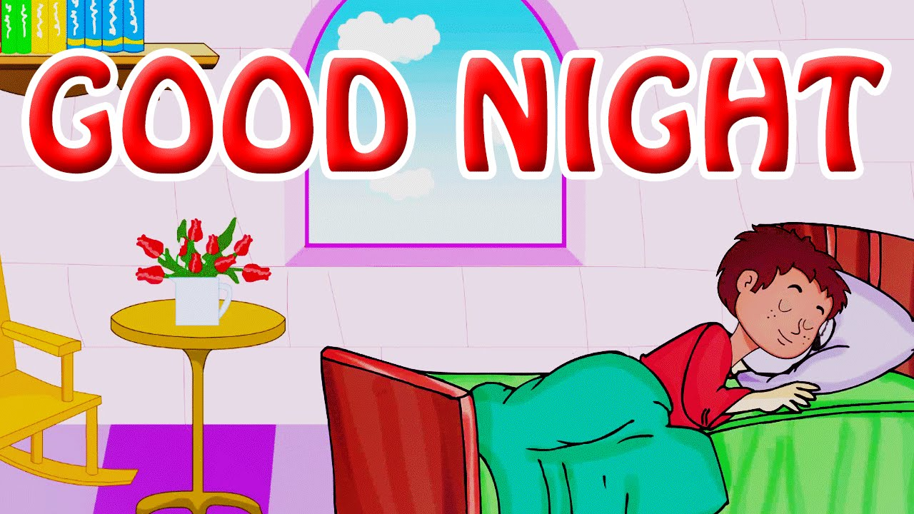

Slide 10
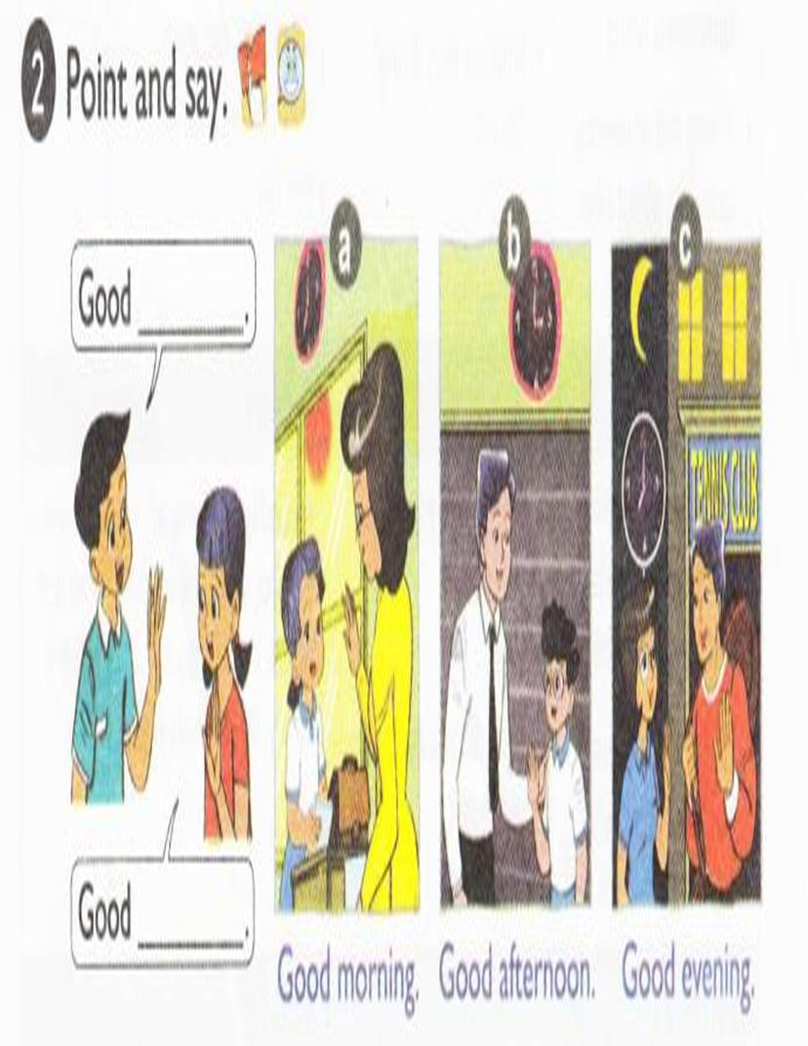

Slide 11
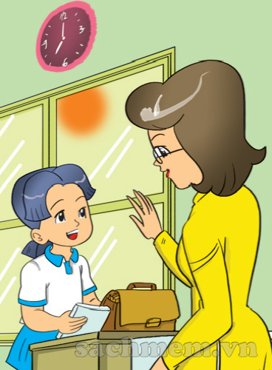
Good morning
Good morning

Slide 12
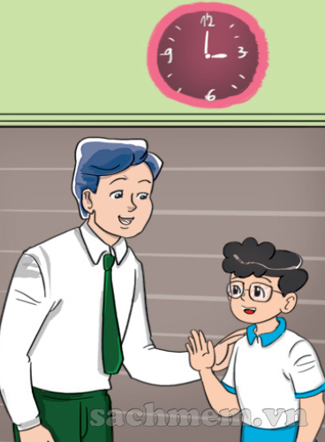
Good afternoon
Good afternoon

Slide 13
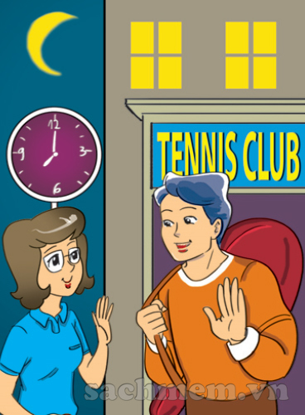
Good evening
Good evening

Slide 14
3. Listen and tick

Slide 15
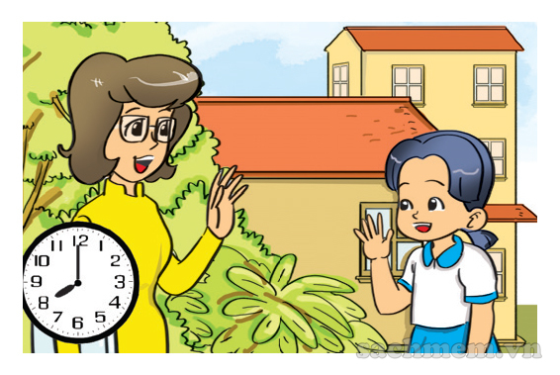
1
a
b
c

Slide 16
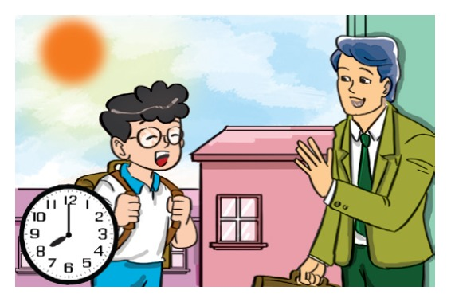
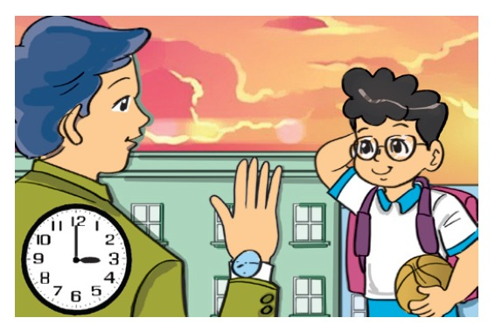
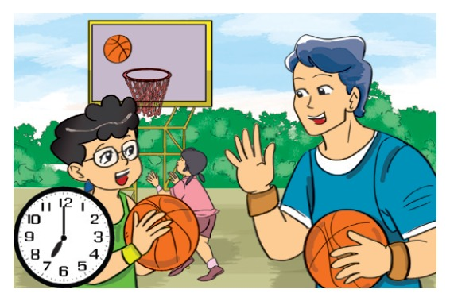
2
a
b
c

Slide 17
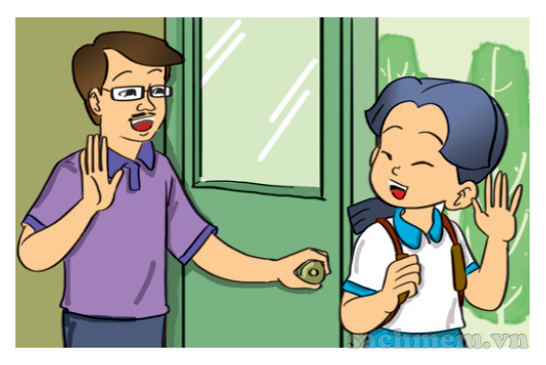
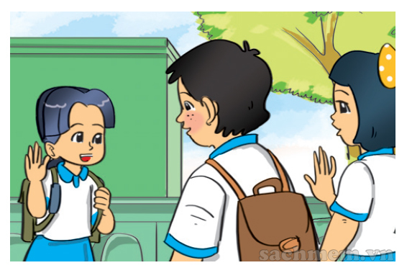
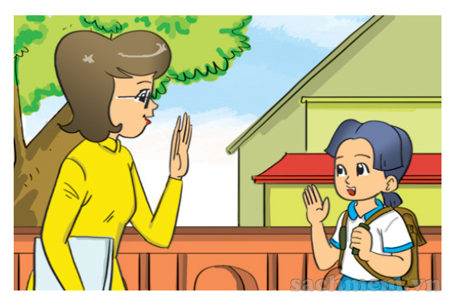
3
a
b
c

Slide 18
LOOK & WRITE

Slide 19
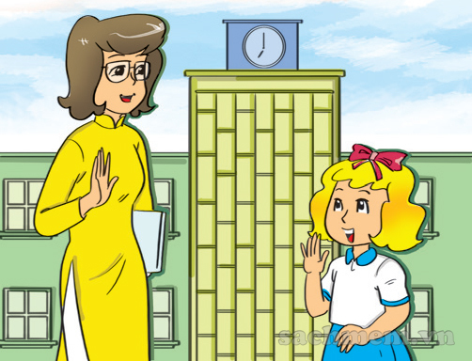
Good

Slide 20
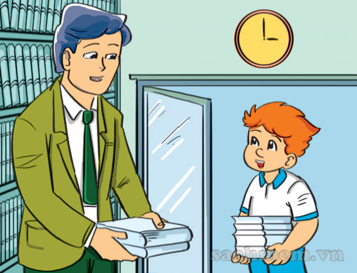
Good

Slide 21
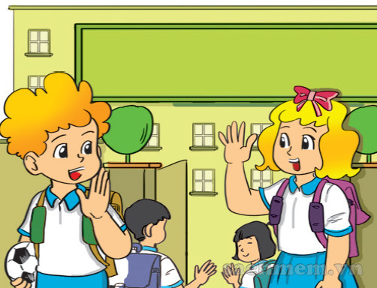
Good

Slide 22

UNIT 1. nice to see you again
LESSON 2

Slide 23
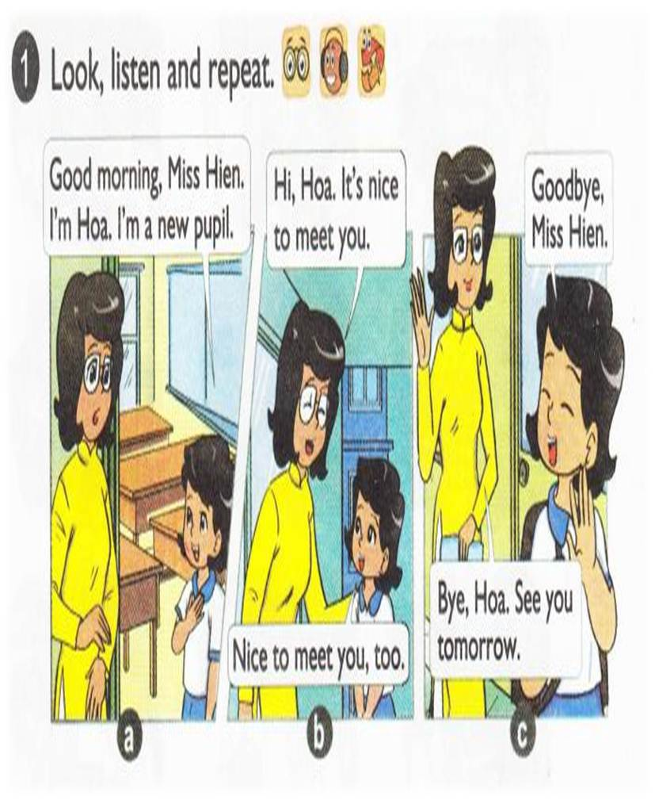


Slide 24
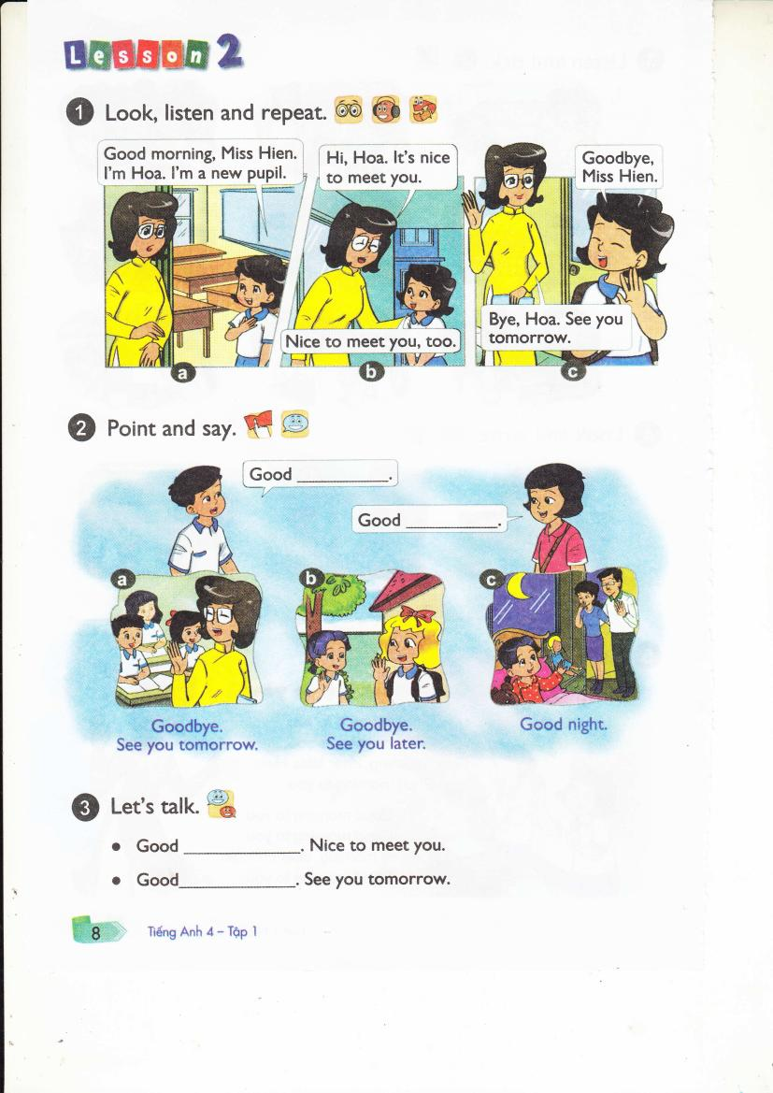

Slide 25
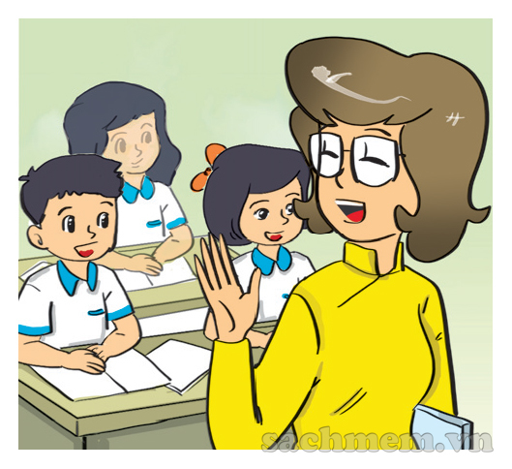
Goodbye. See you tomorrow.
MAI
NAM

Slide 26
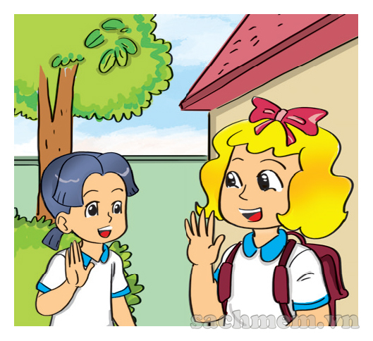
Goodbye. See you tomorrow.
MAI
NAM

Slide 27
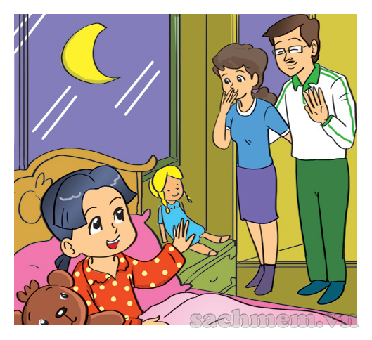
Good night
MAI
NAM

Slide 28

I.New words
Good night
Good bye
See you tomorrow
See you later

Slide 29
Good bye
See you tomorrow.
Good morning/ afternoon/ evening
Nice to meet you.

Slide 30
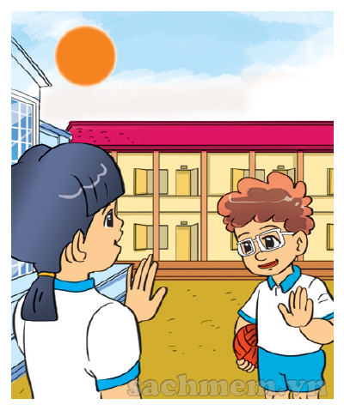
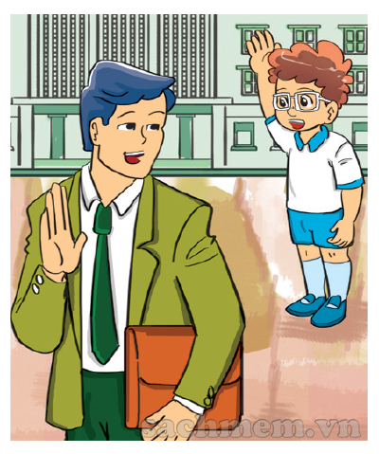
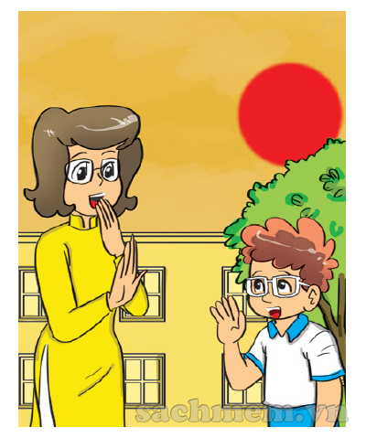
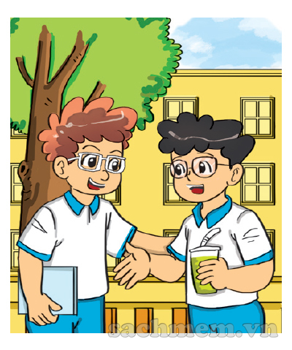
LISTEN & NUMBER
2
4
1
2
3
1
3
4

Slide 31
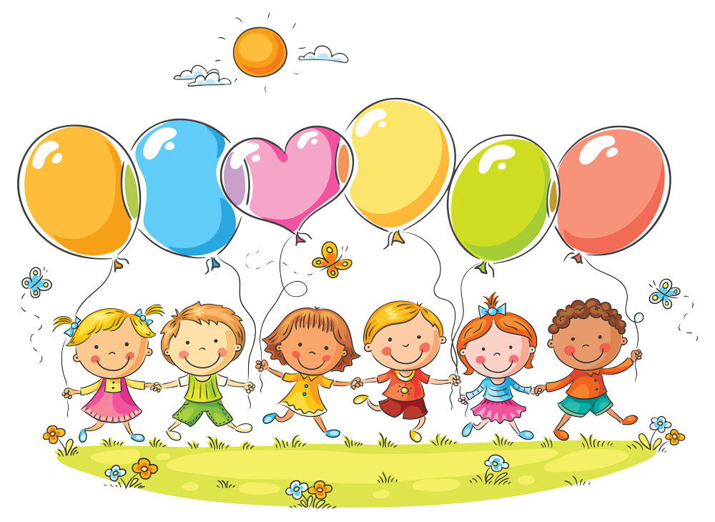
UNIT 1 . NICE TO SEE YOU AGAIN
LESSON 3

Slide 32





Slide 33

Hello, Linda
Linda

Slide 34
night
Good night

Slide 35


Slide 36






1
2
3
4
30
20
40
10
5
6
50
80
60
70
Team 1
Team 2
SPIN

Slide 37
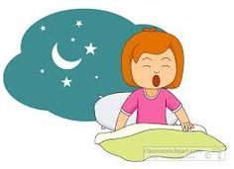
Good moning
Good afternoon
Good night
2

Slide 38

afternoon
morning
night
3

Slide 39
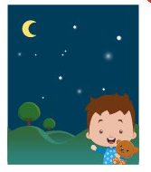
afternoon
morning
night
4

Slide 40
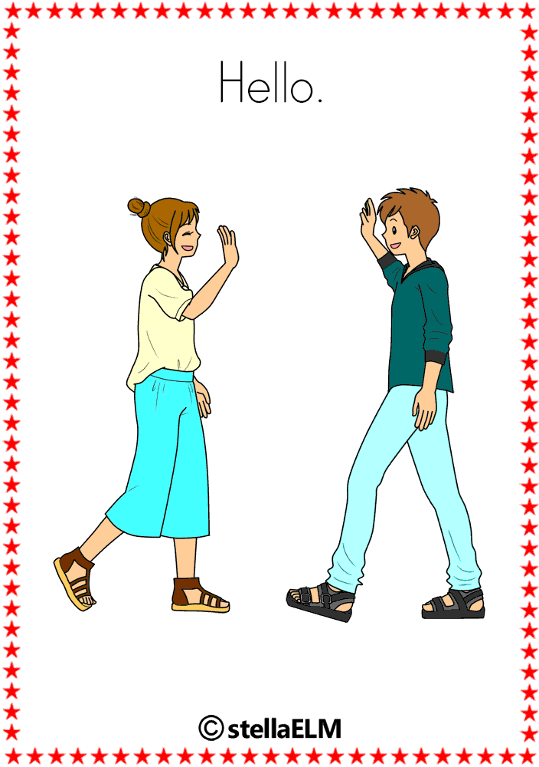
hello
Good bye
bye
5

Slide 41

BYE
GOOD BYE
NICE TO MEET YOU
6

Slide 42

BYE
GOOD BYE
HELLO/ HI
9

Slide 43





