Slide 1

IELTS WRITING TASK 1 –
BAR CHARTS

Slide 2
CONTENTS
1. MAIN FEATURES
2. WRITING TIPS
3. SAMPLE ANALYSIS

Slide 3
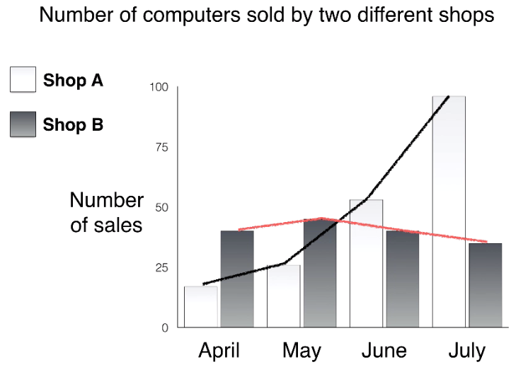
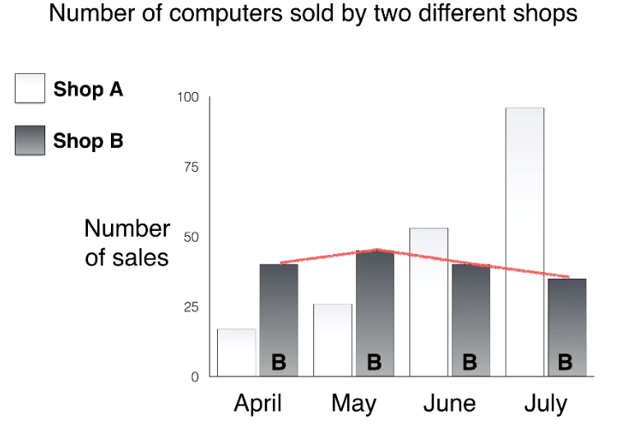
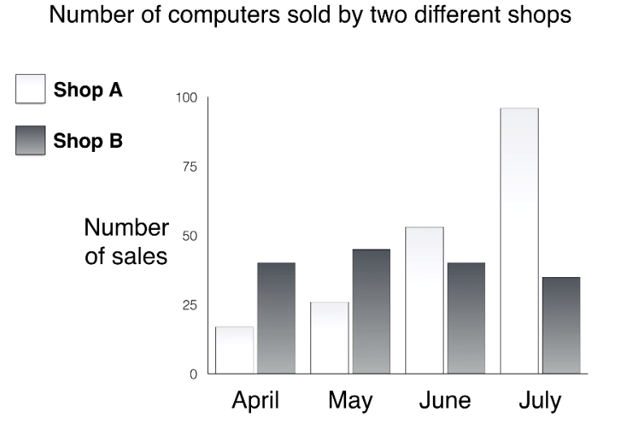
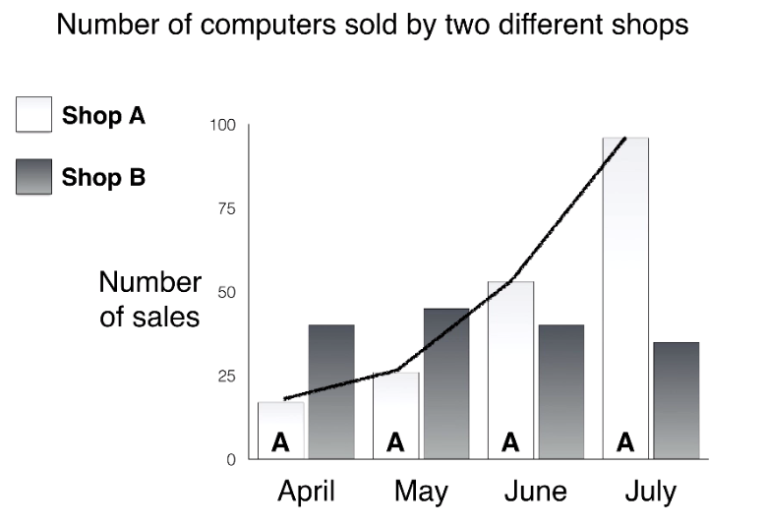
1. BAR CHARTS – MAIN FEATURES
Bar charts can show:
Changes of numbers over time (similar to line graphs)

Slide 4
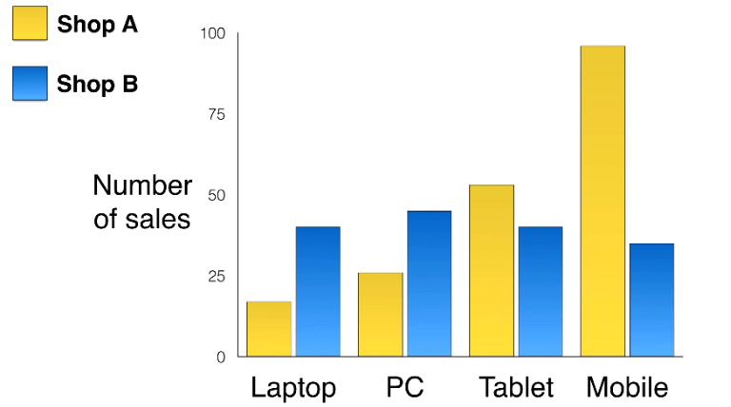
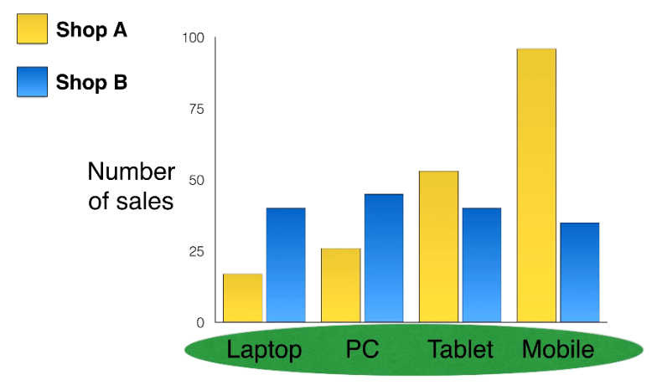
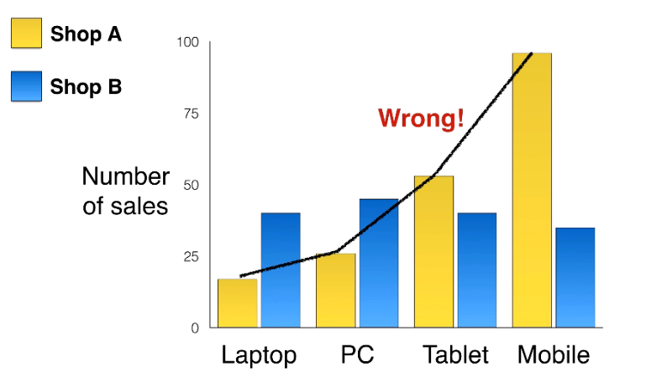
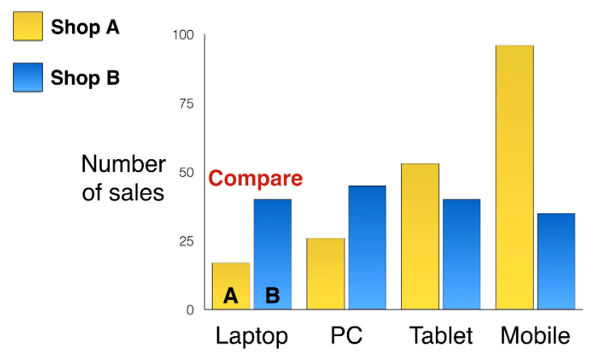
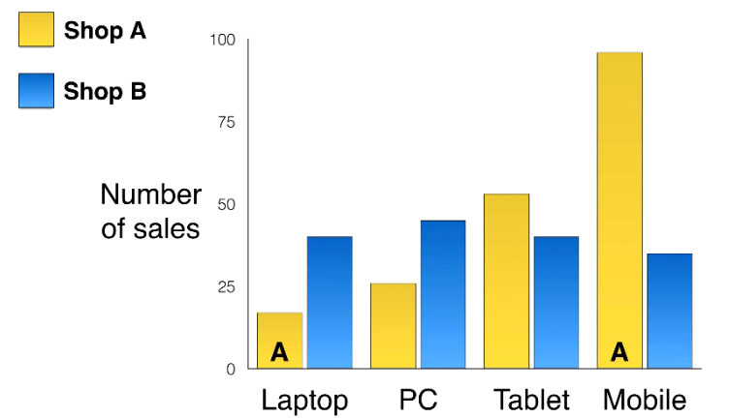
However, bar charts don’t always show time, they often compare numbers/ items, etc...

Slide 5
2. BAR CHARTS – WRITING TIPS
ESSAY STRUCTURE
Paragraph 1: Paraphrase of the question prompt
Paragraph 2: Summary of the main points (the overview paragraph)
Paragraphs 3,4: Detail paragraphs

Slide 6
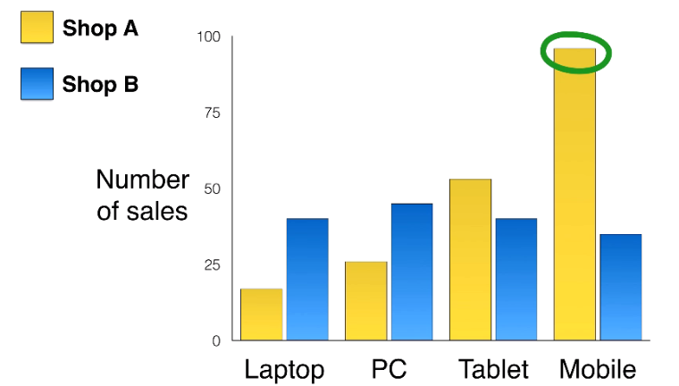
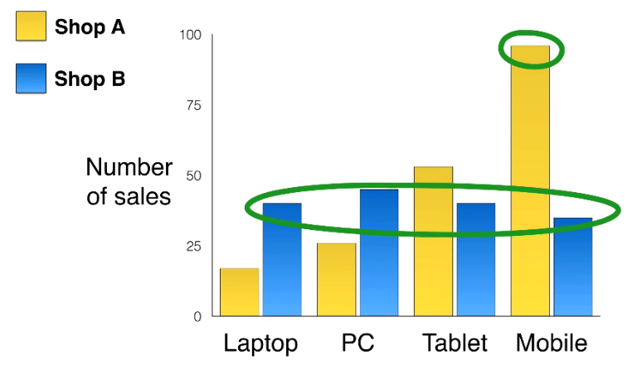
2. BAR CHARTS – WRITING TIPS
PARAGRAPH 2:
Summary of the main points (The overview paragraph)
    Make a very general comparison

Slide 7
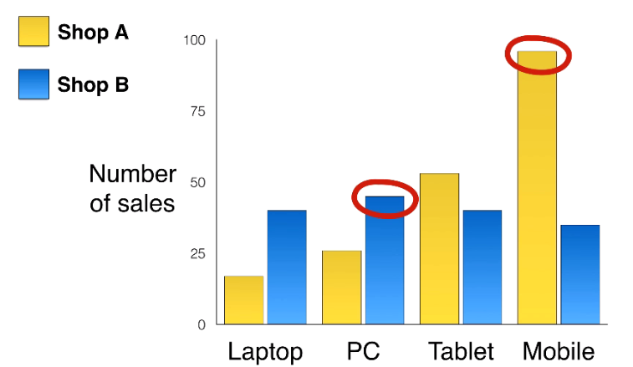
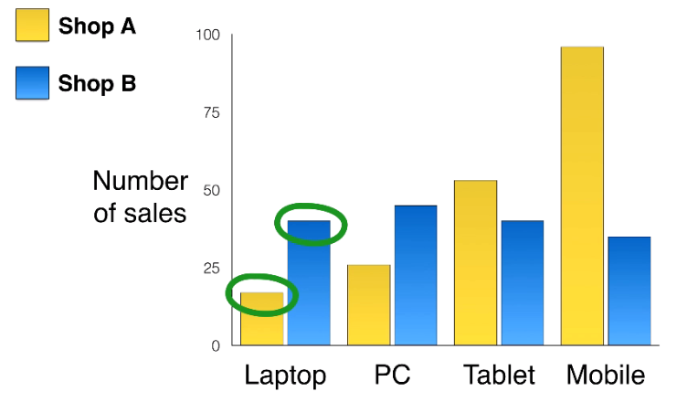
2. BAR CHARTS – WRITING TIPS
PARAGRAPHS 3 & 4
Compare specific numbers

Slide 8
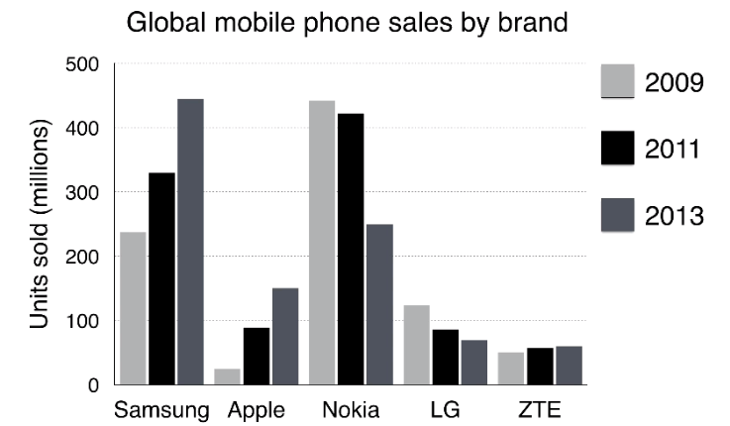
3. SAMPLE ANALYSIS

Slide 9

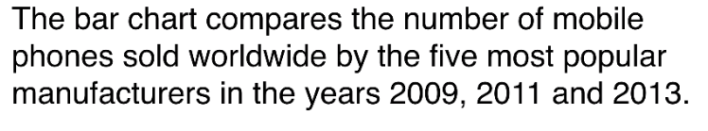
The Introduction – Paraphrasing the question

Slide 10
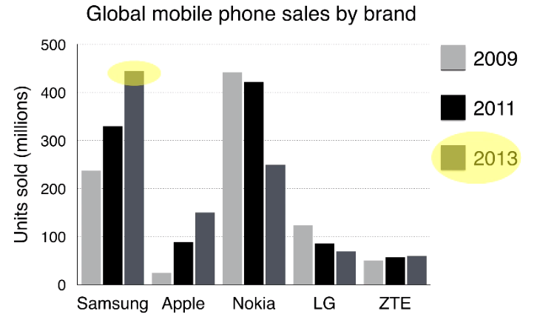
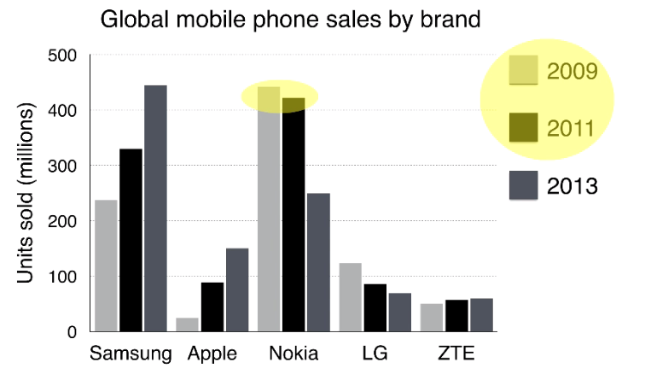
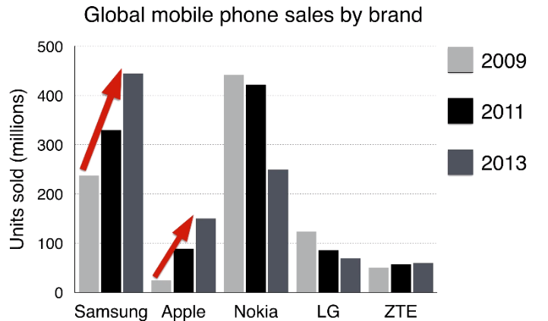
The Overview Paragraph – 2 sentences, 2 main points

Slide 11



The Overview – 2 sentences, 2 main points
Time
Item

Slide 12
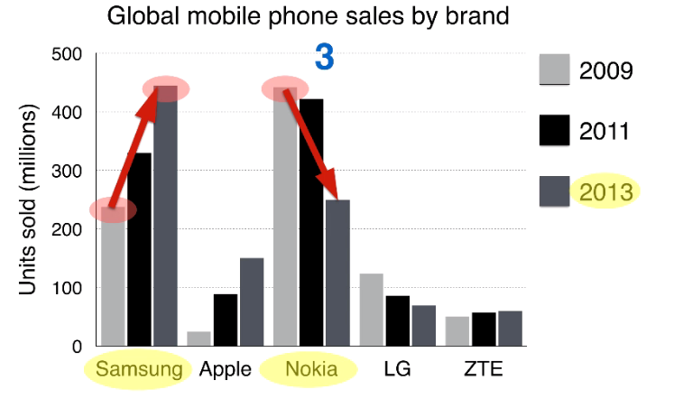
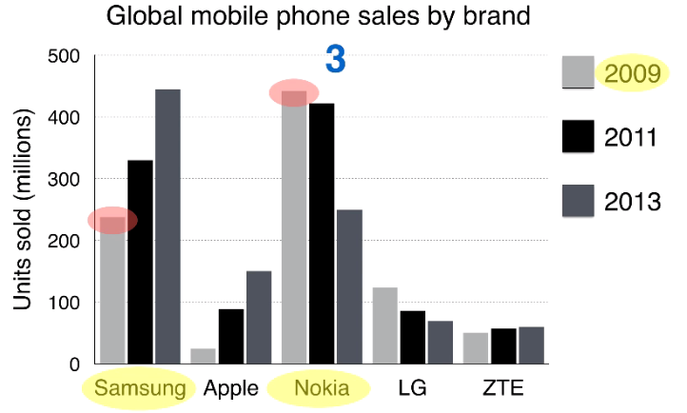
Paragraph 3: The 1st Detail Paragraph

Slide 13
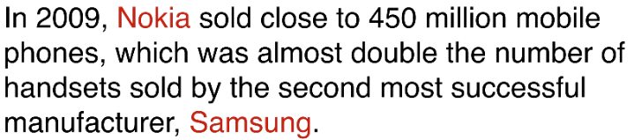


Paragraph 3

Slide 14
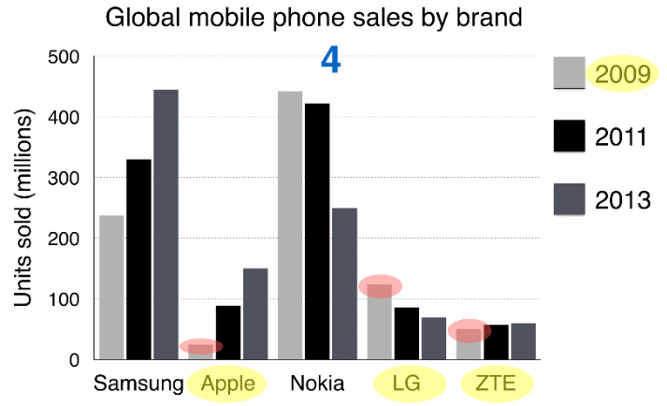
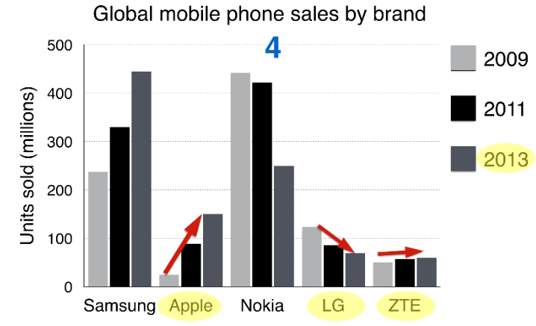
Paragraph 4: The 2nd Detail Paragraph

Slide 15

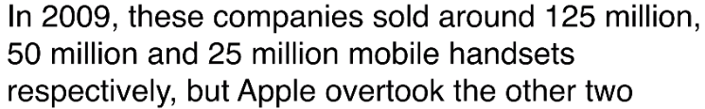

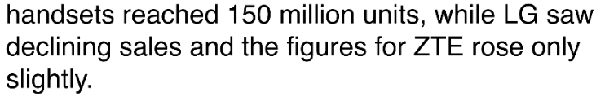
Paragraph 4

