Slide 1


Slide 2
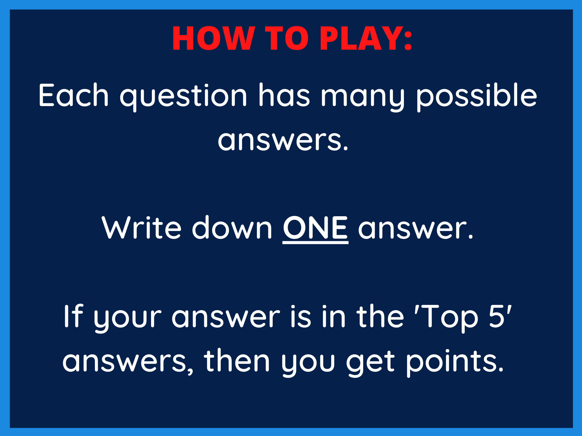

Slide 3


Slide 4
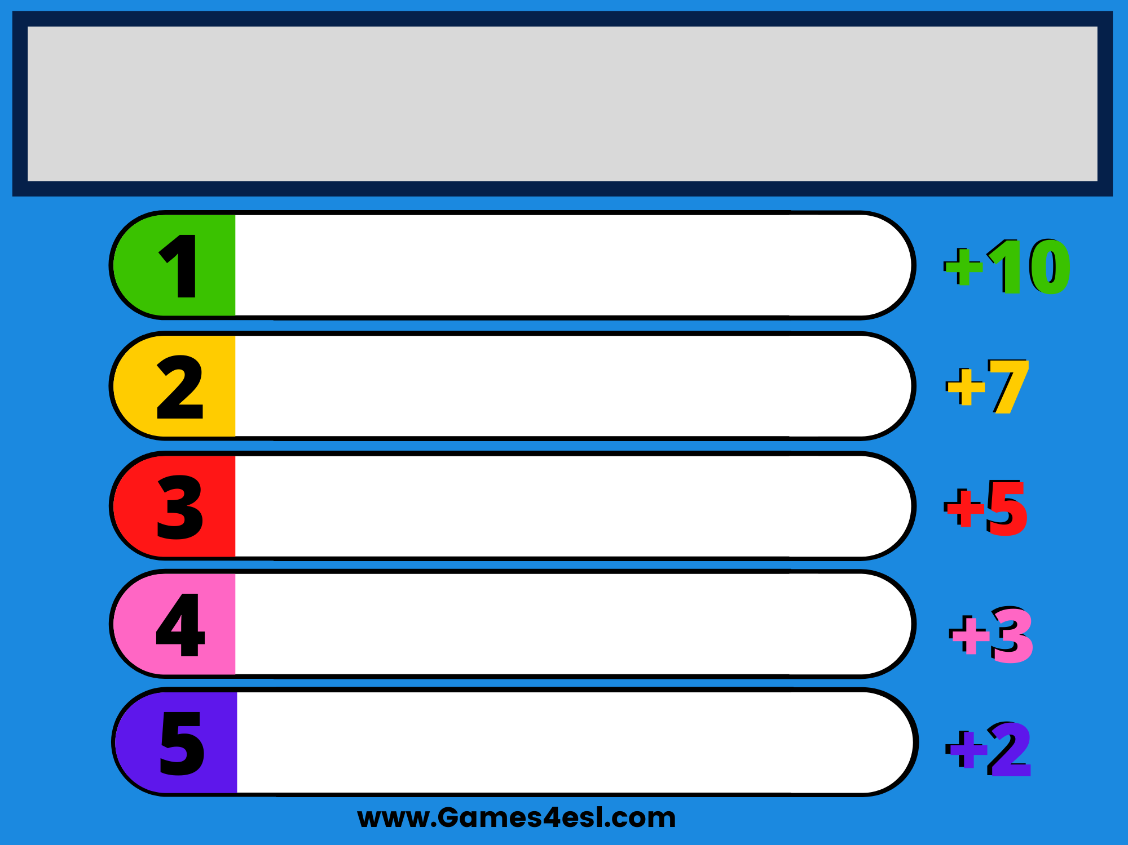
Name an animal you can see at the zoo.
lion
tiger
elephant
giraffe
monkey

Slide 5


Slide 6
Name a fruit
apple
banana
peach
orange
mango

Slide 7


Slide 8
Name a delicious food.
steak
chicken
hamburger
pizza
spaghetti

Slide 9


Slide 10
Name something blue.
sky
sea
swimming pool
jeans
blue bird

Slide 11


Slide 12
Name a room in a house.
living room
bedroom
kitchen
bathroom
dining room

Slide 13


Slide 14
Name a color.
green
orange
red
pink
purple

Slide 15


Slide 16
Name a kind of weather.
sunny
rainy
snowy
windy
cloudy

Slide 17


Slide 18
Name something green.
trees
grass
frog
turtle
apple

Slide 19


Slide 20
Name a job.
doctor
police officer
teacher
pilot
chef

Slide 21


Slide 22
Name a school subject.
English
math
science
P.E
art

