Slide 1



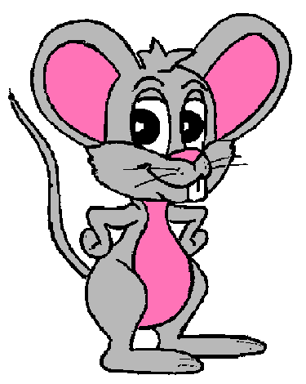




ARTICLES

Slide 2
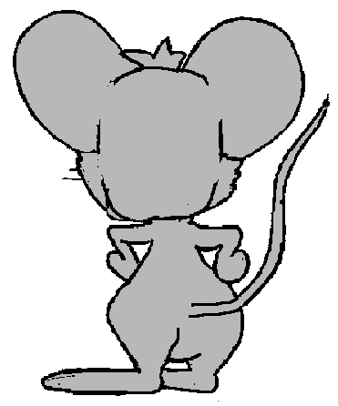

Click on the right article to complete the sentence
1/15
a
an
the
GREAT!
NEXT
We usually go to ____ school library.
the

Slide 3
Click on the right article
2/15
a
an
the
GREAT!
NEXT
a
There is ____ pencil under the chair

Slide 4
Click on the right article
3/15
a
an
the
GREAT!
NEXT
______ girl in the photo is my sister
The

Slide 5
Click on the right article
4/15
a
an
the
GREAT!
NEXT
There is ____ apple in my schoolbag.
an

Slide 6
Click on the right article
5/15
a
an
the
GREAT!
NEXT
a
They have _____ house next to the beach.

Slide 7
Click on the right article
6/15
a
an
the
GREAT!
NEXT
the
This is _____ new red car that my father bought.

Slide 8
Click on the right article
7/15
a
an
the
GREAT!
NEXT
a
My little brother is ____ good student.

Slide 9
Click on the right article
8/15
a
an
the
GREAT!
NEXT
This is ____ easy exercise, isn’t it?
an

Slide 10
Click on the right article
9/15
a
an
the
GREAT!
NEXT
a
The police officer is wearing ____ uniform.

Slide 11
Click on the right article
10/15
a
an
the
GREAT!
NEXT
a
They found ____ snake in the forest.

Slide 12
Click on the right article
11/15
a
an
the
GREAT!
NEXT
His grandfather was ____ honest man.
an

Slide 13
Click on the right article
12/15
a
an
the
GREAT!
NEXT
She bought ____ expensive bracelet.
an

Slide 14
Click on the right article
13/15
a
an
the
GREAT!
NEXT
That boy lives in ____ old house in London.
an

Slide 15
Click on the right article
14/15
a
an
the
GREAT!
NEXT
the
I’m looking at _____ woman who is wearing a big hat.

Slide 16
Click on the right article
15/15
a
an
the
GREAT!
NEXT
The
_____ children are playing basketball.

Slide 17
THANK YOU!

