Slide 1

Unit 6: Where’s your school?
Lesson 3

Slide 2


Slide 3




Slide 4











Question 1: Where____your school?
A : are
B : is
C : am
D : do
A B C D

Slide 5
Question 2: ____class are you in?
A : When
B : What
C : How
D : Where
A B C D

Slide 6

Question 3: Where is_____school
A : she
B : he
C : her
D : you
A B C D

Slide 7
Question 4: What class is _______in
A : she
B : his
C : her
D : you
A B C D

Slide 8
Question 5: Listen and choose the correct answer
A : It’s in Oxford Village
B : She is in class 4A
C : It’s in Oxford Street
D : Yes, it is
A B C D

Slide 9

LOOK AND SAY THE WORDS

Slide 10



Play game
The Bus

Slide 11



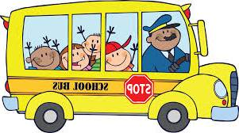
Check
homework
A C R
CAR
school

Slide 12
Check
homework
A C R
CAR
street

Slide 13
Check
homework
A C R
CAR
skipping

Slide 14
Check
homework
A C R
CAR
scheme

Slide 15
Check
homework
A C R
CAR
skate

Slide 16
Check
homework
A C R
CAR
strong

Slide 17
Check
homework
A C R
CAR
straight

Slide 18
Check
homework
A C R
CAR
sky

Slide 19
Check
homework
A C R
CAR
skirt

Slide 20



Slide 21








/sk/
S
C
H
/SK/
SCHOOL
SCHEME

Slide 22
/sk/
S
K
/SK/
SKIPPING
SKATE

Slide 23

/str/
S
T
R
/STR/
STREET
STRONG

Slide 24

LISTEN AND REPEAT

Slide 25


Slide 26










CÂU 1
Pronounce this word ‘school’
HẾT GIỜ!

Slide 27
CÂU
2
Pronounce this word ‘scheme’
HẾT GIỜ!

Slide 28
CÂU
3
Pronounce this word ‘street’
HẾT GIỜ!

Slide 29
CÂU
4
Pronounce this word ‘skipping’
HẾT GIỜ!

Slide 30

CÂU
5
What word is this?
sky
HẾT GIỜ!

Slide 31


Slide 32



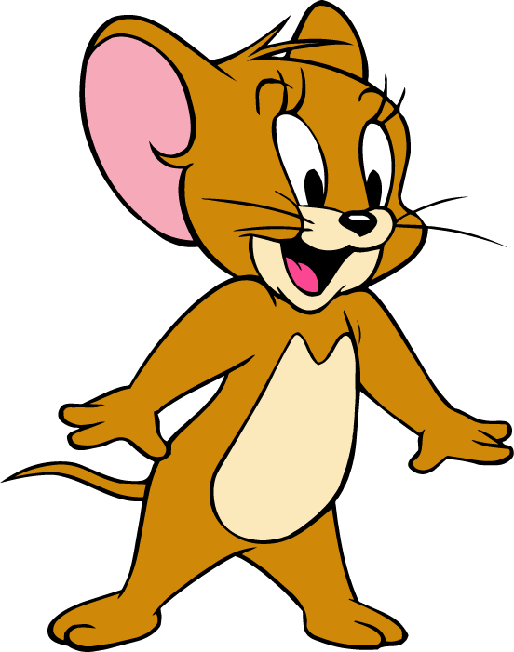


Tom and jerry

Slide 33

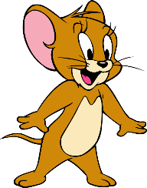
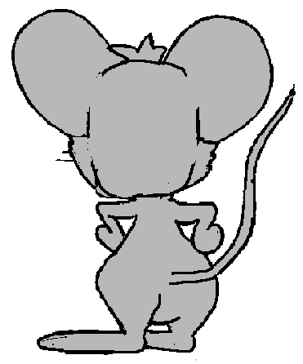
A. /str/
B. /sk/
Good
NEXT
Question 1: Listen and choose
Notes:
Trang nội dung trò chơi Tom và Jerry

Slide 34
A. /str/
B. /sk/
GOOD!
NEXT
Question 2: Listen and choose

Slide 35
A. /str/
B. /sk/
GOOD!
NEXT
Question 3: Listen and choose

Slide 36
A. straight
B. skate
C. ski
GOOD!
NEXT
Question 4: Listen and choose

Slide 37
A. strong
B. scheme
C. sky
GOOD!
NEXT
Question 5: Choose the odd one out

Slide 38
LISTEN AND CIRCLE

Slide 39

READ AND COMPLETE

Slide 40
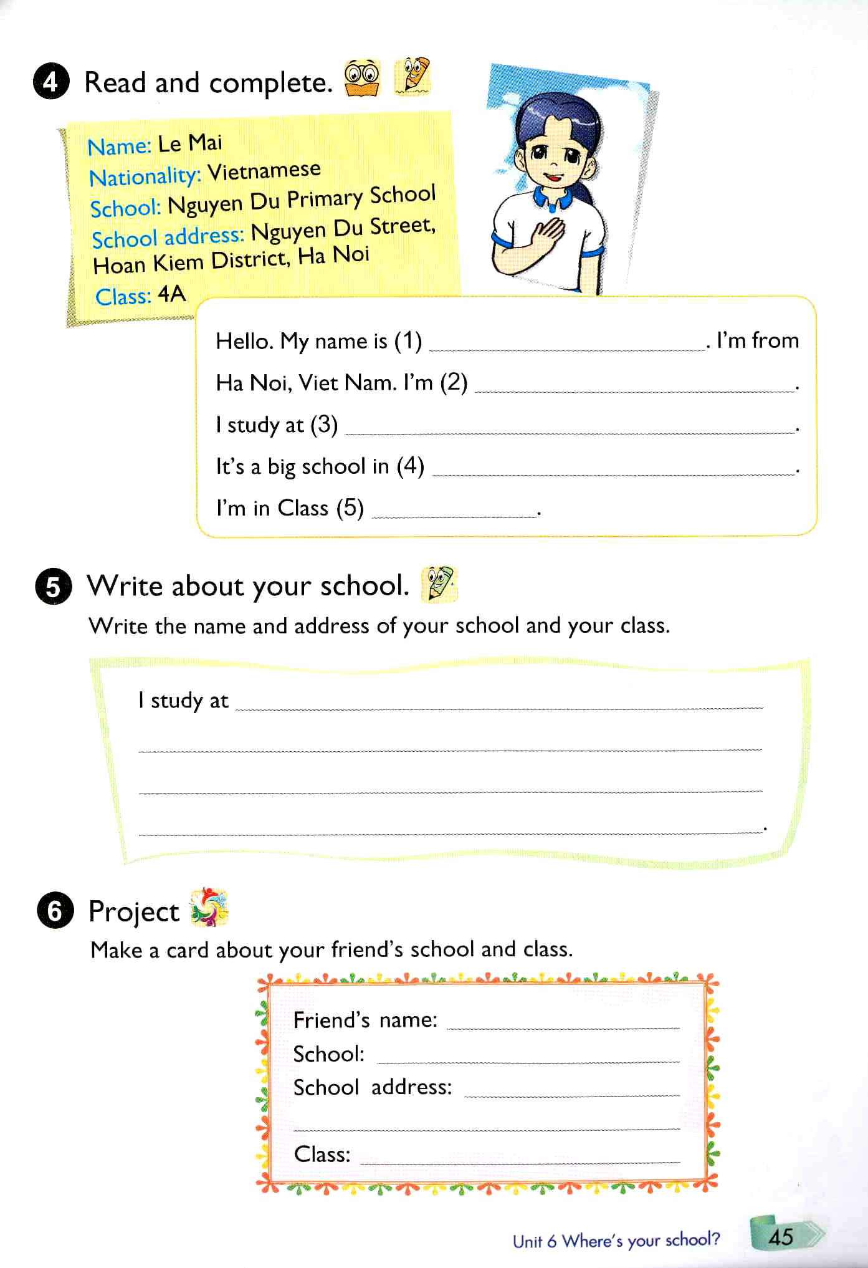
Le Mai
Vietnamese
Nguyen Du Primary school
Nguyen Du Street
4A

Slide 41
PUT THE WORDS IN THE CORRECT COLUMNS

Slide 42

SUMMARY

Slide 43


SK, STR, SCH
/SK/
/STR/
School
Scheme
Skipping
Skate
Sky
Skirt
Street
Strong
Straight

Slide 44


Slide 45


