Slide 1

BÀI HỌC TUẦN 25 MÔN TIẾNG ANH
LỚP 3

Slide 2
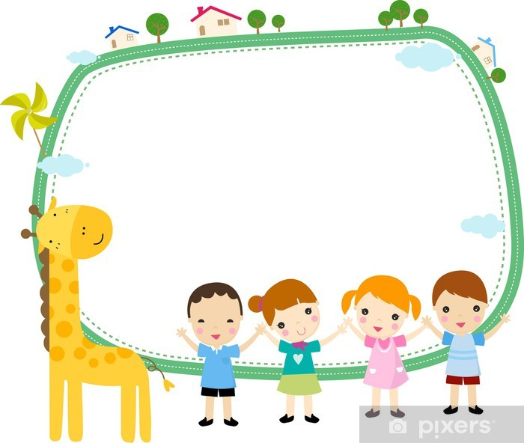
Warm-up Song
I have a pet

Slide 3

CHÚNG TA CÙNG NGHE BÀI HÁT VÀ ÔN LẠI BUỔI HÔM TRƯỚC NHÉ!

Slide 4
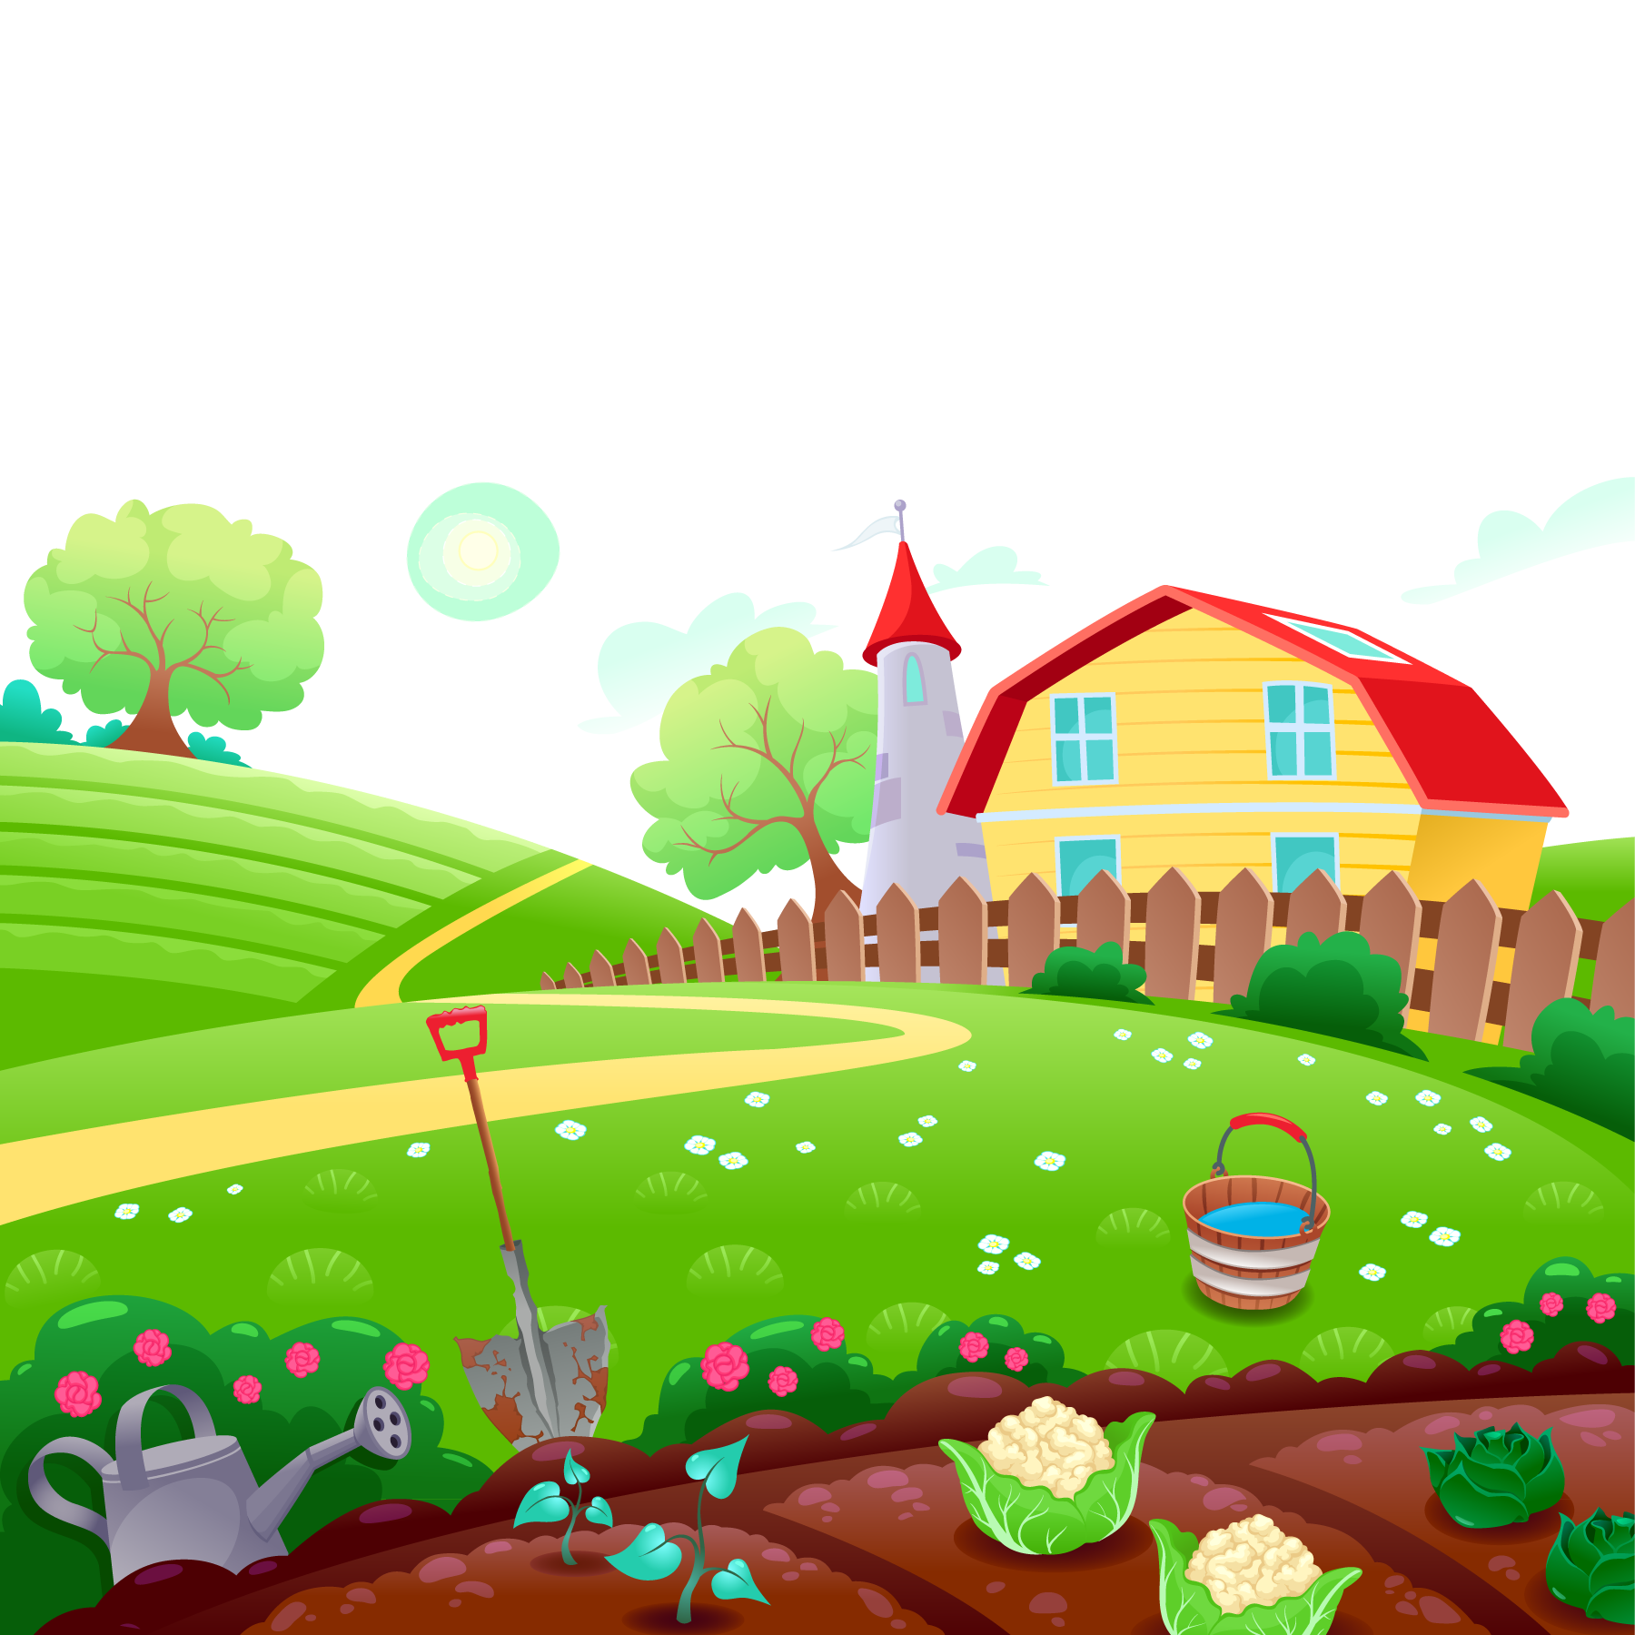

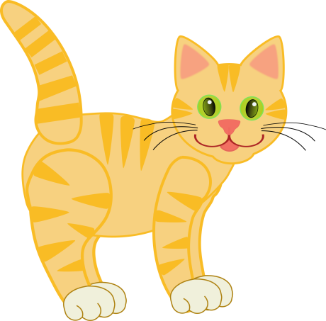
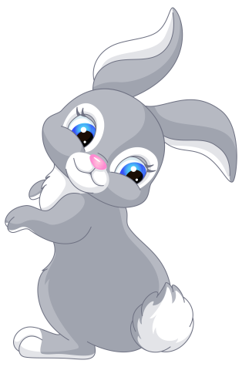
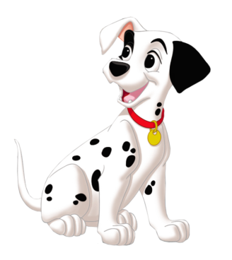

UNIT 16. DO YOU HAVE ANY PETS?
LESSON 2+3

Slide 5
SOME VOCABULARY
01
02
GRAMMAR
03
SOME SOUNDS
04
DO LISTENING & SPEAKING
05
SING, DANCE & PLAY GAMES
(next to, under, behind, in front of, flower pot, fish tank)
TABLE OF CONTENTS
(Where are the….?)
(strong -o, weak -o)

Slide 6
01
VOCABULARY

Slide 7
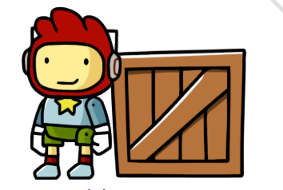
PREPOSITION
N
E
X
T
T
O

Slide 8
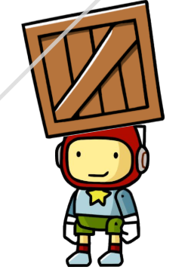
PREPOSITION
U
N
D
E
R

Slide 9
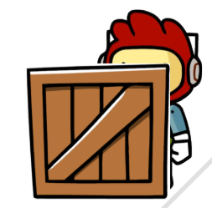
PREPOSITION
B
E
H
I
D
N

Slide 10
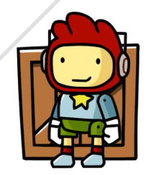
PREPOSITION
F
N
O
F
N
R
O
T
I

Slide 11

F
O
W
E
R
P
O
T
L

Slide 12
S
H
A
N
K
I
F
T

Slide 13


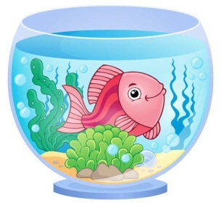
* Vocabulary:
- next to
- under
- behind
- in front of
- flower pot
- fish tank

Slide 14
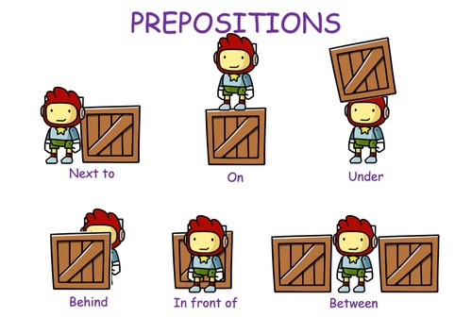
Find the pairs:
GOOD JOB !!
PREPOSITIONS OF PLACE
IN FRONT OF
ON
NEXT TO
BEHIND
UNDER
(GIỚI TỪ CHỈ VỊ TRÍ)

Slide 15
02
GRAMMAR

Slide 16


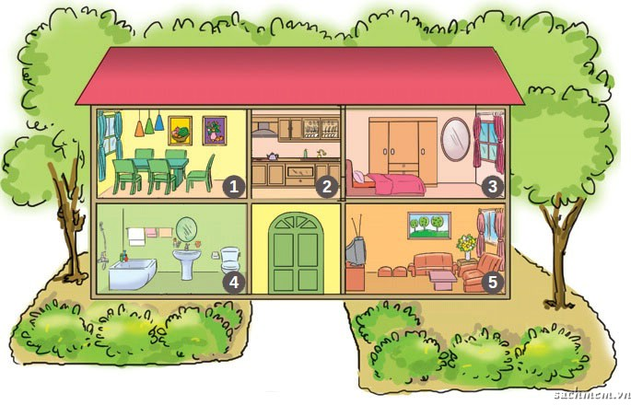
Nam’s house

Slide 17
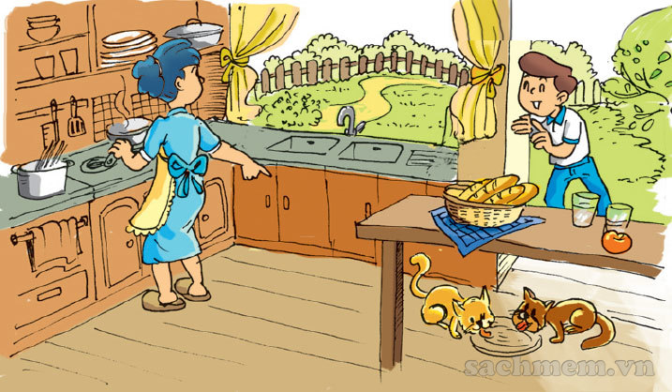
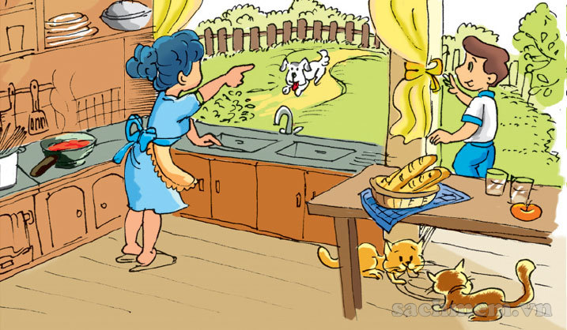
a
b

Slide 18

a
b

Slide 19

a
b

Slide 20
Look, listen and repeat.
Is the dog there with the cats, Mum?
a
Where are my cats, Mum?
b
They’re over there, under the table.
No. He’s in the garden.
Look! He’s there.
(over there = there)

Slide 21
Where are my cats, Mum?
a
They’re over there, under the table.

Slide 22
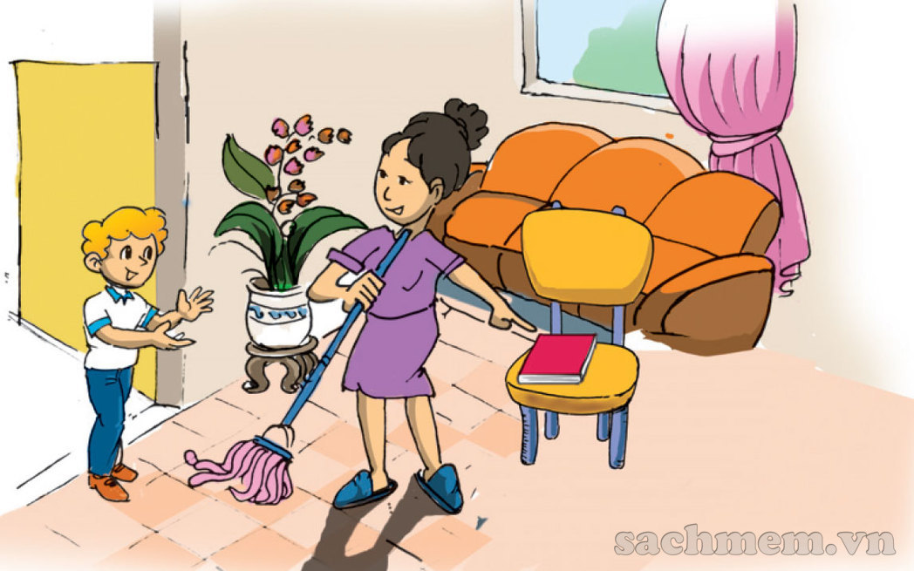
Model sentences:
Where are my cats?
Where are my cats?
They’re over there, under the table.
They’re under the table.
(They’re = They are)
Where’s my book?
Where’s my book?
It’s on the chair.
It’s here, on the chair.
Unit 13

Slide 23
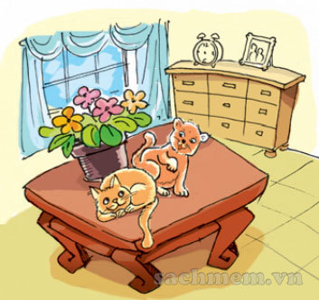
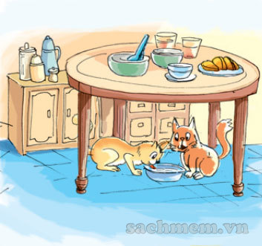
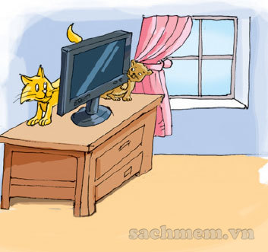
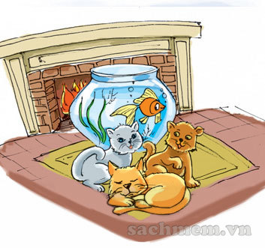
WHERE ARE THE CATS?
a
b
c
d
______ the flower pot
______ the table
______ the TV
________ the fish tank
next to
behind
in front of
under

Slide 24

It
Where are the cats?
It
They’re next to the flower pot.

Slide 25
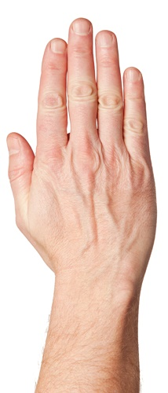
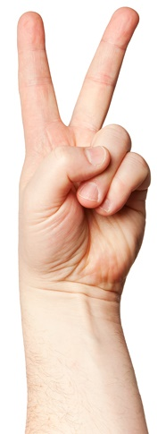
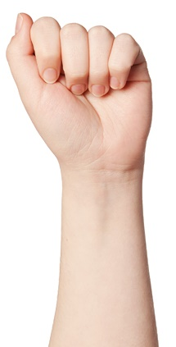

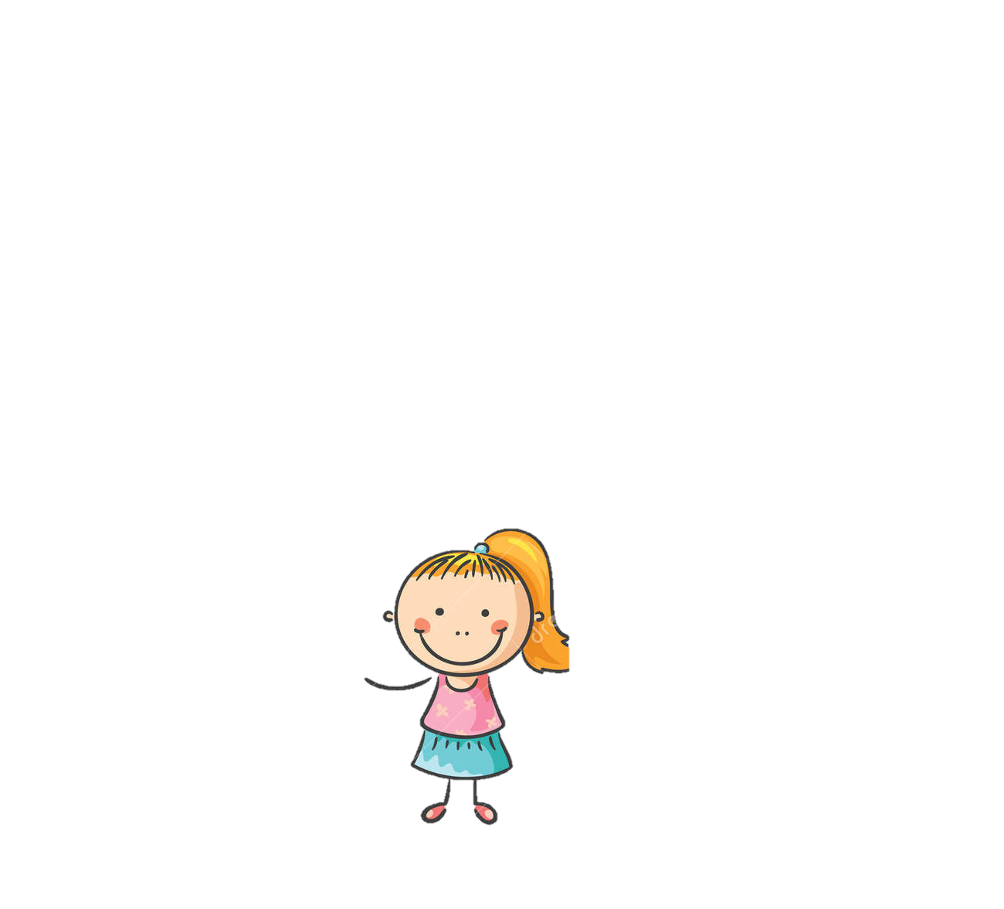



20
19
18
17
16
15
14
13
12
11
10
9
8
7
6
5
4
3
2
1
0
20
19
18
17
16
15
14
13
12
11
10
9
8
7
6
5
4
3
2
1
0
START
a
b
c
1
2
3
4
5
d
e
rock beats scissors, scissors beat paper, paper beats rock.

Slide 26
It
Where are the cats?
It
They’re next to the flower pot.

Slide 27
It
Where are the cats?
It
They’re under the table.

Slide 28
It
Where are the cats?
It
They’re behind the TV.

Slide 29
It
Where are the cats?
It
They’re in front of the fish tank.

Slide 30
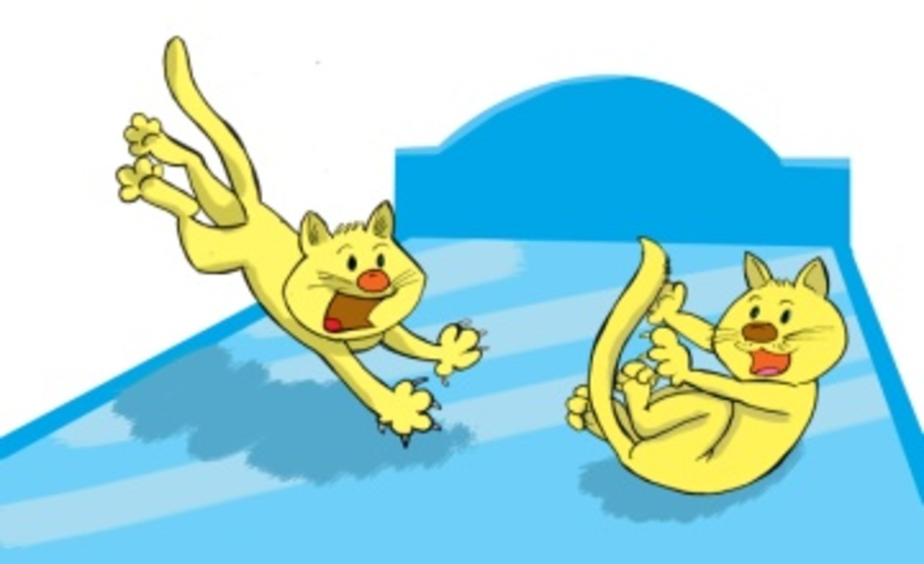
It
Where are the cats?
It
They’re on the bed.

Slide 31
03
PHONICS

Slide 32
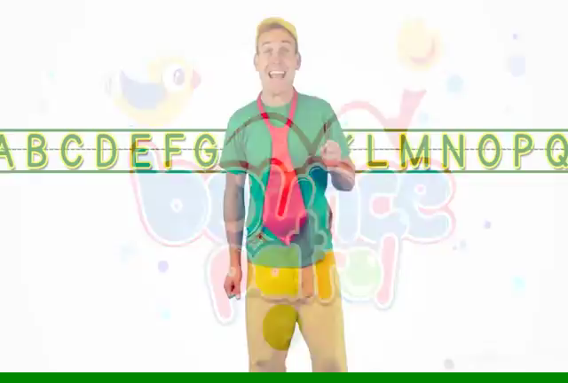

Slide 33

frog
hot
dog
box
pot
octopus
orange

Slide 34

parrot
police
carrot
doctor
tomato
WEAK FORM
today
robot

Slide 35
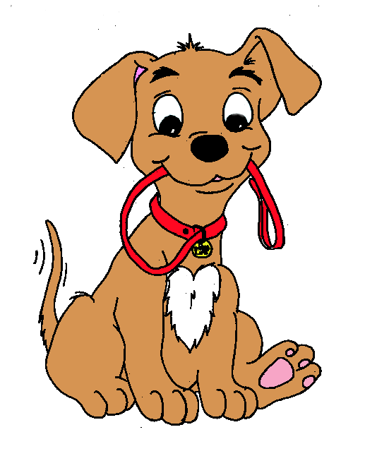

Listen and repeat:
dog
ɒ
O
Where is your dog?

Slide 36

Listen and repeat.
parrot
ə
O
My parrot is in the garden.

Slide 37
Listen and write.
1. Peter has a .
2. Nam has a .

Slide 38
Listen and write.
1. Peter has a .
2. Nam has a .

Slide 39
Listen and check.
Great Job!
parrot
1. Peter has a .
dog
2. Nam has a .

Slide 40
Read and match.
1
Do you have any pets?
A It’s in the garden.
2
Do you have any goldfish?
B They’re in the yard.
3
Where’s you cat?
C Yes. I have two dogs.
4
Where are your dogs?
D No, I don’t.

Slide 41
SOME VOCABULARY
01
02
GRAMMAR
03
SOME SOUNDS
04
DO LISTENING & SPEAKING
05
SING, DANCE & PLAY GAMES
(next to, under, behind, in front of, flower pot, fish tank)
(Where are the….?)
(-o)

Slide 42
WRAP-UP:
1. New words:
next to behind fish tank
in front of under flower pot
2. New sentences:
Where are the dogs?
- They are next to the table.
3. Phonics:
- o : dog, orange, hot, frog …
- o : parrot, carrot, police, today …

Slide 43

* Learn new words and sentences.
HOME-LINK
* Complete exercises in Unit 16.
* Do further practice handouts.
* Prepare for Unit 17.

Slide 44
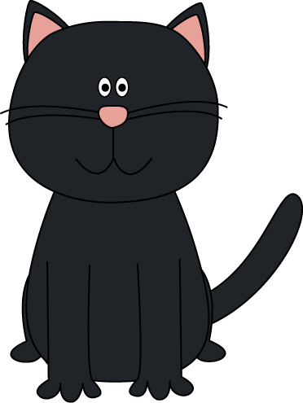

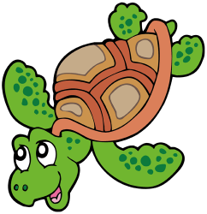
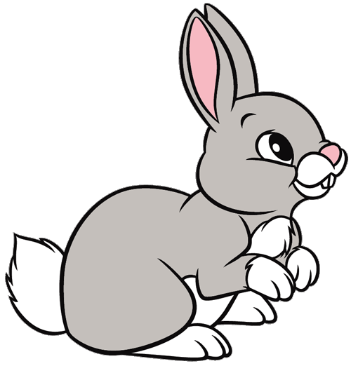
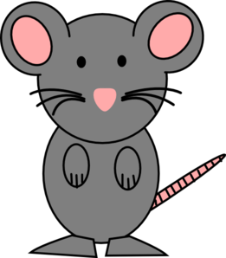
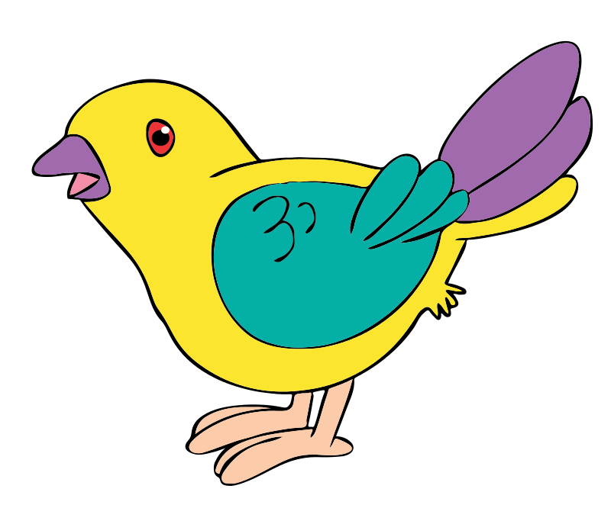

WHERE ARE THE PETS?

Slide 45

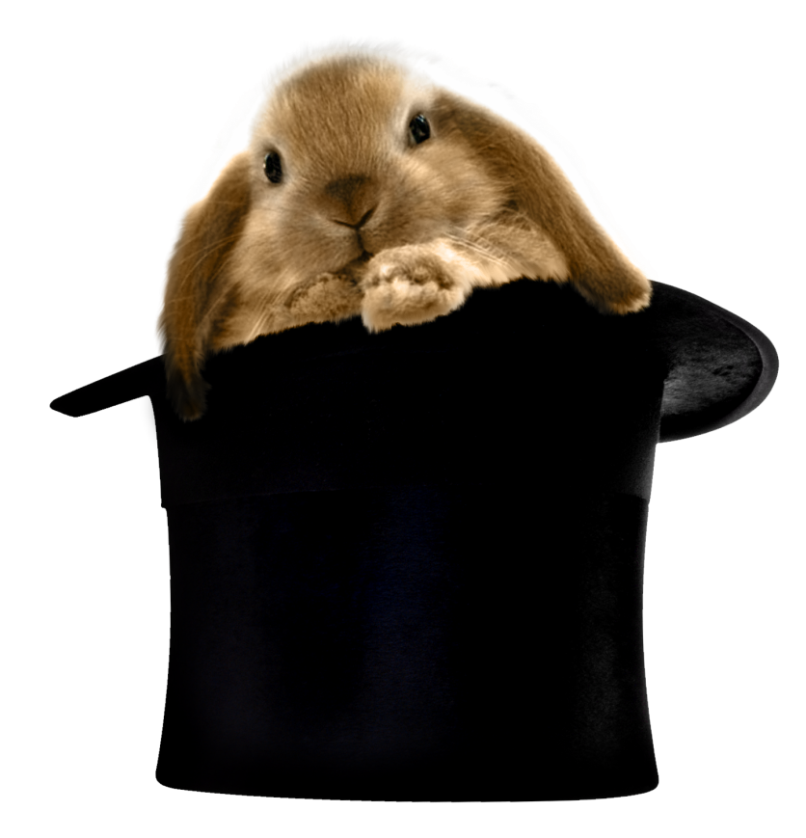
Where is the rabbit?
It’s under the hat.
It’s in the hat.
It’s on the table.
GREAT !

Slide 46

Where is the dog?
It’s on the book.
It’s behind the man.
It’s in the box.
AWESOME !

Slide 47
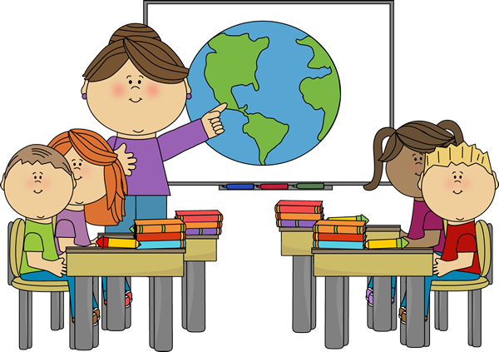
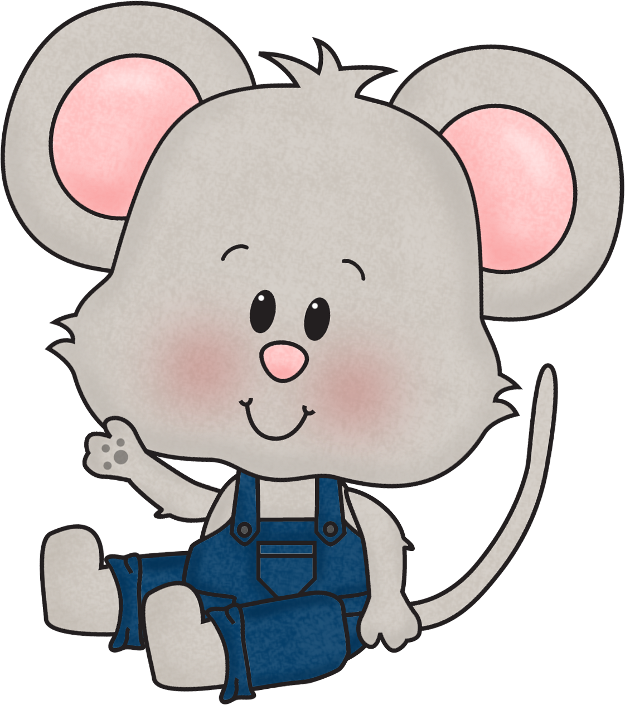
Where are the books?
They’re next to the teacher.
They’re under the tables.
They’re in front of the pupils.
AMAZING !

Slide 48

Where is the parrot?
It’s in the tree.
It’s on the house.
It’s in the house.
NICE !

Slide 49

Where are the frogs?
They’re on the desk.
They’re in the books.
They’re next to the books.
YOU DID IT !

Slide 50
Congratulations
WHERE ARE THE PETS?

Slide 51
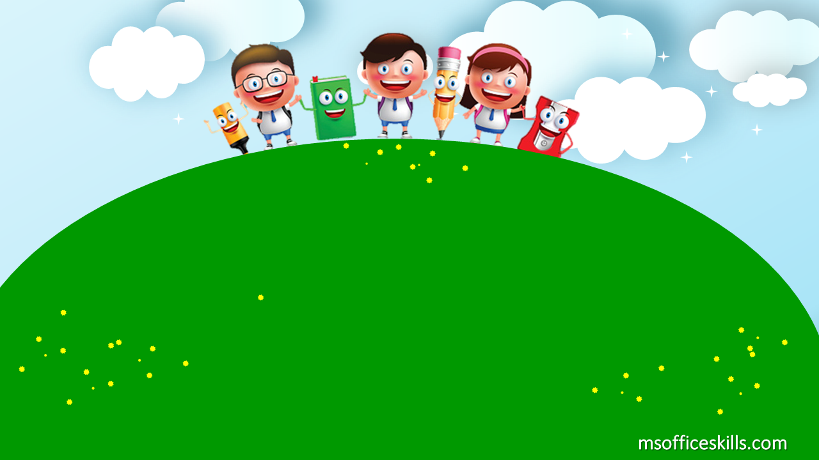
GOODBYE
SEE YOU NEXT TIME!

