Slide 1

ENGLISH 3
SÁCH TIẾNG ANH 3
(Bộ Giáo dục và Đào tạo)

Slide 2

WARM - UP
Let’s sing

Slide 3


Slide 4

UNIT 16:
DO YOU HAVE ANY PETS?
LESSON 1- P.40,41

Slide 5

1 New words

Slide 6

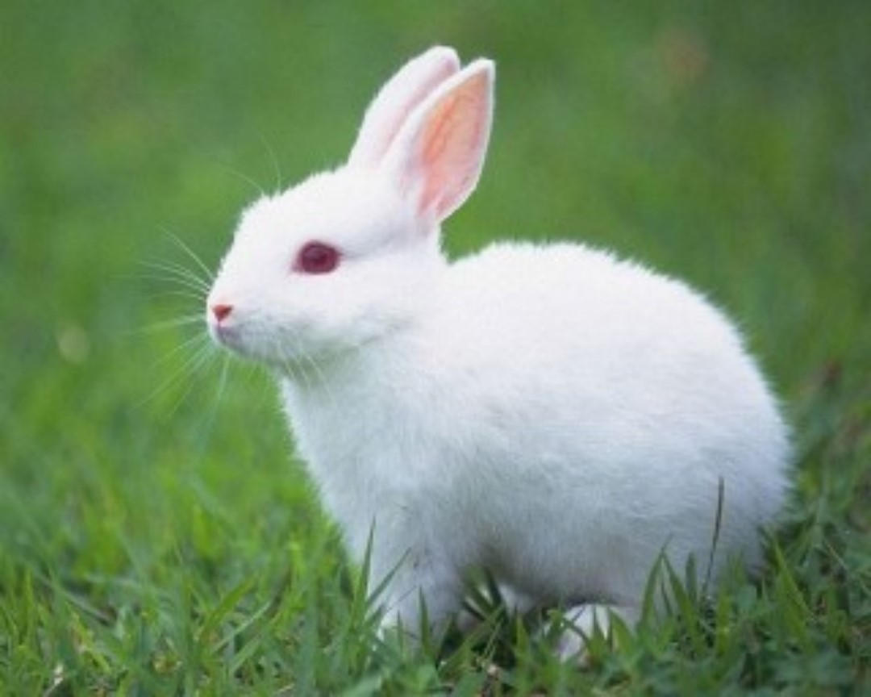

r
a
b
b
i
t
s

Slide 7



g
o
l
d
f
i
s
h

Slide 8

d
o
g
s

Slide 9
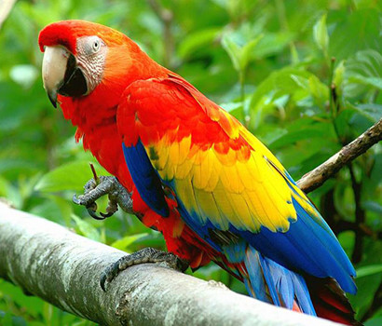
p
a
r
r
o
t
s

Slide 10
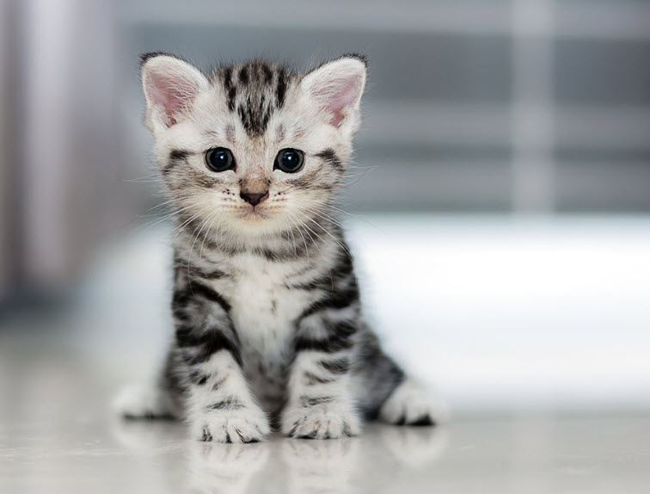

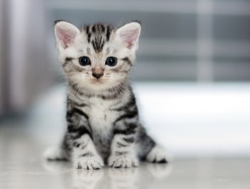
c
a
t
s

Slide 11
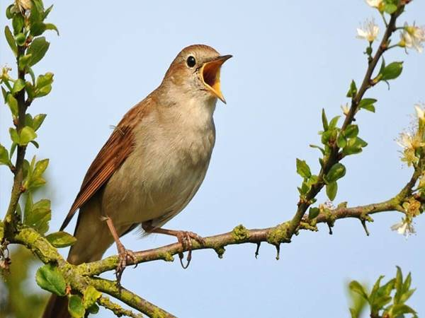

b
i
r
d
s

Slide 12


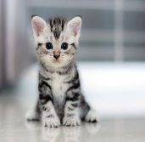


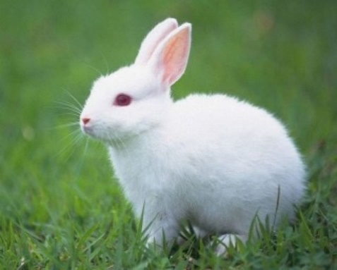


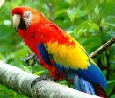
pets
(thú cưng)

Slide 13
2.Look, listen and repeat

Slide 14
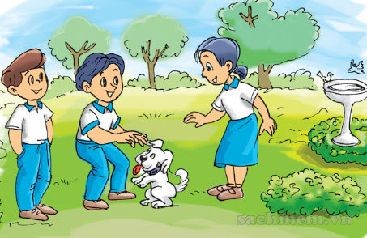
Mai
Nam
Quan

Slide 15
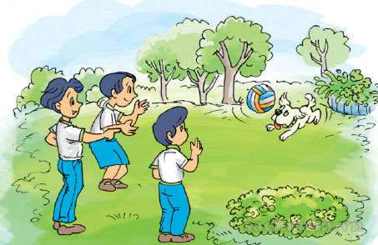
That’s my ____.
Do you have any ____?
Wow! He’s cute.
Yes, I do. I have two ____.

Slide 16
That’s my ____.
Do you have any ____?
a
b
Wow! He’s cute.
Yes, I do. I have two ____.

Slide 17


Slide 18


That’s my ____.
Do you have any ____?
dog
pets
a
b
Wow! He’s cute.
Yes, I do. I have two ____.
dogs

Slide 19
That’s my ____.
Do you have any ____?
dog
pets
a
b
Wow! He’s cute.
Yes, I do. I have two ____.
dogs

Slide 20
That’s my ____.
Do you have any ____?
dog
pets
a
b
Wow! He’s cute.
Yes, I do. I have two ____.
dogs

Slide 21






Model sentences
Do you have any pets?
Yes, I do.
Do you have any pets?
Do you have any cats?
No, I don’t.
Do you have any cats?
don’t = do not

Slide 22


3. Practice
- Point and say

Slide 23
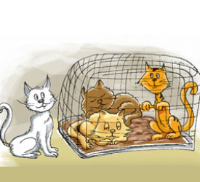
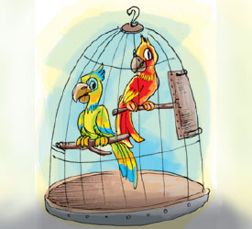
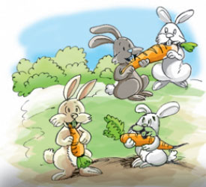


a
b
Do you have any cats?
Yes, I do.
cats/ yes
parrots/ no
cats/ yes
parrots/ no
c
d
No, I don’t.
rabbits/ no
goldfish/ no

Slide 24

It
Do you have any ________ ?
cats
It
Yes, I do.
a

Slide 25

It
parrots
Do you have any ________ ?
b
It
No, I don’t.

Slide 26
It
Do you have any ________ ?
rabbits
c
It
No, I don’t.

Slide 27
It
goldfish
Do you have any ________ ?
d
It
No, I don’t.

Slide 28
3. Practice
- Point and say

Slide 29

4.Listen and tick

Slide 30

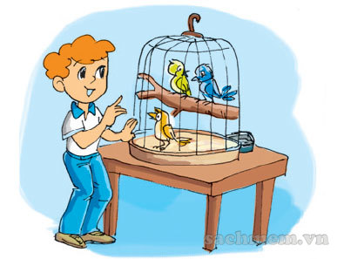
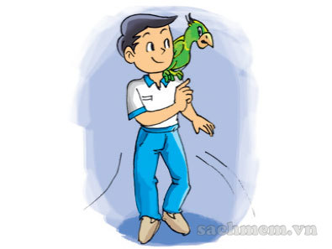
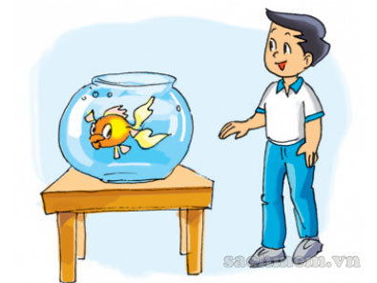
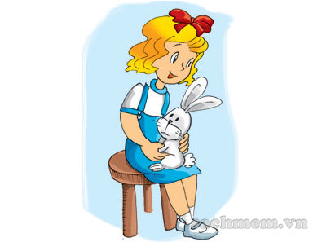
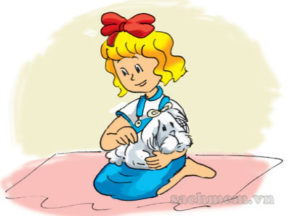
a
b
1
1.

a
b
2
2.

a
b
3
3.


Slide 31
GAME TIME

Slide 32



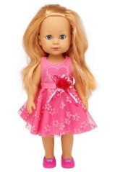













The Hidden Stars
7
4
Do you have any______?
Yes, I do.
No, I don’t.

Slide 33
We have learnt:
1.New words about pets:
cats – dogs – rabbits – parrots – goldfish – birds
2. Model sentences:
Do you have any cats?
Yes, I do. / No, I don’t
*** don’t = do not

Slide 34

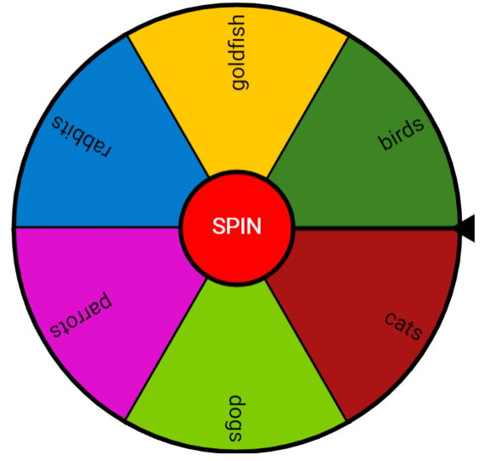









T O Y S
Do you have any ____ ?
Yes, I do.
No, I don’t.
(do not)

Slide 35
1. Learn new words and sentences.
HOME LINK
2. Practice on OLM.VN
3. Prepare for Unit 16 Lesson 2+3.

Slide 36




