Slide 1
BÀI HỌC TUẦN 23 MÔN TIẾNG ANH
LỚP 3

Slide 2
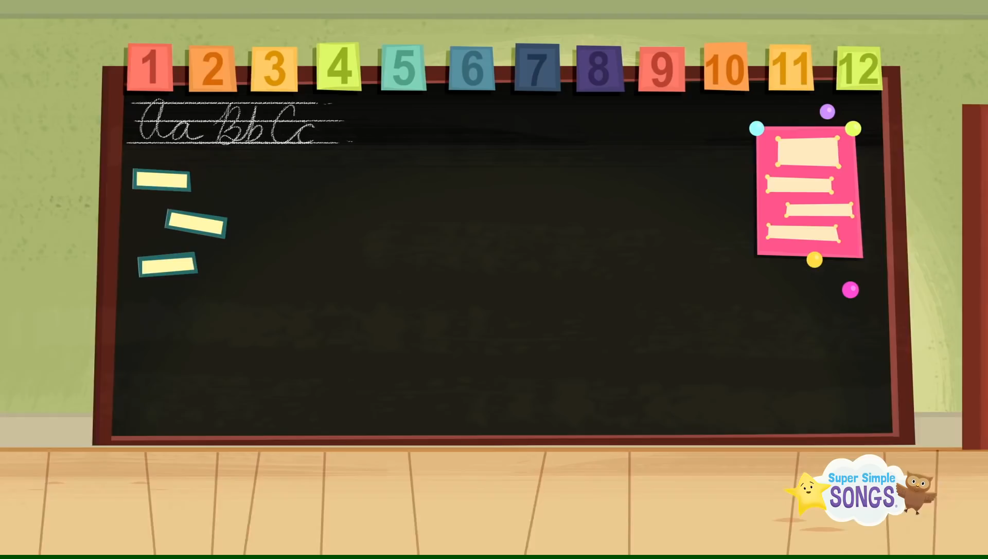

Slide 3
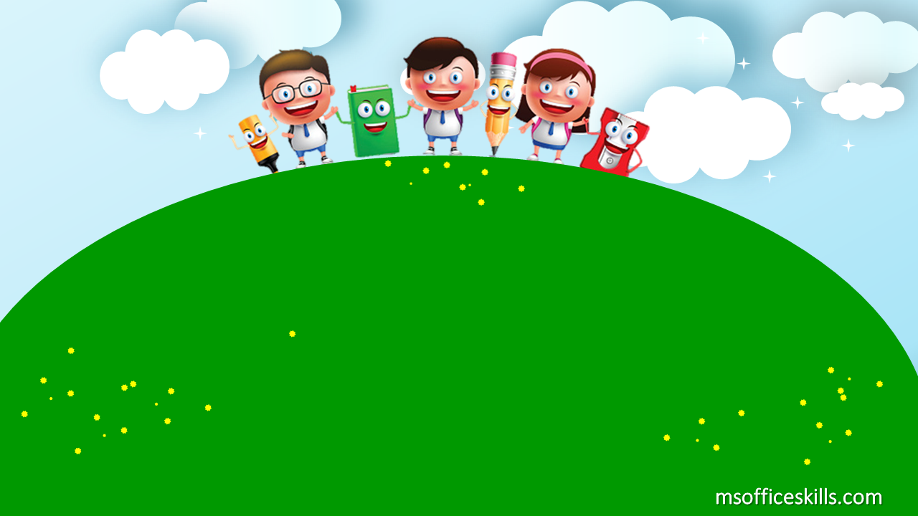
UNIT 14:
ARE THERE ANY POSTERS IN THE ROOM?
LESSON 2 + 3

Slide 4
SOME VOCABULARY
01
02
GRAMMAR
03
SOME SOUNDS
04
DO LISTENING & SPEAKING
05
SING, DANCE & PLAY GAMES
(windows, doors, mirrors, fans)
TABLE OF CONTENTS
(How many ….?)
(-a, -u)

Slide 5
01
VOCABULARY

Slide 6
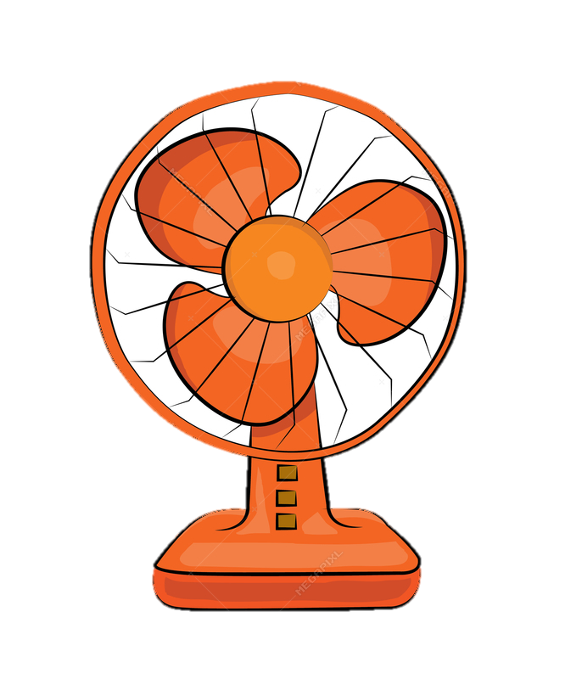
things in the room
F
A
N
S

Slide 7

things in the room
M
I
R
R
O
R
S

Slide 8

things in the room
D
O
O
R
S

Slide 9
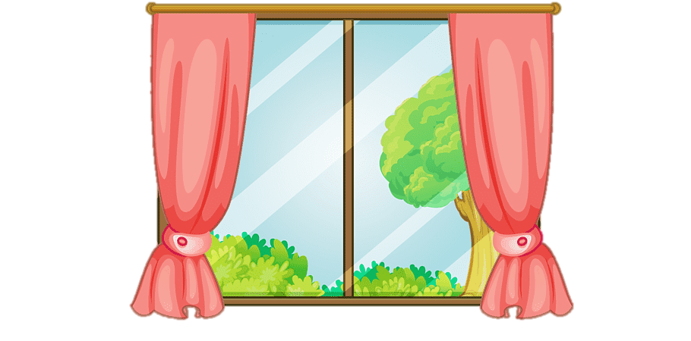
things in the room
W
I
N
D
O
W
S

Slide 10


New words:
- fans
- mirrors
- doors
- windows

Slide 11


Slide 12

ROUND 1

Slide 13
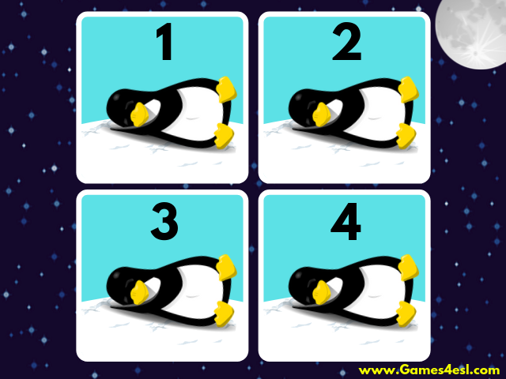

Slide 14
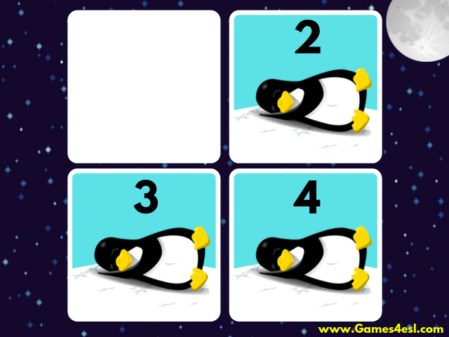

Slide 16
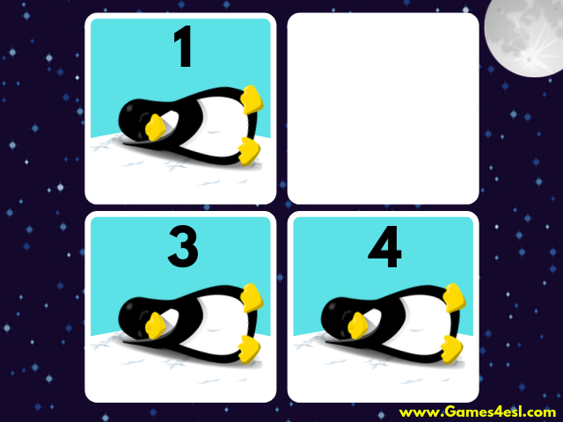

Slide 18
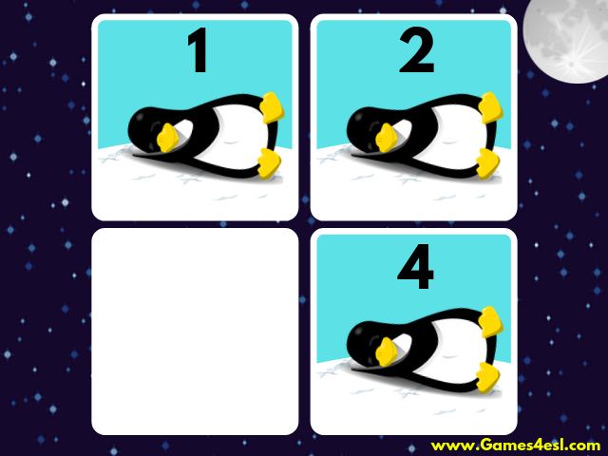

Slide 20
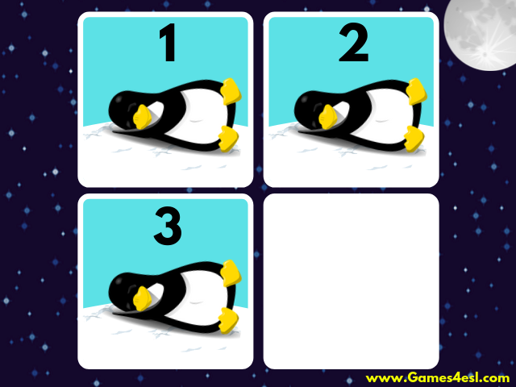

Slide 22


Slide 23

TEAM 1:
mirrors

Slide 24
TEAM 2:
fans

Slide 25
TEAM 3:
doors

Slide 26
TEAM 4:
windows

Slide 27
ROUND 2

Slide 38
TEAM 1:
windows

Slide 39
TEAM 2:
doors

Slide 40
TEAM 3:
fans

Slide 41
TEAM 4:
mirrors

Slide 42


Slide 43
02
GRAMMAR

Slide 44
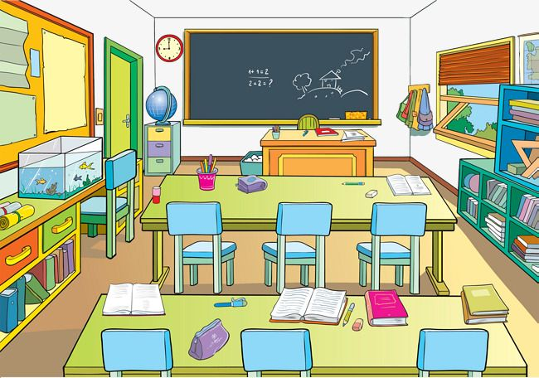

Nam's classroom

Slide 45
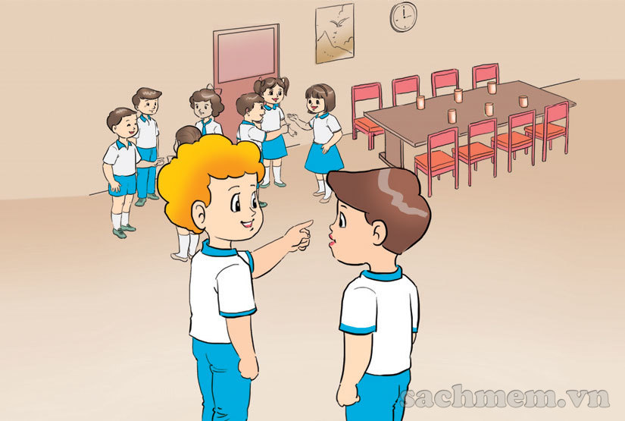

Slide 46
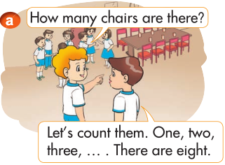


Slide 47
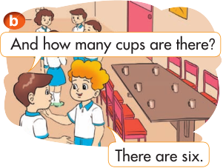

Slide 50
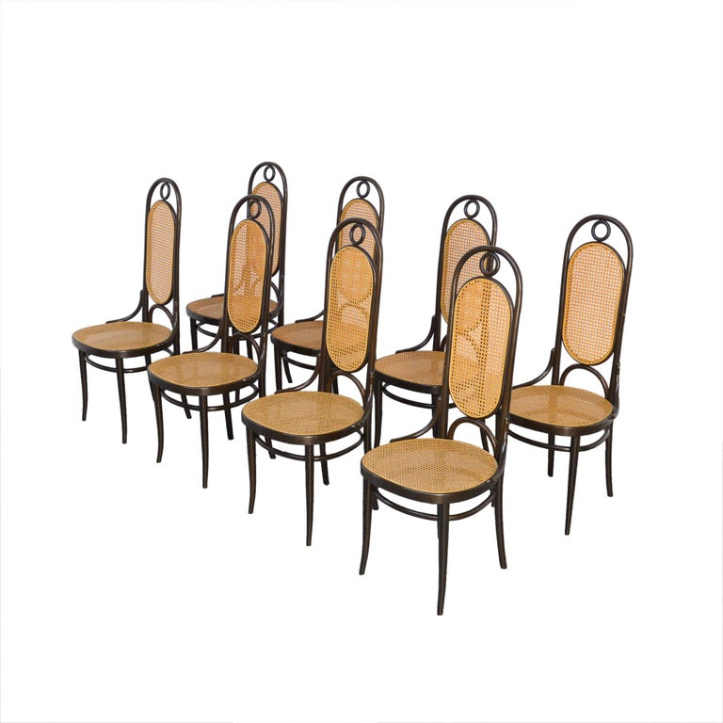
2. New sentences:
How many chairs are there?
How many
- There are eight.
How many doors are there?
- There is one.

Slide 51
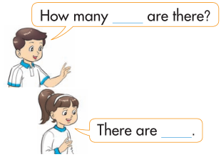
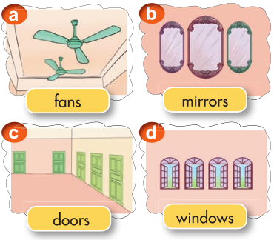
2. Point and say.

Slide 52
2. Point and say.

Slide 53


It
mirrors
How many ______ are there?
It
There are ____.
three

Slide 54
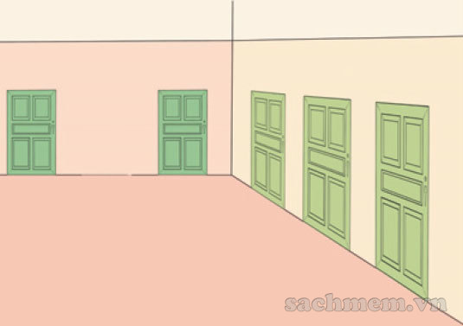
It
doors
How many ______ are there?
It
There are ___.
five

Slide 55
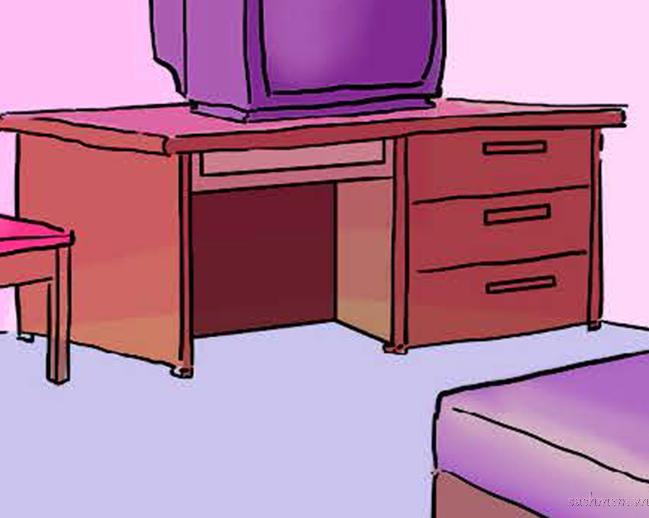
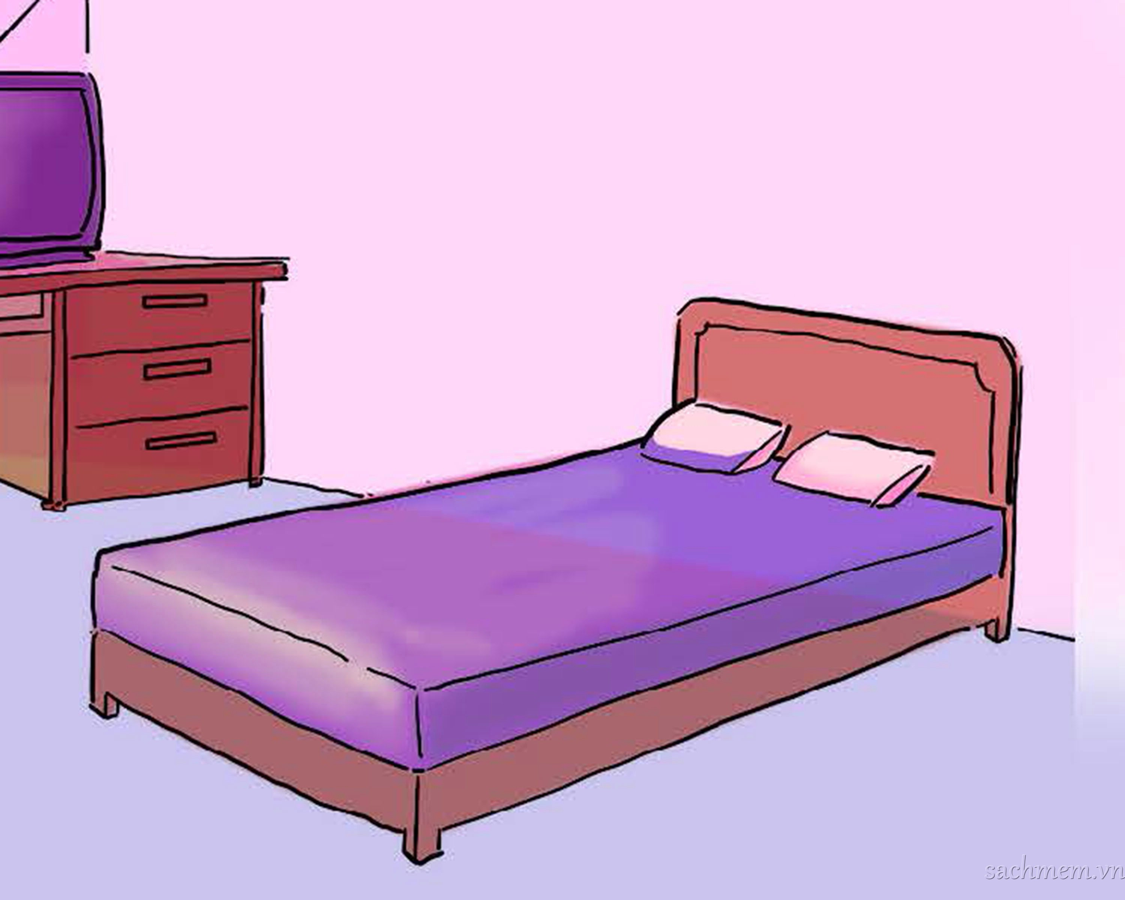
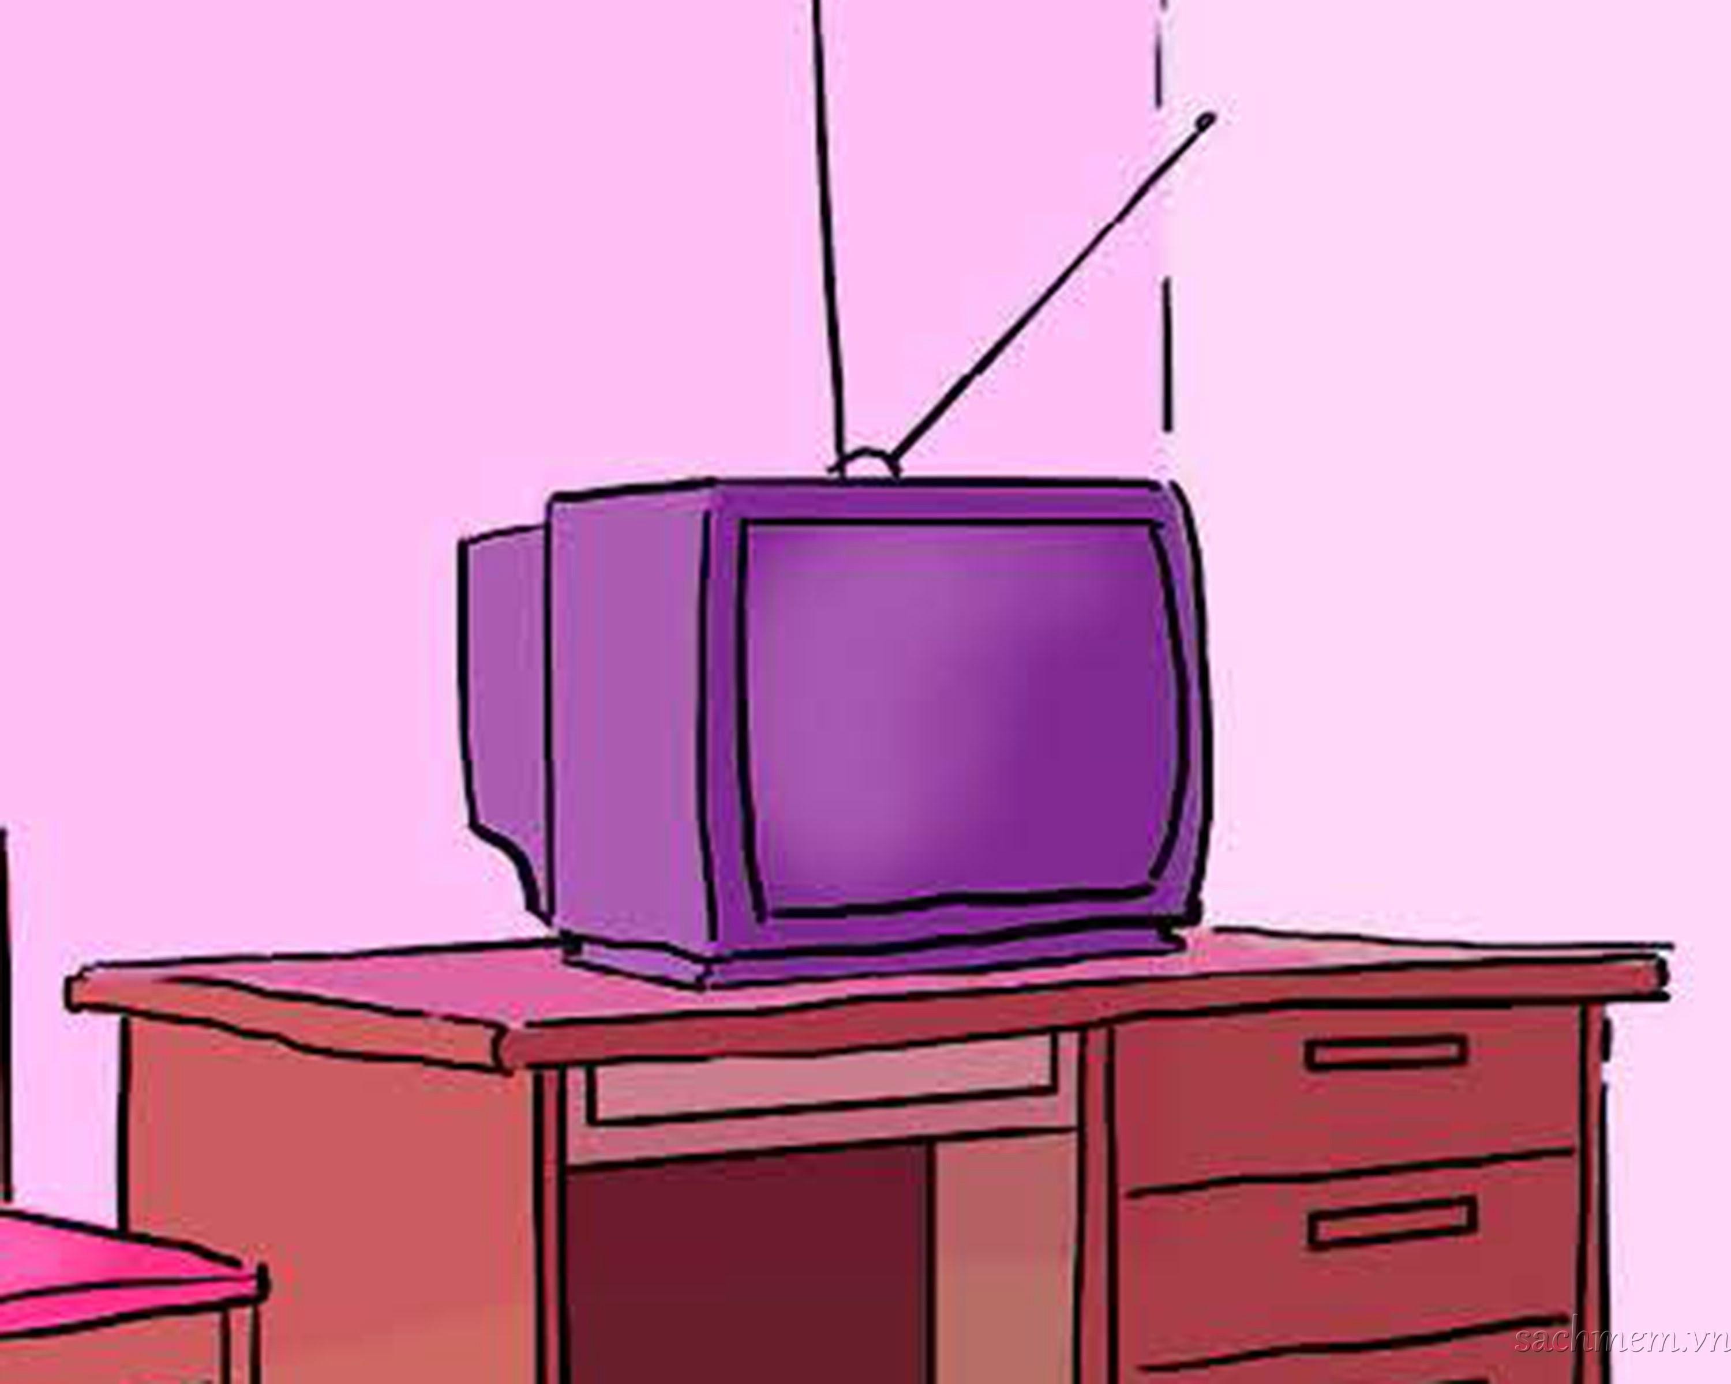
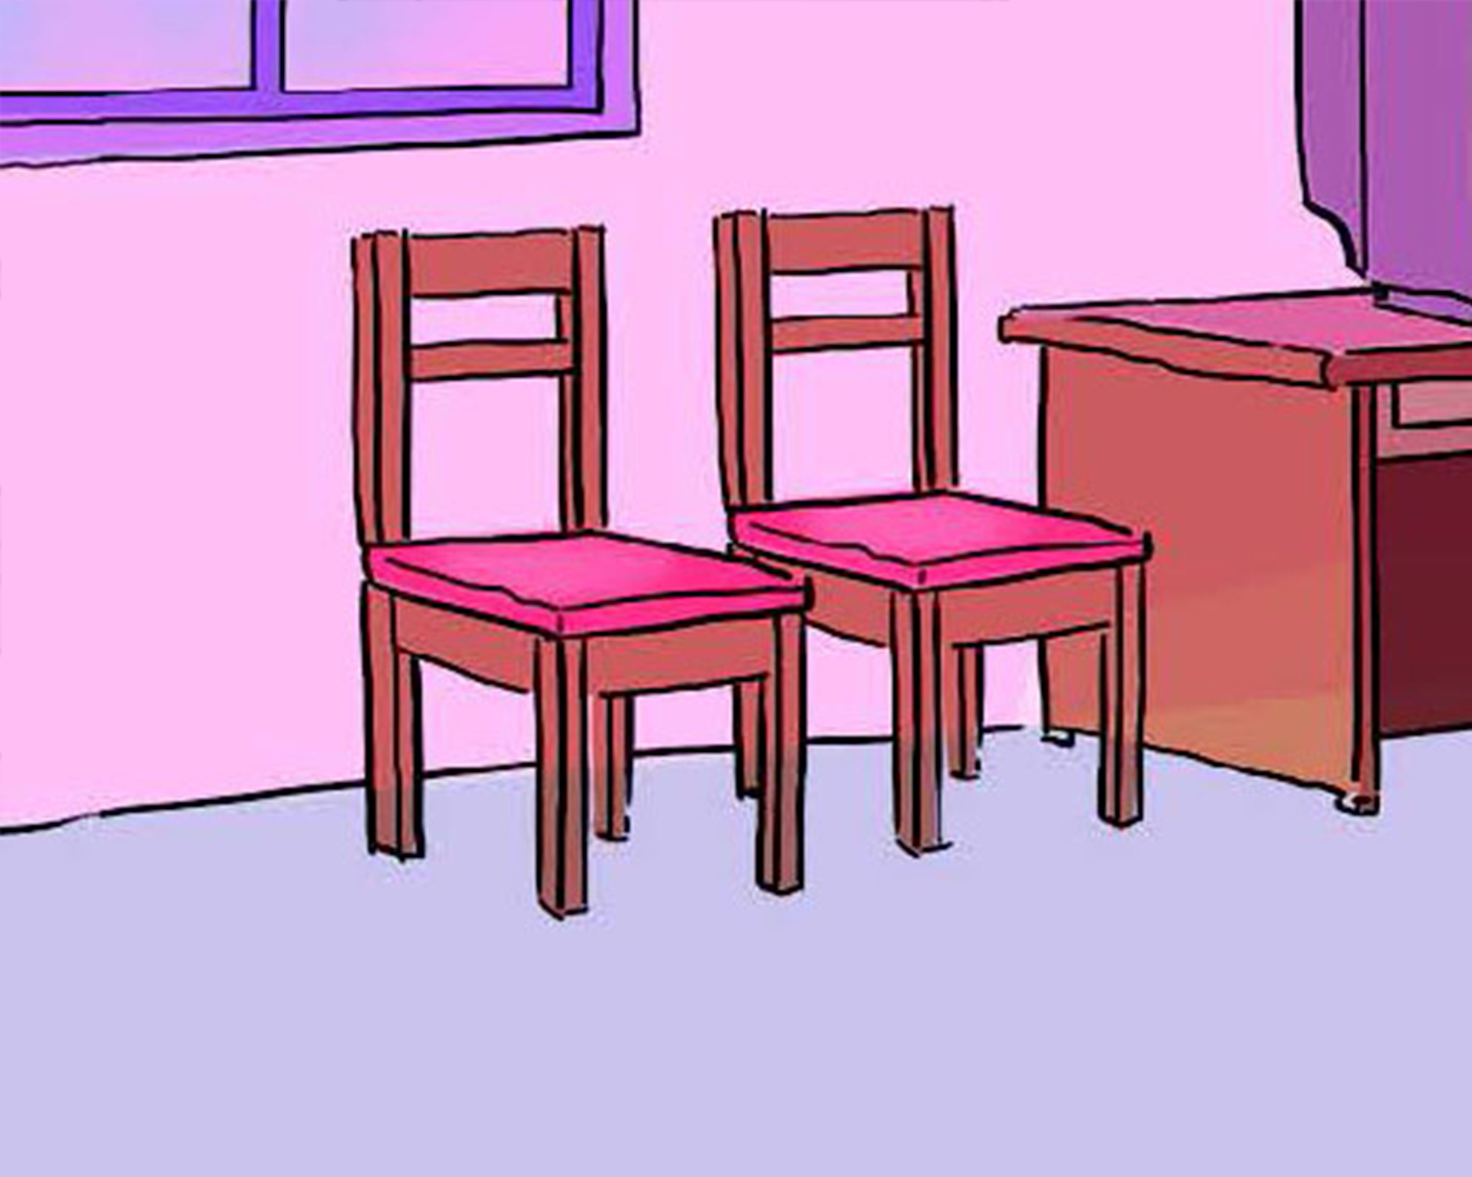
LISTEN AND NUMBER
1
A
B
2
3
4
C
D

Slide 56
LISTEN AND NUMBER
1
A
B
2
2
1
3
4
C
D
4
3

Slide 57
03
PHONICS

Slide 58
3. PHONICS
-a /æ/ | -u /ʌ/

Slide 59
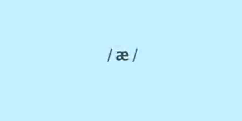

Slide 60


Slide 61
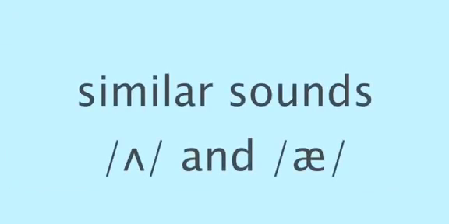

Slide 62
WORD BUILD
Find the words with -a and -u sounds:
-a | -u
Bag
Fan
Up
Fun
Van
Cat
Bus
Cut
Man
Cap
Sun
Cup
Hand
Ran
Tub
Run
Can
…..
Mum
…..

Slide 63
Listen and repeat
a fan There’s a fan on the wall.
u cup There’s a cup on the table.

Slide 64
Listen and write
1. Where’s the ?
2. Where’s the ?

Slide 65
2. Listen and write
cup
1. Where’s the ?
fan
2. Where’s the ?

Slide 66
SOME VOCABULARY
01
02
GRAMMAR
03
SOME SOUNDS
04
DO LISTENING & SPEAKING
05
SING, DANCE & PLAY GAMES
(windows, doors, mirrors, fans)
(How many ….?)
(-a, -u)

Slide 67
WRAP-UP:
1. New words:
fans doors
mirrors windows
2. New sentences:
How many windows are there?
- There are four.
3. Phonics:
- a : fan, van, hand, man …
- u : cup, cut, mum, …

Slide 68
* Learn new words and sentences.
Home-link
* Complete exercises in Unit 14.
* Do further practice handouts.
* Prepare for Unit 15.

Slide 69
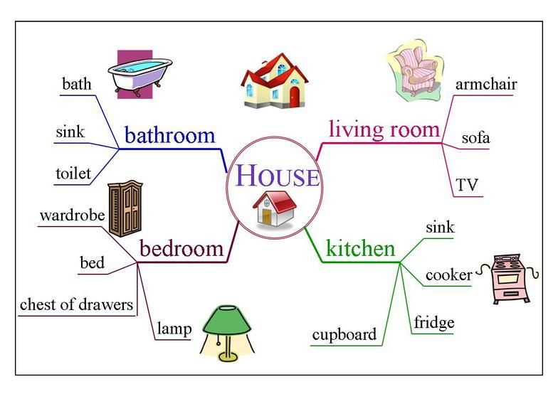
CHECK YOUR MEMORY…
fans
cupboard

Slide 70


