Slide 1
BÀI HỌC TUẦN 21 MÔN TIẾNG ANH
LỚP 3

Slide 2

WARM UP: THE HELLO SONG

Slide 3


Slide 4


Slide 5

UNIT 13. WHERE’S MY BOOK?
LESSON 1

Slide 6
In THIS LESSON, WE WILL learn….
Vocabulary
poster
ball
bed
coat
chair
Ask &
answer
LOCATION

Slide 7

poster
Tranh cổ động, tranh minh họa

Slide 8
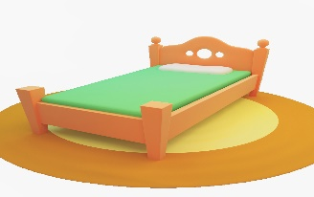
bed

Slide 9

chair

Slide 10

picture
Bức tranh, bức ảnh (vẽ hoặc chụp)

Slide 11

coat

Slide 12

ball

Slide 13





1. New words:
- poster
- bed
- chair
- picture
- coat
- ball

Slide 14
WHAT’S MISSING?
- poster
- bed
- chair
- picture
- coat
- ball

Slide 15

WHAT’S MISSING?
coat

Slide 16
WHAT’S MISSING?
ball

Slide 17
WHAT’S MISSING?
bed

Slide 18
WHAT’S MISSING?
picture

Slide 19



Slide 20
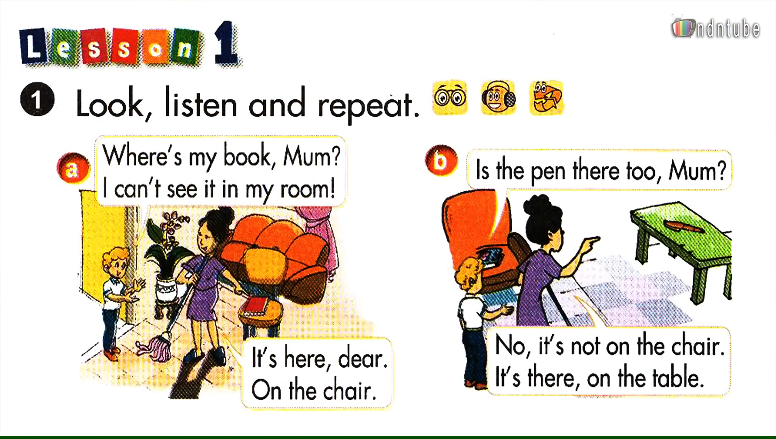

Slide 21
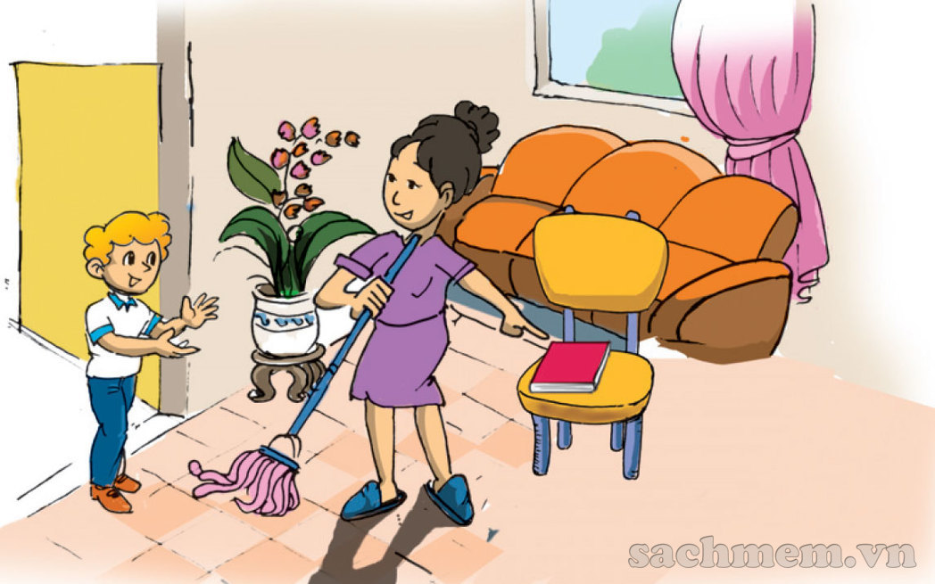

Slide 23
Where’s my book, Mum?

Slide 24
Where’s my book, Mum?
It’s here, dear.

Slide 25
2. New sentences:
Where’s my book?
☞It is here.
The book
Where’s = Where is
It’s = It is
/ ☞ It’s there.

Slide 26
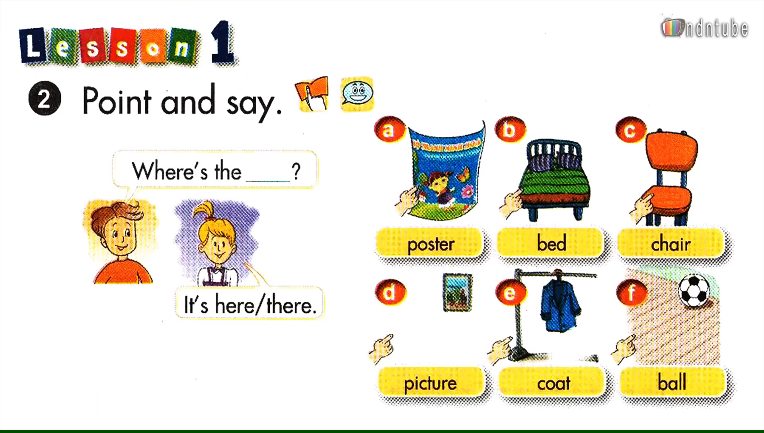

Slide 27

It
poster
Where’s the ______?
It
It’s _____
here.

Slide 28
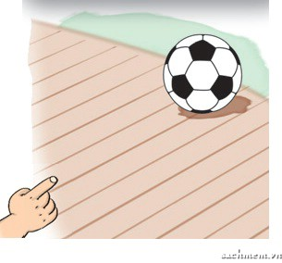
It
ball
Where’s the ____?
It
It’s _____.
there

Slide 29
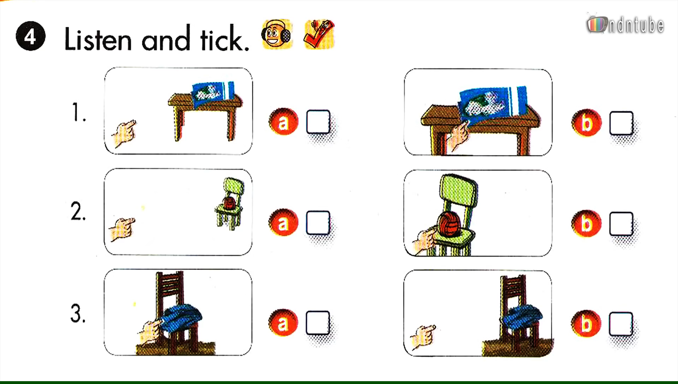

Slide 30
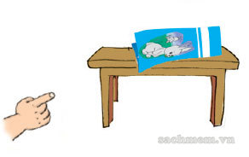
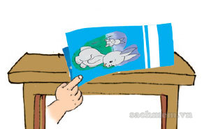


LISTEN AND TICK
B

Slide 31



LISTEN AND TICK
B

Slide 32



LISTEN AND TICK
B

Slide 33
✓
✓
✓

Slide 34

LET’S TALK
Where’s the ?
It’s .

Slide 35





WHEEL OF FORTUNE
30
20
1
2
3
40
10
50
80
4
5
6
60
70
7
8
9
SPIN

Slide 36

Question 1: Fill in the blank
_______ is the table? – It’s there.
Where
BACK

Slide 37
Question 2: Find a mistake
Where’s a poster?
a → Where’s the poster?
BACK

Slide 38
Question 3: Odd one out
bedroom bathroom coat kitchen
coat
BACK

Slide 39
Question 4: Fill in the blank
It ______ here.
is -> It is here.
BACK

Slide 40
Question 5: Complete the word
p_st_r
poster
BACK

Slide 41
Question 6: Read and complete:
Is there a garage? - Yes, _______ is.
there -> Yes, there is.
BACK

Slide 42
Question 6: Read and complete:
Is there a garage? - Yes, _______ is.
there -> Yes, there is.
BACK

Slide 43
Question 7: Odd one out
mum dad sister family
family
QUAY VỀ

Slide 44
Question 8: Complete the sentence
Where ____ the picture?
is -> Where is the picture?
BACK

Slide 45
Question 9: Find the mistake
There are one living room.
is -> There is one living room.
BACK

Slide 46
WRAP-UP:
1. New words:
poster bed coat
picture chair ball
2. New sentences:
Where’s the picture?
- It’s here/ there.

Slide 47

Where’s the ______?
It’s here. / there.
chair
bed
UNIT 13
Lesson 1
poster
picture
coat
ball

Slide 48

Thank you
for your attention!

