Slide 1

BÀI HỌC TUẦN 21 MÔN TIẾNG ANH
LỚP 3

Slide 2
Unit 12: This is my house lesson 2+3

Slide 3
In THIS LESSON, WE WILL learn….
Vocabulary
fence
gate
yard
garage
pond
Ask &
answer
about our house

Slide 4

Warm-up song my house

Slide 5



Slide 6
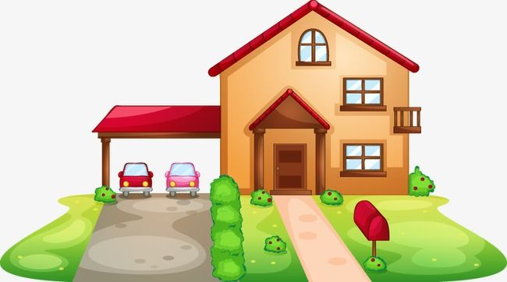


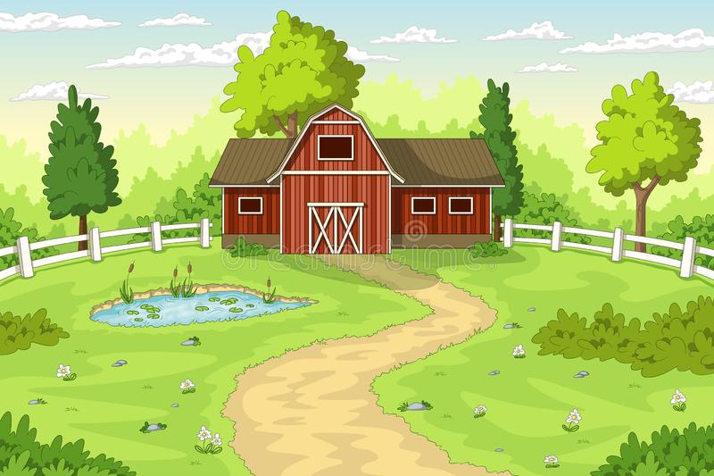

Things around my house
G
G
A
R
A
E
P
O
N
D
G
A
E
F
E
N
C
E
T
Y
A
R
D

Slide 7







1. Vocabulary:
- pond
- gate
- yard
- fence
- garage
sân
nơi để xe
hàng rào
cổng
ao nước

Slide 8
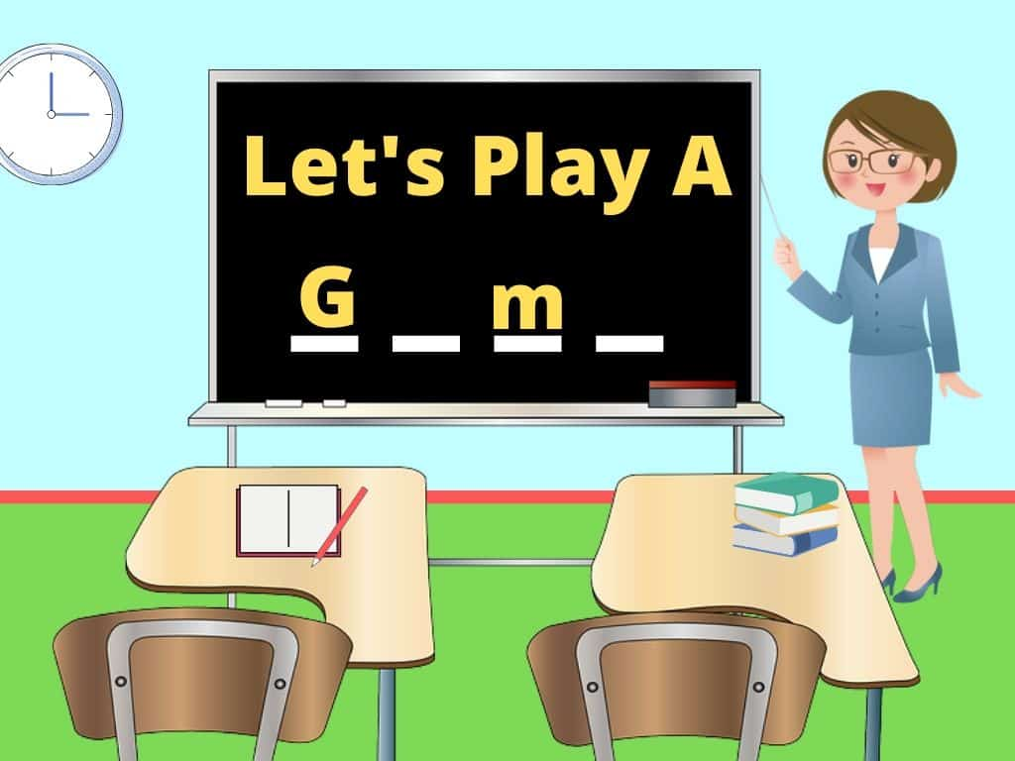

Slide 9
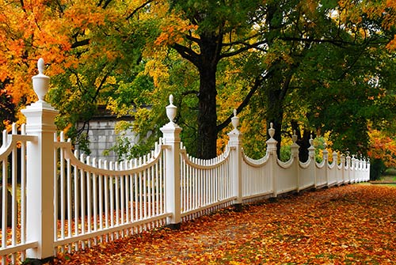
FENCE
SHOW

Slide 10
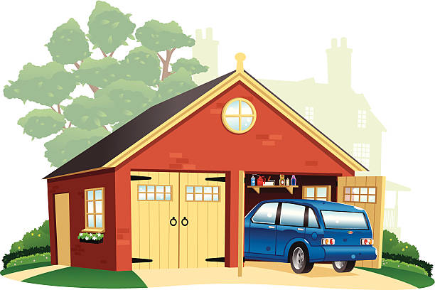
GARAGE
SHOW

Slide 11
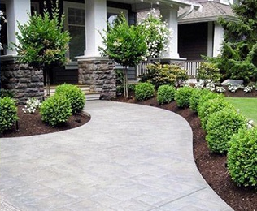
YARD
SHOW

Slide 12
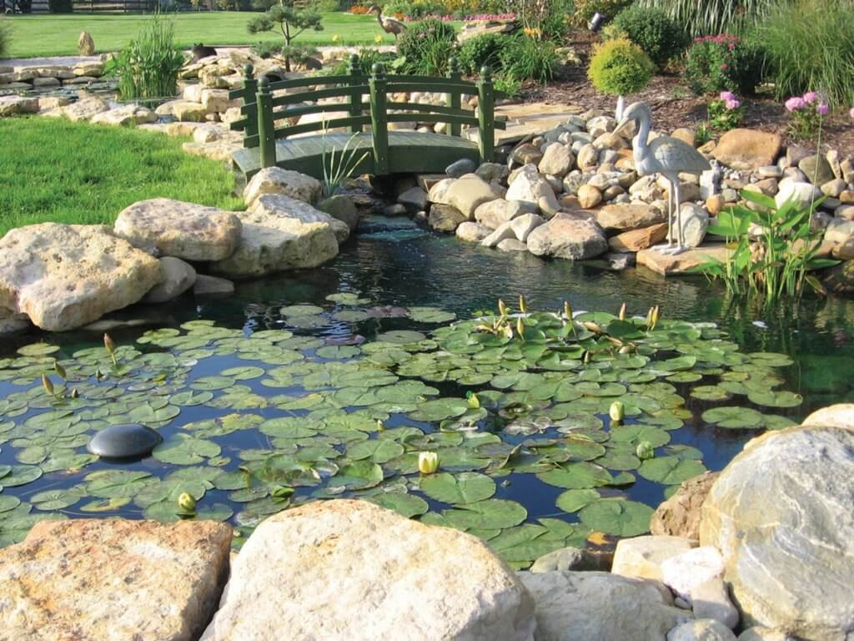
POND
SHOW

Slide 13
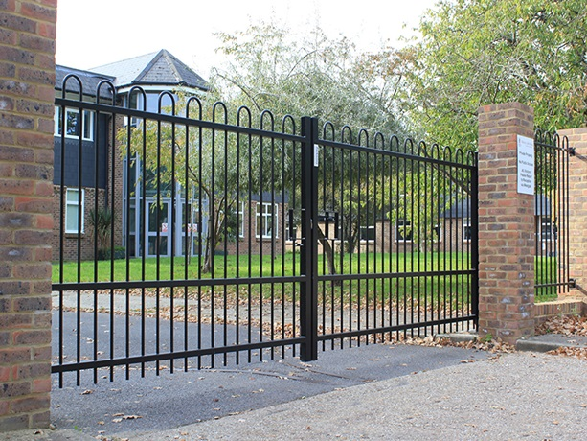
GATE
SHOW

Slide 14

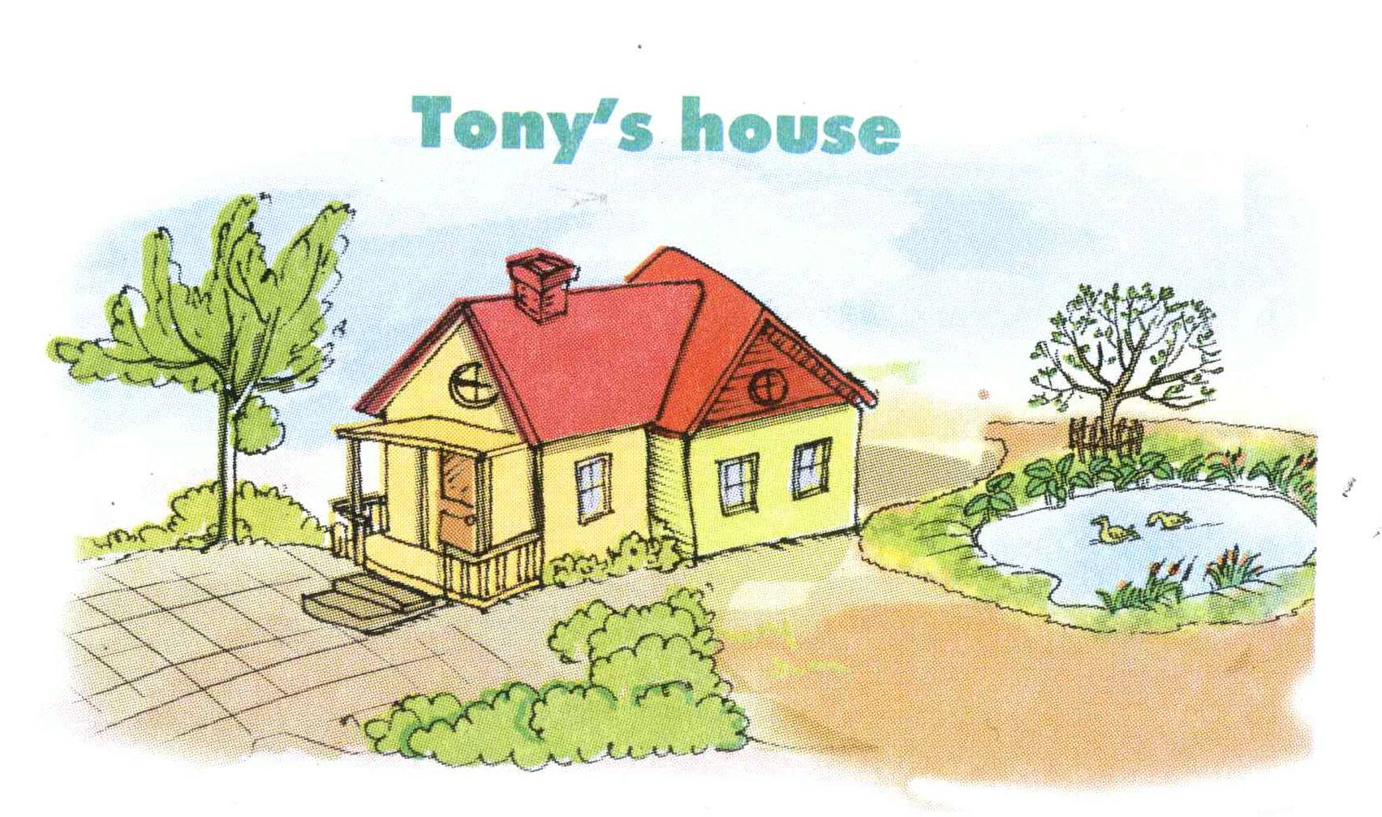

Slide 15
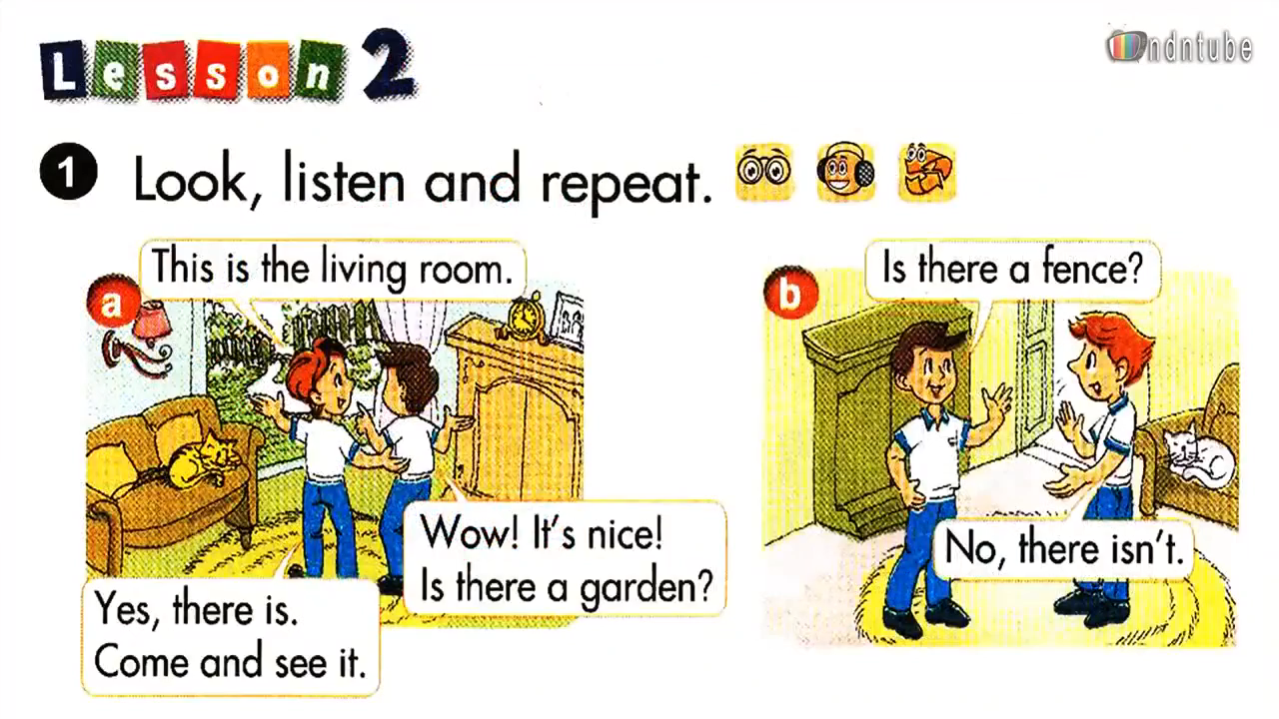


Slide 16

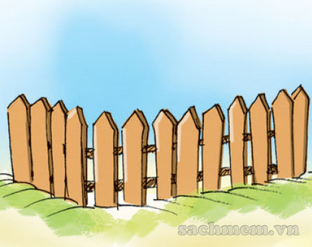

2. Model sentences:
Is there a garden?
Yes, there is.
Is there a fence?
No, there isn’t.

Slide 17
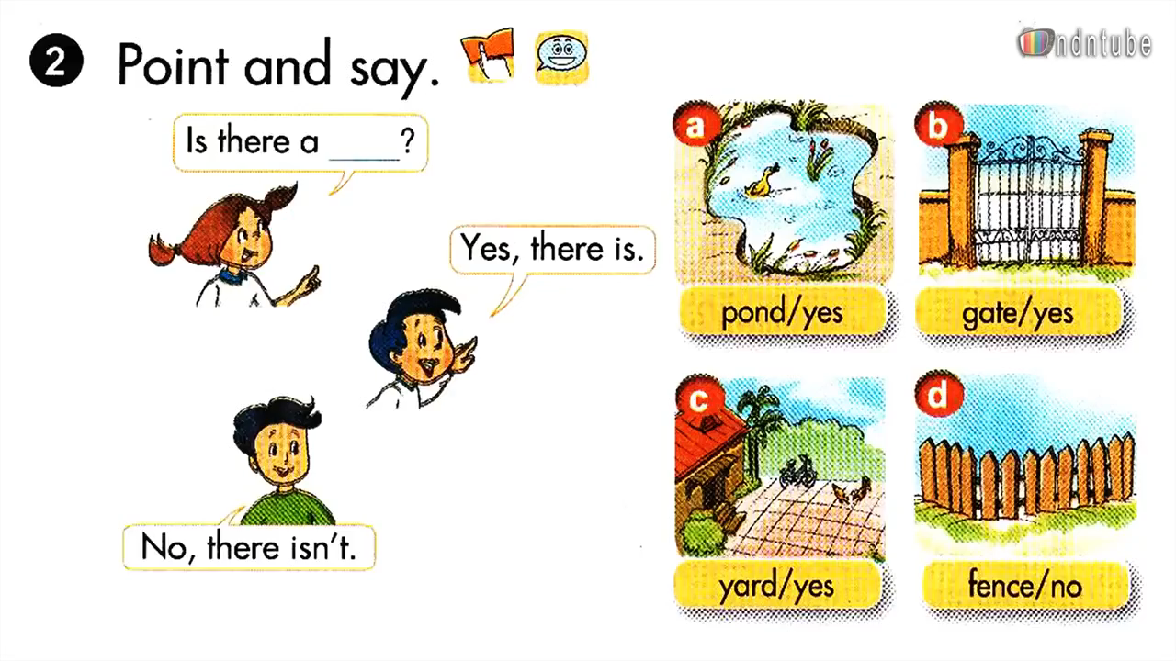
1 / 40

Slide 18
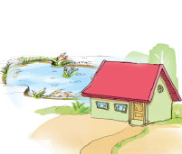
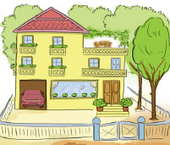


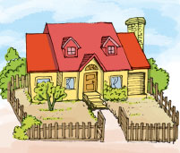
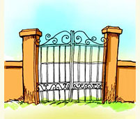
LISTEN AND NUMBER
2
1
1
B
2
3
4
4
3
C
D

Slide 19
3. PHONICS
-CH | -TH

Slide 20
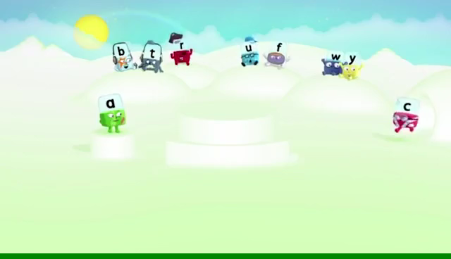
3. PHONICS
-CH | -TH

Slide 21
3. PHONICS
-CH | -TH

Slide 22
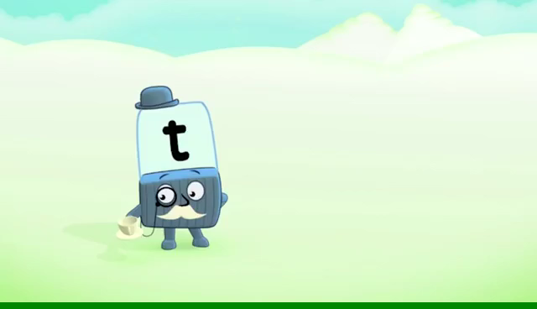
3. PHONICS
-CH | -TH

Slide 23
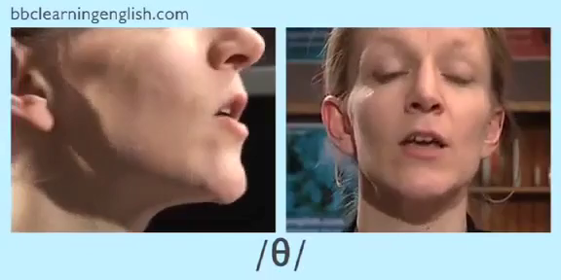
3. PHONICS
-CH | -TH

Slide 24
Word build find more words with –ch and –th sounds
-CH | -TH
CHAIR
CHEESE
THREE
TEETH
TEACHER
SANDWICH
THURSDAY
THANKS

Slide 25
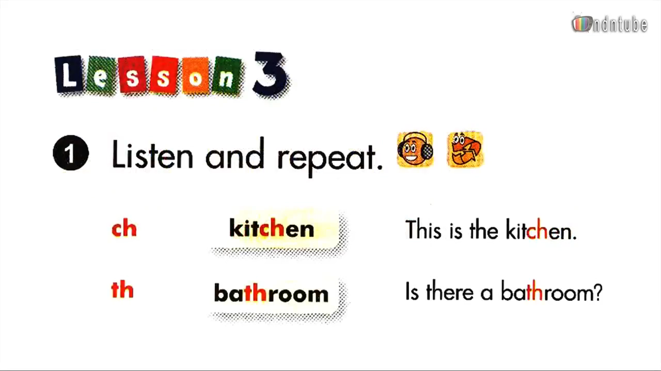

Slide 26
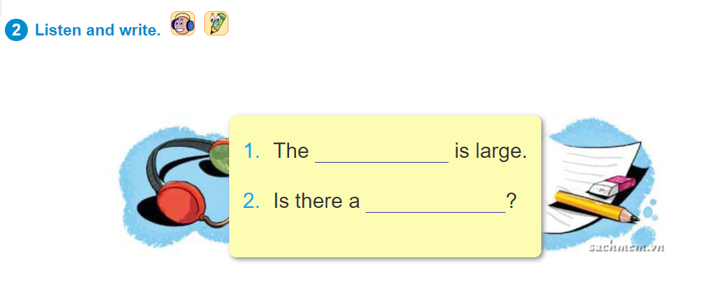
bathroom
kitchen

Slide 27
SUMMARY:
1. New words:
fence gate pond
yard garage
2. New sentences:
Is there a gate? - Yes, there is./ No, there isn’t.
3. Phonics:
-ch : kitchen, chair, techer, …
- th : three, bathroom, thanks, …

Slide 28
* Learn new words and sentences.
Home-link
* Complete exercises in Unit 12.
* Prepare for Unit 13.

Slide 29
CHECK YOUR MEMORY…
01
03
LISTENING & SPEAKING
Describe your house
VOCABULARY
FENCE
YARD
GATE
POND
GARAGE:
02
04
PHONICS
-CH
-TH
GRAMMAR
Is there a fence?
Yes, there is.
- No, there isn’t.

Slide 30


