Slide 1
IELTS WRITING TASK 1
MAPS

Slide 2
CONTENTS
Types of Map Questions
Writing the Introduction
Writing the Overview
Grammar and Vocabulary for Describing Maps
Sample Task and Model Answer

Slide 3
1. TYPES OF MAP QUESTIONS
Maps in Writing Task 1 often shows you the development of an area and you have to describe its main changes over time.
Generally, there are 2 types of maps in the IELTS test
  Diachronic maps: 2 maps of the same place but in different times (e.g 1940, 2010)
  Synchronic maps (less common): 1 single map and we have to describe two locations on them or even compare them

Slide 4
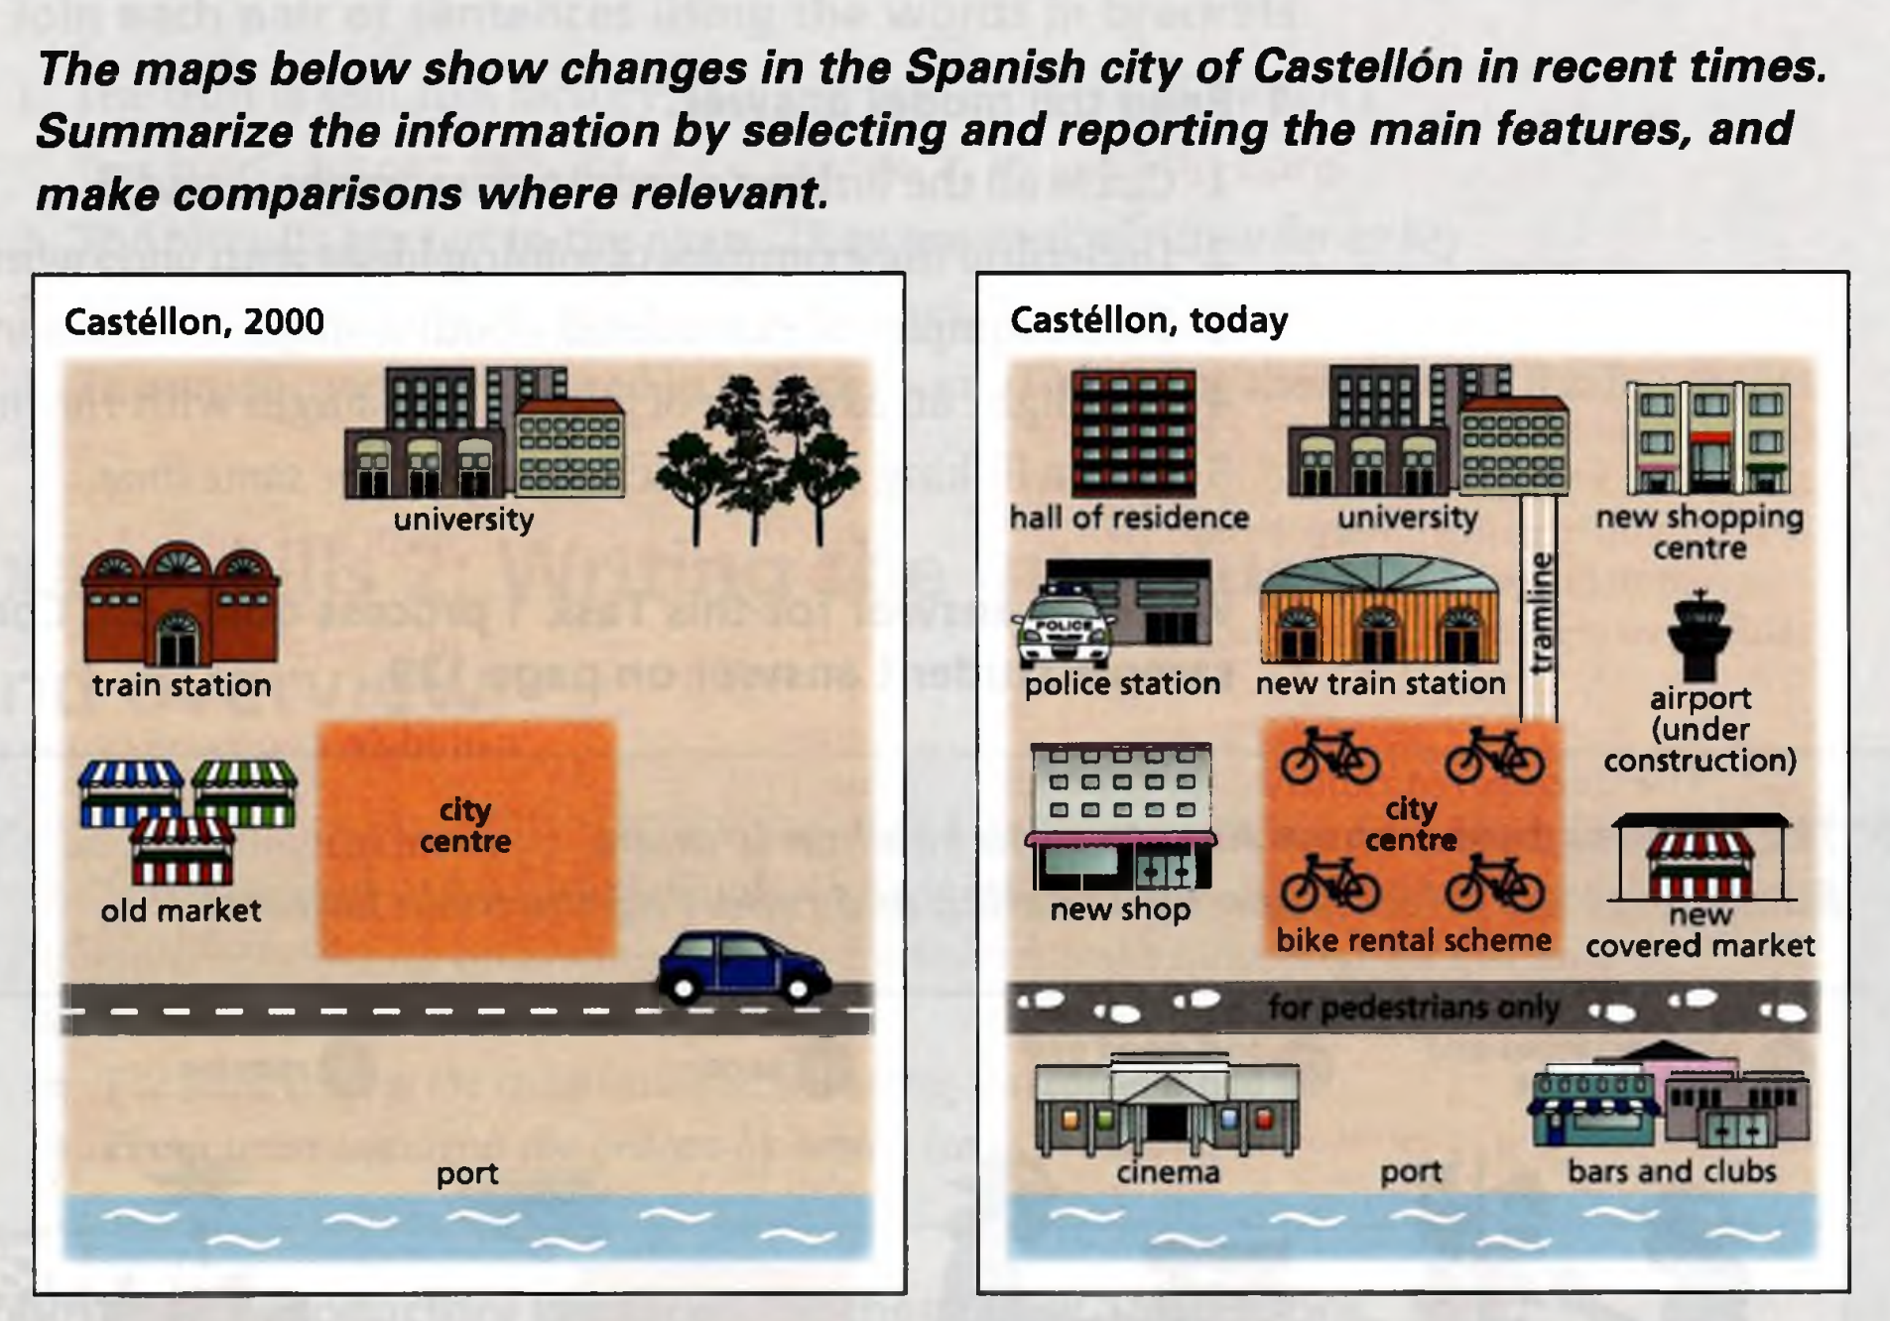
Diachronic maps

Slide 5
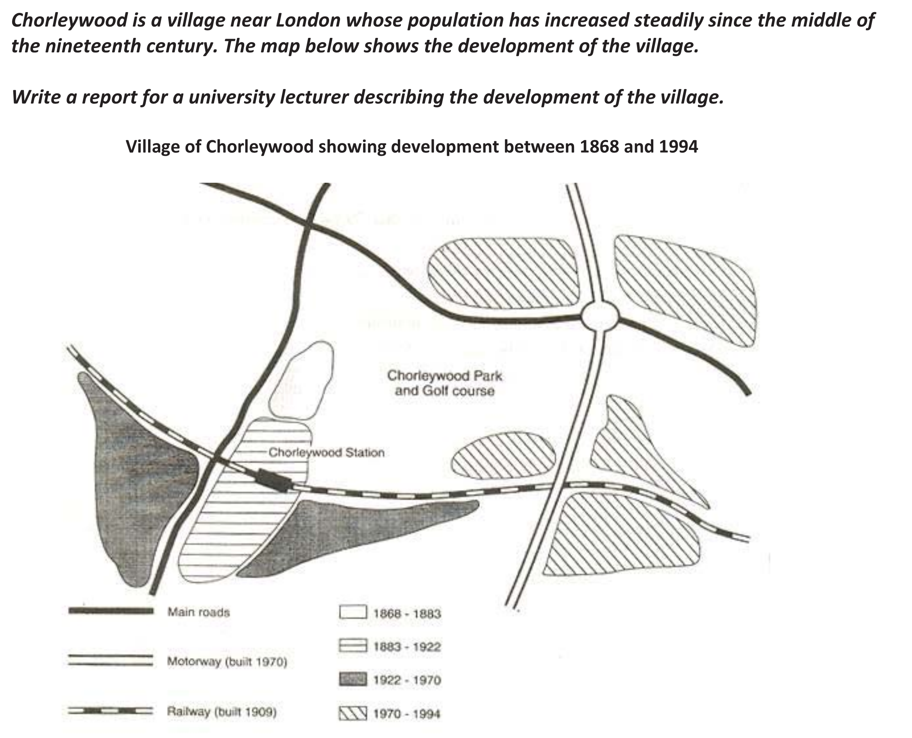
Synchronic maps

Slide 6
ESSAY STRUCTURE
Paragraph 1 - The Introduction
    State what the map(s) show(s)
Paragraph 2 – The Overview
    Write about the most noticeable differences between the two maps/ over the time period
Paragraph 3- Main Body 1
    Three to four sentences about specific changes that have occurred.
Paragraph 4- Main Body 2
    Further three to four sentences about specific changes that have occurred.
(You can group information together in paragraph 3 and 4 by time or location, depending on the question asked.)

Slide 7
2. WRITING THE INTRODUCTION
Useful Structures
The maps show/compare/illustrate + the changes/ growth/ developments which took place in (name of the town) over a period from … to …/between …and…)
The maps show/compares/illustrate + how (name of the town) has changed/ transformed/ developed from … to..

Slide 8
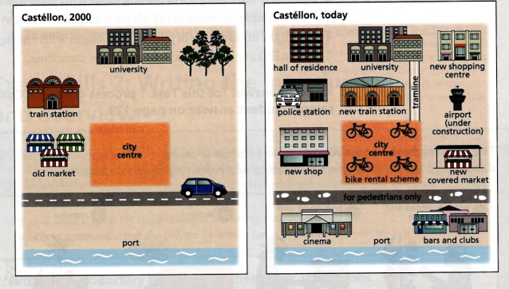
Choosing the information:
You need to figure out the general change of the place.
2. WRITING THE OVERVIEW
1st sentence: more shopping and transport facilities => become a much more modern city today
2nd sentence (an interesting change): new tramline

Slide 9
2. WRITING THE OVERVIEW
1st sentence:
2nd sentence:
Another / One interesting change is that....
Overall, / In general, | it is clear from the diagram | that …..
 | the most significant change in the graph is
 | what stands out from the graph

Slide 10
In general, the most significant change in the graph is that Castellon has become a much more modern city, with far more shopping and transport facilities. One interesting change is that a new tram line has been built, to connect the university with the town center.

Slide 11
Verb Tense and Passive Voice
4. Grammar and Vocabulary for
Describing Maps
Maps comparing 2 periods of time in the past (e.g. 1995) and now:
Use the present perfect passive to describe the change in the present.
Use the simple past passive to illustrate features in the past.

Slide 12
Verb Tense and Passive Voice
4. Grammar and Vocabulary for
Describing Maps
Maps comparing two periods of time in the past (e.g. 1990 and 2005):
Use the simple past passive to describe the change in 2005.
Use the past perfect passive to illustrate the features in 1990.

Slide 13
4. Grammar and Vocabulary for
Describing Maps
Describing Major Changes
The town has become more/less residential in the year…compared to ….
Some of the changes are negligible but ……(a change)… is dramatic over these years.
(Place A) experienced a number of noticeable changes. The greatest is that….
The most noticeable difference between place A and B is …X…
The biggest change occurred to the north of (place A).
…X…has experienced a transformation since more ….X… is constructed in the area.
(Place A) has undergone considerable changes in ….X…. and ….Y….
The (place A) was a much greener residential area with a large number of trees and individual houses.

Slide 14
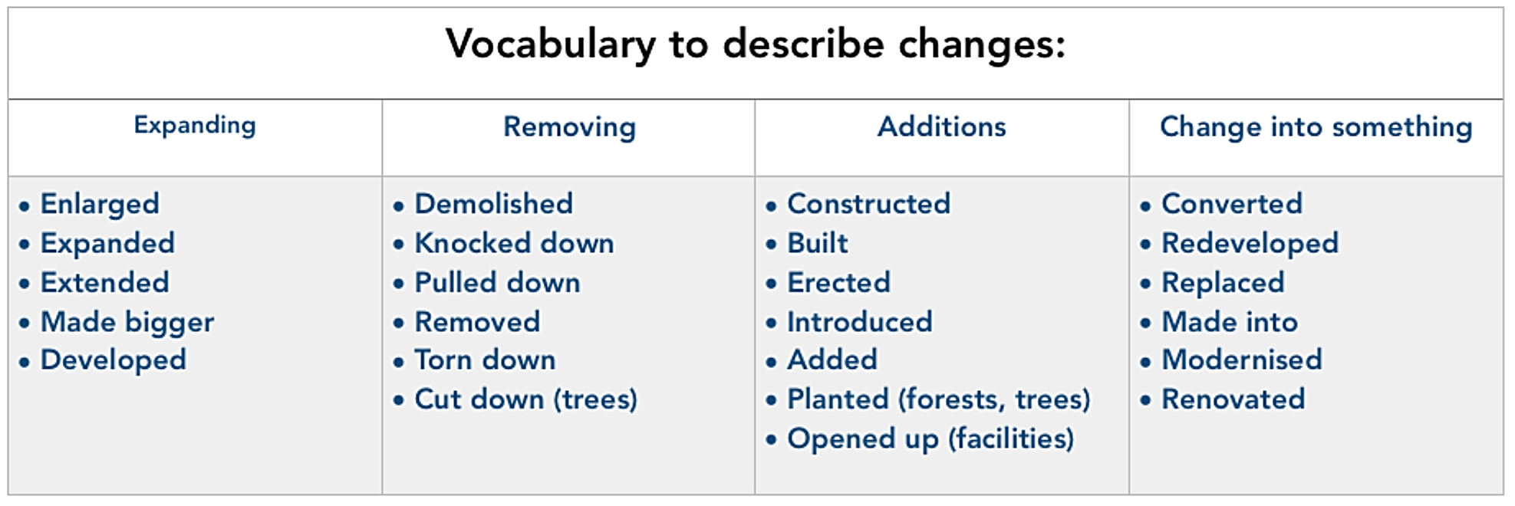
4. Grammar and Vocabulary for
Describing Maps

Slide 15
4. Grammar and Vocabulary for
Describing Maps
Examples:
The offices were demolished and the surrounding area was redeveloped with a new leisure center opening up.
The shopping center was extended and the parking area was enlarged to accommodate more cars.
The tree were cut down and a new office block was erected.
A railway was constructed with the introduction of a new train station.
The industrial area was modernized and made bigger with lots of new factories being built.
The local government had the sports facilities renovated and the small park was made into a children’s playground.
The park was replaced with a new housing complex.

Slide 16
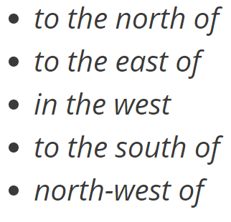
4. Grammar and Vocabulary for
Describing Maps
Vocabulary for Showing Location

Slide 17
4. Grammar and Vocabulary for
Describing Maps
Examples
The trees to the north of the river were cut down and a new office block was built.
A railway was constructed to the east of the housing estate with the introduction of a new train station.
The forest to the west of the park was cut down and a new housing complex was constructed.
The industrial area to the south-west of the station was expanded.

Slide 18
4. Grammar and Vocabulary for
Describing Maps
Other Useful Vocabulary
Housing/Residential area: an area that has lots of houses and some schools.
Industrial area: an area that has lots of factories
Commercial area: an area that has lots of stores
Skyscraper: very tall buildings
Warehouse: a building where things are kept until they are sold.
Woodland: an area with lots of trees
Intersection/Junction: the point where several streets meet.
Recreation: an activity that is exciting, stimulating or relaxing.

Slide 19
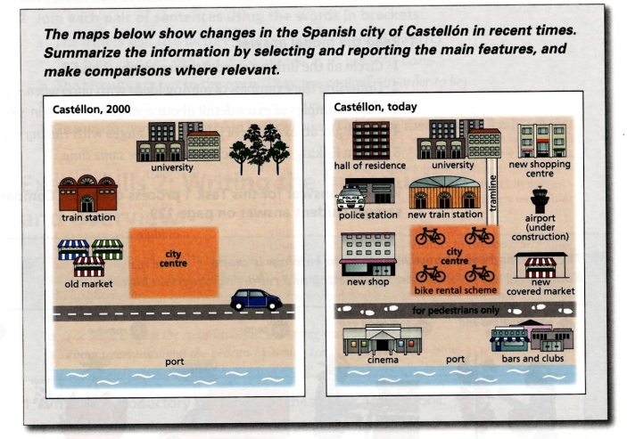
5. Sample Task

Slide 20
