Slide 1
IELTS Speaking Strategies Part 1

Slide 2

Today you will learn:
IELTS Speaking Overview
IELTS Speaking Part 1
Part 1- Topic: Family

Slide 3
1, IELTS SPEAKING OVERVIEW
IELTS Speaking is a one-on-one interview between the candidate and an examiner.
IELTS Speaking is recorded.
Timing: 11-14 minutes

Slide 4
1, IELTS SPEAKING OVERVIEW
The 3 parts give the candidate opportunities to use a range of different speaking skills
Part | Task Type | Timing
1 | Introduction and interview | 4-5 mins
2 | Independent long turn | 3-4 mins
3 | Discussion | 4-5 mins

Slide 5
Speaking test component
Part 1
Lasts 4-5 minutes
You will be asked about some aspects of yourself (family, work, friends, entertainment, hobbies…)

Slide 6
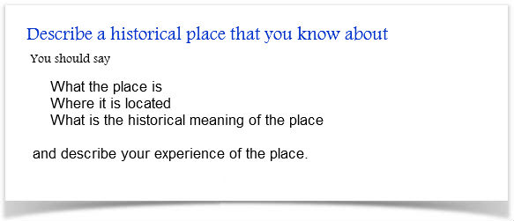
Speaking test component
Part 2:
Last 4-5 minutes
You will be given a topic card with questions on (topic will be personal).

Slide 7
Speaking test component
Part 3:
Topics will be relevant to Part 2 topic
It tests your ability to analyze and discuss in depth (general, not personal)
You should give opinions and reasons for your choices.

Slide 8
The Four Grading Criteria
Fluency and Coherence 25%
How fluently you speak and how well you link your ideas together
Lexical Resource (Vocabulary) 25%
How accurate and varied your vocabulary is
Grammatical Range & Accuracy 25%
How accurate and varied your grammar is
Pronunciation 25%
How accurate your pronunciation is
Notes:
Introduce Sound Pair 1 by doing the following: 1) teacher clicks on each pair going horizontally, and class chorally repeats the sound. Teacher corrects or isolates students who are incorrectly pronouncing the words 2) Have students alternate and go through each pair until each student has said all sounds. Teacher records informally using “Pronunciation Pre-Test 1: Minimal Pairs” using the check or x system for correct/incorrect pronunciation.

Slide 9
Speaking Score Calculation
For example, if your marks are:
Fluency and Cohesion: 7.5
Pronunciation: 7.0
Lexical Resources: 7.0
Grammatical Range and Accuracy: 7.5
Then your total score for IELTS Speaking is (7.5+7.0+7.0+7.5)/4 =7.25, which will be rounded to 7.5.

Slide 10
Fluency & Coherence
Fluency is a combination of:
Speed of speech
Length of answer
Pausing correctly
Coherence is the ability to:
Answer the questions directly
Expand your answers by adding relevant details to explain or illustrate your answers
Connect your sentences by using tenses and connectors

Slide 11
Pronunciation
Features of good pronunciation include:
Basic word pronunciation
Linked speech sounds
Correct sentence stress
Correct use of intonation (rising and falling)
You should note that there is no need to have a “British” or “American” accent.

Slide 12
Lexical Resource (Vocabulary)
Do you have enough words to express yourself clearly? This is judged by your ability to:
Have enough vocabulary to discuss a range of topics
Use vocabulary accurately
Be able to explain yourself when you DO NOT have the right word

Slide 13
Common Mistakes
A common mistake here is to use long words without really knowing what they mean.

Slide 14
Grammatical Range & Accuracy
Two key points :
Avoid grammar mistakes especially with your tenses
Use a range of grammatical structures and you should not just use simple sentences all the time

Slide 15
2, IELTS Speaking Part 1
4 to 5 minutes
~ 10 questions related to yourself, your daily life and your interests.
Common topics are: hobbies, family, friends, food, music etc.
The examiner must get through all of the questions in 5 minutes or less. That's only about 30 seconds per question.

Slide 16
Part 1 Formula: Short & Simple Answers
E: Do you prefer home-cooked food or food from restaurants?
C: I prefer home-cooked food because I think it's healthier and you know exactly what you're eating. I also enjoy cooking for family and friends.
-> You don't need to say any more than this. Just answer the question with:
a full sentence
Then give a reason, and maybe add one extra piece of information.
Then stop speaking. Stop with confidence and look at the examiner, ready for the next question.

Slide 17
Speaking Part One - Tips
Tip 1: Avoid one or two word answers.
Lie if needed, but expand and say something specific.
Wrong: Question “What kind of music do you like?” “Oh, well I like everything really.”
Tip 2: Focus on using words you know.
It’s good to use higher vocabulary, but if you can’t pronounce it correctly or don’t know the correct use, then choose a simpler word.
Wrong: “I would ensure him that he can solve his problem”

Slide 18
Speaking Part One - Tips
Tip 3: Don’t think too much! If you can’t think of a word, simply paraphrase it.
She is very punctual -> She’s never late./She’s always on time.
Tip 4: Follow the structures, but don’t memorize answers.
E: What do you do?
Wrong: C: I work for a market research company. We do market research for companies that are planning to develop new products. My job is every demanding. It requires strong communication and interpersonal skills to get things done. The best thing about my job is the team that I work with. My work starts at 9am and finishes at 7pm…
Tip 5: Speak slowly (not too slowly) and clearly. Focusing on speed will result in more errors.

Slide 19
Strange questions
Do you like parks?
Do you think different colors can change our moods?
When do people give flowers in your country?
Don’t be shocked by these questions. Just give a simple answer with a reason. Don’t worry about using fantastic grammar or vocabulary; just try to answer without hesitating.

Slide 20
Strange questions
For example:
Yes, I like parks because they are great places to relax. I think all cities need green areas.
Yes, I think bright colors, like red, can make you feel energetic and positive. Some greens and blues can also be more relaxing.
People give flowers on special occasions like birthdays or on Valentine’s Day. In my country, giving flowers is seen as romantic.

Slide 21
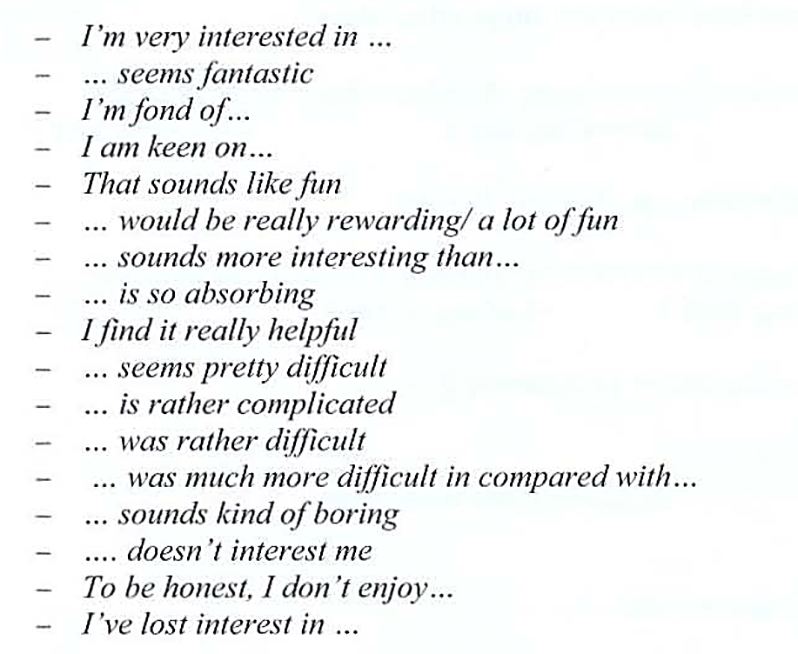
Useful expressions

Slide 22
3, Speaking Part 1 – Topic: Family
Sample Questions will include:
Let’s talk about your family:
Tell me about your family
Do you have a large or small family?
How much time do you spend with your family?
What do you like to do together as a family?
Do you get along well with your family?

Slide 23
Interview Part One: Speaking Test Family
Listen to the recording of yourself.
Write down or type any errors in pronunciation, grammar, or vocabulary that you hear.
Then your teacher will give you feedback and tips

Slide 24
Interview Part One: Your Score-Families
Fluency/Coherence:
Vocabulary:
Grammar:
Pronunciation
Total:

