Slide 1
Unit 18 – Lesson 1
What are you doing?

Slide 2
VOCABULARY

Slide 3
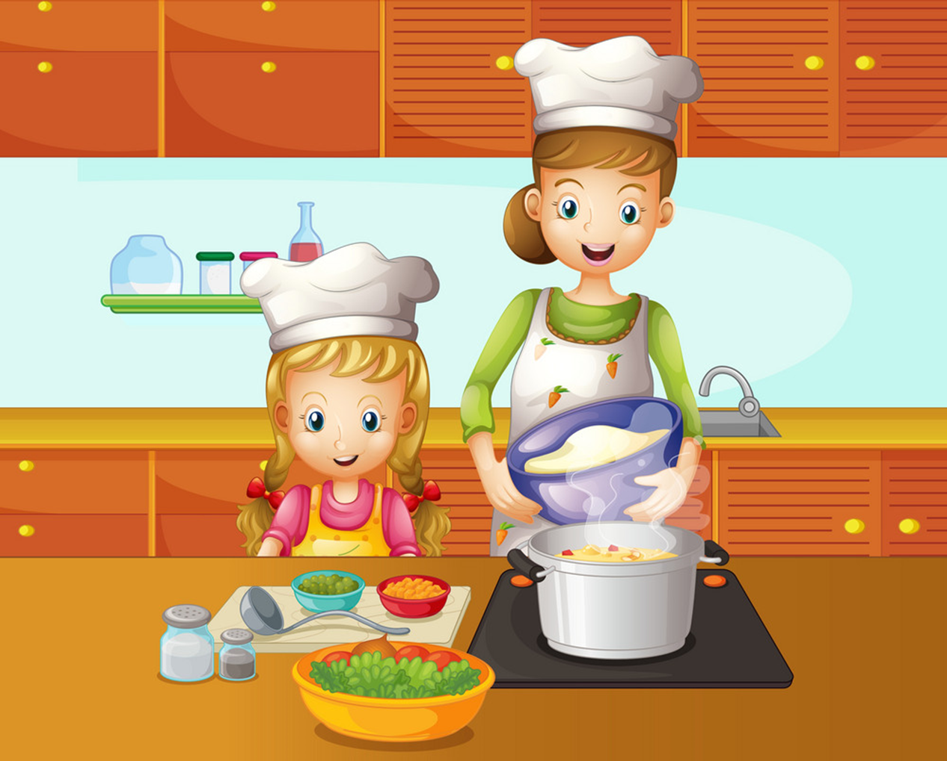

Vocabulary
cooking
/ˈkʊkɪŋ/

Slide 4

Vocabulary
reading
/ˈriːdɪŋ/

Slide 5

Vocabulary
listening to music
/ˈlɪsnɪŋ təˈmjuːzɪk/

Slide 6
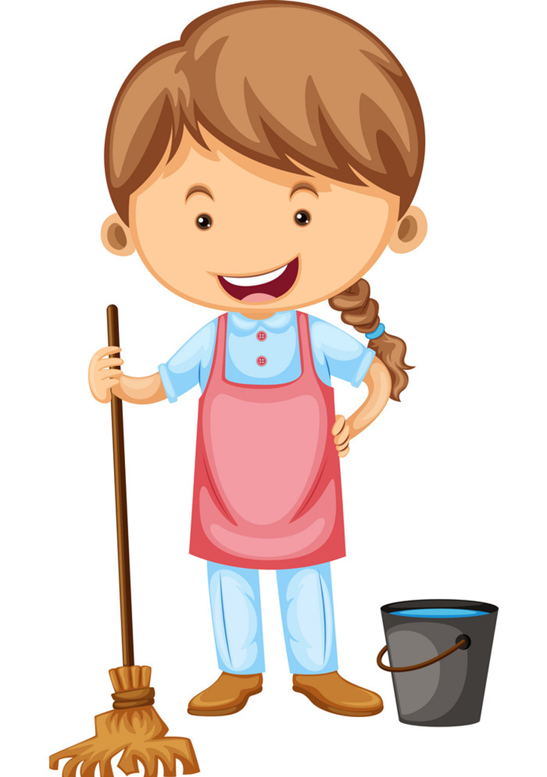
Vocabulary
cleaning the floor
/kliːnɪŋ ðə flɔːr /

Slide 7
Vocabulary
Listening to music
Cooking
Reading
Cleaning the floor

Slide 8



Reading
A.
B.
C.

Slide 9
Cooking
A.
B.
C.

Slide 10
Listening to music
A.
B.
C.

Slide 11
Cleaning the floor
A.
B.
C.

Slide 12
_____ the house
A.
Listening
Reading
B.
Cleaning
C.

Slide 13
_____ to music
A.
cooking
Listening
C.
Reading
B.

Slide 14
________
A.
Cooking
Reading
C.
Cleaning
B.

Slide 15
_______
cleaning
A.
B.
cooking
reading
C.

Slide 16
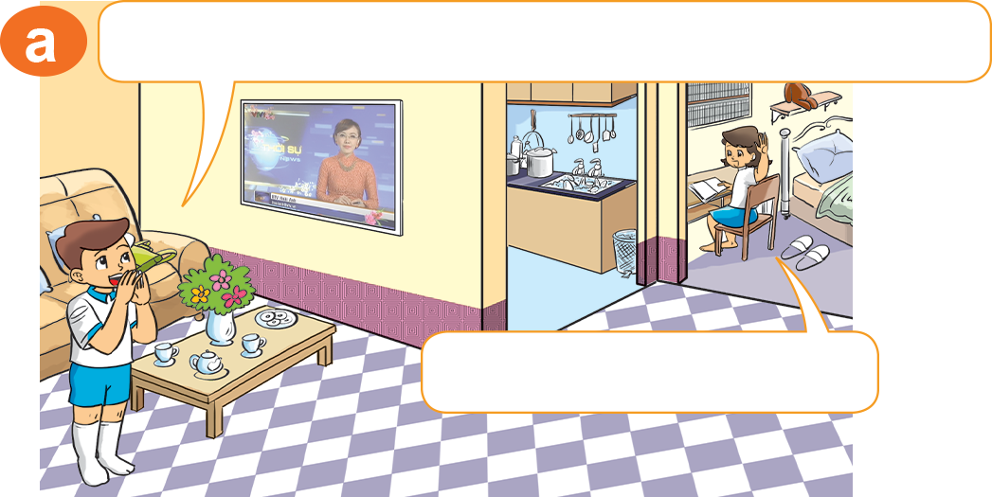
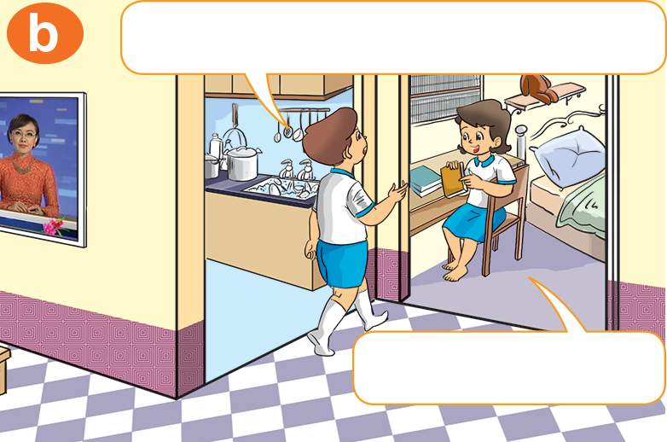

I'm in my room.
1. Look, listen and repeat
I'm home. Where are you, Hoa?
What are you doing?
I'm in my room.
I'm reading.

Slide 17


2. Point and say
What are you doing?
cleaning the floor
I’m ____________________.

Slide 18
2. Point and say
What are you doing?
reading
I’m ____________________.

Slide 19
2. Point and say
What are you doing?
cooking
I’m ____________________.

Slide 20
2. Point and say
What are you doing?
listening to music
I’m ____________________.

Slide 21
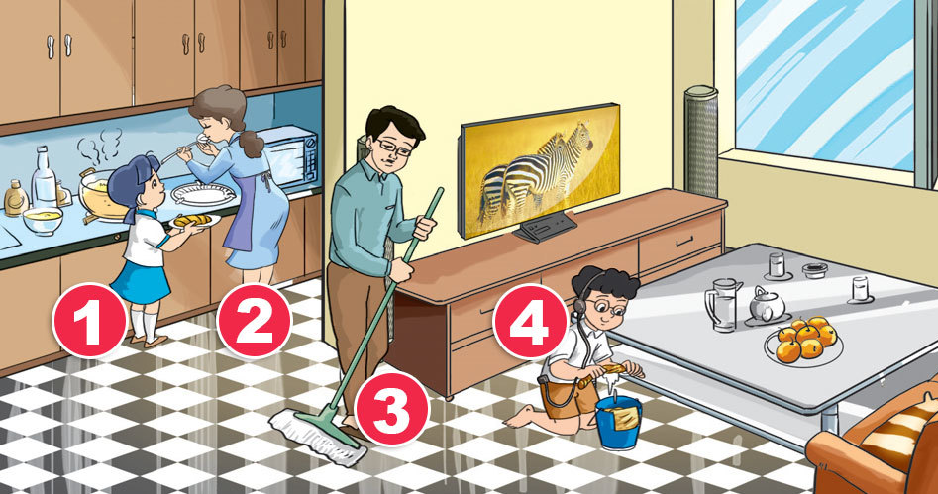
3. Let's talk
What are you doing?
I’m _____________.

Slide 22


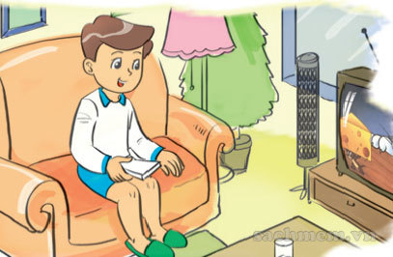
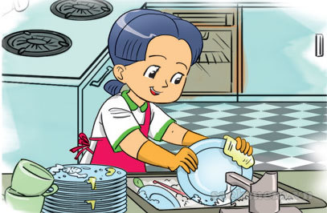

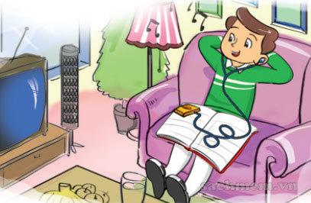
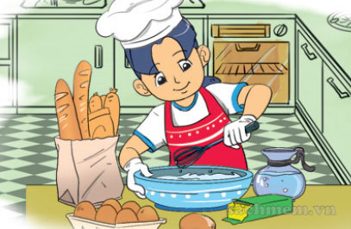
4. Listen and tick
1
2
3
a
a
a
✔
b
b
b
✔
✔

Slide 23
5. Look, read and write
Today Mai's family is at home. Mai's father is in the living room. He is reading. Mai's brother is listening to music. Mai and her mother are in the kitchen. They are cooking.
What are they doing?
1. Mai's father is _________________.
2. Her brother is _________________.
3. Mai and her mother are _________________.
cooking
reading
listening to music

Slide 24
Model sentence
What are you doing?
I’m _____________.
Cooking
Listening
to music
Cleaning
the floor
Reading

Slide 25
6. Let's write
1. What are you doing?
2. What is your father doing?
3. What is your mother doing?

Slide 26









Hoa Mặt Trời
Notes:
Ms Huyền Phạm - 0936.082.789 – YOUTUBE: MsPham. Facebook: Dạy và học cùng công nghệ.

Slide 27


What are you doing?
I’m reading.
A
B
C
D
Notes:
Ms Huyền Phạm - 0936.082.789 – YOUTUBE: MsPham. Facebook: Dạy và học cùng công nghệ.

Slide 28
What are you doing?
I’m listening to music.
A
B
C
D
Sai
Sai
Đúng
Sai
Notes:
Ms Huyền Phạm - 0936.082.789 – YOUTUBE: MsPham. Facebook: Dạy và học cùng công nghệ.

Slide 29
What are you doing?
I’m cooking.
A
B
C
D
Sai
Đúng
Sai
Sai
Notes:
Ms Huyền Phạm - 0936.082.789 – YOUTUBE: MsPham. Facebook: Dạy và học cùng công nghệ.

Slide 30
What are you doing?
I’m ______ the floor.
A
B
C
D
reading
cooking
cleaning
cooking
Notes:
Ms Huyền Phạm - 0936.082.789 – YOUTUBE: MsPham. Facebook: Dạy và học cùng công nghệ.

Slide 31
What are you doing?
I’m cleaning the floor.
A
B
C
D
Sai
Sai
Sai
Đúng
Notes:
Ms Huyền Phạm - 0936.082.789 – YOUTUBE: MsPham. Facebook: Dạy và học cùng công nghệ.

Slide 32
_________________
I’m cooking.
A
B
C
D
What are you doing?
What do you do?
Where are you going?
What is she doing?
Notes:
Ms Huyền Phạm - 0936.082.789 – YOUTUBE: MsPham. Facebook: Dạy và học cùng công nghệ.

Slide 33
What are you doing?
______________.
A
B
C
D
I like reading.
I’m reading.
I reading.
She is reading.
Notes:
Ms Huyền Phạm - 0936.082.789 – YOUTUBE: MsPham. Facebook: Dạy và học cùng công nghệ.

Slide 34
What are you doing?
_______ cooking.
A
B
C
D
I go
I do
I
I’m
Notes:
Ms Huyền Phạm - 0936.082.789 – YOUTUBE: MsPham. Facebook: Dạy và học cùng công nghệ.

Slide 35
What are you doing?
I’m _______ to music.
A
B
C
D
going
cleaning
doing
listening
Notes:
Ms Huyền Phạm - 0936.082.789 – YOUTUBE: MsPham. Facebook: Dạy và học cùng công nghệ.

Slide 36
What _____ you doing?
I’m reading a book.
A
B
C
D
is
am
are
do
Notes:
Ms Huyền Phạm - 0936.082.789 – YOUTUBE: MsPham. Facebook: Dạy và học cùng công nghệ.

Slide 37


Notes:
Ms Huyền Phạm - 0936.082.789 – YOUTUBE: MsPham. Facebook: Dạy và học cùng công nghệ.

