Slide 1


Unit
19
What animal do
you want to see?
Lesson 2

Slide 2
VOCABULARY

Slide 3
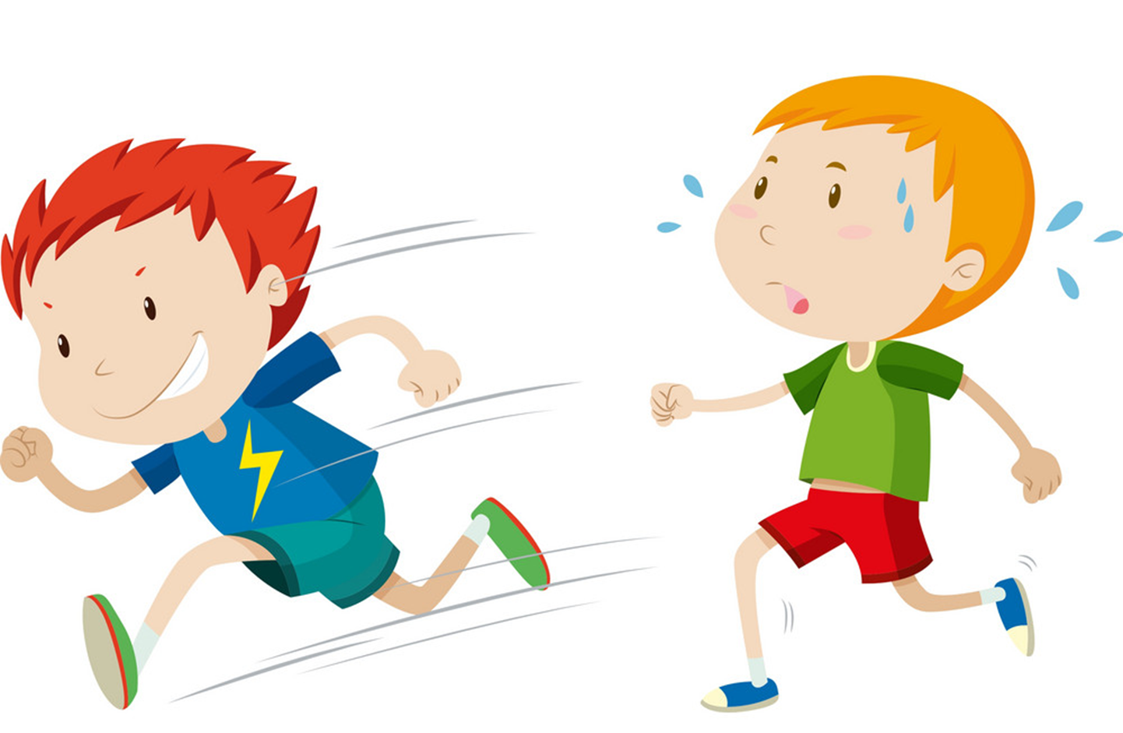
Vocabulary
fast
/fæst/

Slide 4
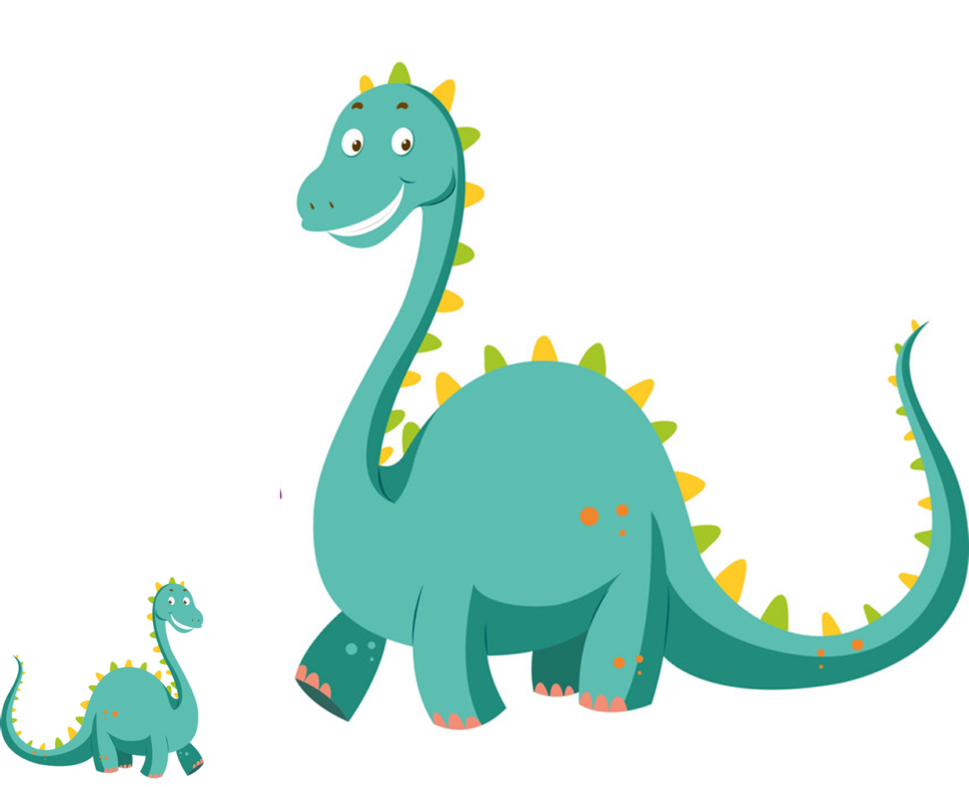
Vocabulary
big
/bɪɡ/

Slide 5
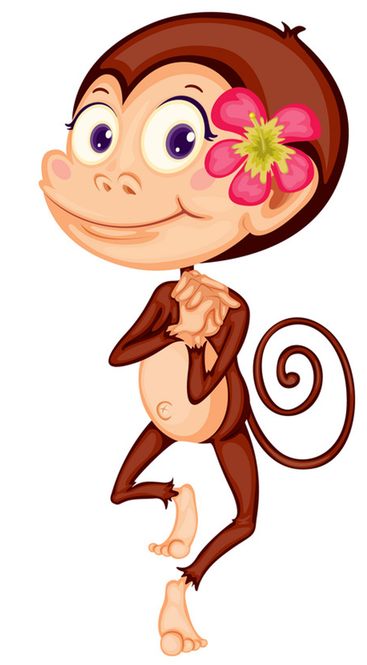
Vocabulary
beautiful
/ˈbjuːtɪfl/

Slide 6

Vocabulary
scary
/ˈskeri/

Slide 7
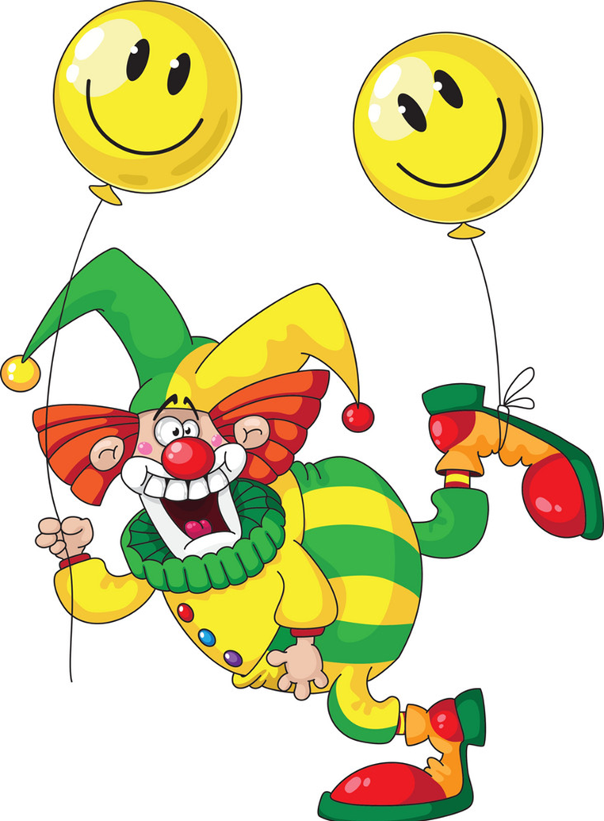
Vocabulary
funny
/ˈfʌni/

Slide 8
Vocabulary
fast
scary
big
beautiful
funny

Slide 9


small
funny
scary
beautiful
big
fast

Slide 10
small
funny
scary
beautiful
big
fast

Slide 11
small
funny
scary
beautiful
big
fast

Slide 12
small
funny
scary
beautiful
big
fast

Slide 13
small
funny
scary
beautiful
big
fast

Slide 14
See
&
you
Good
Later!
Job!

Slide 15
GRAMMAR

Slide 16
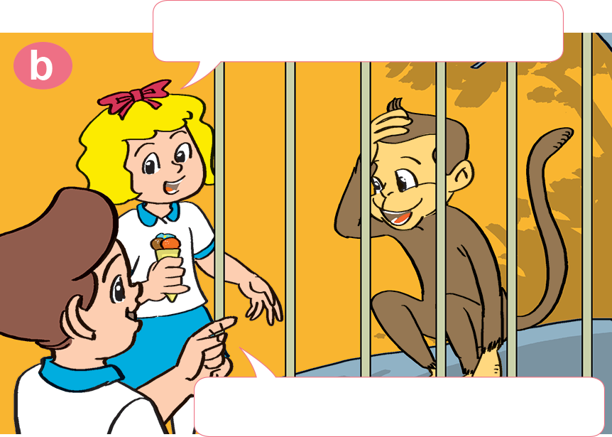
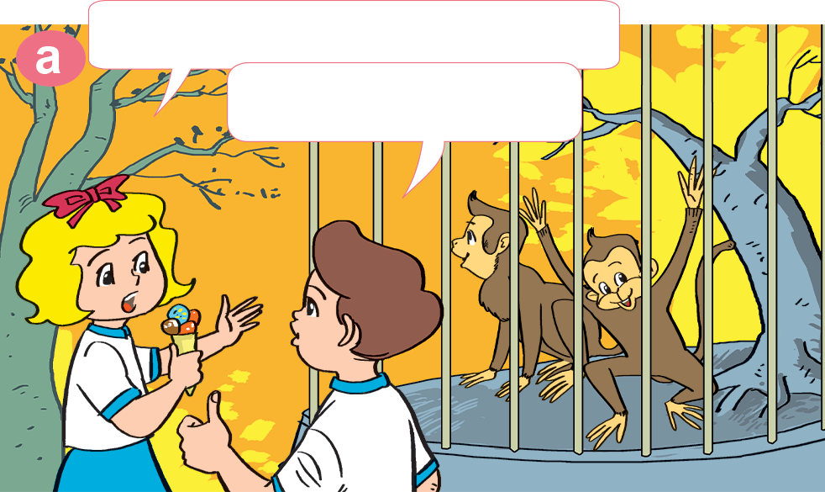

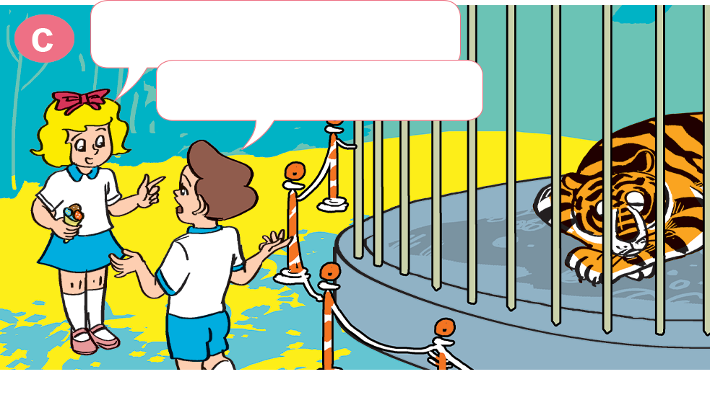
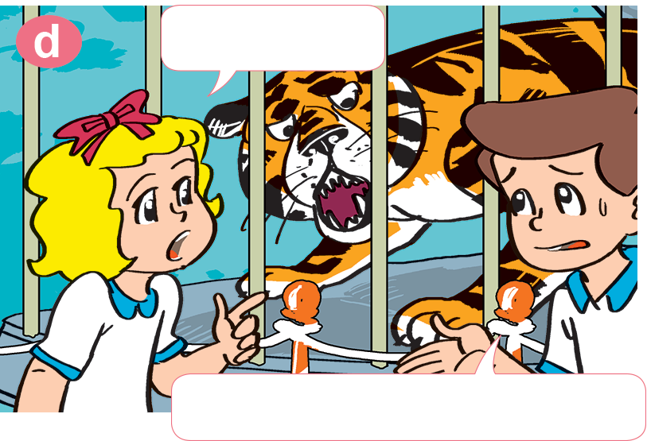
1. Look, listen and repeat.
Why do you like them?
What animal do you like?
I like monkeys.
Because they're funny.
What about tigers?
Why not?
I don't like tigers.
Because they are scary.

Slide 17
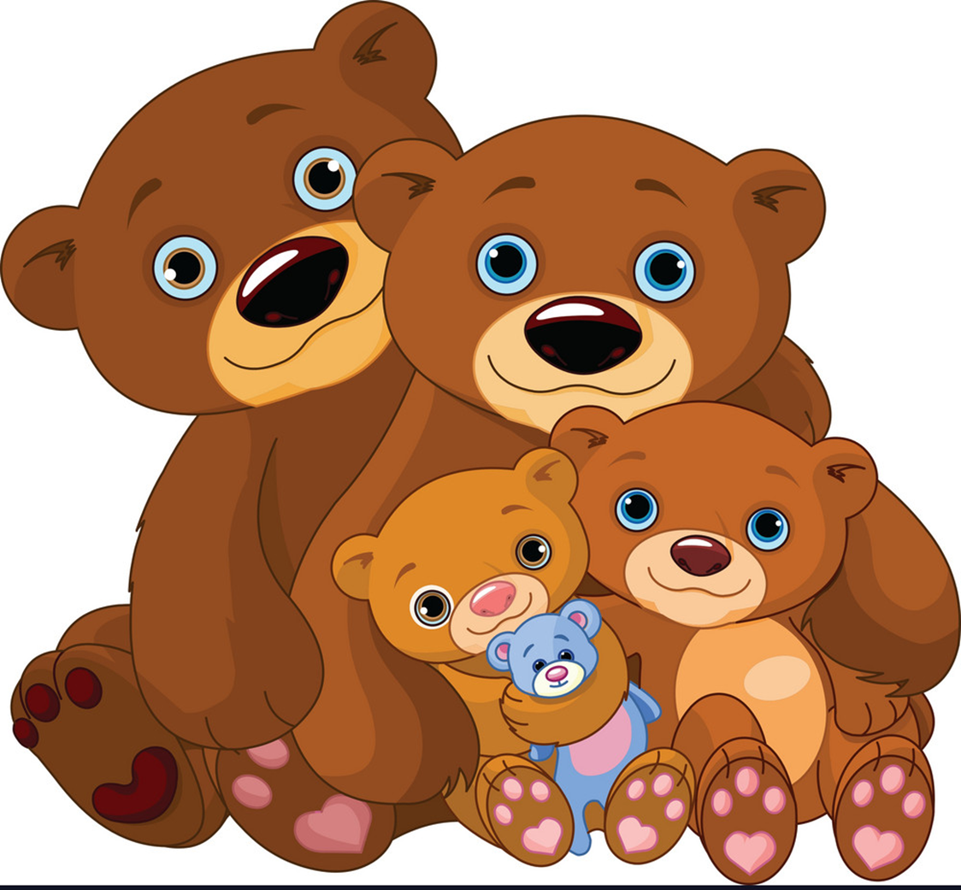
2. Point and say
bears
big
I like _______ because they're _______.

Slide 18
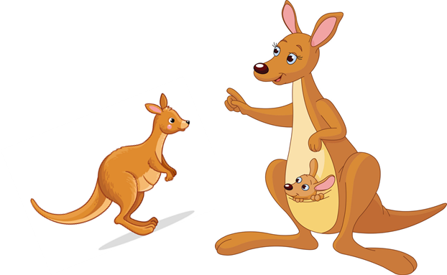
2. Point and say
kangaroos
fast
I like __________ because they're _______.

Slide 19
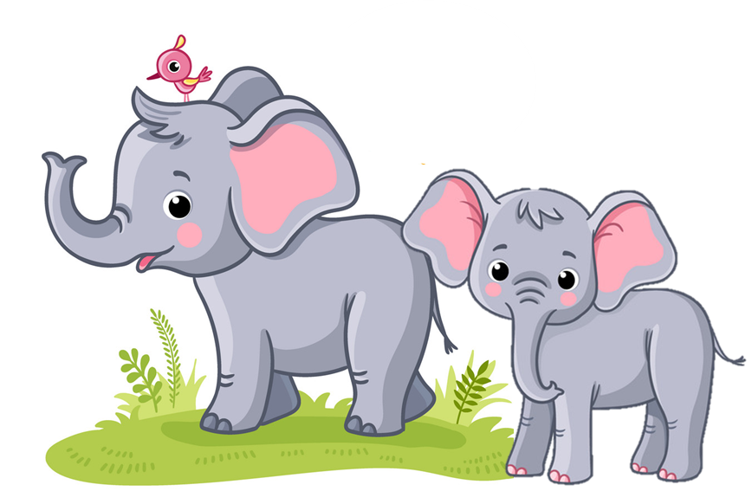
2. Point and say
elephants
big
I like _________ because they're _______.

Slide 20
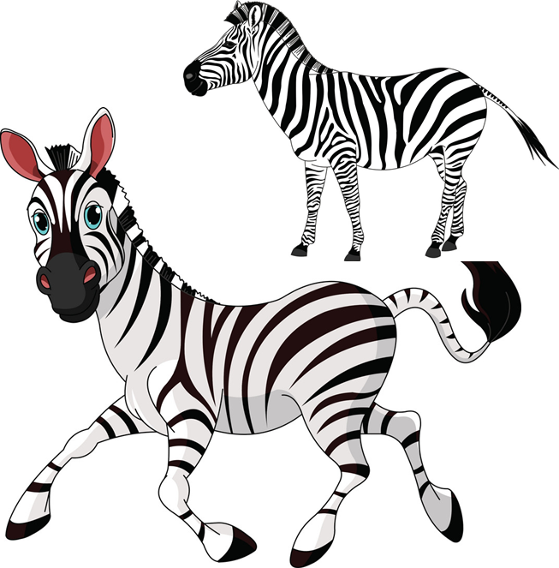
2. Point and say
zebras
fast
I like _______ because they're _______.

Slide 21


2. Point and say
crocodiles
scary
I don’t like ___________ because they're _______.

Slide 22
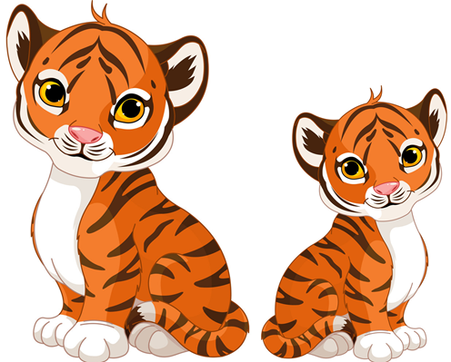
2. Point and say
tigers
scary
I don’t like _______ because they're _______.

Slide 23
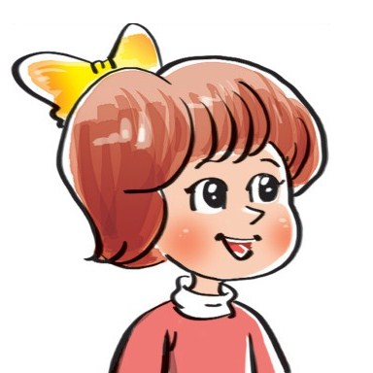

I/they don’t like / like _____ because _____.
scary
big
fast
beautiful

Slide 24
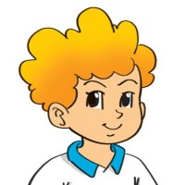



3. Let's talk.
What animal do you want to see?
I want to see ___________.
I like ___________ because .
I don't like ___________ because ___________.

Slide 25
He/she likes/doesn’t like ____ because ______.
scary
big
fast
beautiful

Slide 26

4. Listen and write.
1. Linda does not like elephants because they are _______.
2. Peter likes kangaroos because they are __________.
3. Mai likes monkeys because they are __________.
4. Nam does not like tigers because they are __________.
big
fast
funny
scary

Slide 27
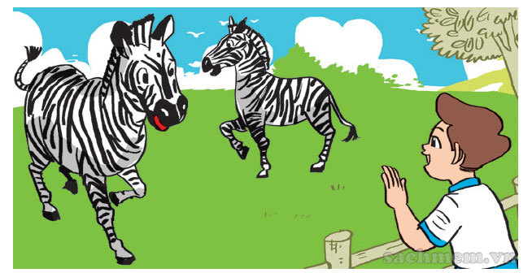
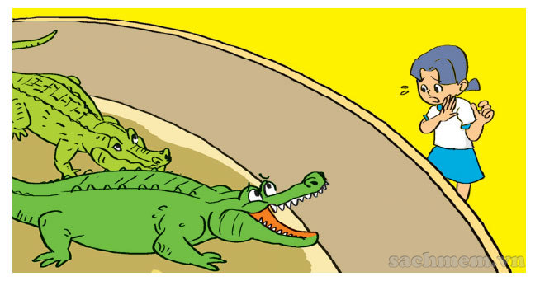
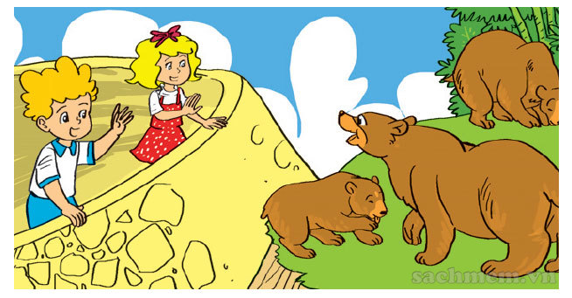
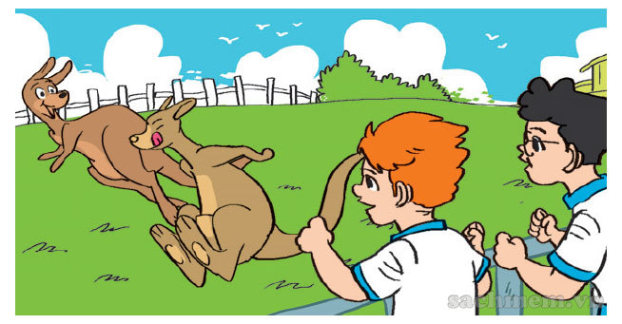
5. Look and write.
Nam likes ____________
because ______________.
Mai does not like ___________
because ______________.
zebras
zebras
they’re beautiful
they are scary
Linda and Peter like ______
because _______________.
Phong and Tony like _________
because ____________.
bears
kangaroos
they are big
they are fast

Slide 28
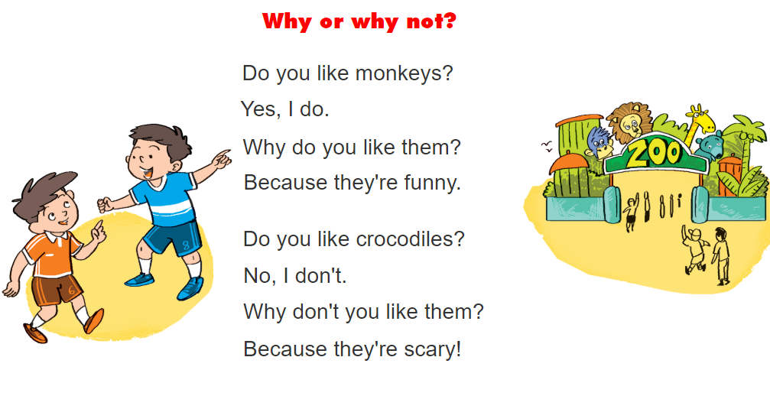

6. Let's sing.

Slide 29




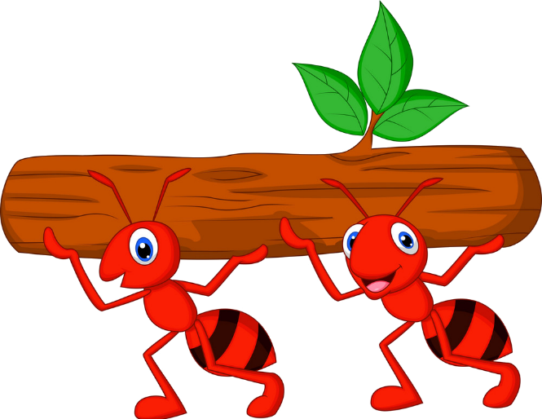



Kiến chăm chỉ
PLAY

Slide 30

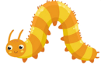





He don’t / doesn’t like tigers because they’re scary.
Doesn’t
Next
Notes:
Ms Huyền Phạm - 0936.082.789 – YOUTUBE: MsPham. Facebook: Dạy và học cùng công nghệ.

Slide 31
She don’t / doesn’t like bears because they’re big.
Doesn’t
Next
Notes:
Ms Huyền Phạm - 0936.082.789 – YOUTUBE: MsPham. Facebook: Dạy và học cùng công nghệ.

Slide 32
Linda don’t / doesn’t like crocodiles because they’re scary.
Doesn’t
Next
Notes:
Ms Huyền Phạm - 0936.082.789 – YOUTUBE: MsPham. Facebook: Dạy và học cùng công nghệ.

Slide 33
I don’t / doesn’t like zebras because they’re fast.
Don’t
Next
Notes:
Ms Huyền Phạm - 0936.082.789 – YOUTUBE: MsPham. Facebook: Dạy và học cùng công nghệ.

Slide 34
Tom and I don’t / doesn’t like monkeys because they’re fast.
Don’t
Next
Notes:
Ms Huyền Phạm - 0936.082.789 – YOUTUBE: MsPham. Facebook: Dạy và học cùng công nghệ.

Slide 35
My mother like /likes kangaroos because they’re beautiful.
likes
Next
Notes:
Ms Huyền Phạm - 0936.082.789 – YOUTUBE: MsPham. Facebook: Dạy và học cùng công nghệ.

Slide 36
I like /likes tigers because they’re stronger.
like
Next
Notes:
Ms Huyền Phạm - 0936.082.789 – YOUTUBE: MsPham. Facebook: Dạy và học cùng công nghệ.

Slide 37
They like /likes elephants because they’re cute.
like
Next
Notes:
Ms Huyền Phạm - 0936.082.789 – YOUTUBE: MsPham. Facebook: Dạy và học cùng công nghệ.

Slide 38
I like kangaroos ______ they’re beautiful.
because
Next
Notes:
Ms Huyền Phạm - 0936.082.789 – YOUTUBE: MsPham. Facebook: Dạy và học cùng công nghệ.

Slide 39
She doesn’t _____ crocodile because they’re big and scary.
like
Next
Notes:
Ms Huyền Phạm - 0936.082.789 – YOUTUBE: MsPham. Facebook: Dạy và học cùng công nghệ.

Slide 40
WELL DONE!
EXIT
Notes:
Ms Huyền Phạm - 0936.082.789 – YOUTUBE: MsPham. Facebook: Dạy và học cùng công nghệ.

Slide 41



THANK YOU!
Welcome to join with me!
MsPham Powerpoint
Mspham

