Slide 1
Unit 1
Hello
Lesson 3
Teacher: Ms.

Slide 2
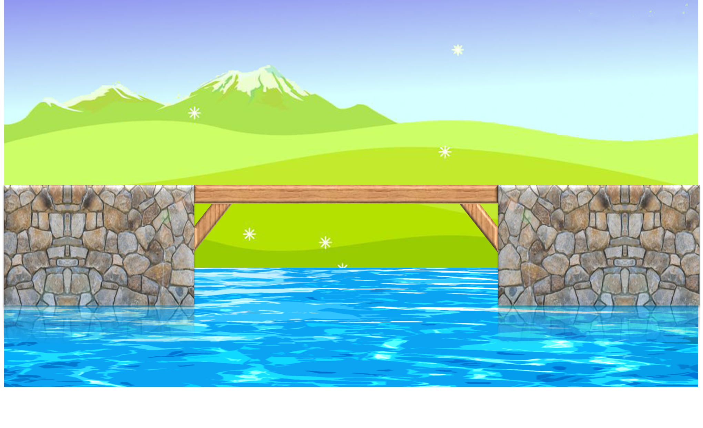
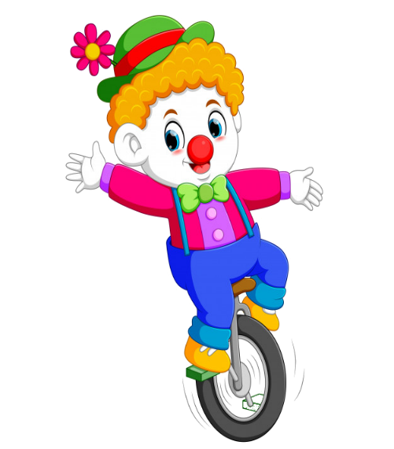



PLAY

Slide 3



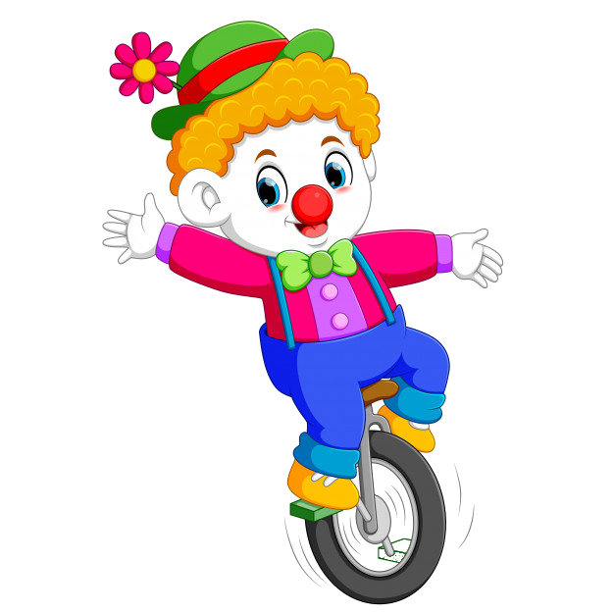
Goodbye, class.
Goodbye, class.
Hello, teacher.
Hello, class.
Goodbye, teacher.

Slide 4
How are you?
I’m fine. Thank you.
Hello. I’m Lan.
Nice to meet you.
Thanks.

Slide 5
Bye, Quan.
Thanks, Mai.
Bye, Mai.
How are you Mai?
Hello, Mai.

Slide 6
: tìm
Hello, I'm Mai.
Bye, Mai.
This is Quan.
Hello, Mai. I’m Quan.
Hello Quan.

Slide 7
I’m fine. Thanks.
How old are you?
How you are?
How are you?
How am I?

Slide 8
Hello. I’m ____ Hien.
My
Miss
Mis
fine

Slide 9
______. See you later.
Nice to see you
Hello
Thanks
Goodbye

Slide 10
Meet – to – nice - you
Nice to meet you
Meet you to nice
To nice meet you
Nice you meet to

Slide 11


EXIT

Slide 12

1. Look, listen and repeat
b | bye | Bye, Nam.
h | hello | Hello, Nam.

Slide 13
2. Listen and write.
1. _______, Nam.
2. _______, Mai.
Bye
Hello

Slide 14
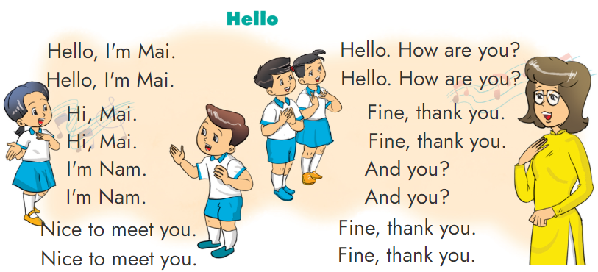
3. Let’s chant.

Slide 15
4. Read and match
a
Hello, Nam. I’m Mai.
c
I’m fine. Thanks.
b
d
Hello, MissHien.
Nice to meet you.
Bye, Nam
1
d
Hello, MissHien.
Nice to meet you.
Hello. I'm Miss Hien.
2
Hi. I'm Nam.
a
Hello, Nam. I’m Mai.
3
Bye, Mai.
b
Bye, Nam
4
How are you?
c
I’m fine. Thanks.

Slide 16
5. Read and write
1. ____________. I'm Mai.
2. Hi, Mai. _______ Nam.
3. _______ to meet you, Miss Hien.
4. _______ are you?
5. _____________, thanks.
/ Hi
Hello
I’m
Nice
How
Fine
/ I’m fine

Slide 17
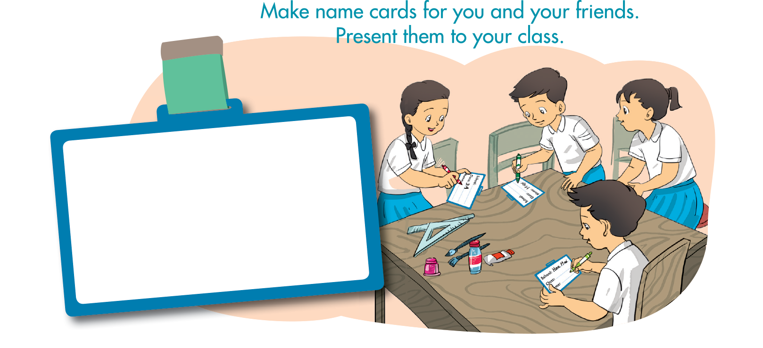
6. Project.
School: __________
Class: ___________
Name: ___________

Slide 18

THANK YOU!
Welcome to join with me!

