Slide 1
Unit 8
What subjects do you
have today?
Lesson 2

Slide 2
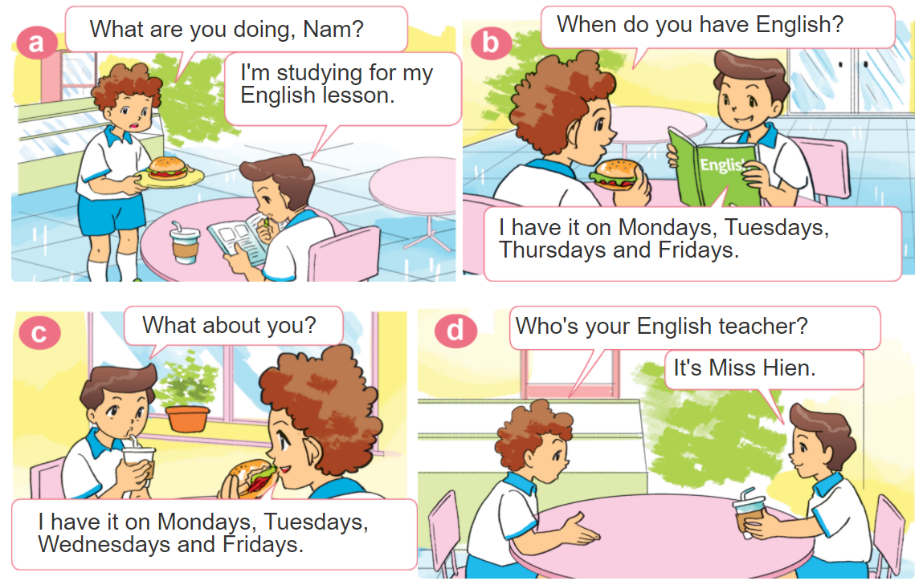

1. Look, listen and repeat.

Slide 3
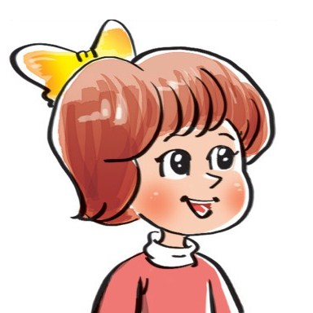
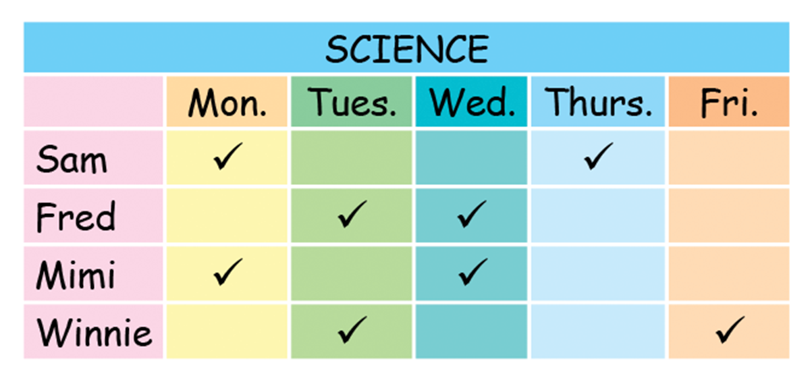
2. Point and say
When do you have Science, ___.
I have it on ___________.

Slide 4


Structures:
Hỏi và trả lời hôm nay bạn có những môn gì:
When do you have ____________?
I have it on _______.
+ môn học
+ thứ
(Khi nào bạn có
môn ________?)
(Tớ có vào thứ ______.)
Hỏi và trả lời ai dạy bạn môn học nào đó:
Who is your _________ teacher?
It’s Mr./Miss
__________.
+ môn học
+ tên giáo viên
(Ai là giáo viên môn ____?)
(Đó là thầy/cô ____)

Slide 5
3. Let’s talk
What subjects do you
have today?
I have _________.
When do you have ________?
I have it on _____.
Who is your ______ teacher?
It’s ________.

Slide 6












Ms Huyền Phạm
0936.082.789
Ms Huyền Phạm
0936.082.789
Ms Huyền Phạm
0936.082.789
Ms Huyền Phạm - 0936.082.789 – YOUTUBE: MsPham. Facebook: Dạy và học cùng công nghệ.
Ms Huyền Phạm
0936.082.789
Notes:
Ms Huyền Phạm - 0936.082.789 – YOUTUBE: MsPham. Facebook: Dạy và học cùng công nghệ.

Slide 7

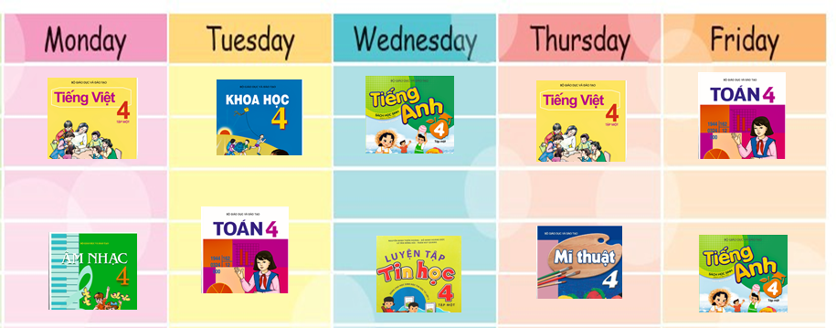





When do you have
Vietnamese?
Next
I have it on Monday and Thursday.
I have it on Monday and Thursdays.
I have it on Mondays and Thursday.
I have it on Mondays and Thursdays.
Notes:
Ms Huyền Phạm - 0936.082.789 – YOUTUBE: MsPham. Facebook: Dạy và học cùng công nghệ.

Slide 8
When do you have Music?
Next
I have it on Thursdays.
I have it on Tuesdays.
I have it on Mondays.
I have it on Wednesday.
Notes:
Ms Huyền Phạm - 0936.082.789 – YOUTUBE: MsPham. Facebook: Dạy và học cùng công nghệ.

Slide 9
When do you have Sciences?
Next
I have it on Tuesdays.
I have it on Thursdays.
I have it on Fridays.
I have it on Mondays and Fridays.
Notes:
Ms Huyền Phạm - 0936.082.789 – YOUTUBE: MsPham. Facebook: Dạy và học cùng công nghệ.

Slide 10
When do you have ____________?
Next
I have it on Tuesdays.
I have it on Wednesdays.
I have it on Fridays.
I have it on Thursdays.
Notes:
Ms Huyền Phạm - 0936.082.789 – YOUTUBE: MsPham. Facebook: Dạy và học cùng công nghệ.

Slide 11
When do you have Maths?
Next
I have it Tuesdays and Fridays.
I have it on Mondays and Fridays.
I have it on Mondays and Thursdays.
I have it on Tuesdays and Fridays.
Notes:
Ms Huyền Phạm - 0936.082.789 – YOUTUBE: MsPham. Facebook: Dạy và học cùng công nghệ.

Slide 12
Who is your English teacher?
Next
It’s on Mondays.
It’s Miss Hien.
I have it on Mondays.
It’s Mondays.
Notes:
Ms Huyền Phạm - 0936.082.789 – YOUTUBE: MsPham. Facebook: Dạy và học cùng công nghệ.

Slide 13
Who is your Sciences _____?
Next
today
subject
teacher
have
Notes:
Ms Huyền Phạm - 0936.082.789 – YOUTUBE: MsPham. Facebook: Dạy và học cùng công nghệ.

Slide 14
Next
____ is your Maths teacher?
Who
what
when
What sujects
Notes:
Ms Huyền Phạm - 0936.082.789 – YOUTUBE: MsPham. Facebook: Dạy và học cùng công nghệ.

Slide 15
Who is your ______ teacher?
Next
have
Vietnam
England
Art
Notes:
Ms Huyền Phạm - 0936.082.789 – YOUTUBE: MsPham. Facebook: Dạy và học cùng công nghệ.

Slide 16
Who is your ______ teacher?
Next
She’s
She
He’s
He
Notes:
Ms Huyền Phạm - 0936.082.789 – YOUTUBE: MsPham. Facebook: Dạy và học cùng công nghệ.

Slide 17
_______ IT?
I have it on Wednesday.
Next
When do you have
What do you have
Who do you have
How do you have
Notes:
Ms Huyền Phạm - 0936.082.789 – YOUTUBE: MsPham. Facebook: Dạy và học cùng công nghệ.

Slide 18
When do you have English?
_______ Wednesdays and Fridays.
Next
I have it
I have it on
I have on
It’s
Notes:
Ms Huyền Phạm - 0936.082.789 – YOUTUBE: MsPham. Facebook: Dạy và học cùng công nghệ.

Slide 19








Notes:
Ms Huyền Phạm - 0936.082.789 – YOUTUBE: MsPham. Facebook: Dạy và học cùng công nghệ.

Slide 20
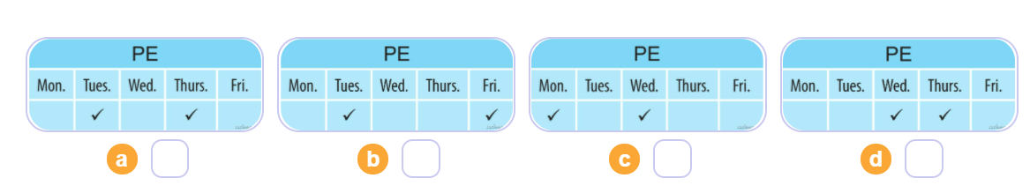

4. Listen and number
1
2
3
4
3
4
1
2

Slide 21
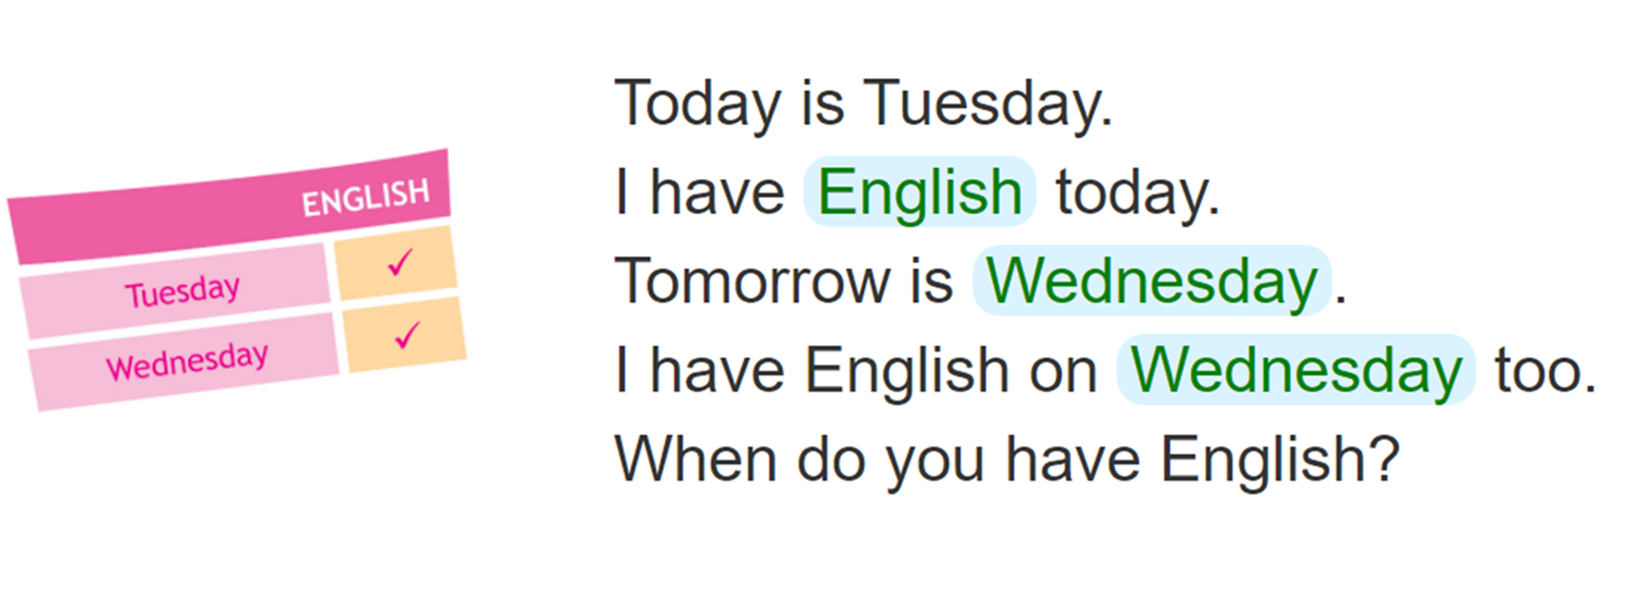
5. Look and write
____________
_________________
_________________

Slide 22

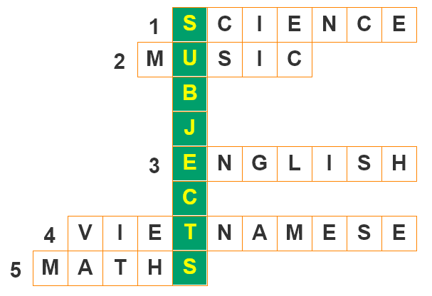


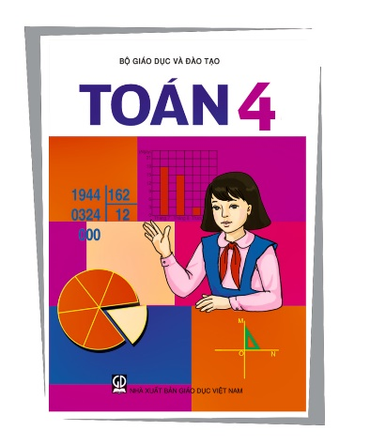

6. Let’s play
Write the names of the subjects.

