Slide 1
Unit 6
Where’s
your school?
Lesson 1

Slide 2
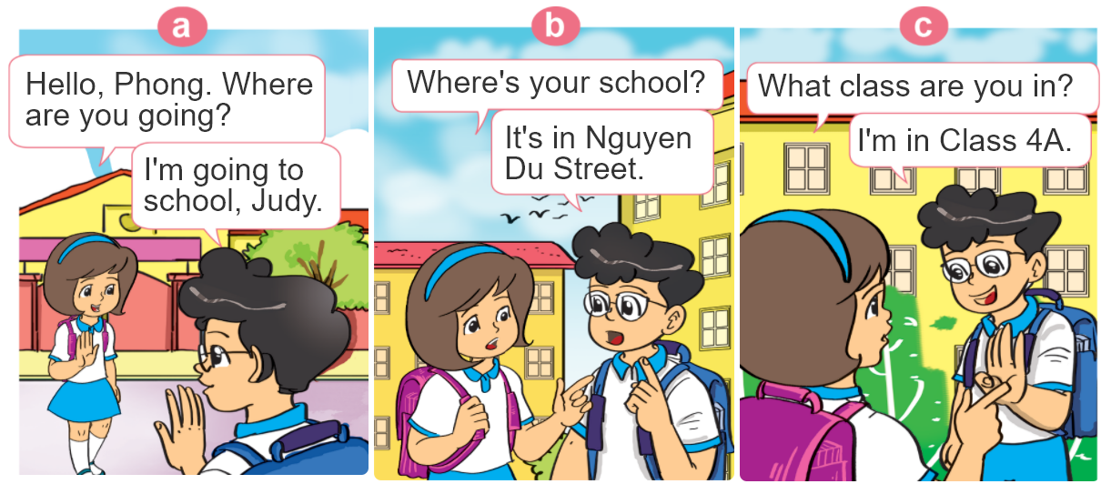

1. Look, listen and repeat.

Slide 3


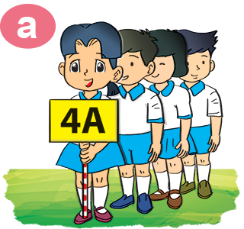

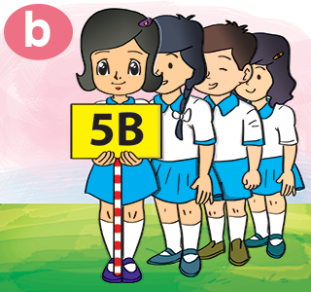
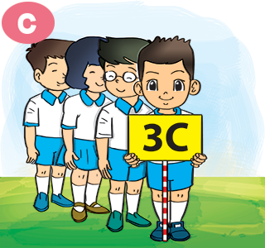
2. Point and say
What class is she/he in?
She/He’s in Class ____.

Slide 4

B. Structures:
Hỏi và trả lời TÊN LỚP của bạn là gì:
What class are you in?
I’m in Class _______.
+Tên lớp
(Bạn học lớp nào?)
(Tớ học lớp ______.)
Hỏi và trả lời TÊN LỚP của cô ấy anh ấy là gì:
What class is she/he in?
(Cô ấy/anh ấy học lớp nào?)
She/He’s in Class ______.
+Tên lớp
(Cô ấy/anh ấy học lớp ______.)

Slide 5
3. Let’s talk
____ Primary School.
What's the name of your school?
It’s in ________.
Where is it?
What class are you in?
I am in Class ____.

Slide 6








Slide 7




He’s in Class 5B.
I’m in Class 5B.
What class are you in?
She’s in Class 5B.

Slide 8
He’s in Class 4D.
I’m e’s in Class 4D.
What class is he in?
She’s in Class 4D.

Slide 9
She’s in Class 2E.
He’s in Class 2E.
What class is she in?
I’m in Class 2E.

Slide 10
He’s in Class 3A.
I’m in Class 3A.
What class are you in?
She’s in Class 3A.

Slide 11
He’s in Class 1C.
She’s in Class 1C.
What class are you in?
I’m in Class 1C.

Slide 12
I’m in Class 4A.
She’s in Class 4A.
What class is he in?
He’s in Class 4A.

Slide 13
I’m in Class 5A.
He’s in Class 5A.
What class is she in?
She’s in Class 5A.

Slide 14
He’s in Class 3B.
She’s in Class 3B.
What class is he in?
I’m in Class 3B.

Slide 15
I’m in Class 2H.
She’s in Class 2H.
What class are you in?
He’s in Class 2H.

Slide 16
Time’s up!

Slide 17
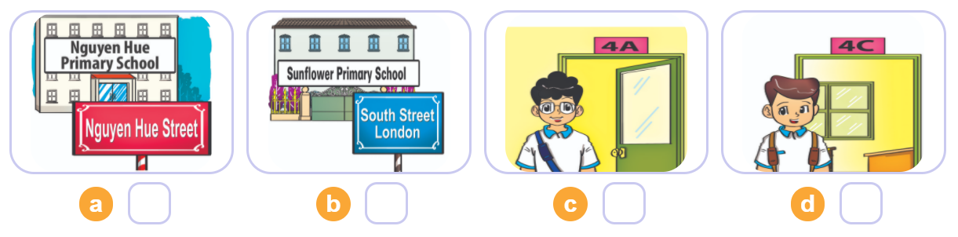

4. Listen and number
3
1
4
2
1
2
3
4

Slide 18
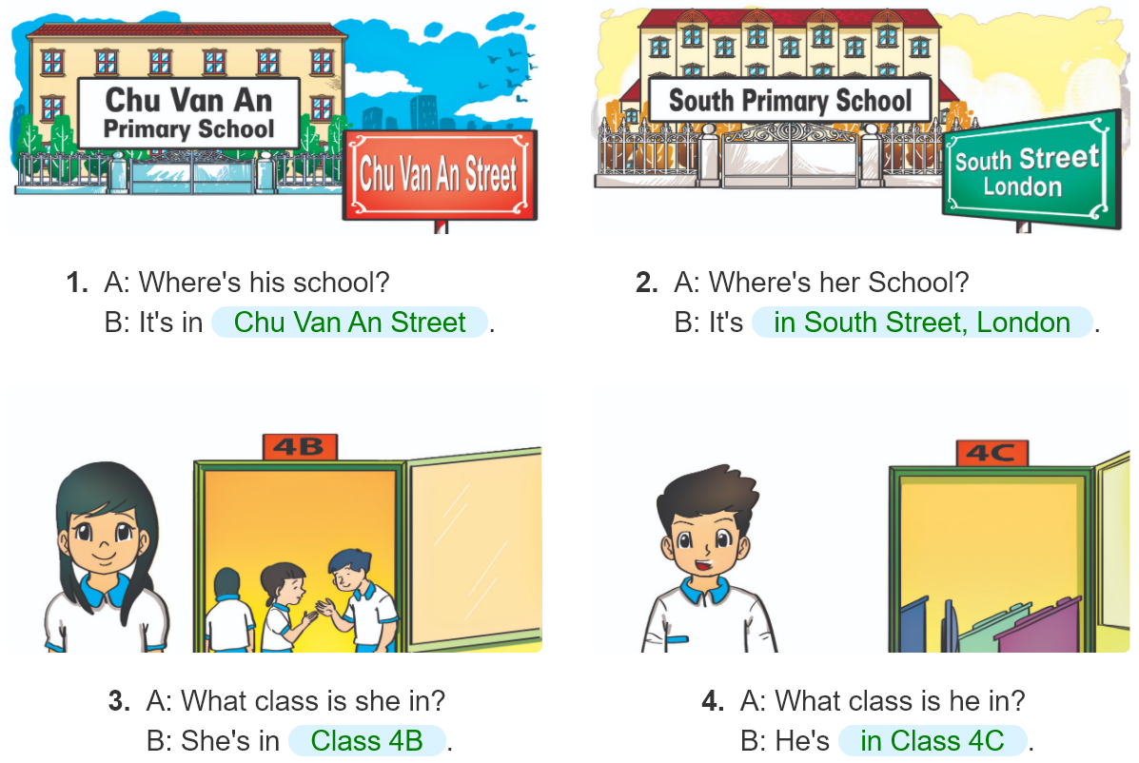
5. Look and write.
_______________
_______________
________.
________.

Slide 19
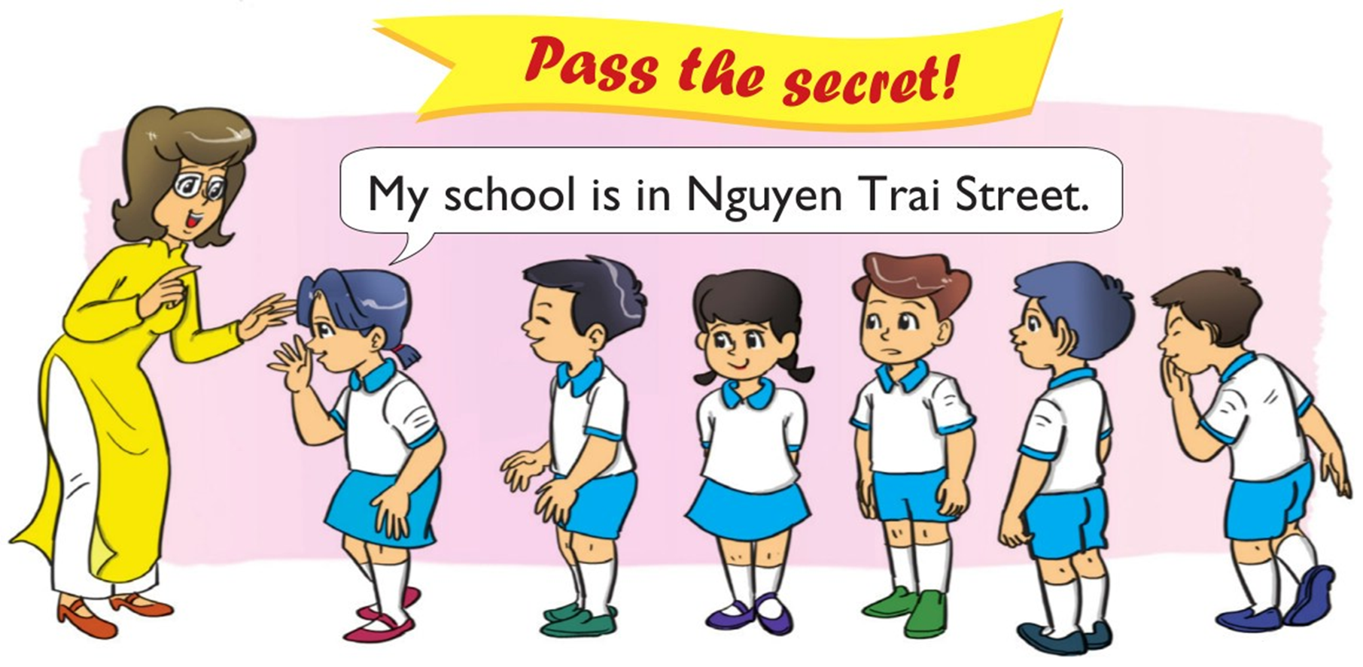
6. Let’s play

