Slide 1
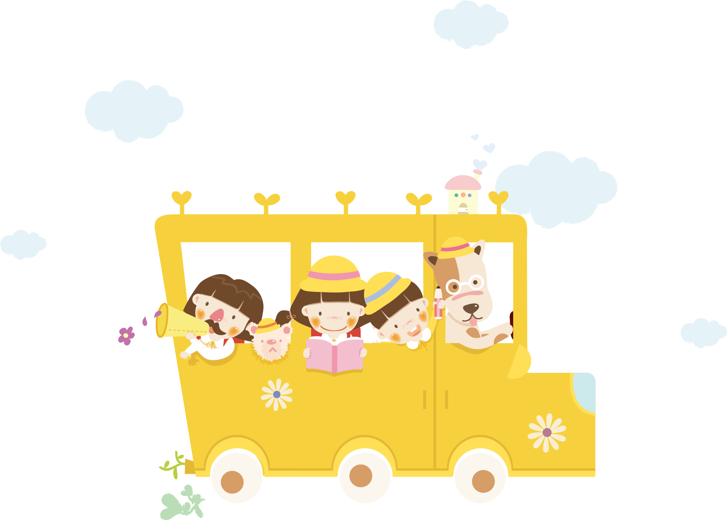
UNIT 5. ARE THEY YOUR FRIENDS?
LESSON 1

Slide 2
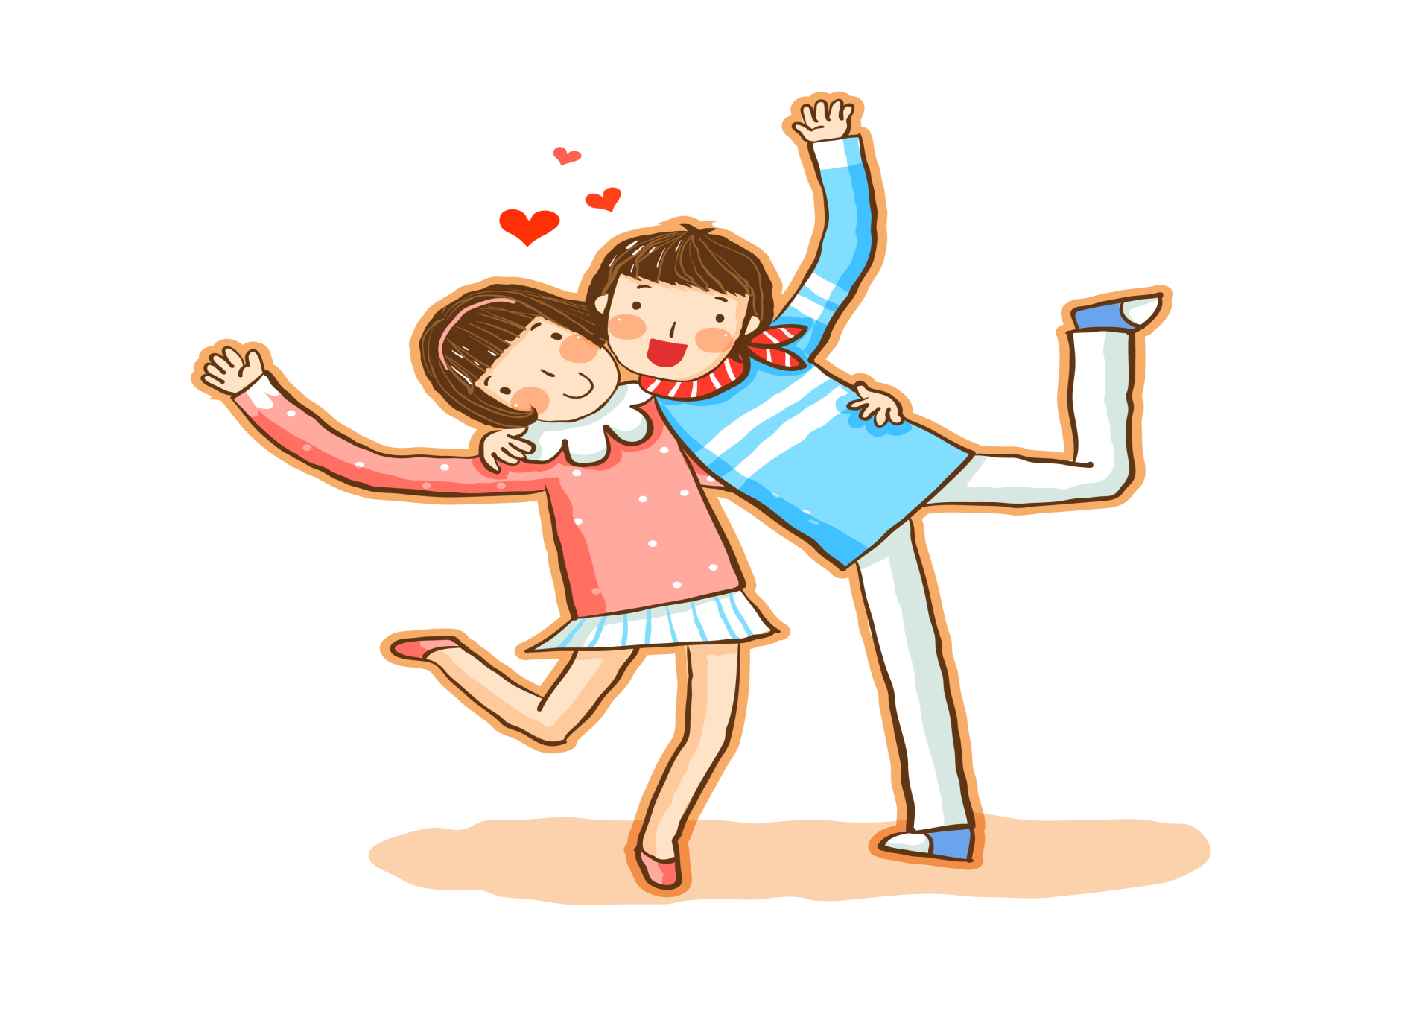
friend

Slide 3
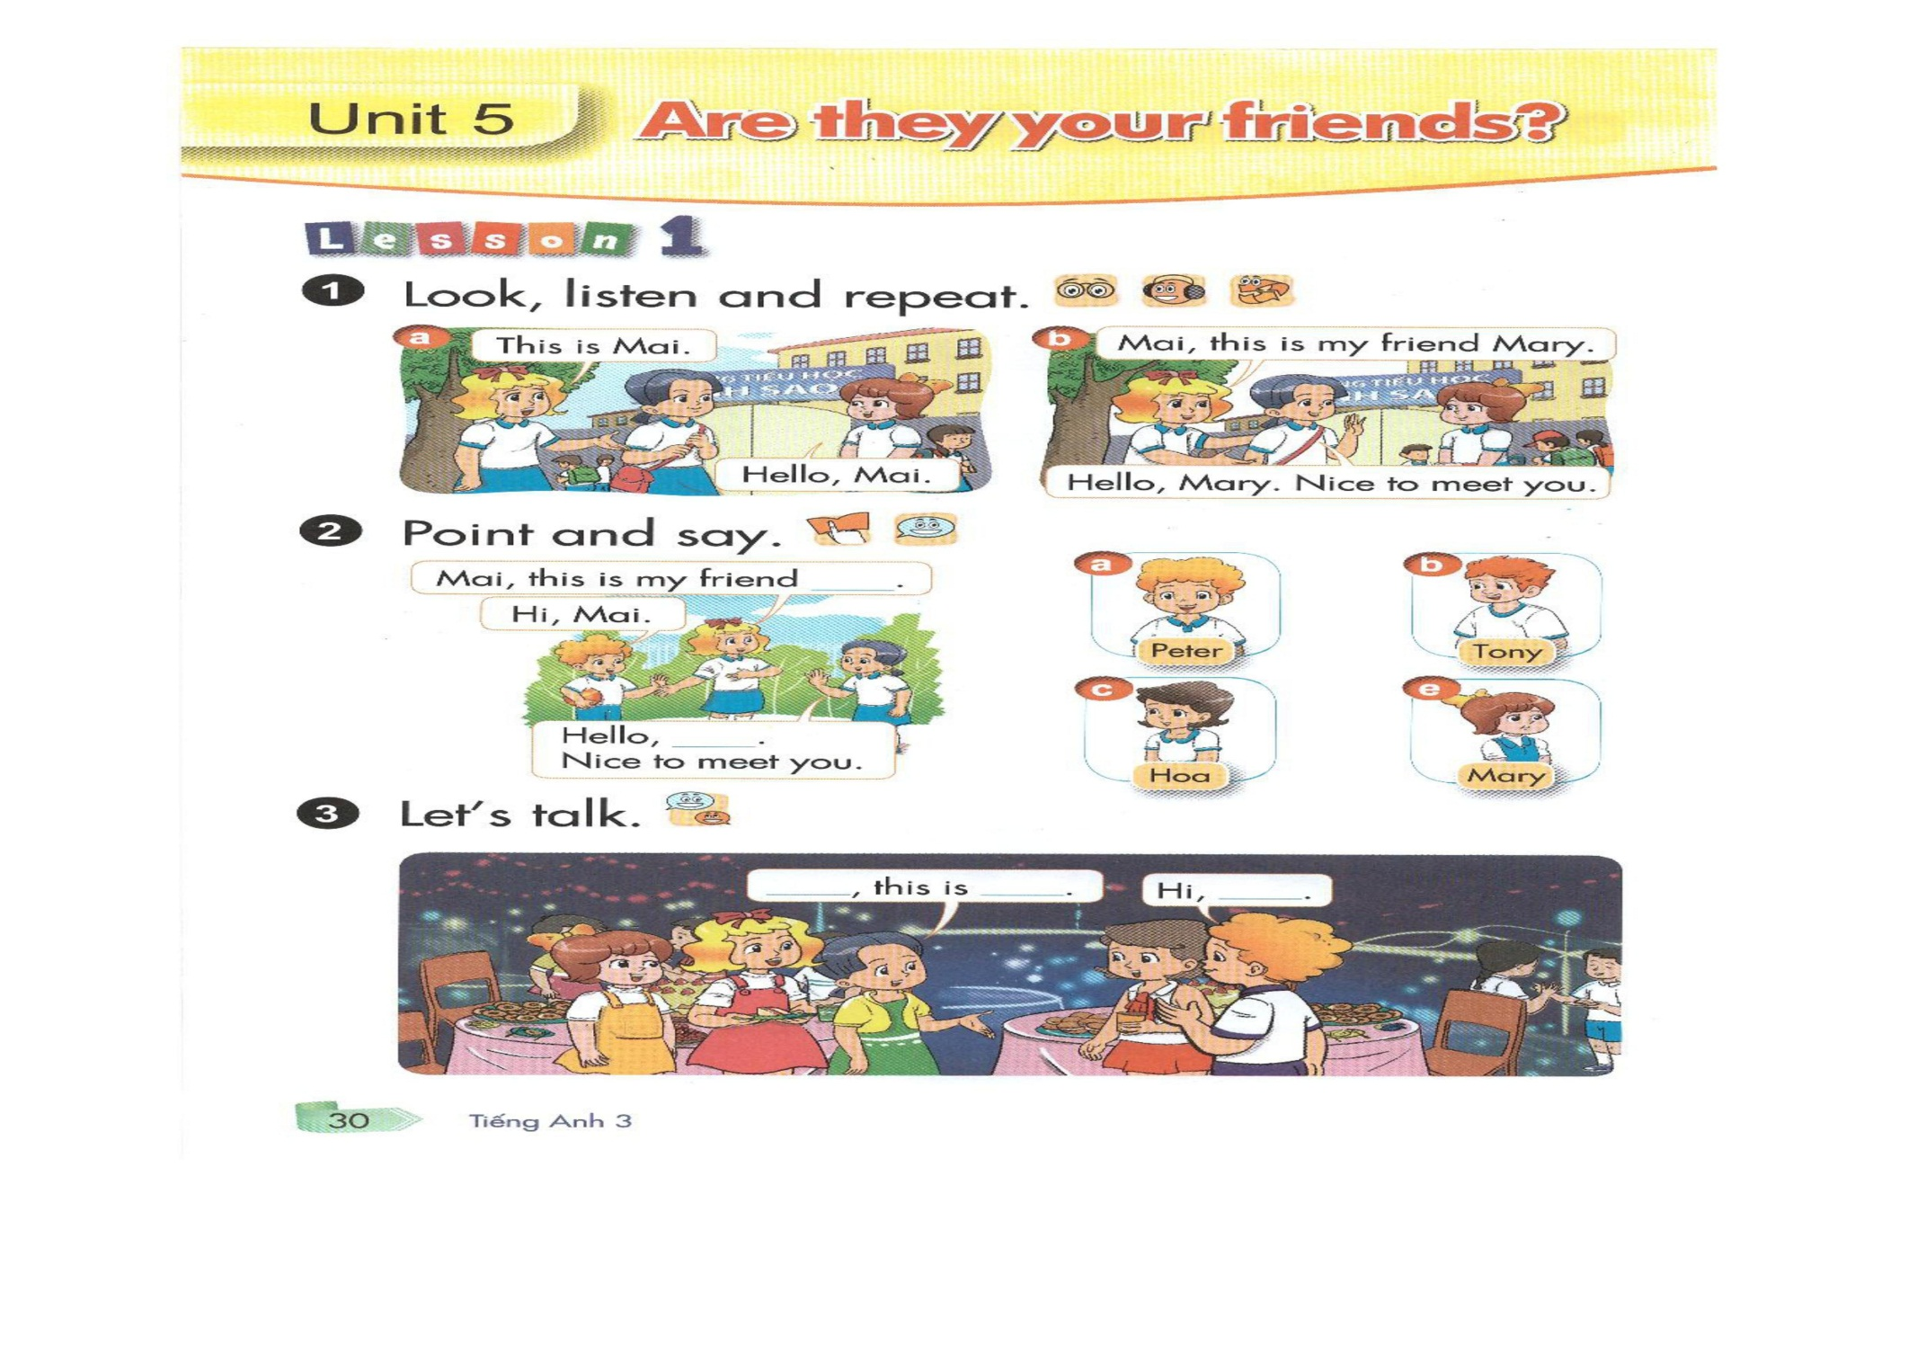


Slide 4


Slide 5
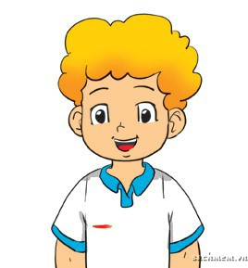
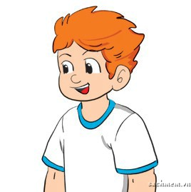
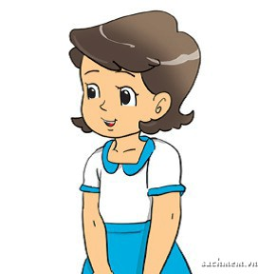
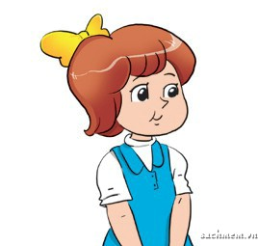
HOA
HOA
TONY
peter
peter
MARY
MARY
TONY

Slide 6
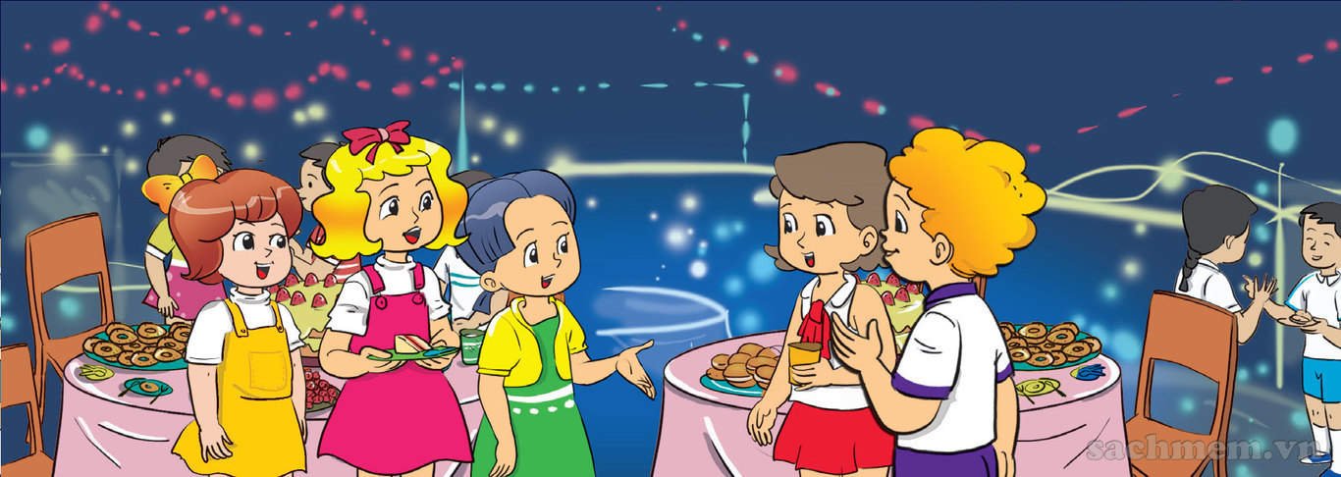


Mary
Peter
Peter
Hoa
Hoa
1
2
3
4
5
Mary
Hello
Nice to meet you.
Linda
This is my friend
Linda
Mai
Mai

Slide 7
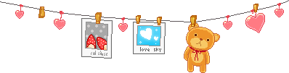
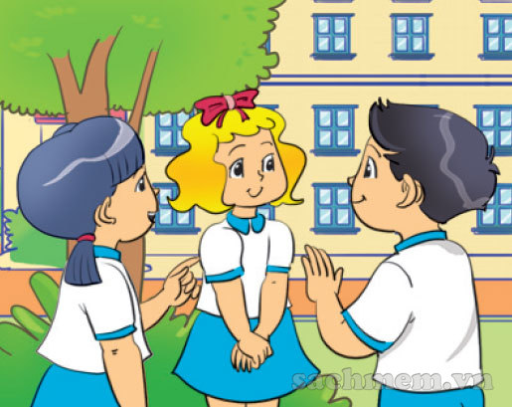
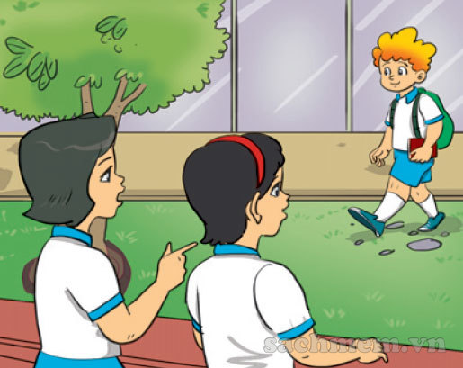


1

Slide 8
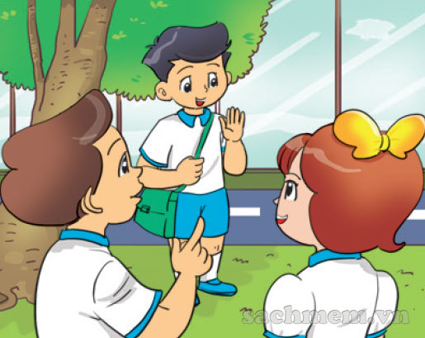
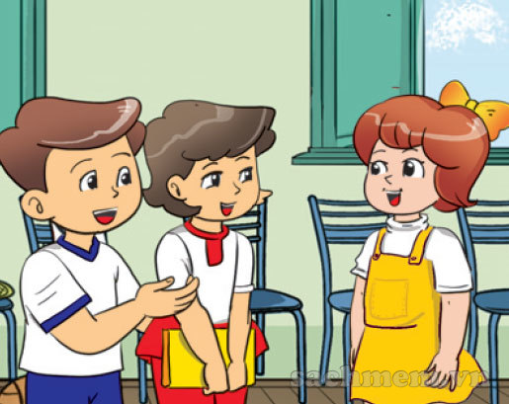
2
By Jessica

Slide 9
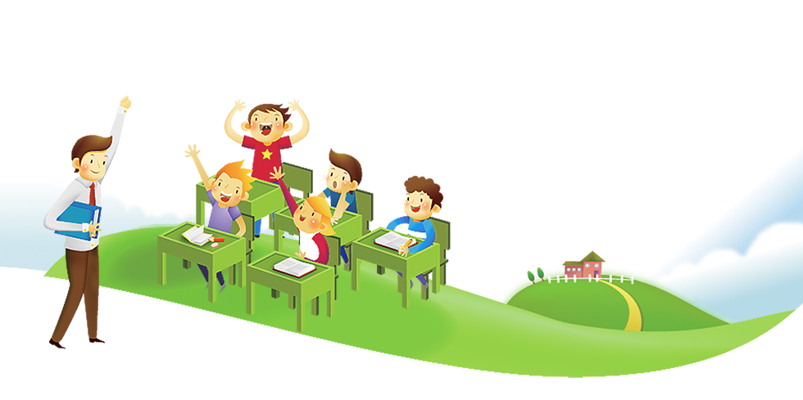
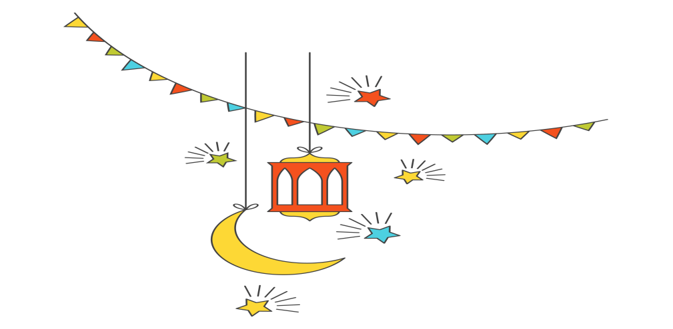
UNIT 5. Are they your friends?
Lesson 2

Slide 10

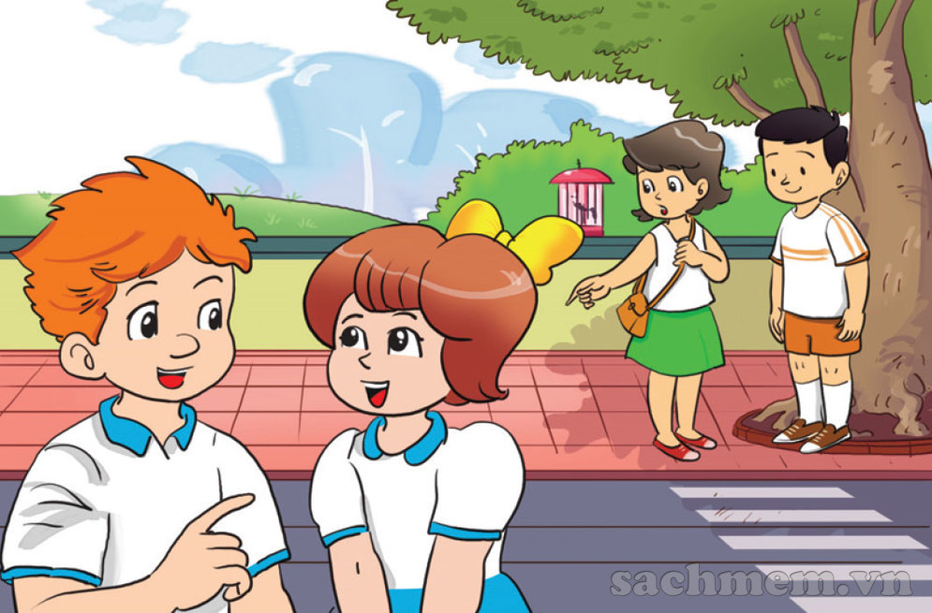

Slide 11
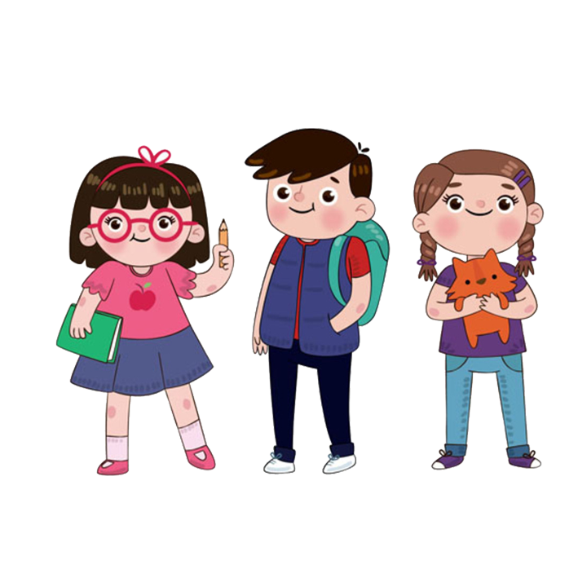

I
THEY

Slide 12
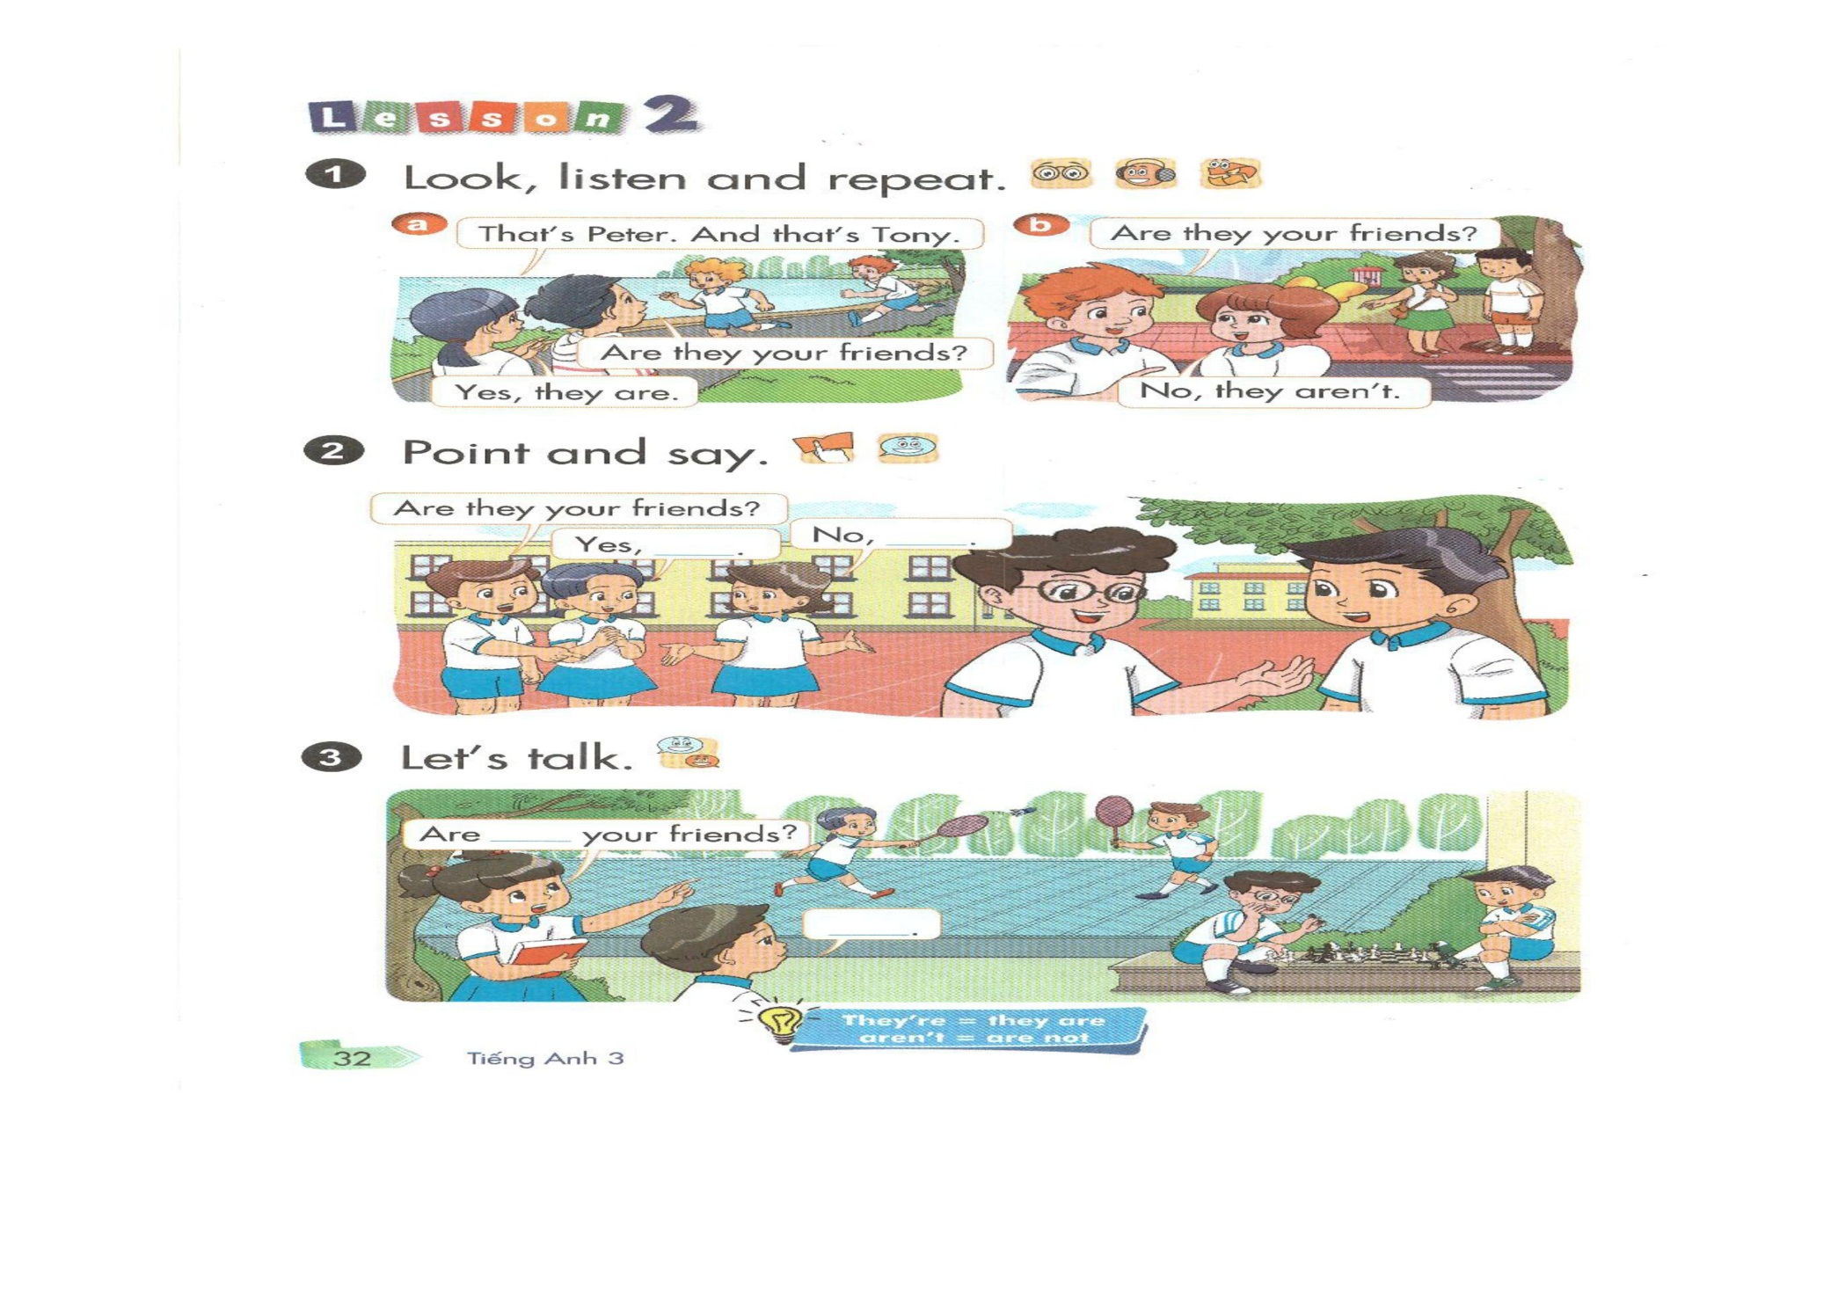


Slide 13
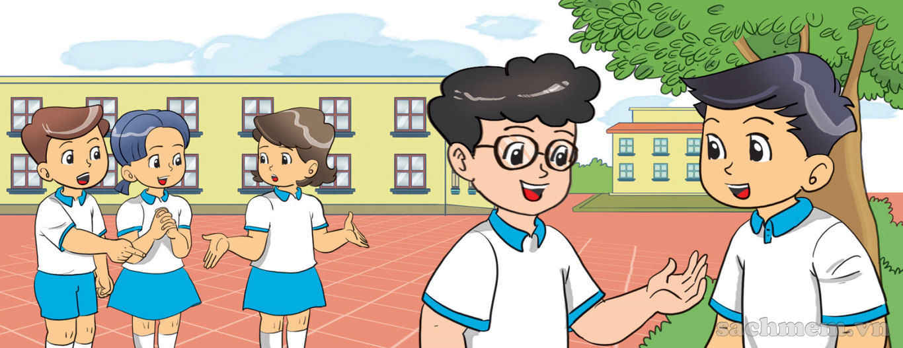
Are they your friends?
Yes, they are
No, they aren’t

Slide 14
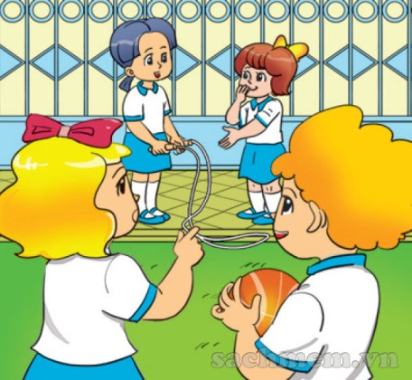
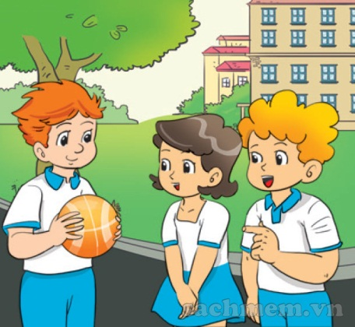
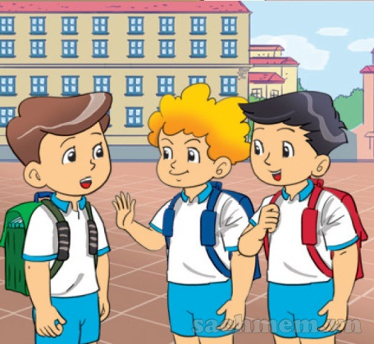
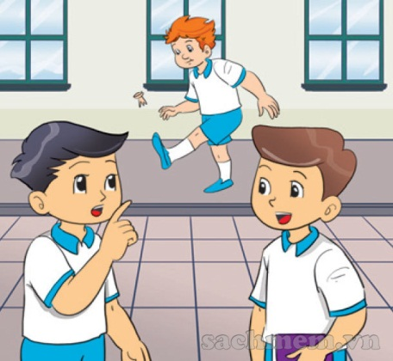

LISTEN & number
2
3
1
2
4
1
3
4

Slide 15
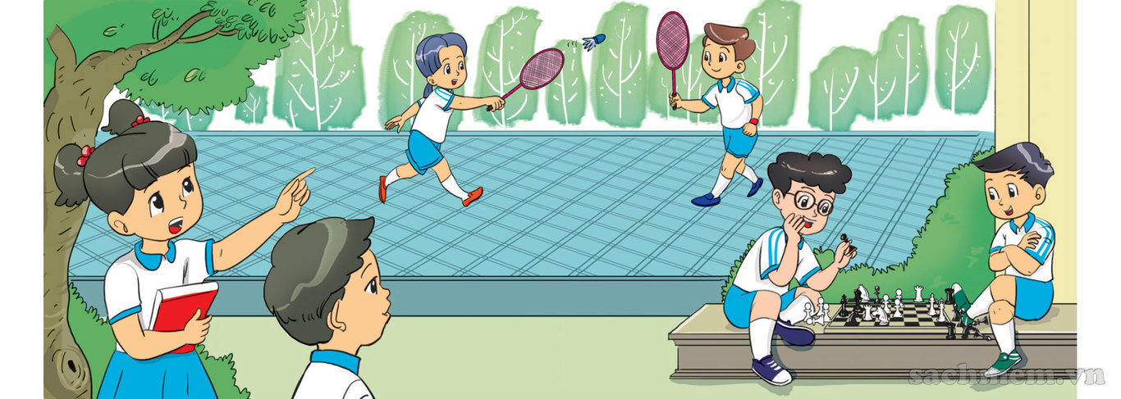
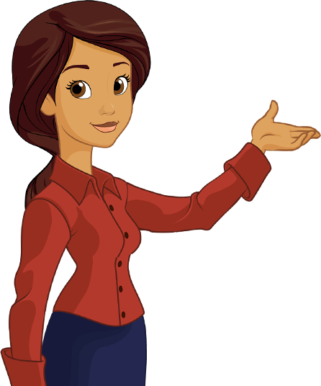
Gợi ý: có thể dùng ảnh thật chụp học sinh trong trường lớp,và học sinh ở những nơi khác. Với những tấm ảnh có học sinh ở trường lớp, học sinh thấy quen sẽ trả lời Yes, they are. Ngược lại,với những tấm hình không quen sẽ trả lời với No, they aren’t

Slide 16
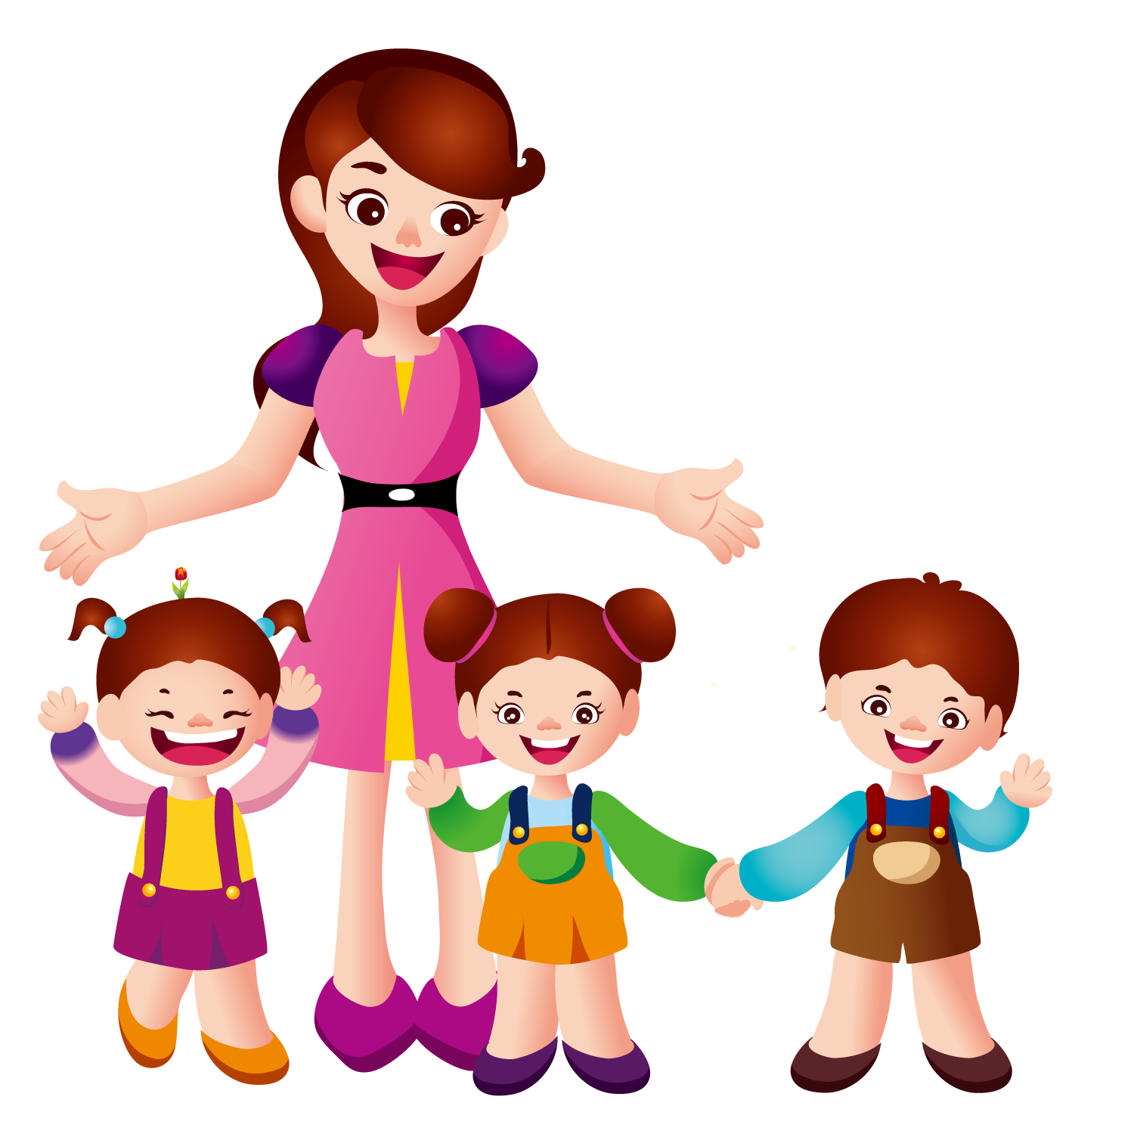
UNIT 5. ARE THEY YOUR FRIENDS?
LESSON 3

Slide 17
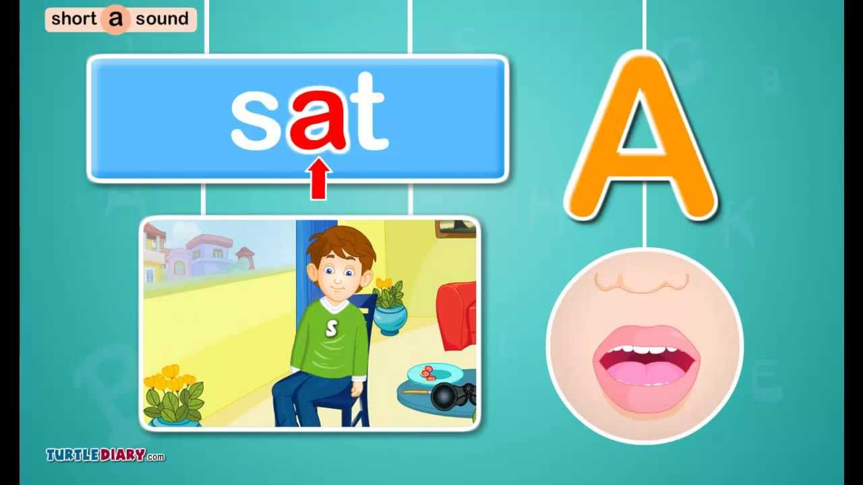
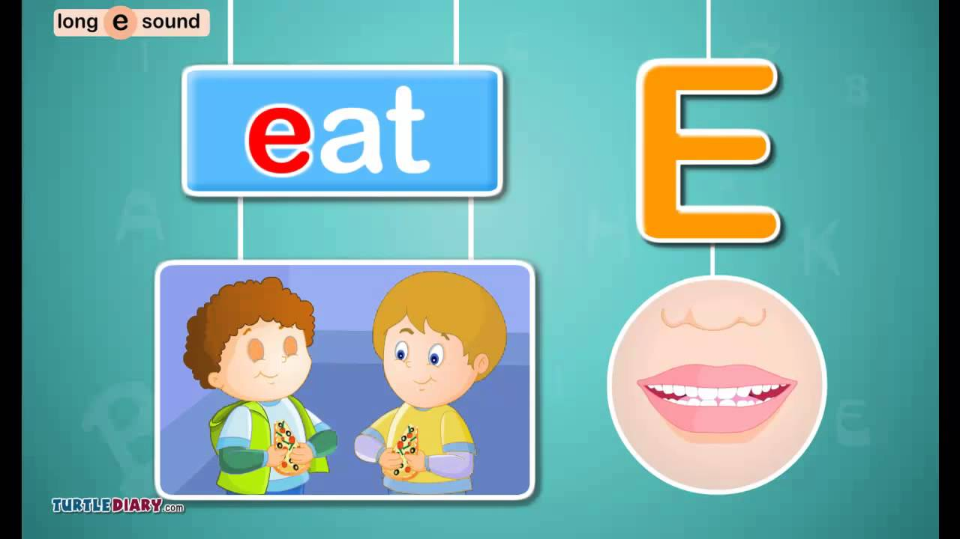

By Jessica

Slide 18
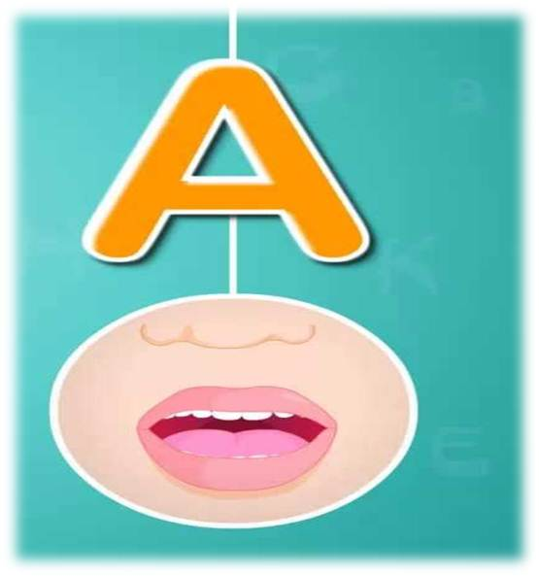
that
Who’s is that?
By Jessica

Slide 19
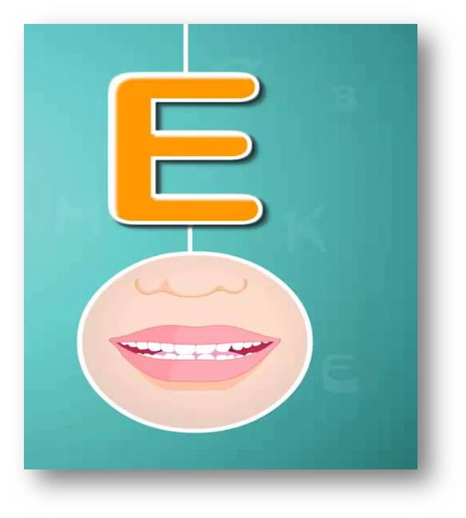
yes
Yes, it is

Slide 20


1. Vocabulary 3. Phonics
- They A / E
- friend/friends
2. Model sentences
- This is my friend, Peter
Hello, Peter . Nice to meet you.
- Are they your friends?
Yes, they are or No, They aren’t

Slide 21
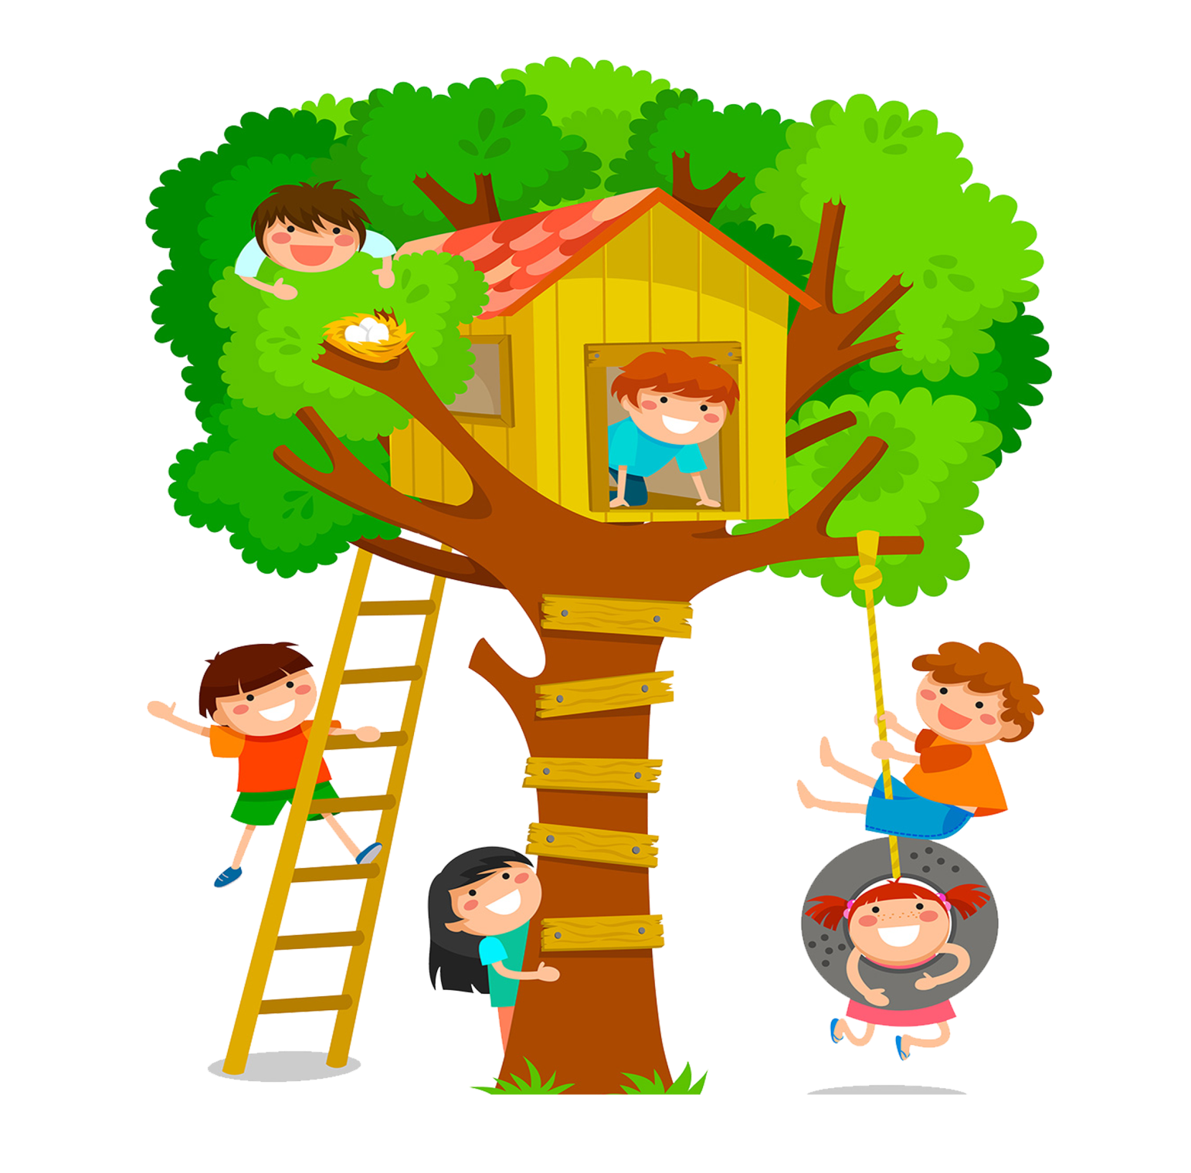

PLAY

Slide 22


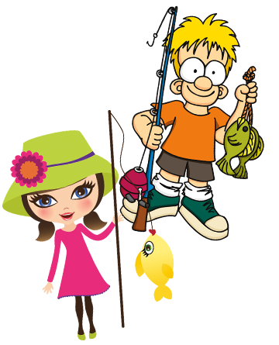
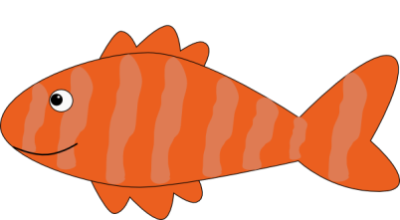



Slide 23
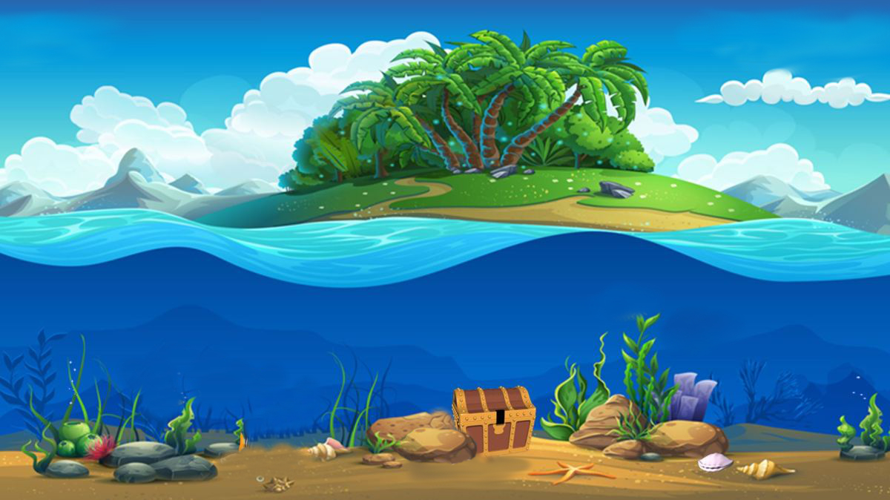
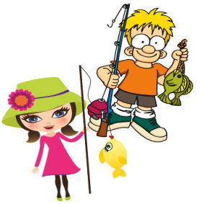



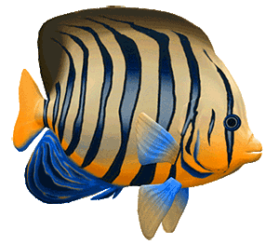
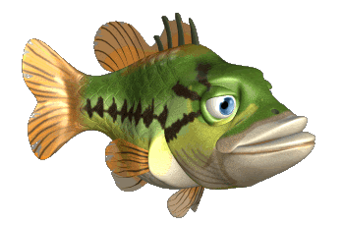
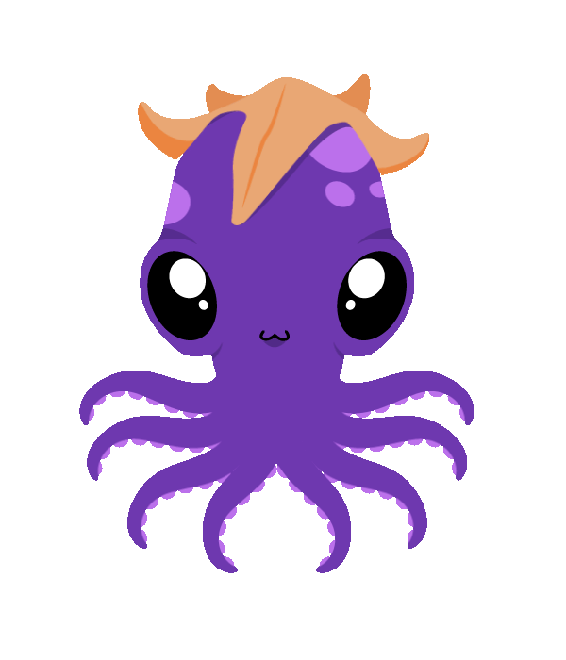
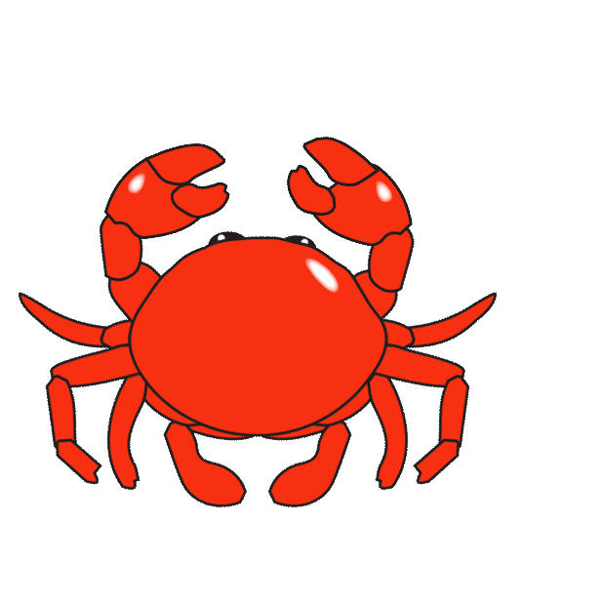
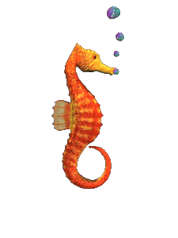
Wow
Wow
Wow
Wow
Wow
Wow
Wow

Slide 24



This is my friend
This is my friend, Peter

Slide 25
This is my friend
This is my friend, Tony

Slide 26
This is my friend
This is my friend, Hoa

Slide 27
Hi, I’m
Hi, I’m Mary

Slide 28
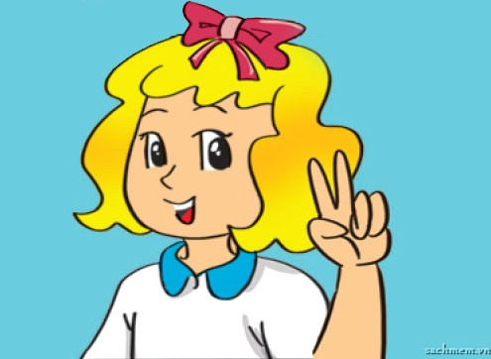
Hi, I’m
Hi, I’m Linda

Slide 29
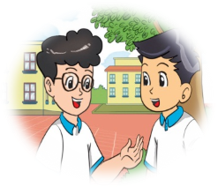
They are my friends,
They are my friends, Phong and Nam.

Slide 30
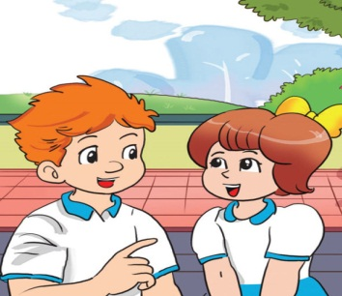
They are my friends,
They are my friends, Tony and Mary.

