Slide 1

UNIT 2. nice to see you again
LESSON 2

Slide 2
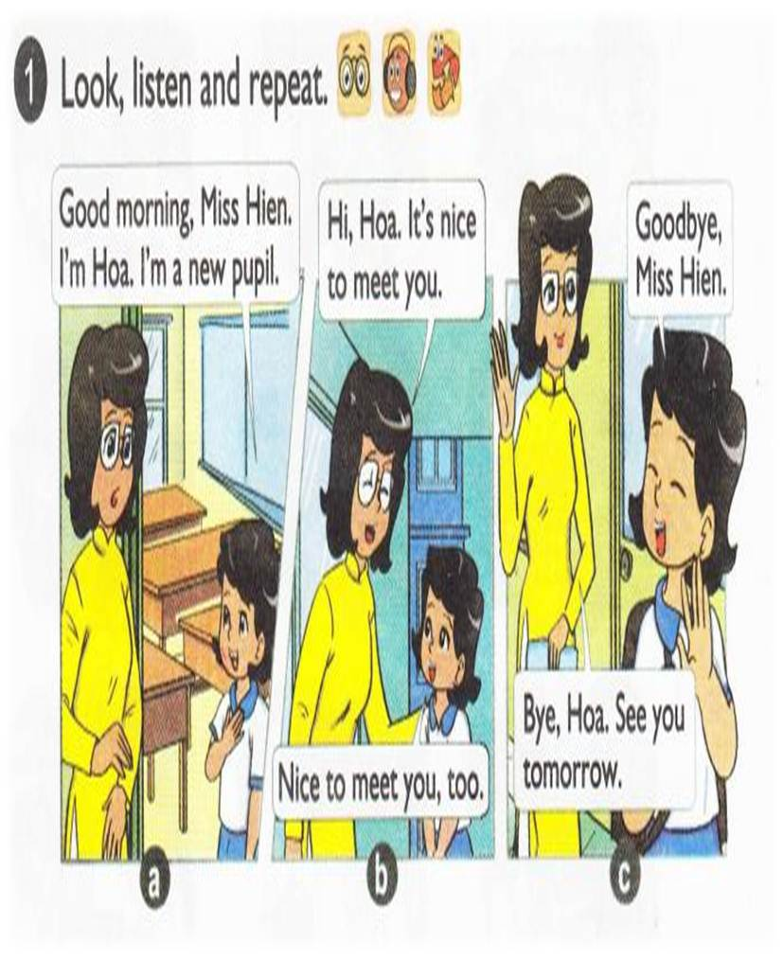


Slide 3
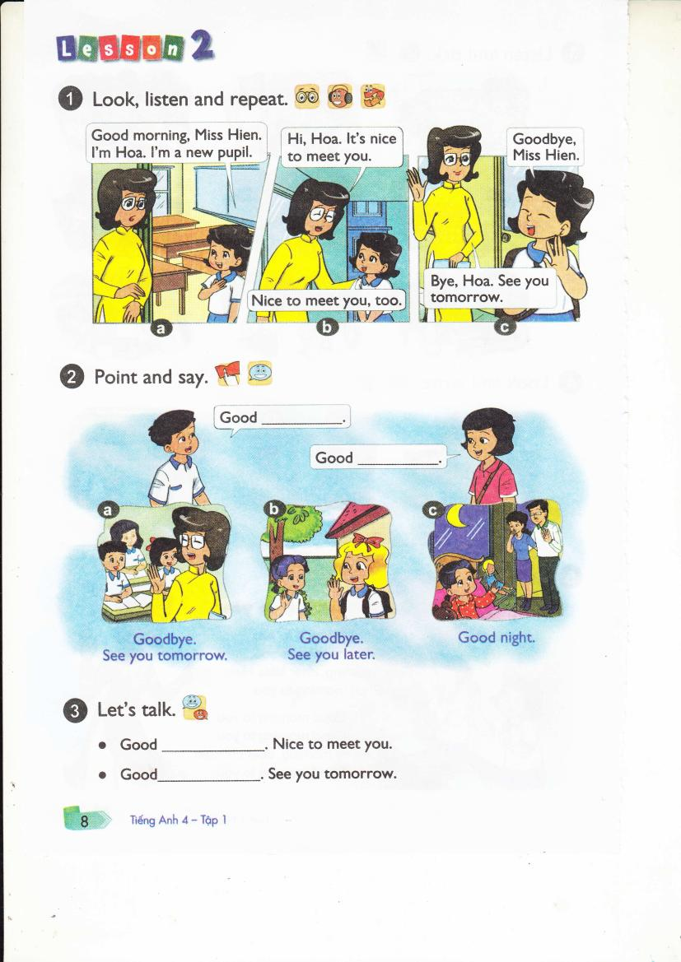

Slide 4
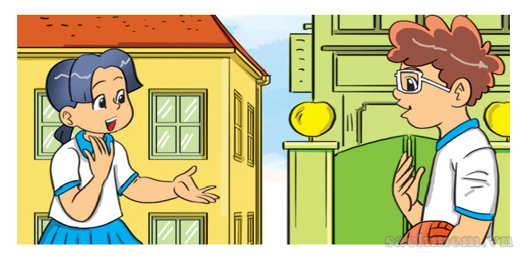
LOOK & WRITE
1.A: Hello. I'm Mai. I'm from .
B: Hello. I'm . I'm from America.
Viet Nam
Tom

Slide 5
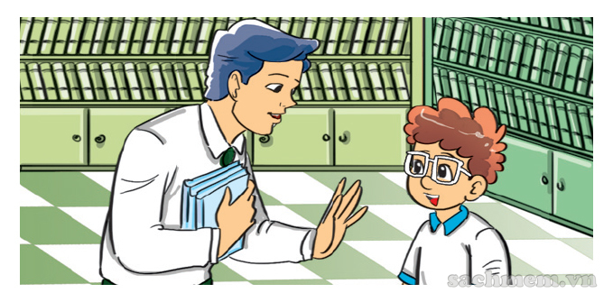
LOOK & WRITE
2.A: Good morning, . B: , Tom.
Nice to meet you.
Mr Loc
Good morning / Hi / Hello

Slide 6
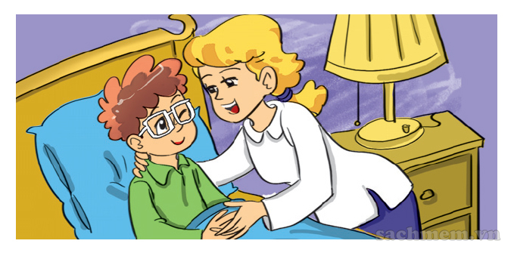
LOOK & WRITE
3.A: , Mum. B: , Tom.
Good night
Good night

