Slide 1


Slide 2
WARM UP

Slide 3


Slide 4
Unit 13- Would you like some milk?
Lesson 1

Slide 5
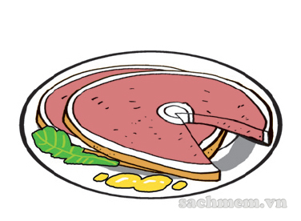
pork

Slide 6
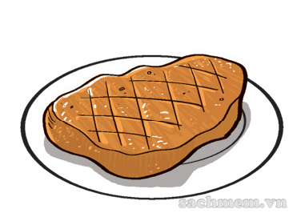
beef

Slide 7
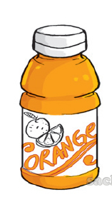
orange juice

Slide 8
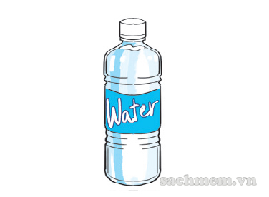
water

Slide 9
New words
Pork
Beef
Orange juice
Water

Slide 10
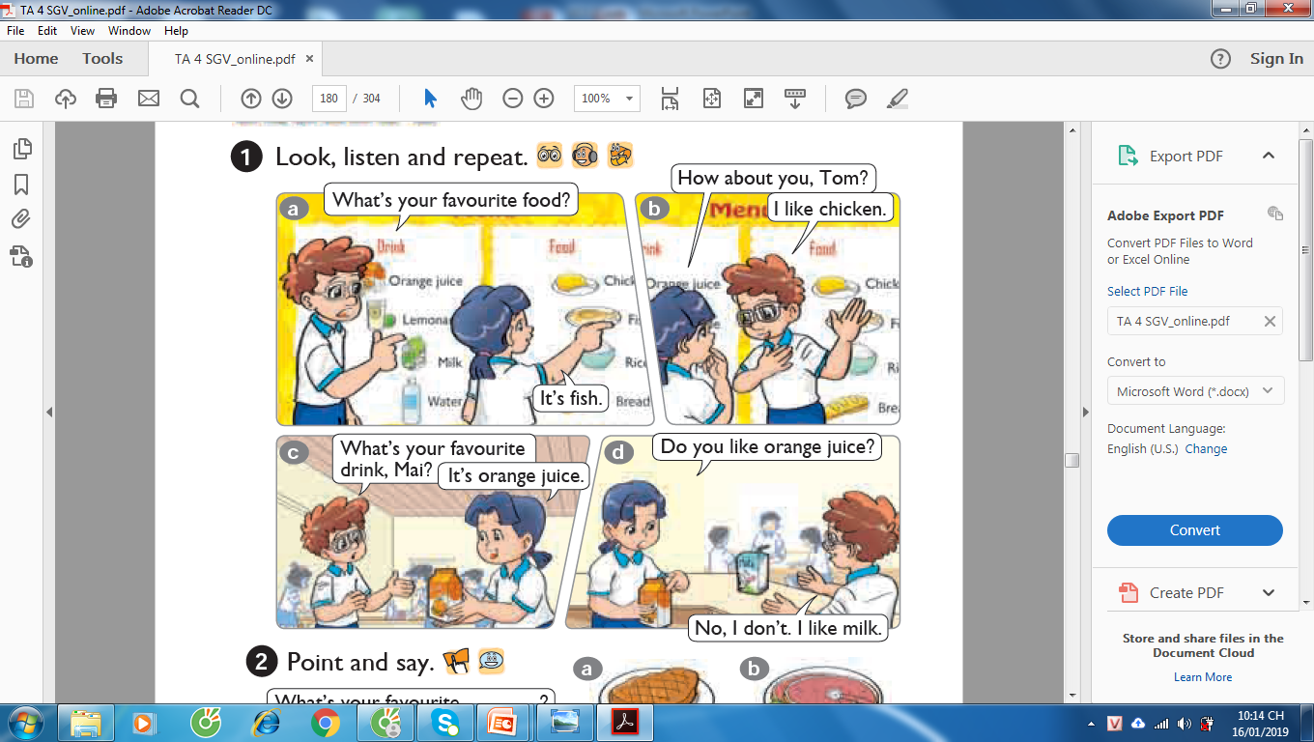

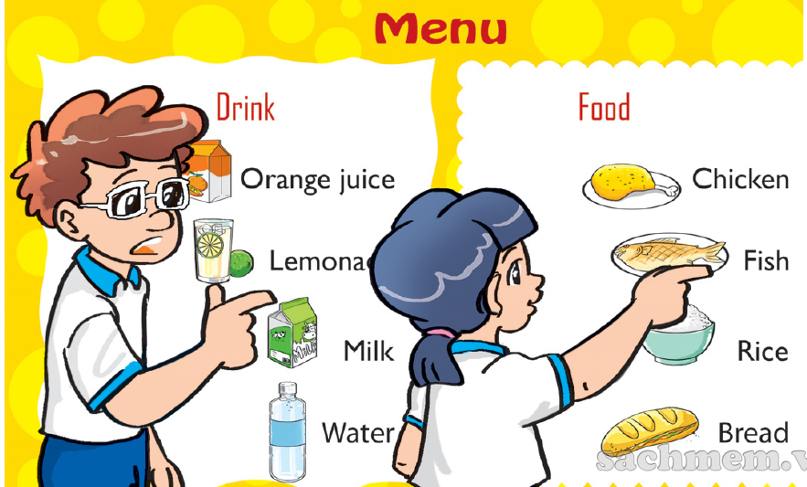
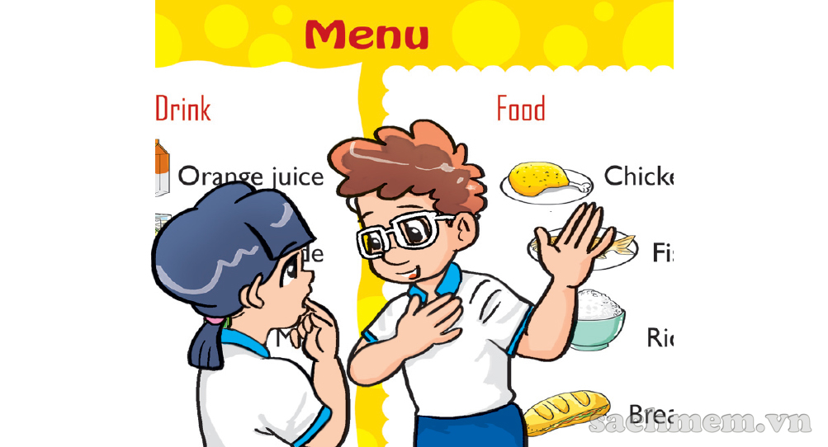
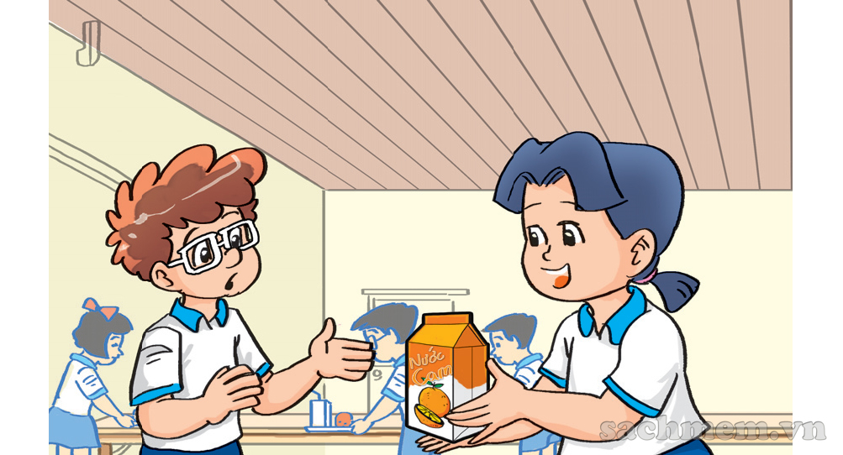
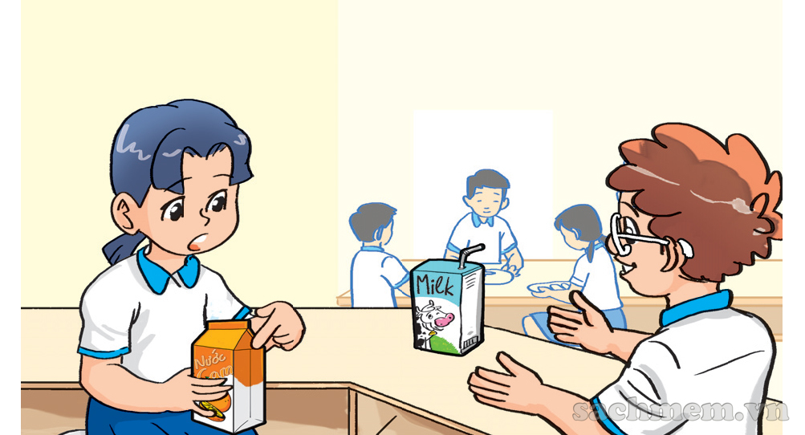
What’s your favourite food?
How about you, Tom?
I like chicken.
It’s fish.
What’s your favourite drink, Mai?
Do you like orange juice?
No, I don’t. I like milk.
It’s orange juice.

Slide 11
II. New sentence
A: What’s your favourite food/drink?
B: It’s beef/milk.

Slide 12
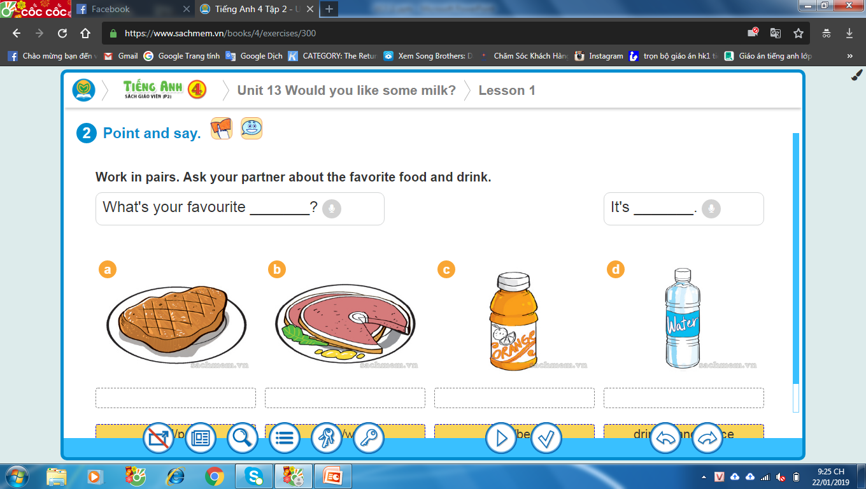
a
b
c
d

Slide 13
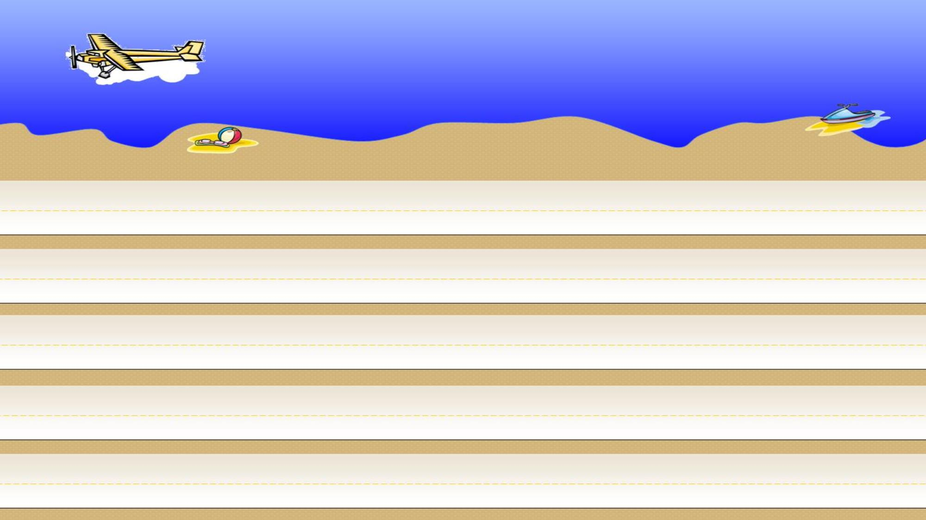



TEAM 1
TEAM 2
1
2
3
4
Start

Slide 14


What’s your favourite food?
It’s ………………..
pork
QUAY VỀ

Slide 15
What’s your favourite drink?
It’s ………………..
water
QUAY VỀ

Slide 16
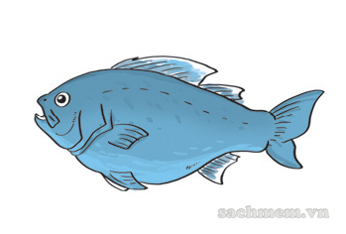
What’s your favourite food?
It’s ………………..
fish
QUAY VỀ

Slide 17
What’s your favourite food?
It’s ………………..
beef
QUAY VỀ

Slide 18
What’s your favourite drink?
It’s ………………..
orange juice
QUAY VỀ

Slide 19
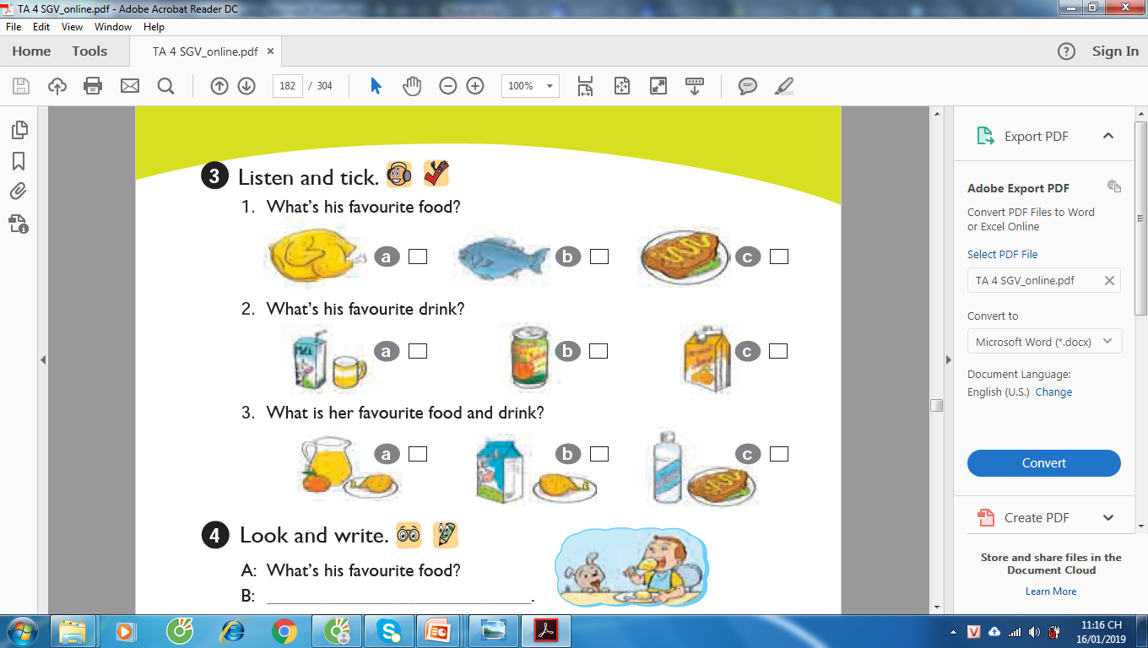
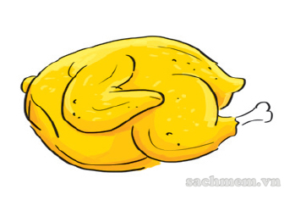
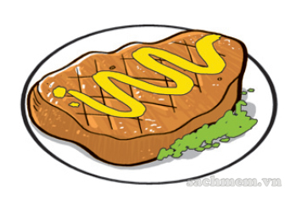
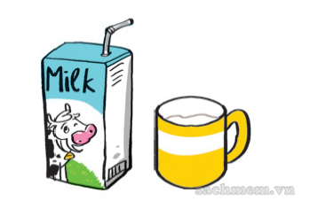
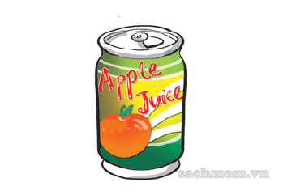
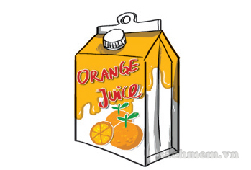
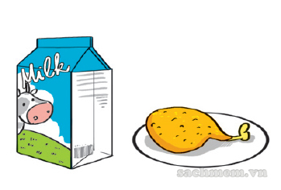
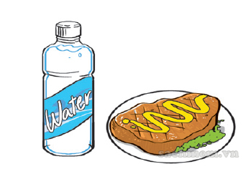
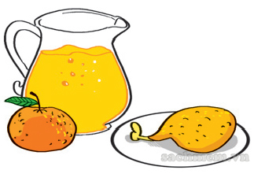
✓
✓
✓

Slide 20
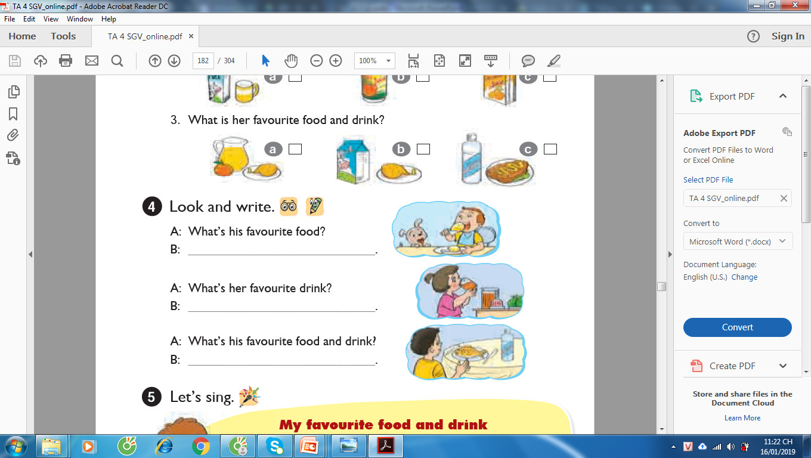
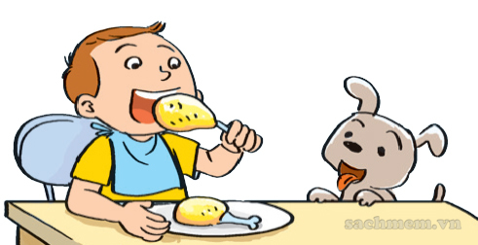
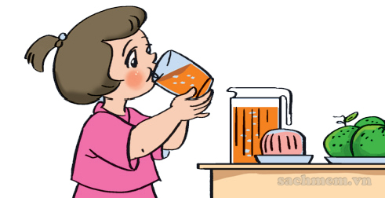
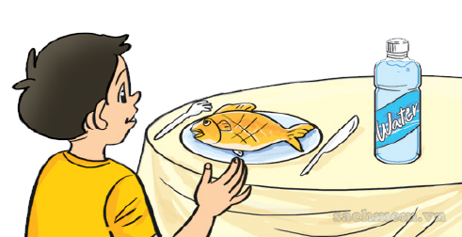
A: What’s his favourite food?
B: ........................................
It’s chicken
2. A: What’s her favourite drink?
B: ........................................
It’s orange juice
3. A: What’s his favourite food and drink?
B: ........................................
It’s fish and water

Slide 21
SUMMARY
New words
New sentence
Vocabulary about food and drink
What’s your favourite food/drink?
It’s ______.

