Slide 1


UNIT 1 . NICE TO SEE YOU AGAIN
LESSON 3

Slide 2


Hello, Linda
Linda

Slide 3

night
Good night

Slide 4
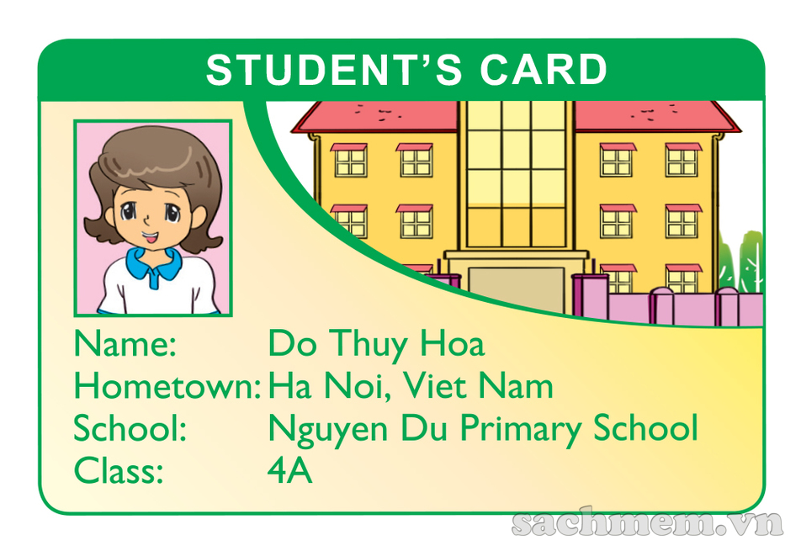

READ & ANSWER
1. What is the girl's name?
2. Where is she from?
→ Her name is Do Thuy Hoa.
→ She's from Ha Noi, Viet Nam.

Slide 5
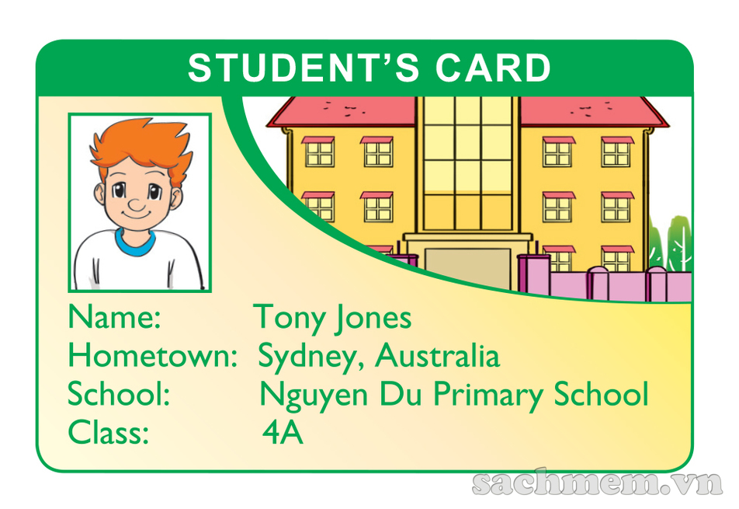
READ & ANSWER
1. What is the boy's name?
2. Where is he from?
→ His name is Tony jones.
→ He's from Sydney, Australia.

