Slide 1
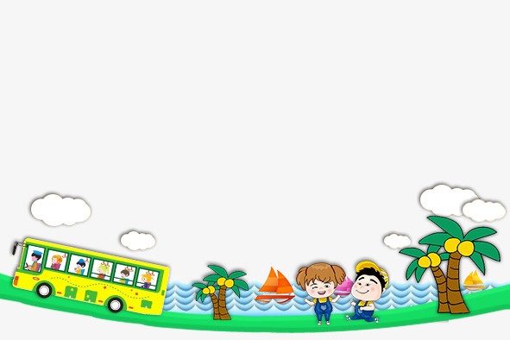

UNIT 9. WHAT DID YOU SEE AT THE ZOO?
LESSON 3

Slide 2


LISTEN AND REPEAT
'When did you 'go to the 'zoo?
I 'went there 'yesterday.
'What did the 'tigers 'do when you were 'there?
They 'roared 'loudly.

Slide 3
1. Vocabulary
- move slowly
- roar loudly
- move beautifully
- eat slowly
- python
- crocodile
- peacock
- gorilla
- tiger
- panda

Slide 4
2. Model sentence
- What did you see at the zoo?
I saw crocodiles.
- What did the crocodiles like when you were there?
They moved slowly.

