Slide 1
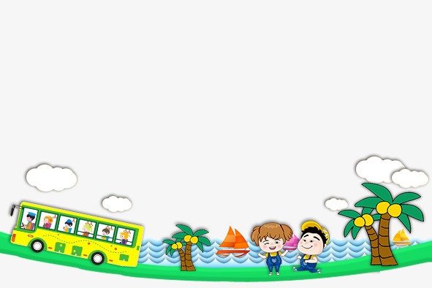

UNIT 9. WHAT DID YOU SEE AT THE ZOO?
LESSON 1

Slide 2

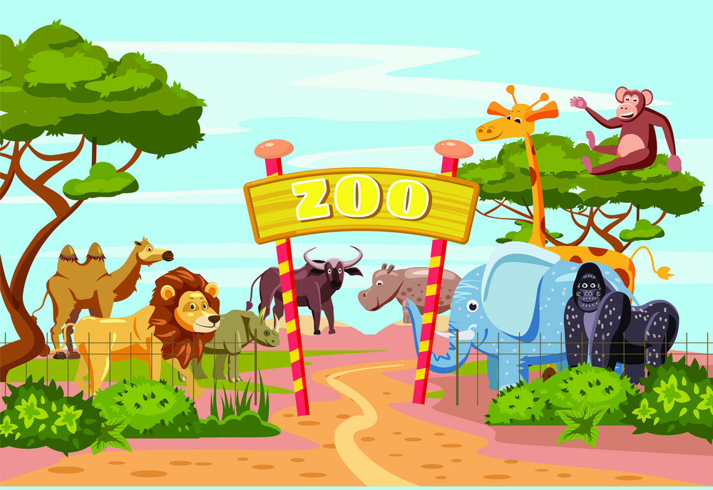

Slide 3
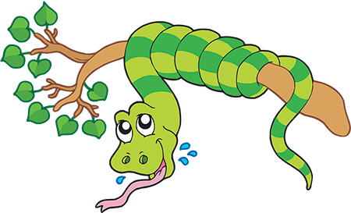

pythons

Slide 4
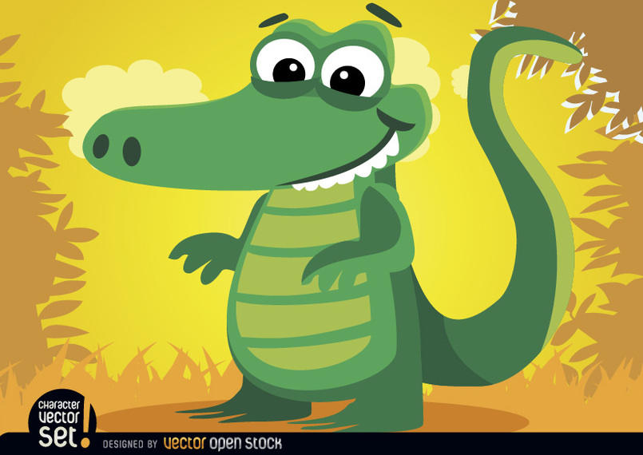
crocodiles

Slide 5

peacocks

Slide 6
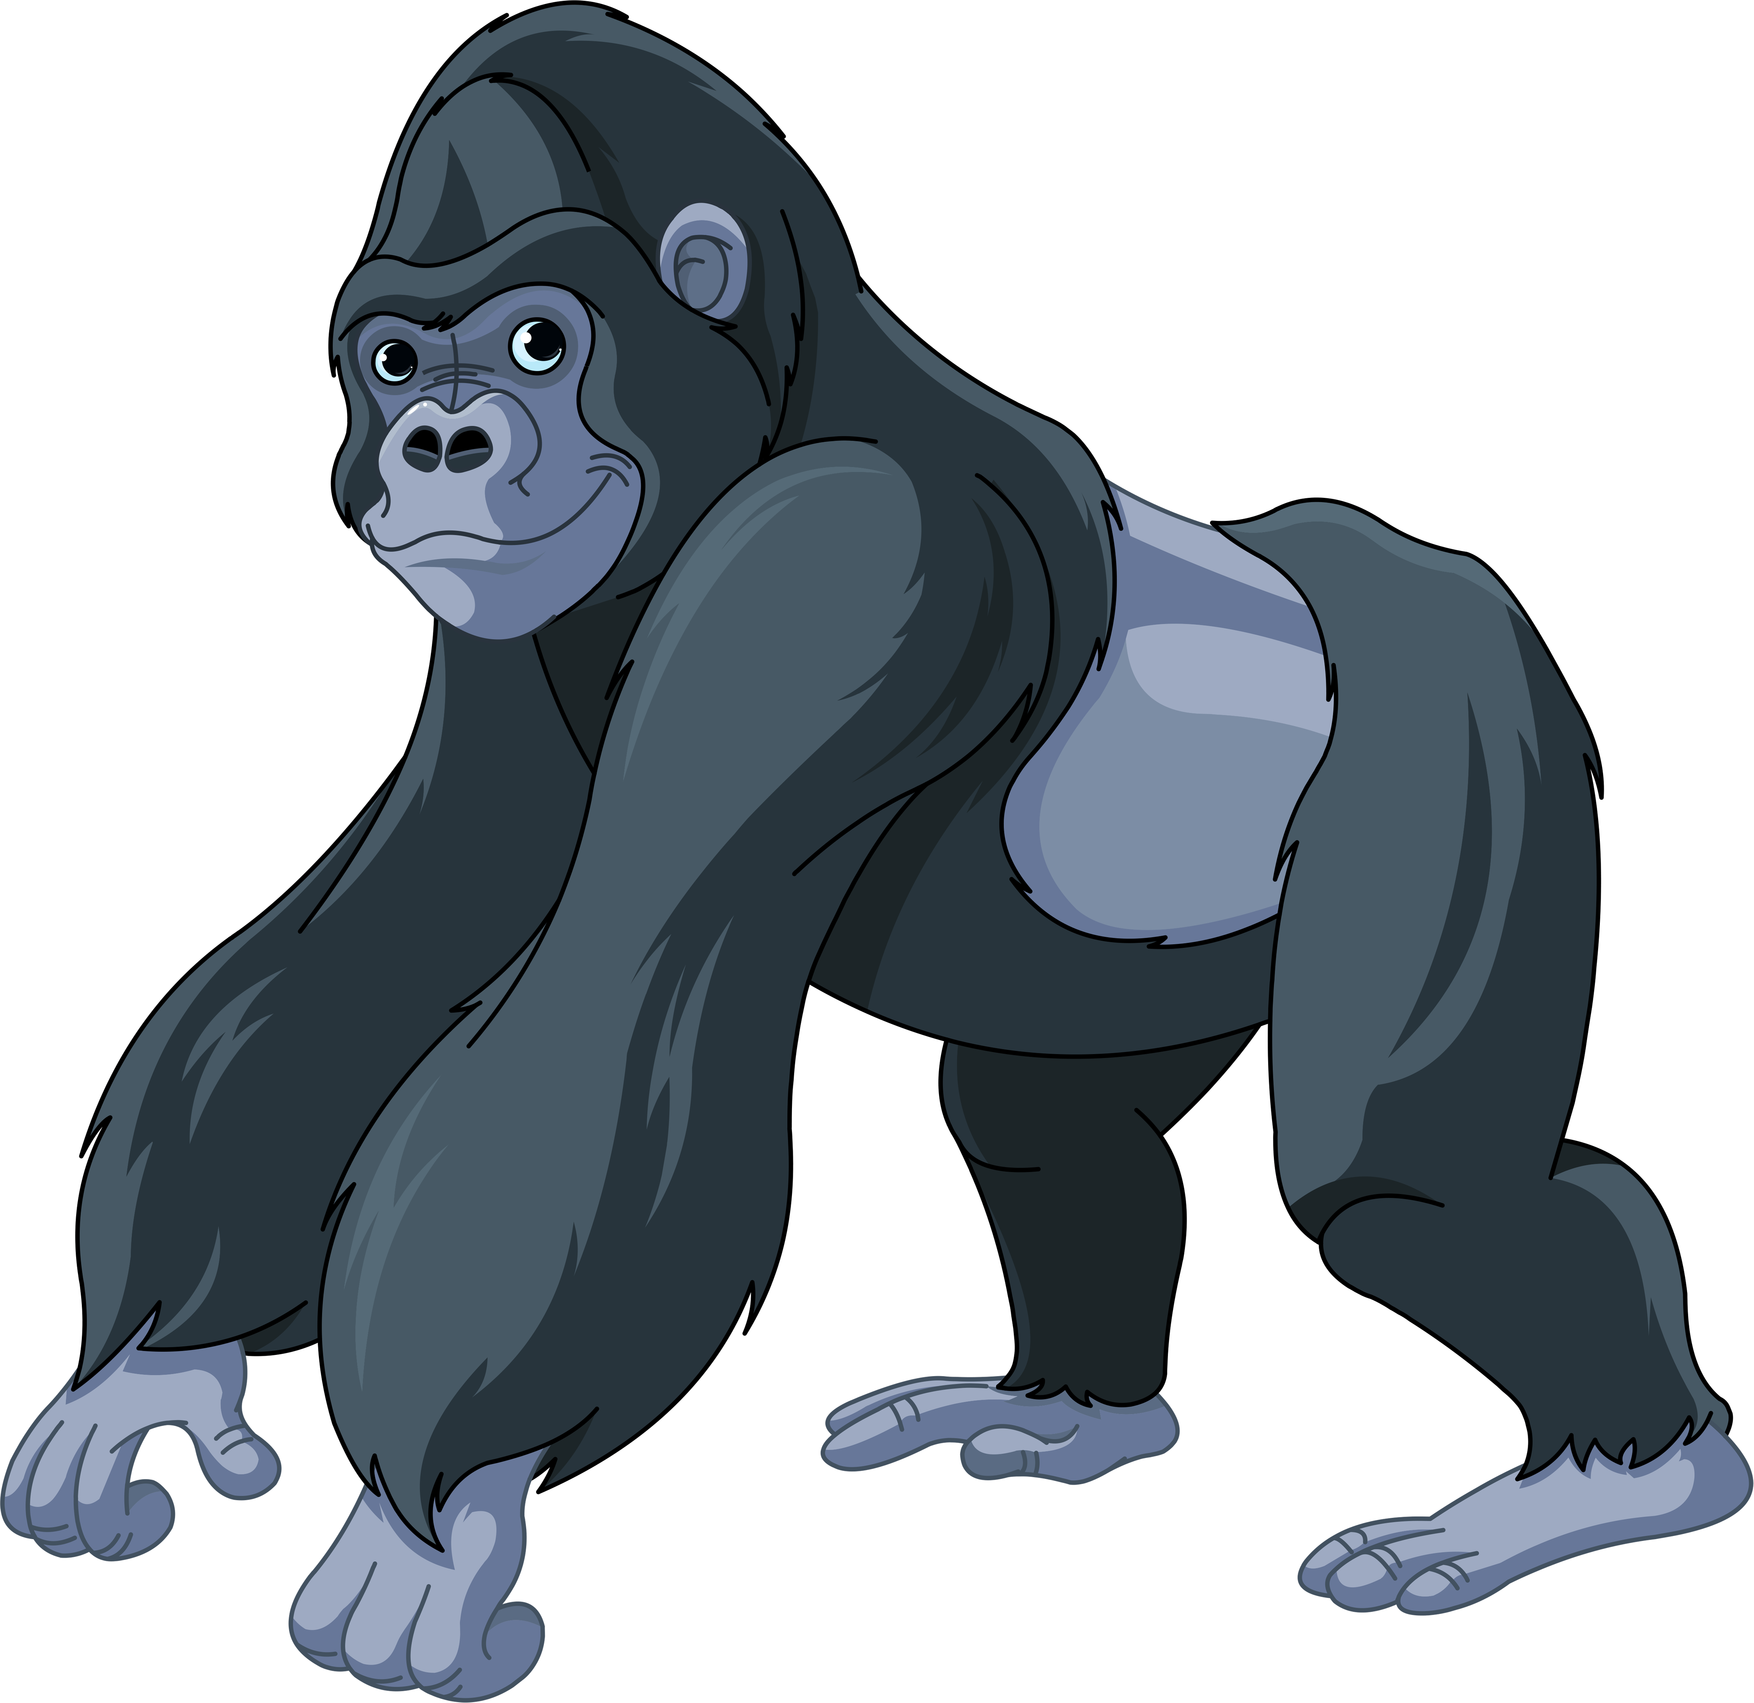
gorillas

Slide 7
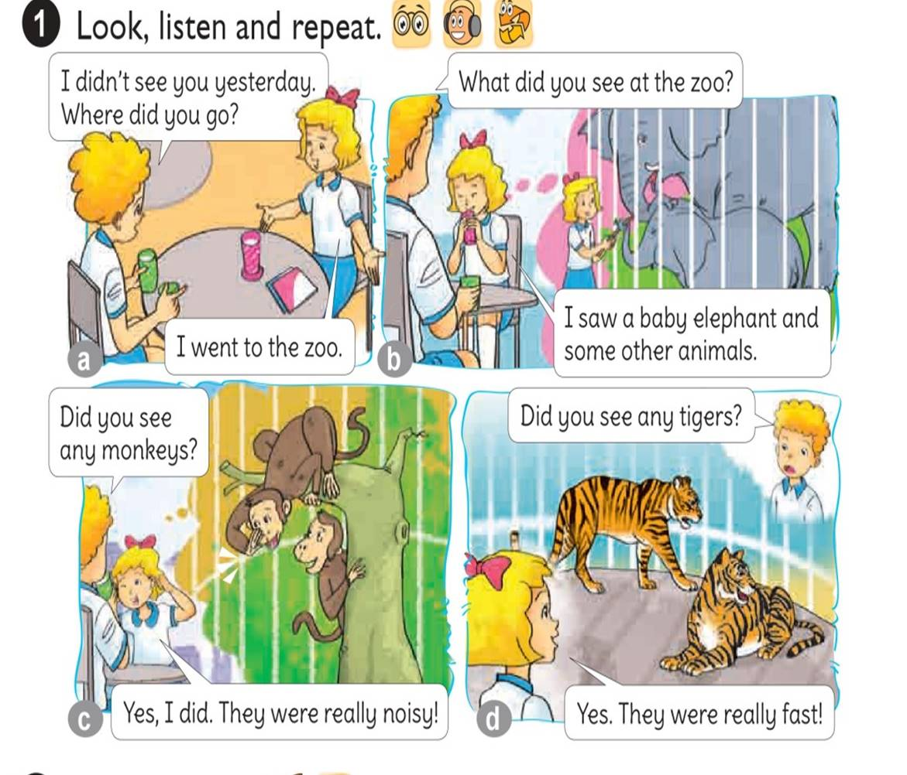


Slide 8
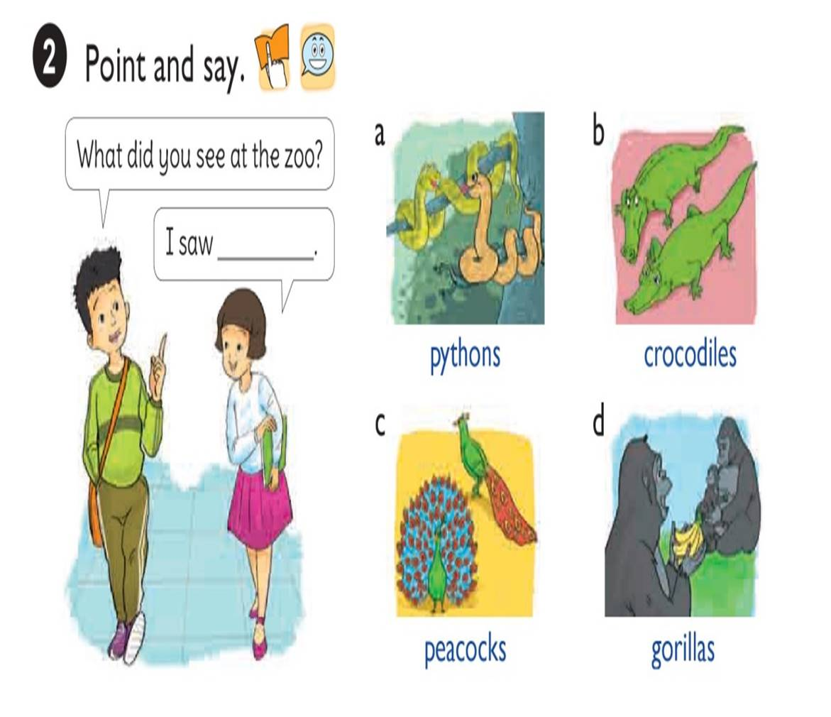

Slide 9



What did see at the zoo?
I saw
pythons.

Slide 10
What did see at the zoo?
I saw
crocodiles

Slide 11

What did see at the zoo?
I saw
peacocks.

Slide 12
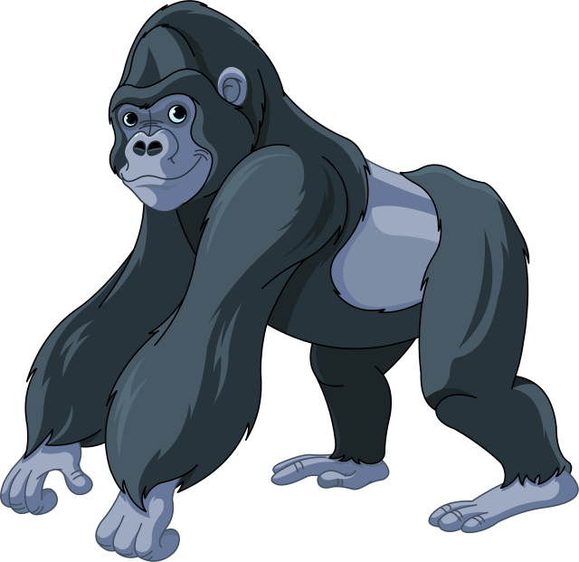
What did see at the zoo?
I saw
gorillas.

Slide 13
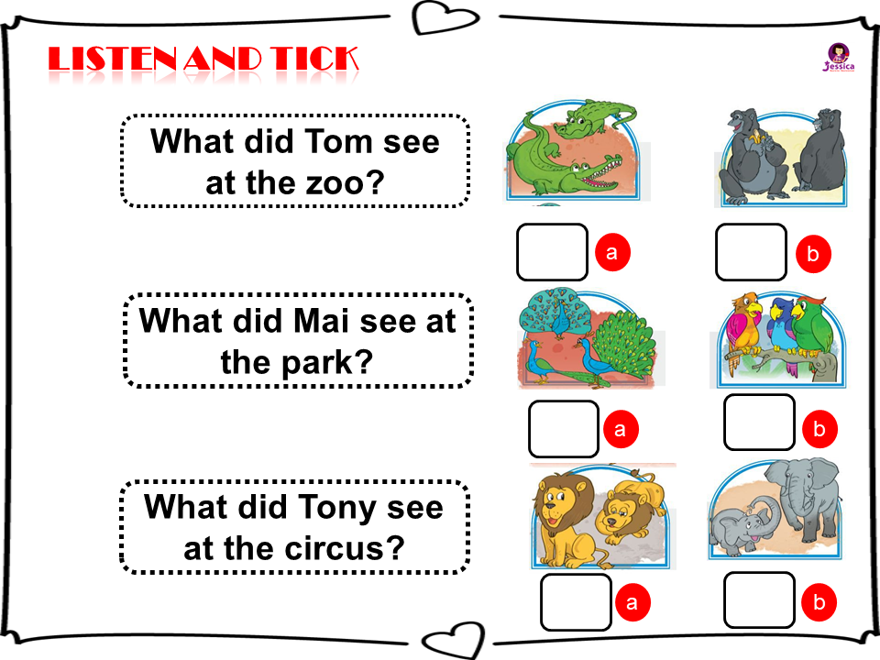



1
2
3

Slide 14
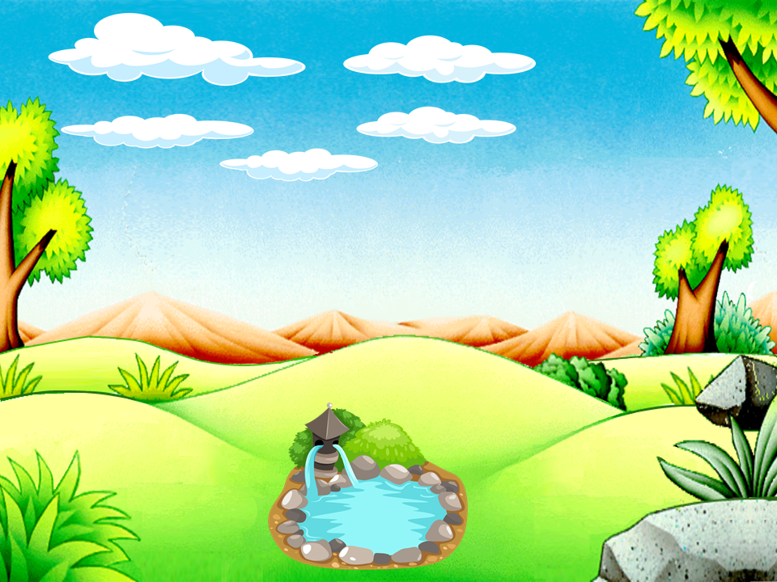


What did the tigers like when you were there?
They ……
eat slowly
move beautifully
roared loudly

Slide 15
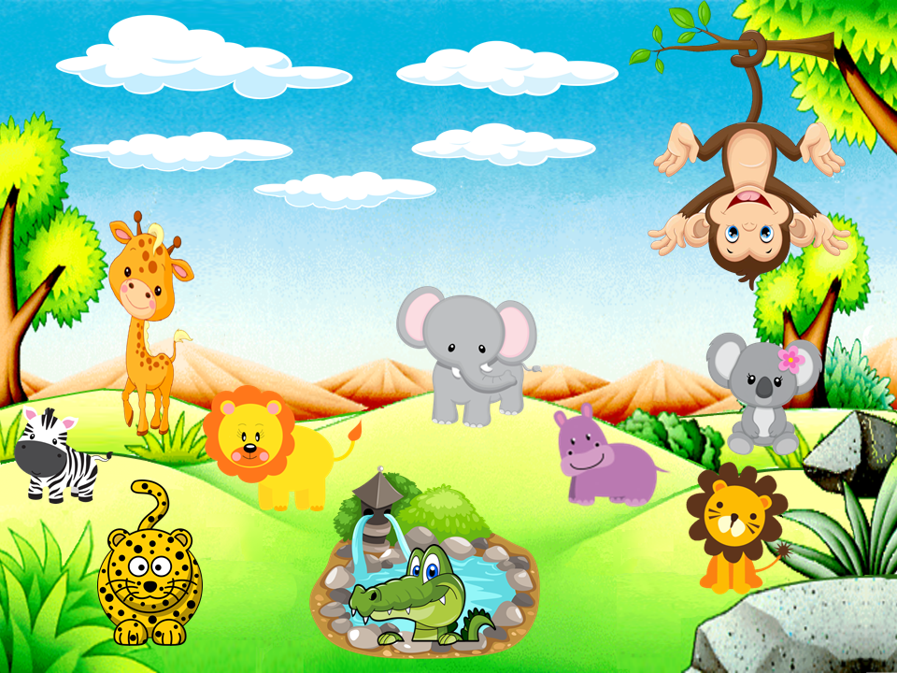
Good Bye

