Slide 1


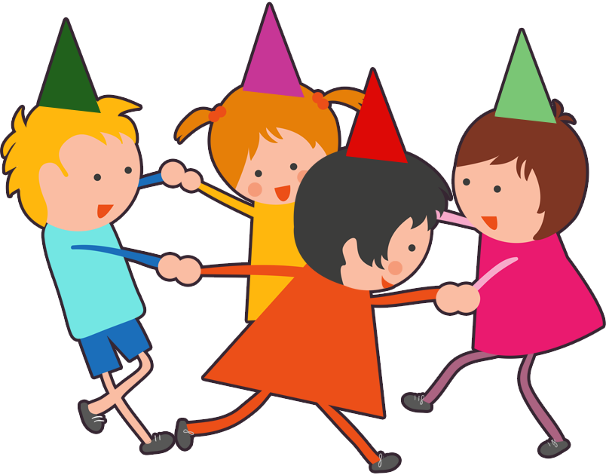

UNIT 10. WHEN WILL
SPORTS DAY BE?
LESSON 2

Slide 2
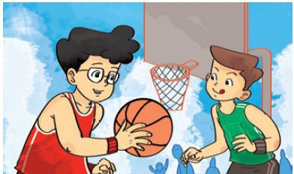
Play basketball

Slide 3
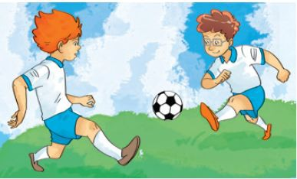

Play football

Slide 4
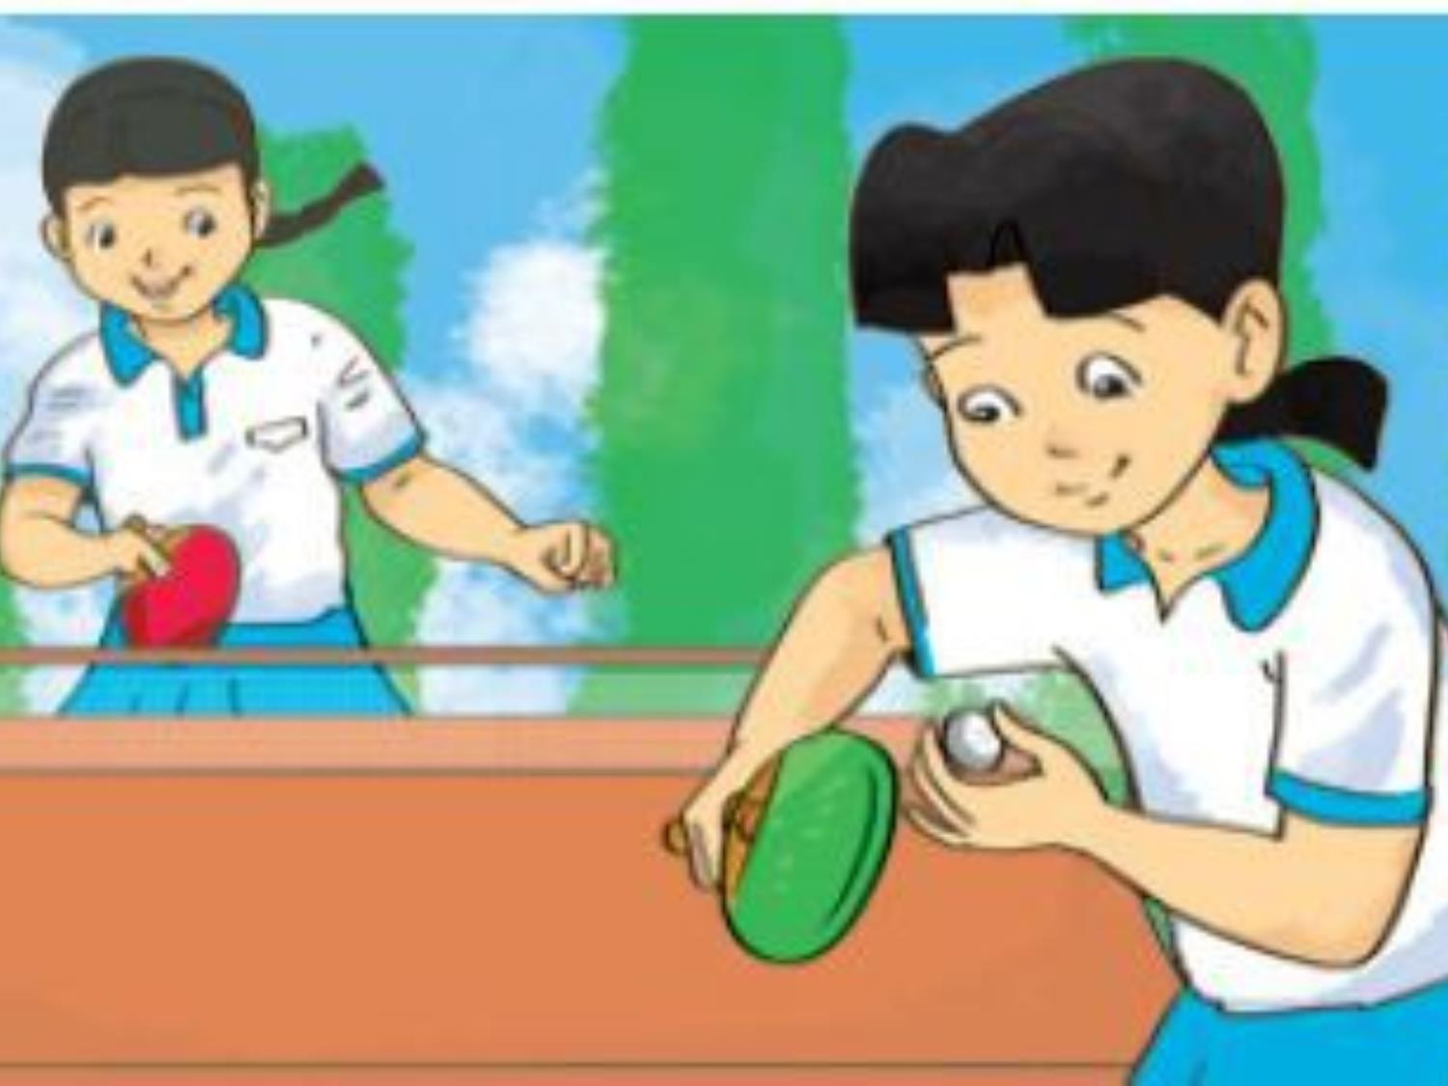
play table tennis

Slide 5
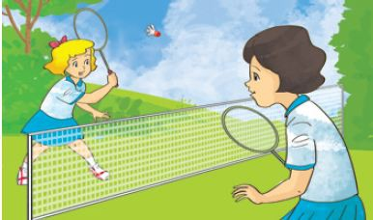

Play badminton

Slide 6
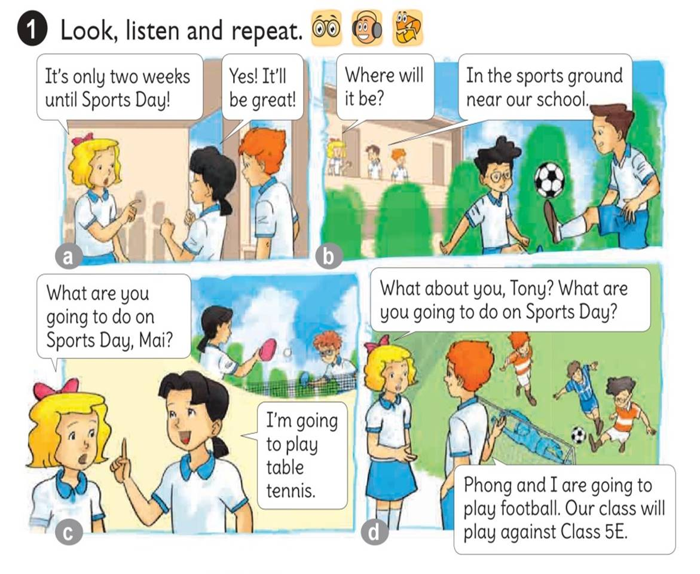




Slide 7
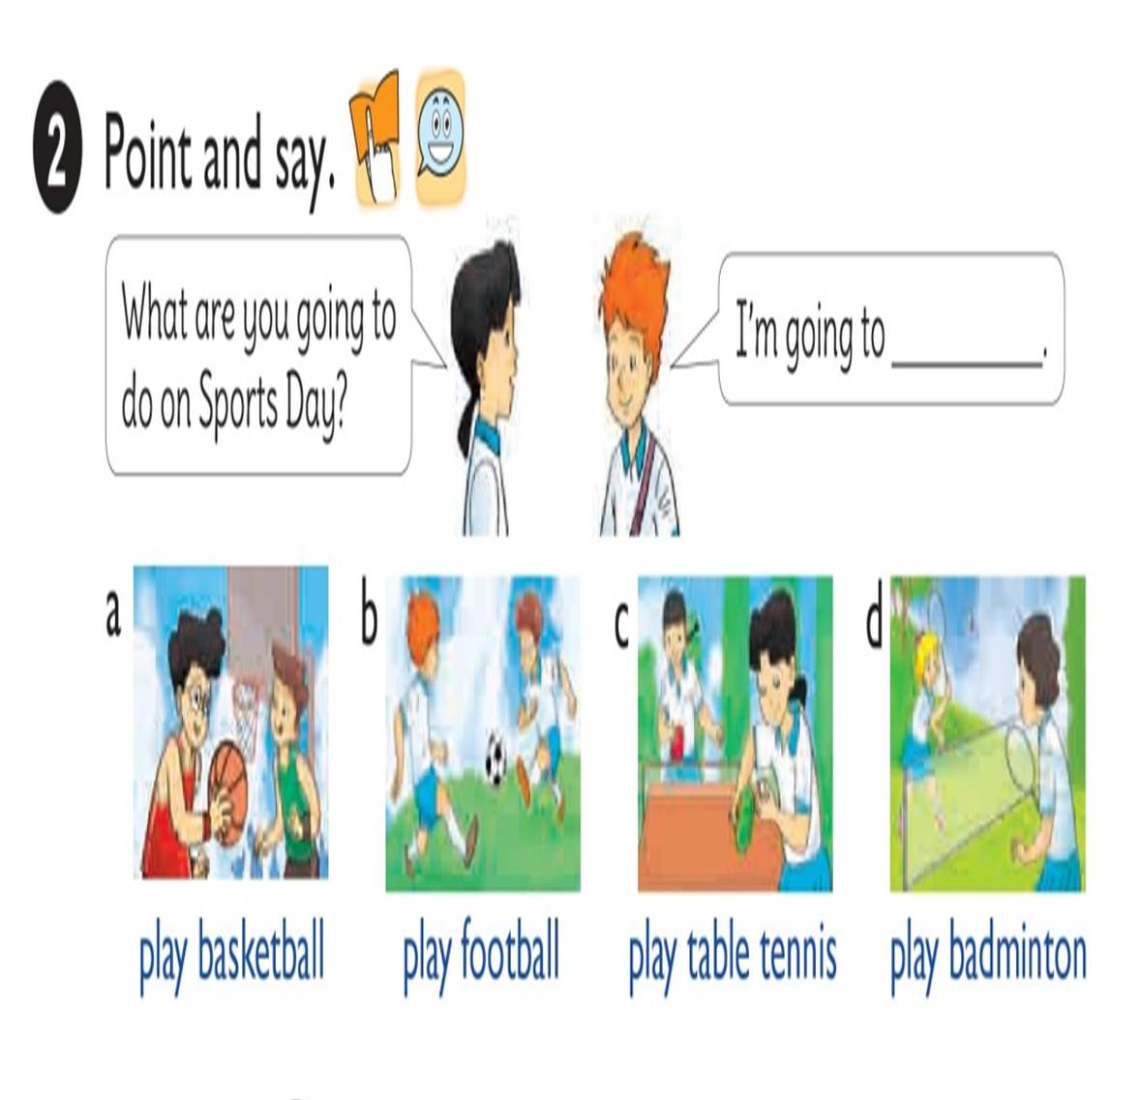

Slide 8
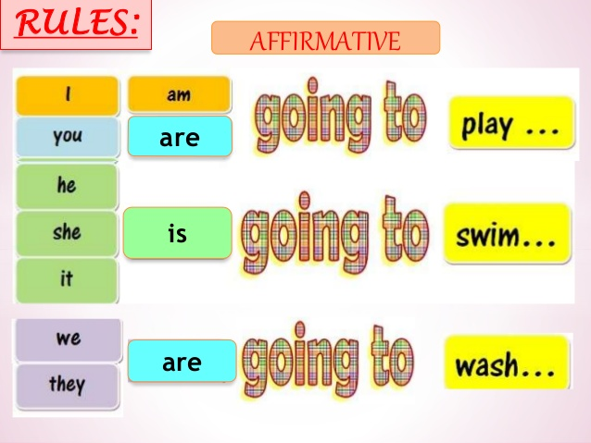

Slide 9
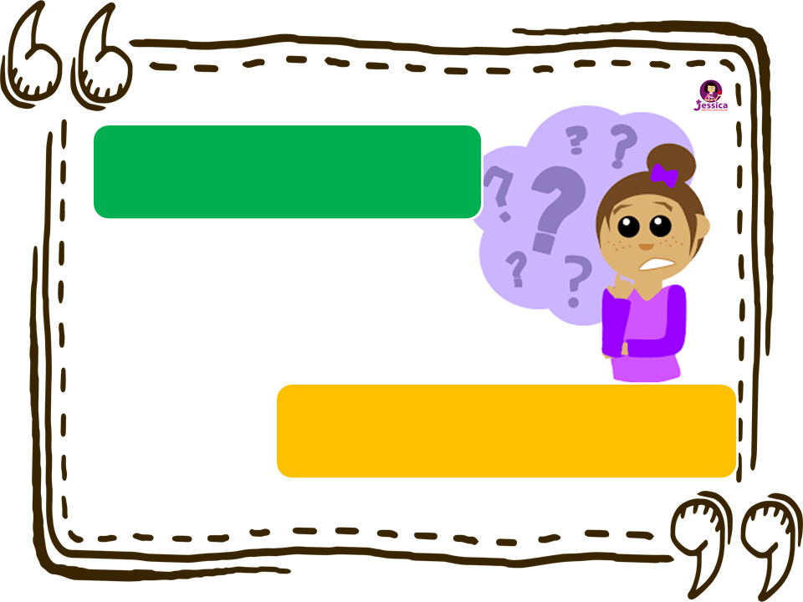
What are you going to do on Sports Day?
I’m going to .
play basketball

Slide 10

What are you going to do on Sports Day?
I’m going to .
play football

Slide 11
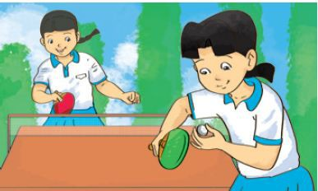
What are you going to do on Sports Day?
I’m going to .
play table tennis

Slide 12
What are you going to do on Sports Day?
I’m going to .
play badminton

Slide 13


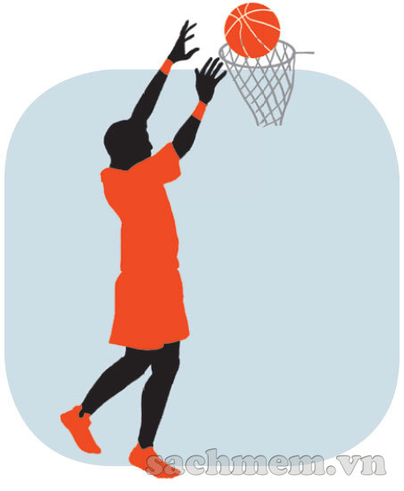
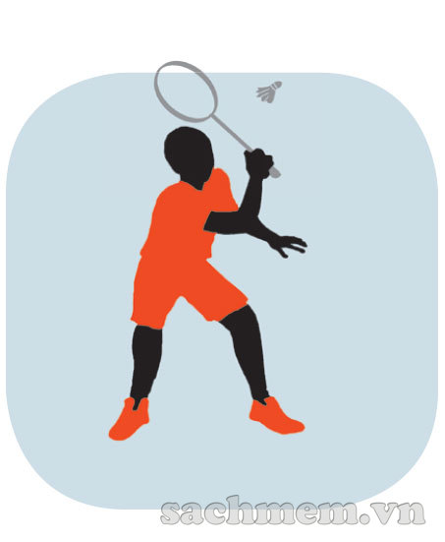
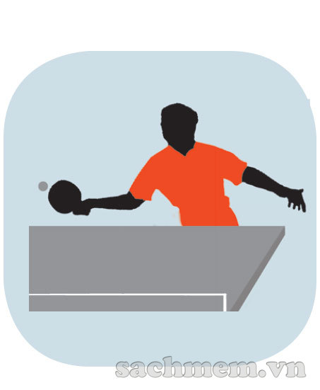


1
2
3
4
LISTEN & NUMBER
4
2
3
1

Slide 14
1. Vocabulary
- play basketball
- play football
- play table tennis
- play badminton
2. Model sentence
What are you going to do on Sports Day?
I’m going to play football

