Slide 1


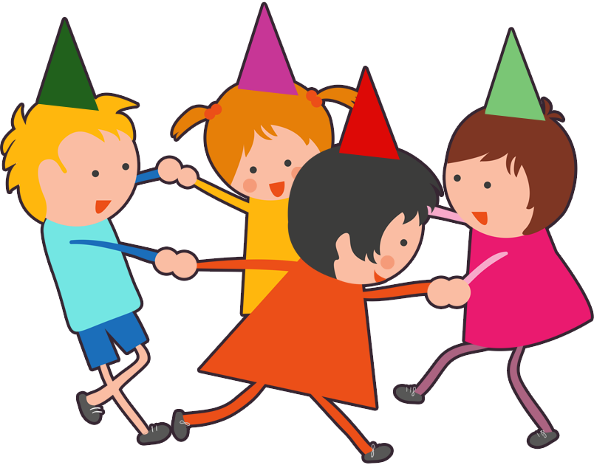

UNIT 10. WHEN WILL
SPORTS DAY BE?
LESSON 1

Slide 2



Slide 3

Teachers’ Day

Slide 4
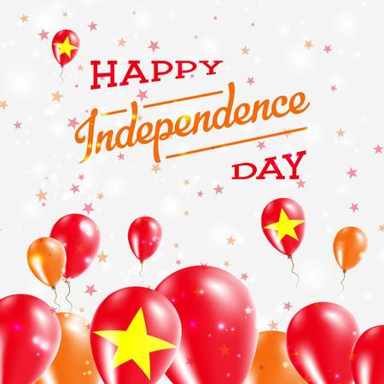

Slide 5



Slide 6
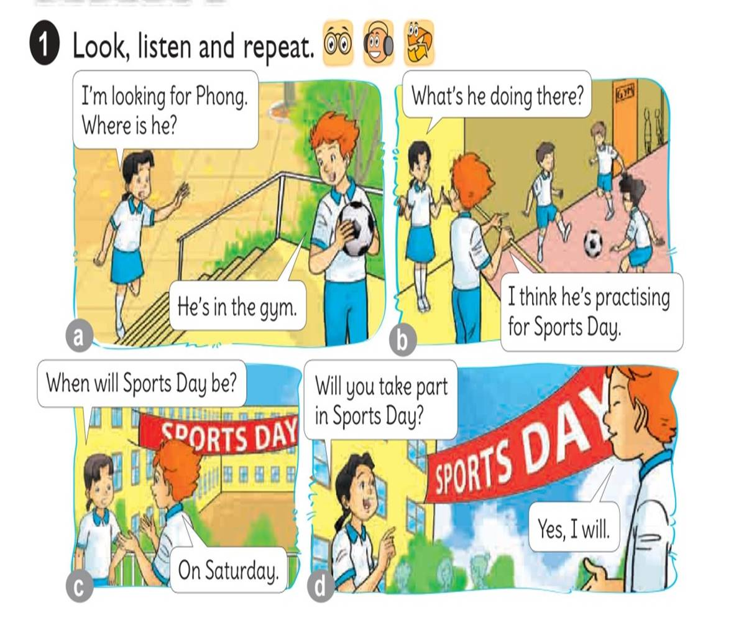




Slide 7
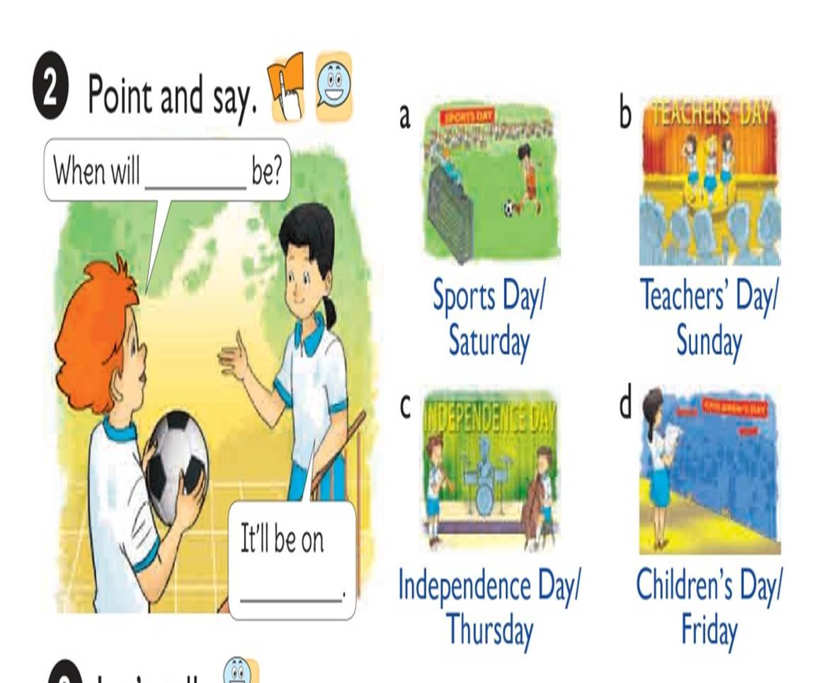

Slide 8

When will be?
Sports Day
It’’ll be on
Thứ 7
Saturday.

Slide 9

What will be?
Teachers’Day
It’’ll be on
Sunday.
Chủ Nhật

Slide 10
When will be?
Independence Day
It’’ll be on
Thứ 5
Thursday.

Slide 11
When will be?
Children’s Day
It’’ll be on
Thứ 4
Wednesday.

Slide 12

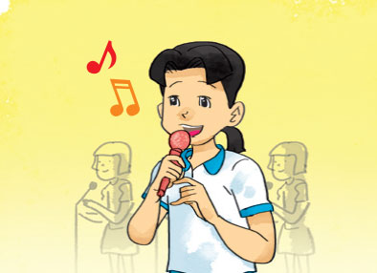
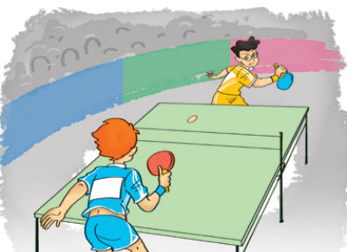
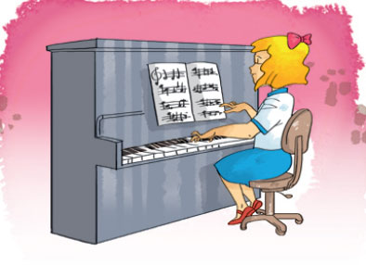


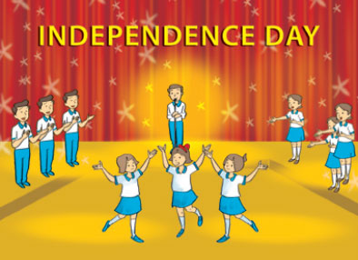
Listen and match
1
2
3
2
3
1
a
b
c

