Slide 1
Unit 4
When’s your birthday?
Lesson 3

Slide 2
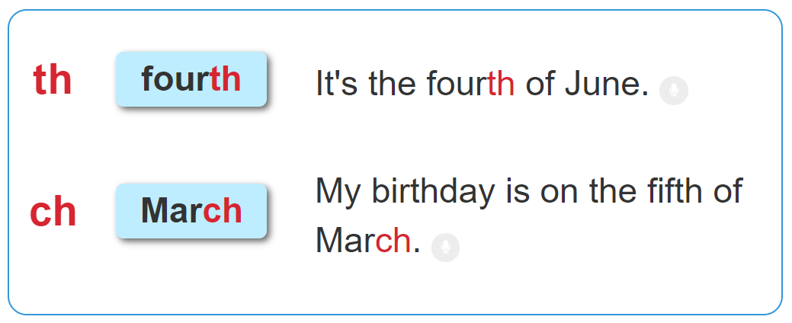

1. Listen and repeat.

Slide 3
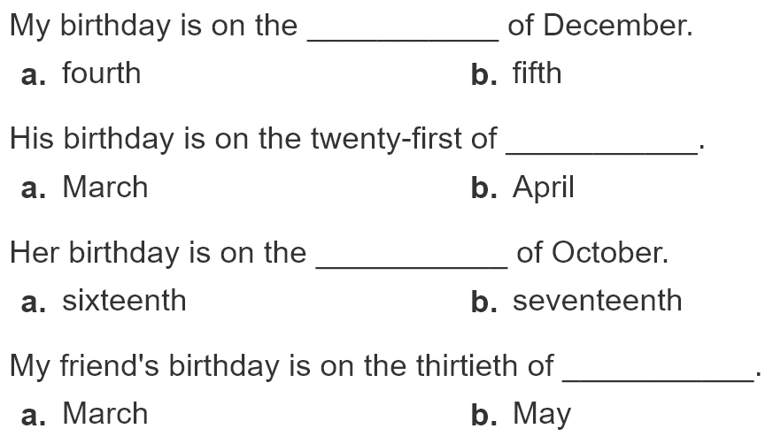
2. Listen and circle. Then say aloud.
1
2
3
4

Slide 4
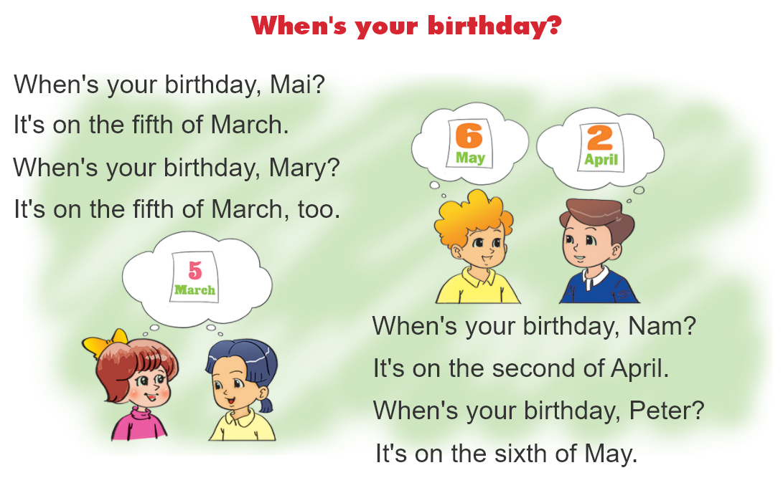

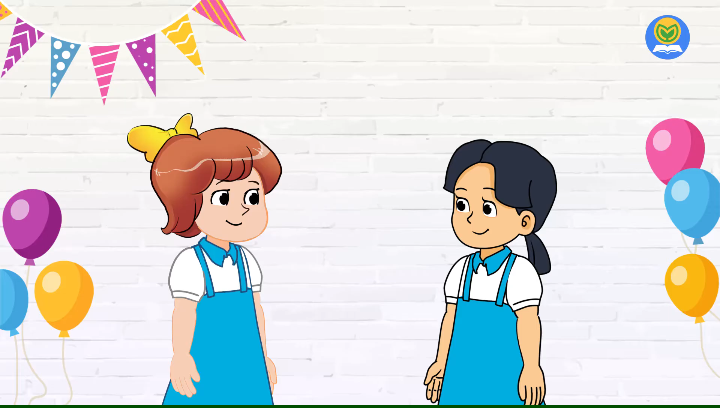
3. Let's chant.

