Slide 1
Unit 4
When’s your birthday?
Lesson 2

Slide 2
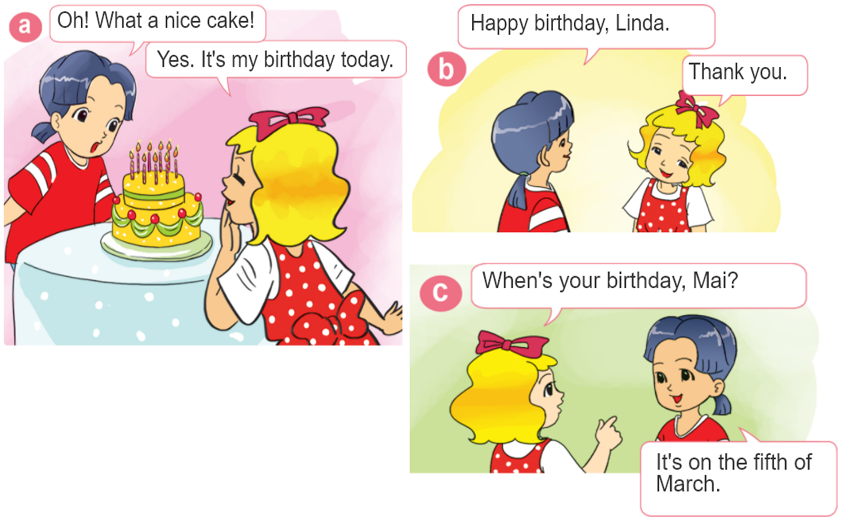

1. Look, listen and repeat.

Slide 3




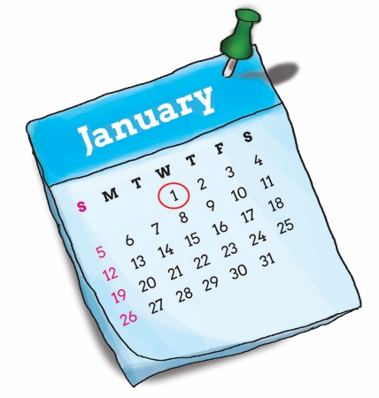
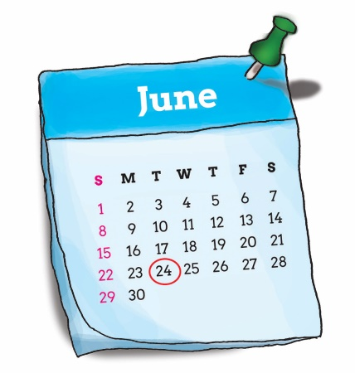
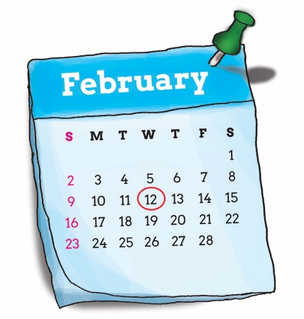
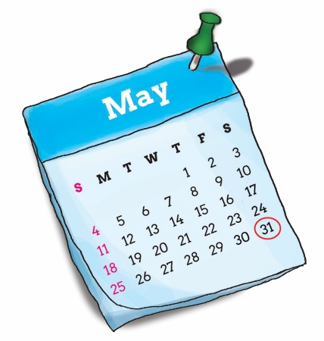
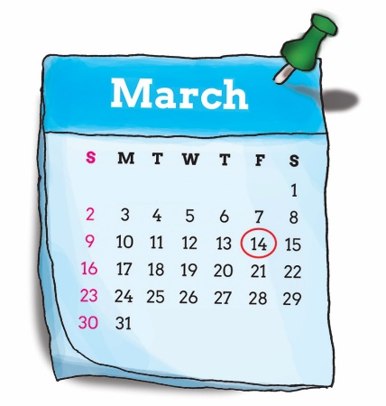
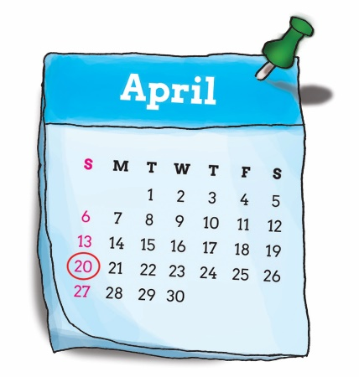
2. Point and say.
When’s your birthday?
It’s on the ____ of _____.
first
twenty-fourth
January
twelveth
thirty-first
June
February
fourteenth
twentieth
May
March
April

Slide 4
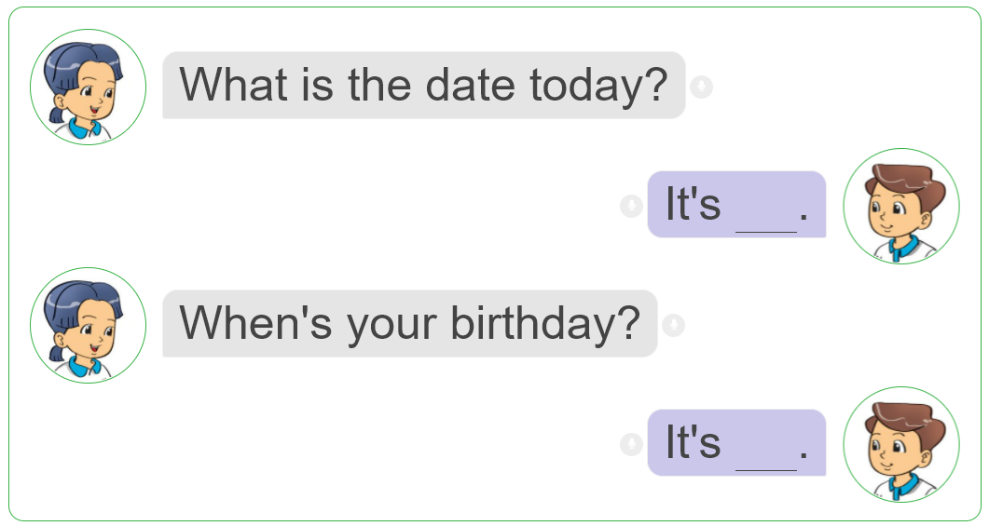
3. Let's talk.

