Slide 1
Unit 3
What day is it to day ?
Lesson 3

Slide 2
phonics

Slide 3
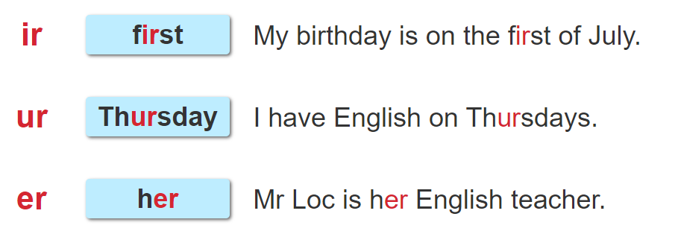

1. Listen and repeat.

Slide 4
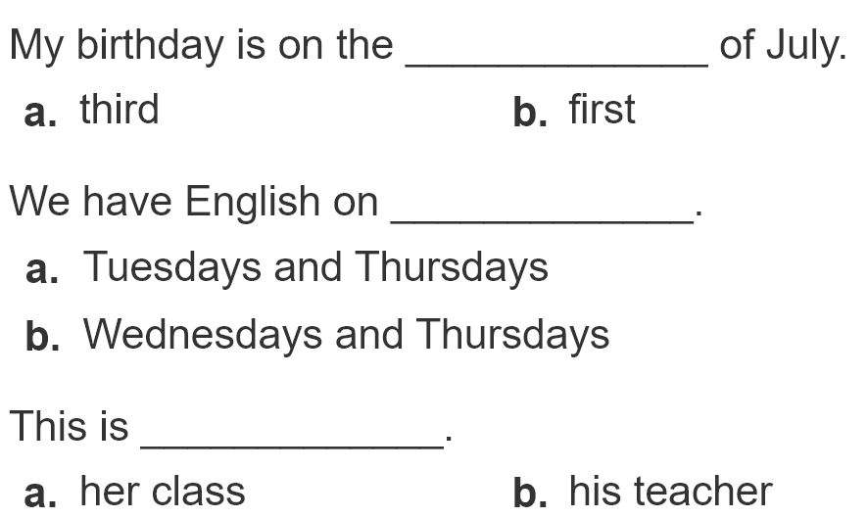
2. Listen and circle. Then say aloud.
1
2
3

