Slide 1
Unit 3
What day is it to day ?
Lesson 2

Slide 2
vocabulary

Slide 3

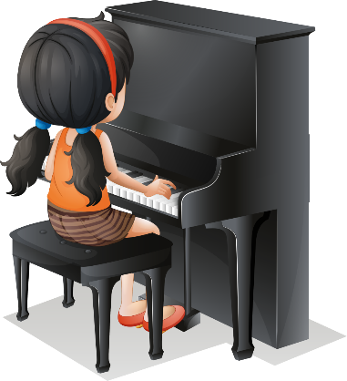
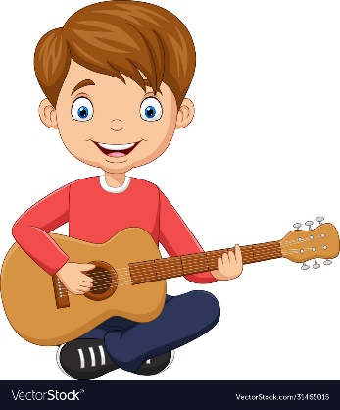
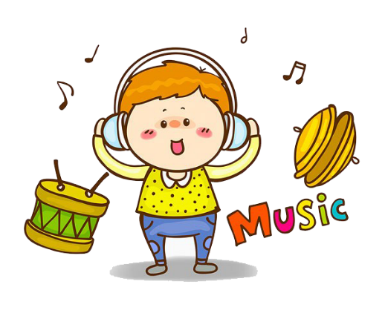
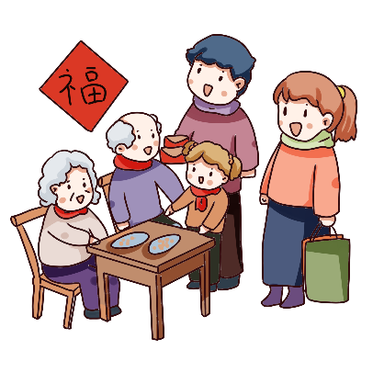

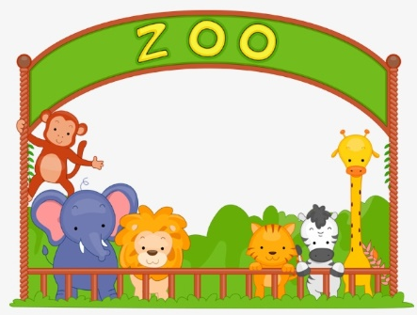
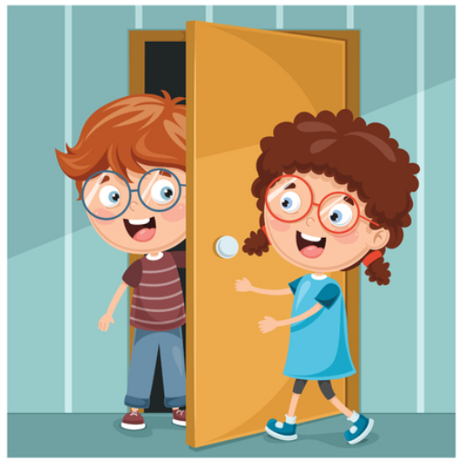
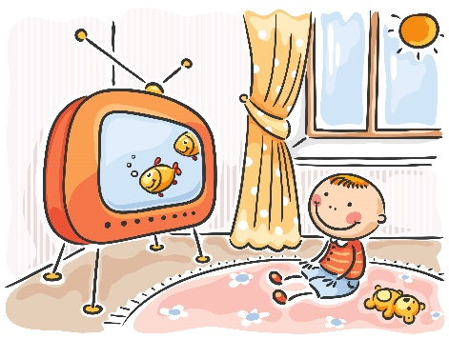
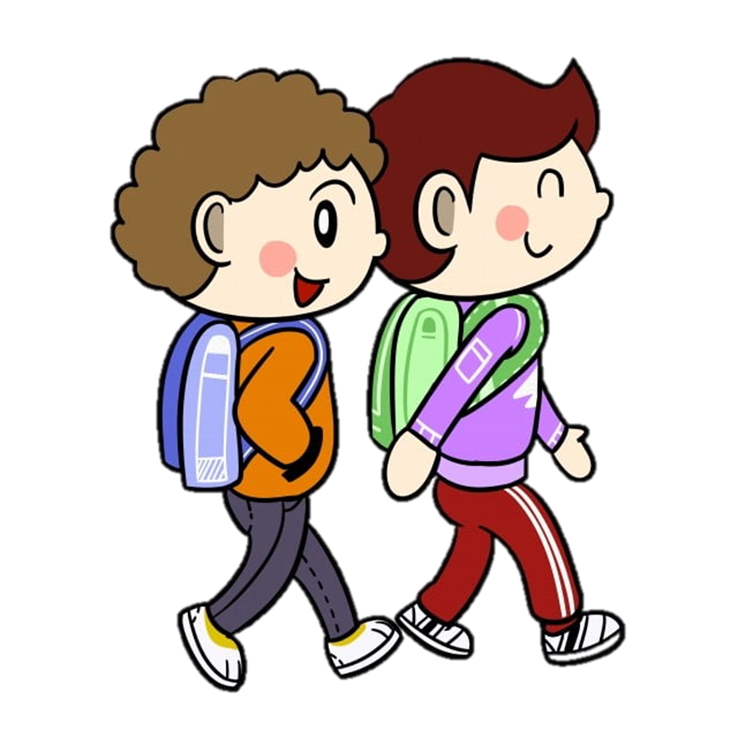
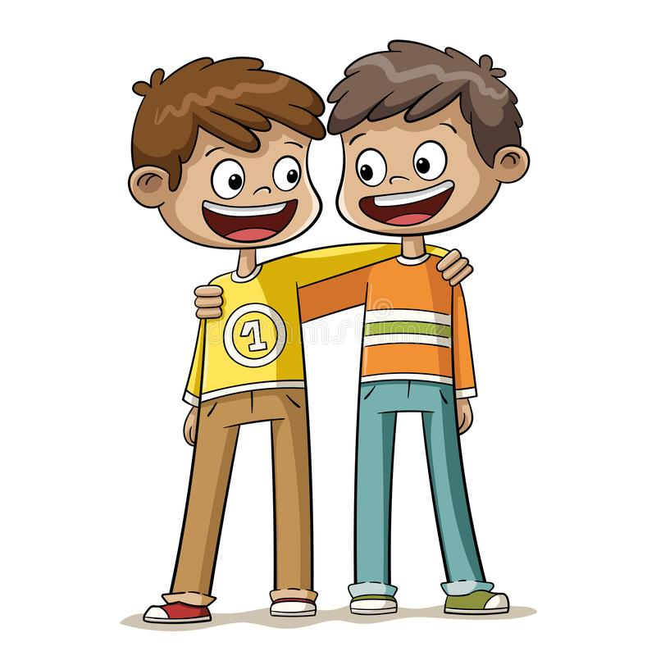
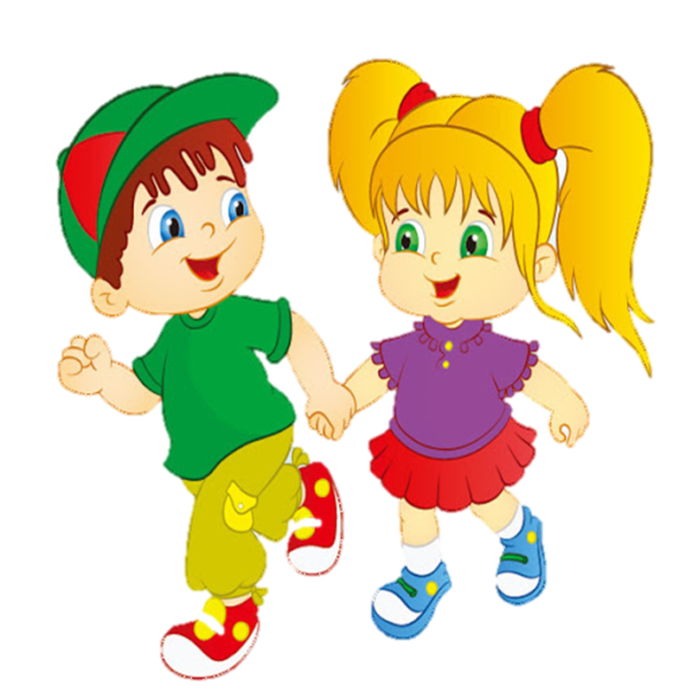
Vocabulary
Go to school
Play the piano
Play the guitar
Listen to music
Visit my grandparents
Go swimming
Go to the zoo
Visit my friend
Watch TV

Slide 4
grammar

Slide 5
What do you do on Monday?
What do you do on Wednesday?

Slide 6
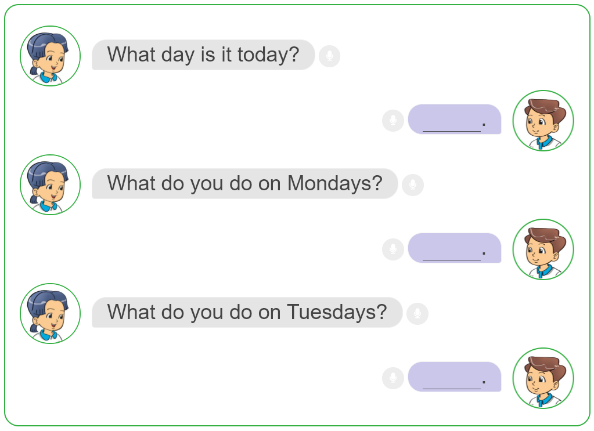
3. Let's talk.

