Slide 1
English grade 4
Unit 2 – Lesson 3
I’m from japan

Slide 2
PHONICS

Slide 3
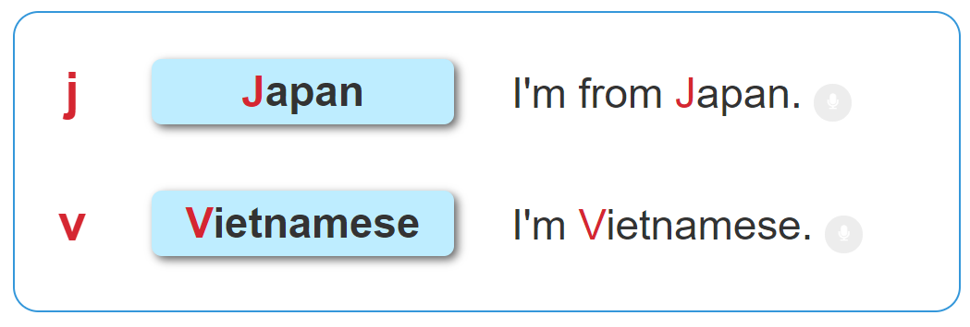

1. Listen and repeat.

Slide 4

2. Listen and tick. Then say aloud.
a. Japan
b. Japanese
a. Viet Nam
b. Vietnamese
1
2

Slide 5
PRACTISE

Slide 6
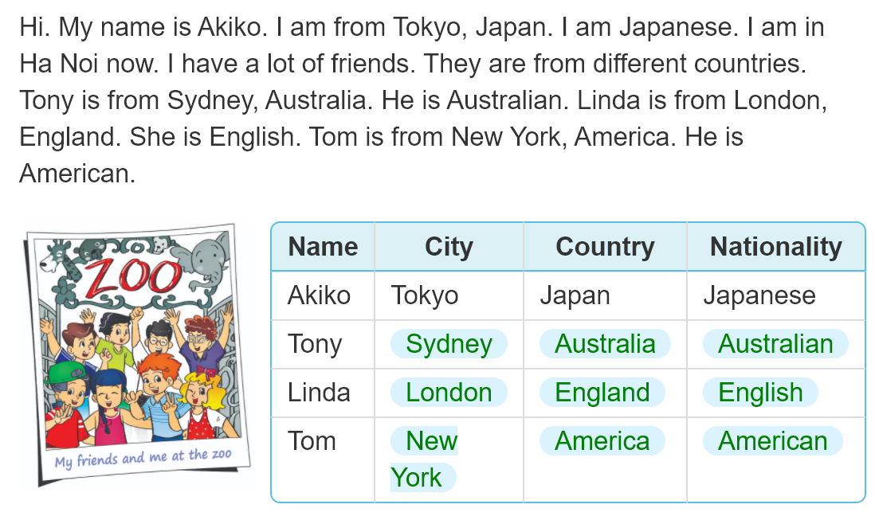
4. Read and complete.

Slide 7
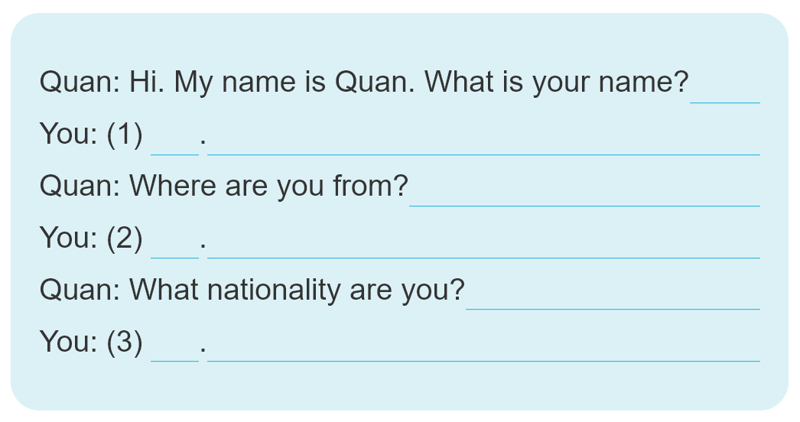
5. Let's write.

