Slide 1
Wednesday, Febuary 22nd 2017
UNIT 14. Are there any posters in the room?
Lesson 2
New words
Cup: cốc
Count: đếm
Mirror: gương
Fan: quạt
How many: bao nhiêu
II. New sentence
How many fans are there?
There are two fans.

Slide 2
Wednesday, Febuary 22th 2017
UNIT 14. Are there any posters in the room?
Lesson 3
Phonics
a fan
u cup

Slide 3
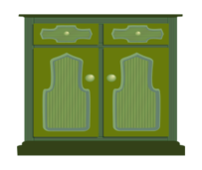
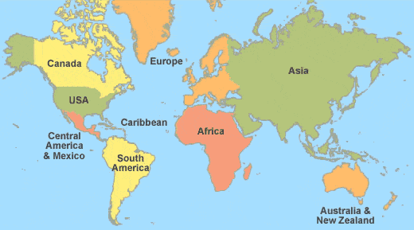

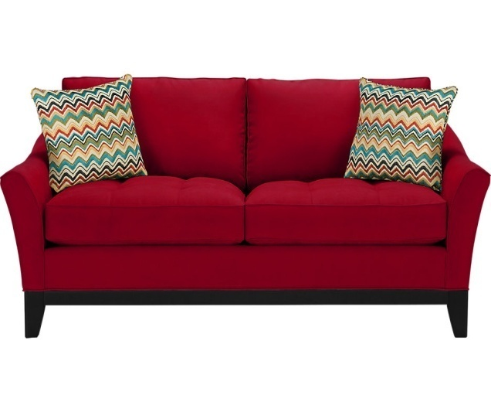
I. New words
Cupboard: tủ chứa đồ
Map: bản đồ
Sofa: ghế sô-pha Wardrobe: tủ quần áo

Slide 4
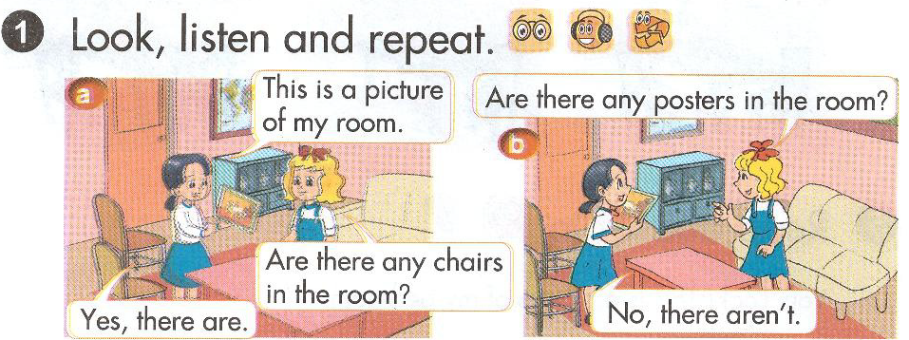

Slide 5
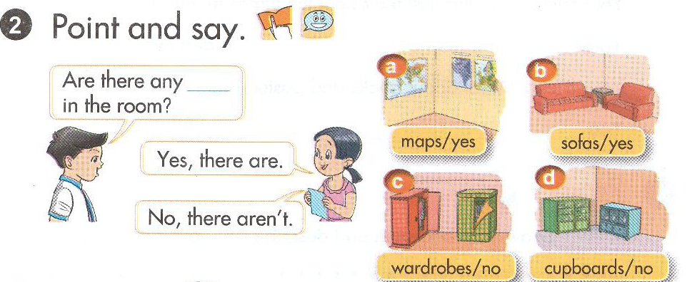
II.New sentence
Are there any maps in the room?
Yes, there are. / No, there aren’t.

Slide 6
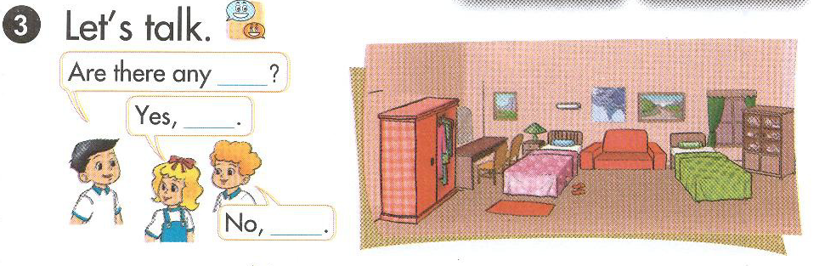

Slide 7
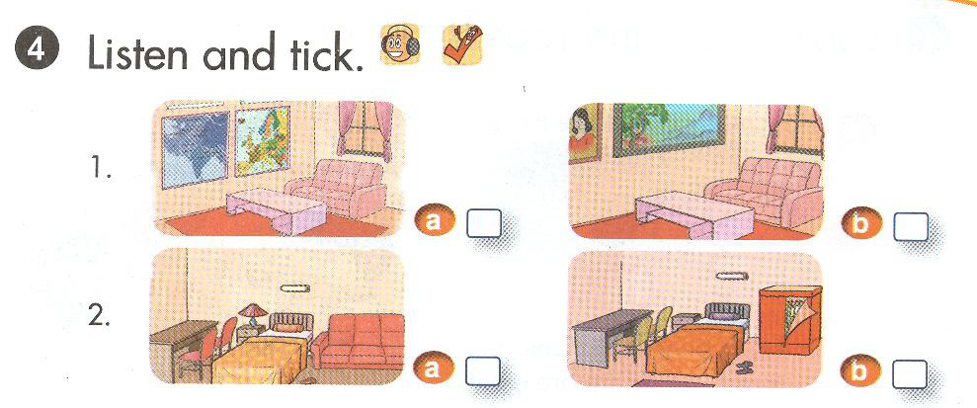

Slide 8
✓
✓

Slide 9
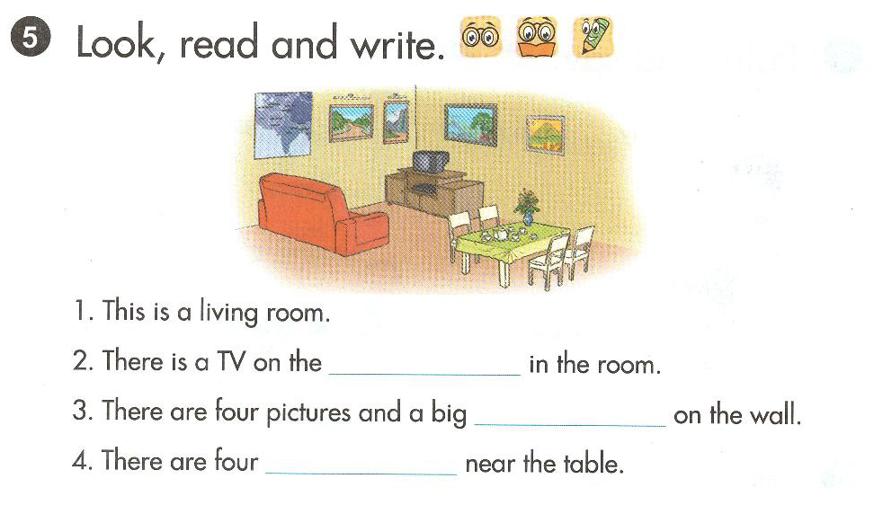

Slide 10
cupboard
map
chairs

Slide 11
