Slide 1


Week 21
Welcome to my class

Slide 2

Guessing game
Brain storming
pen
……….
School things
……….
……….

Slide 3

New words
poster

Slide 4
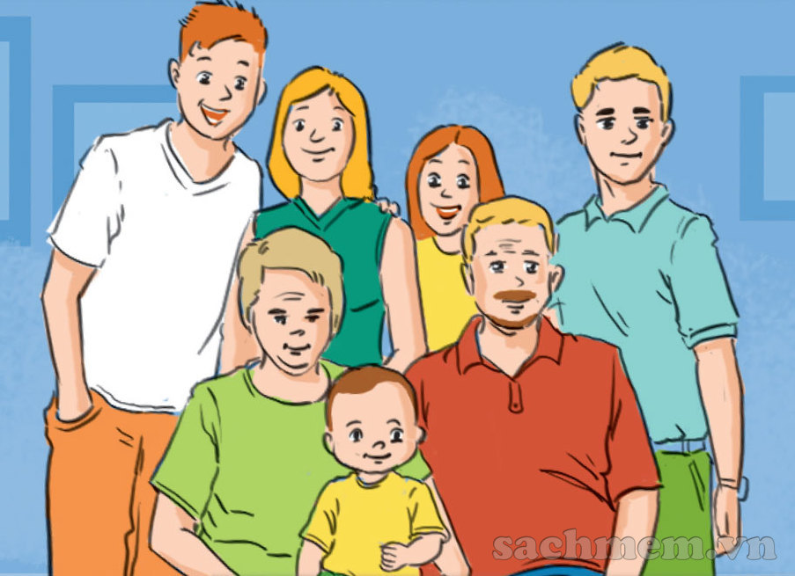
picture

Slide 5

poster
picture

Slide 6

bed

Slide 7
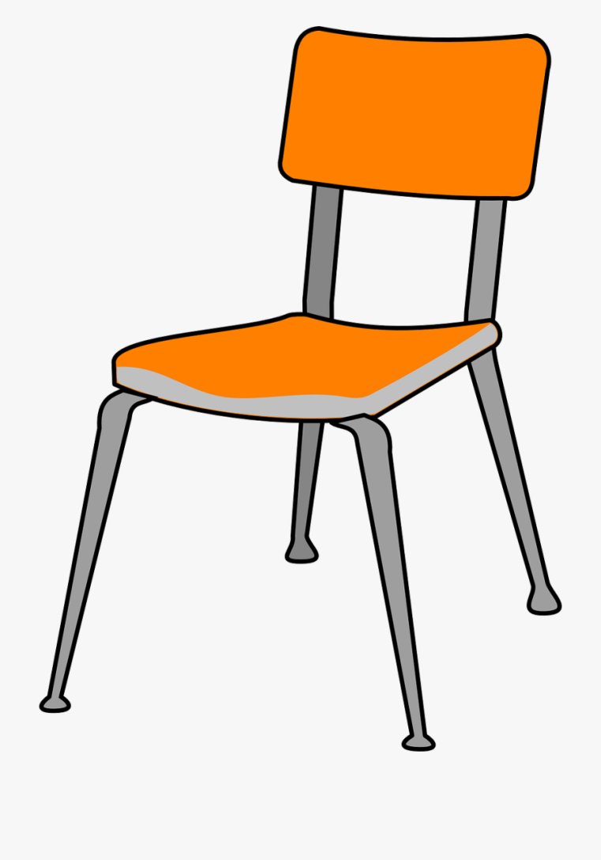
chair

Slide 8

coat

Slide 9

ball

Slide 10
game
Finding pictures

Slide 11

Unit 13: Where’s my book?
Lesson 1

Slide 12

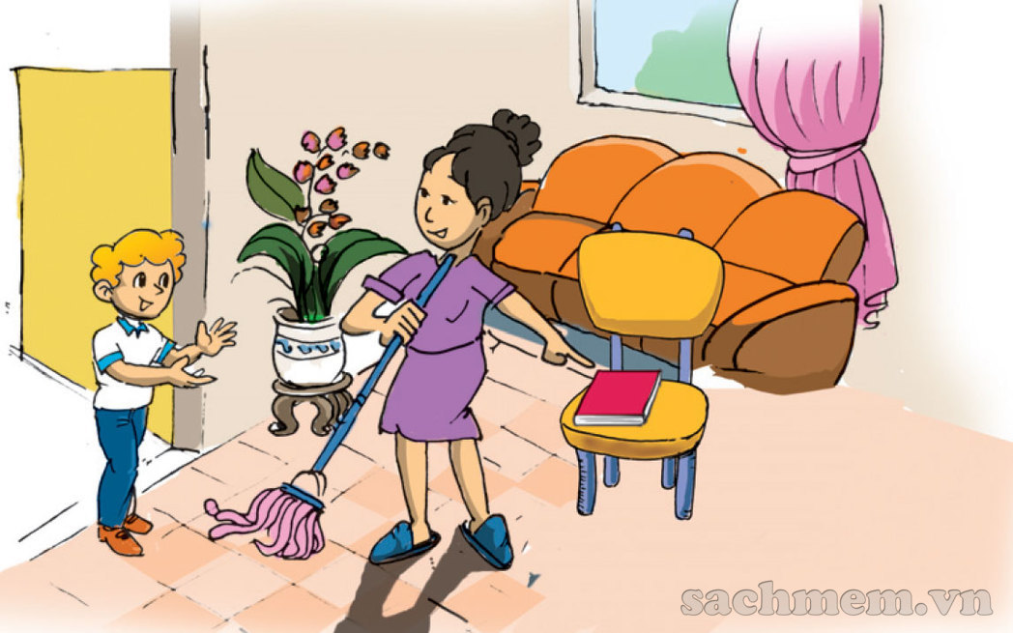
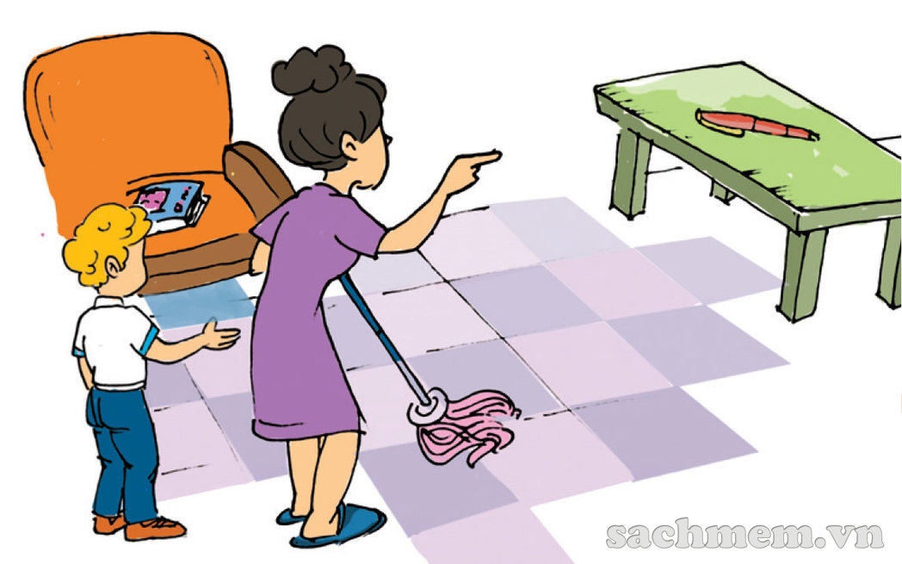
Where’s my book, Mum?
I can’t see it in my room!
Is the pen there too, Mum?
It’s here, dear.
On the chair.
No, it’s not on the chair. It’s there, on the table.

Slide 13
II. Question and Answer:
Where’s the book ?
It’s here.
It’s there.
Where’s =
Where is

Slide 14
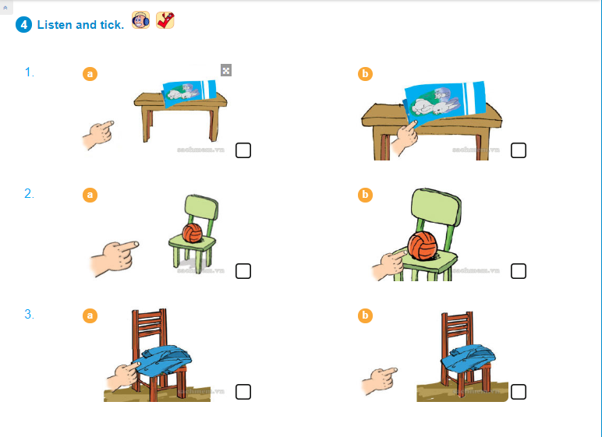


Slide 15
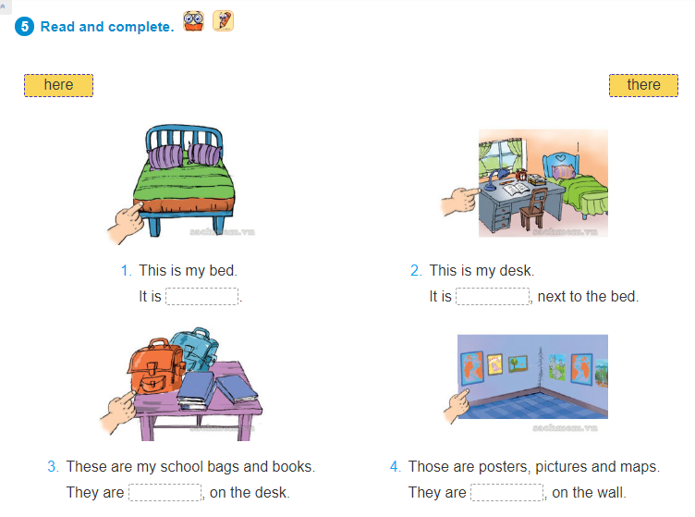
here
here
here
there

Slide 16

Unit 13: Where’s my book
Lesson 1
I. Words:
a poster
a picture
a bed
a coat
II. Q & A:
Where’s the book?
It’s here / there

