Slide 1


UNIT 13 – LESSON 1

Slide 2
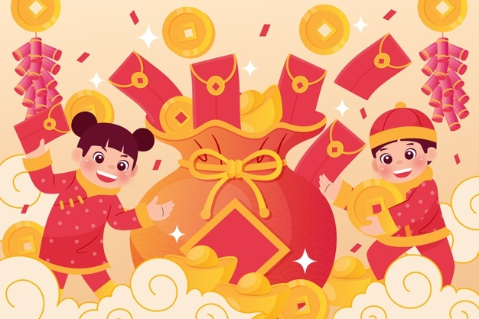
Wish my dear students always look great, do well at school, have good friends and have an exciting new year.
Chúc các học trò yêu quý của cô luôn rạng rỡ, học tập tốt, có những người bạn tốt và một năm mới đầy ắp những điều thú vị.

Slide 3
New words

Slide 4

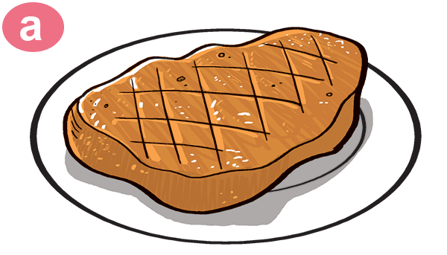
New words
beef
/biːf/

Slide 5
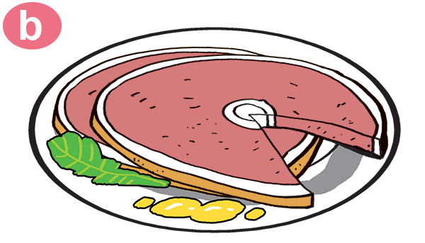
New words
Pork
/pɔːk/

Slide 6


New words
chicken
/ˈtʃɪkɪn/

Slide 7
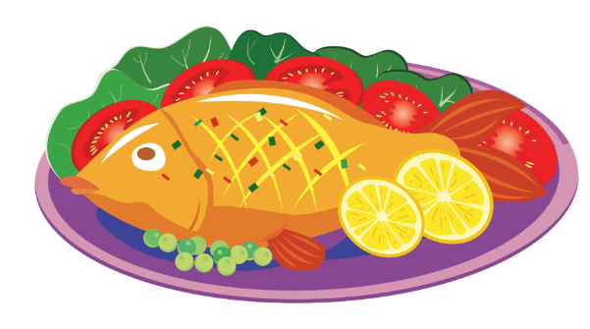
New words
fish
/fɪʃ/

Slide 8
New words
food
/fuːd/

Slide 9
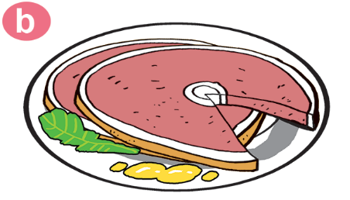
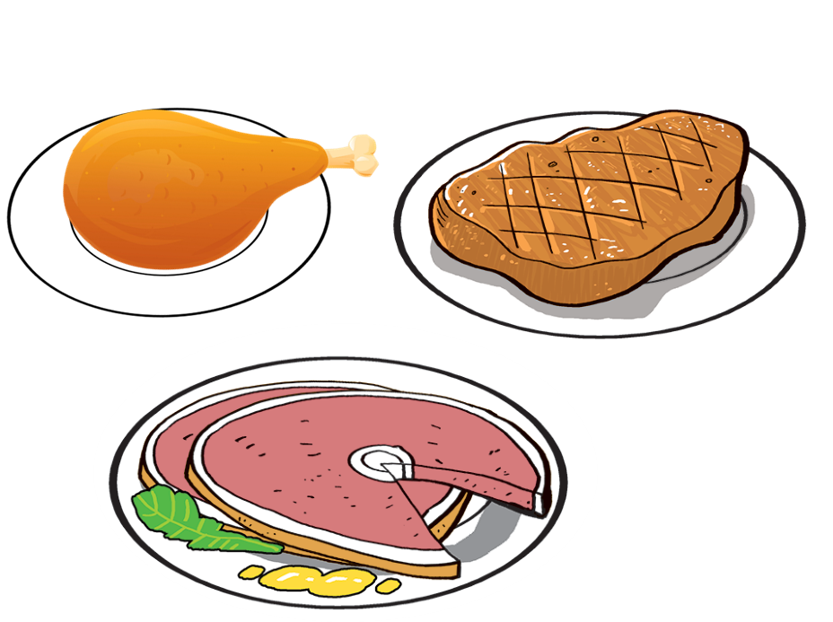
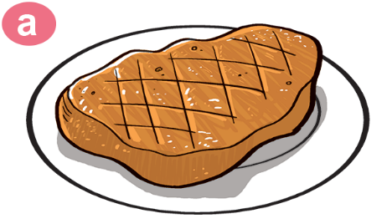

1
2
3
4
5
Chicken
Pork
beef
Fish
Food

Slide 10
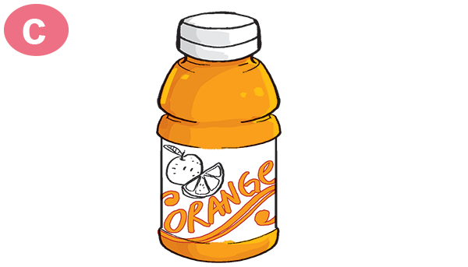
New words
Orange juice
/ˈɔːrɪndʒ dʒuːs/

Slide 11
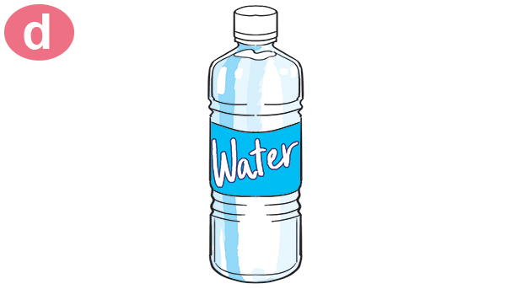
New words
water
/ˈwɔːtər/

Slide 12
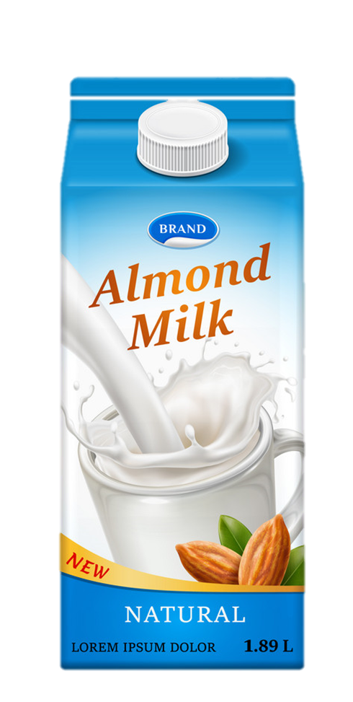
New words
milk
/mɪlk/

Slide 13
New words
drink
/drɪŋk/

Slide 14
New words
favourite
/ˈfeɪvərɪt/

Slide 15
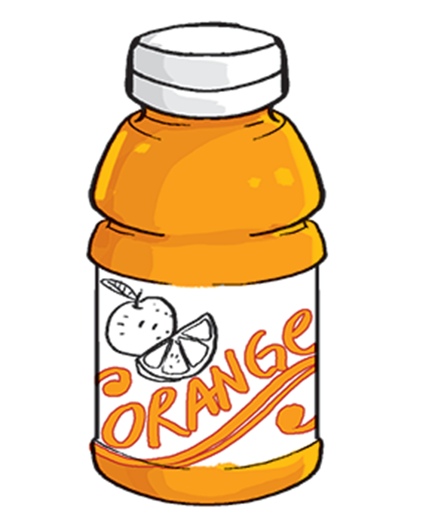
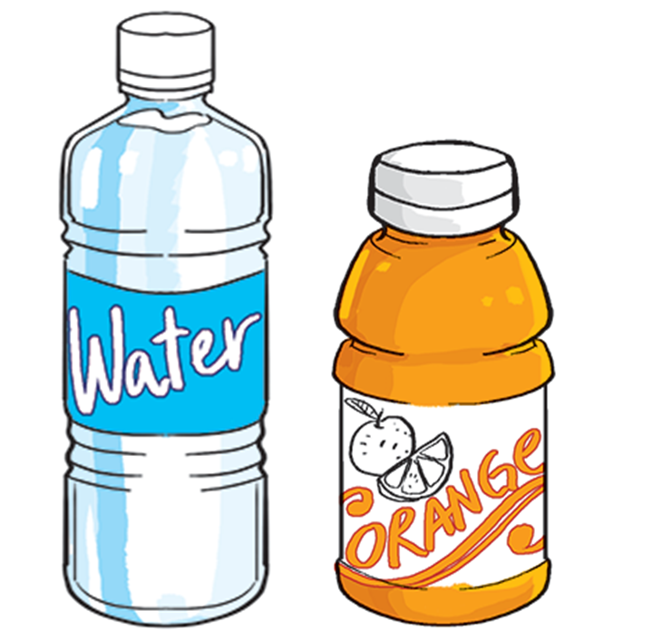

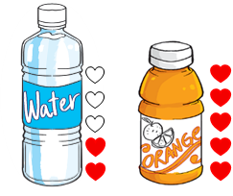
6
7
8
9
Milk
Water
Orange juice
Drink
Favourite
10

Slide 16

New words
1
2
3
4
5
Chicken
Pork
beef
Fish
Food
6
7
8
9
Milk
Water
Orange juice
Drink
Favourite
10

Slide 17






Slide 18



Chicken
beef

Slide 19
Fish
beef

Slide 20
food
drink

Slide 21
Food
Fish

Slide 22
Water
Orange juice

Slide 23
beef
Pork

Slide 24
Drink
Fish

Slide 25
Favourite
Orange juice

Slide 26
Orange juice
Water

Slide 27
Orange juice
Milk

Slide 28


Slide 29
GRAMMAR

Slide 30
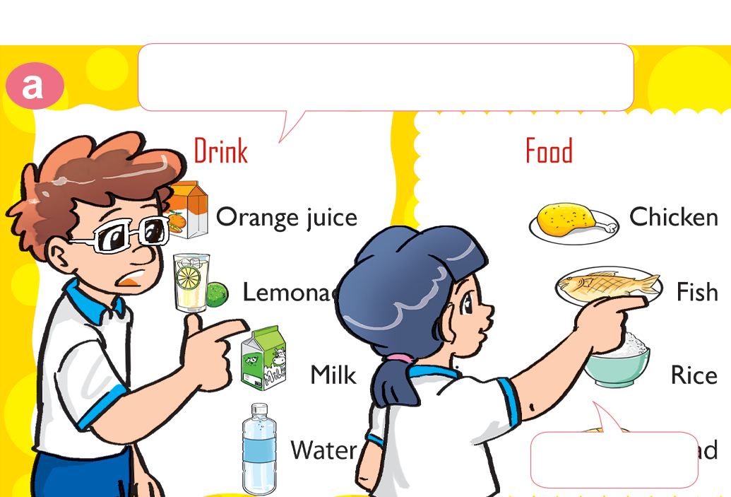
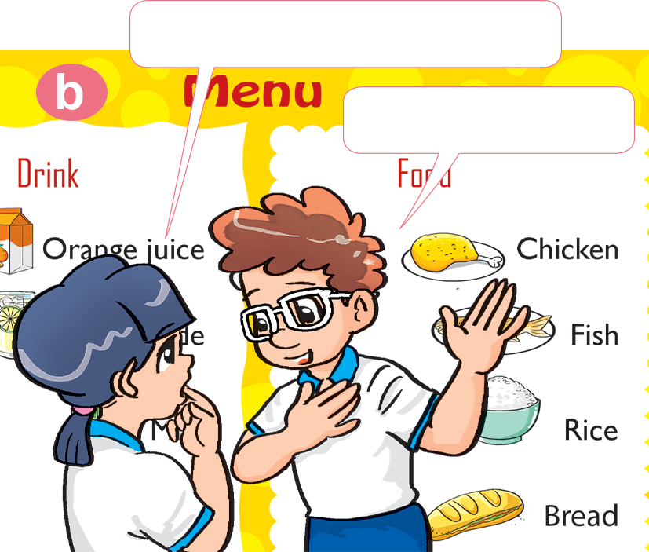
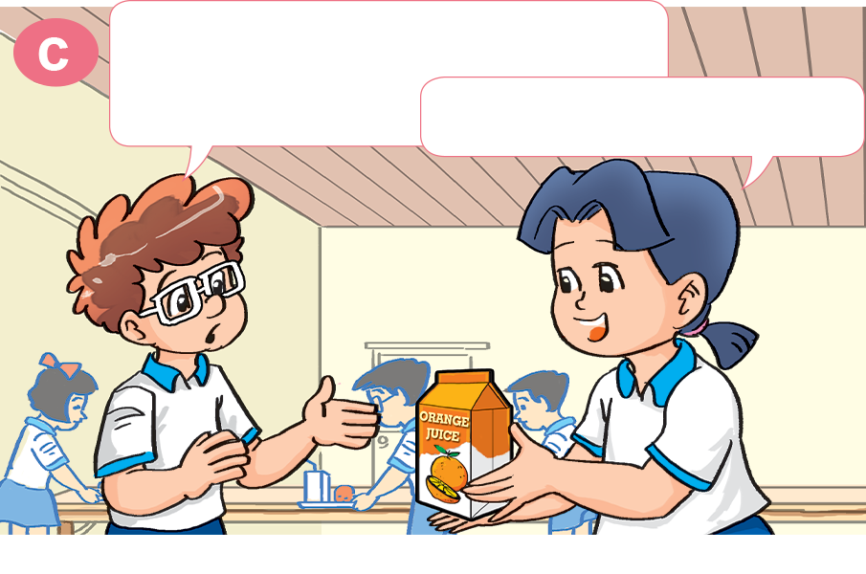
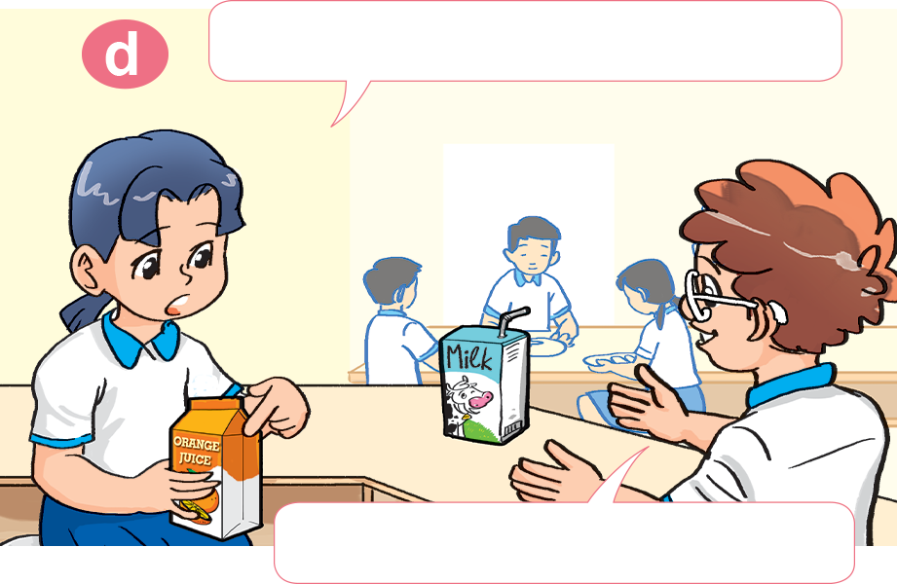
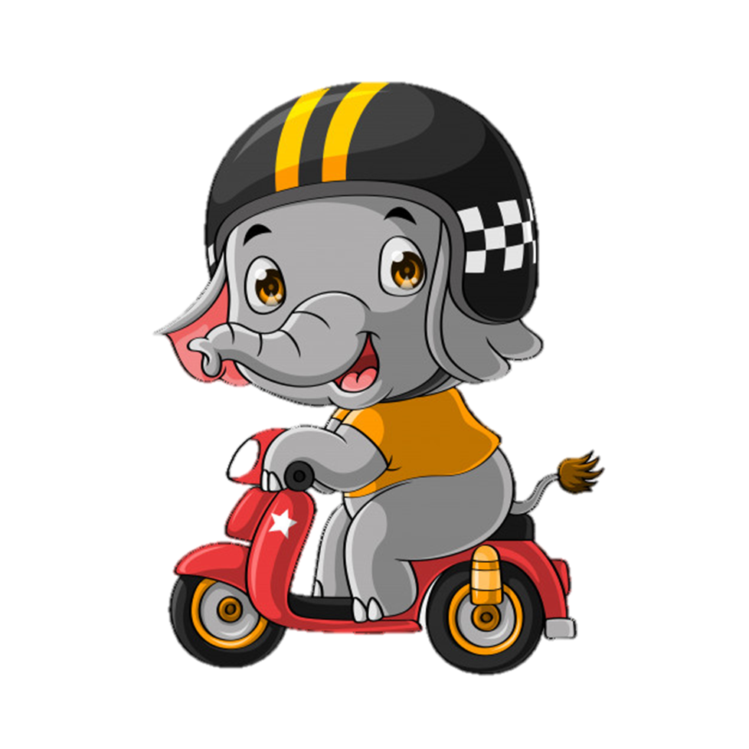
1. Look, listen and repeat
How about you, Tom?
What's your favourite food?
I like chicken.
It's fish.
What's your favourite drink, Mai?
Do you like orange juice?
It's orange juice.
No, I don't. I like milk.

Slide 31

Model sentence
What's your favourite food/drink?
It's ___________.
orange juice
chicken
pork
water
beef
fish
milk

Slide 32
2. Point and say.
What's your favourite __________?
It's ___________.
food
beef

Slide 33
2. Point and say.
What's your favourite __________?
It's ___________.
food
pork

Slide 34
2. Point and say.
What's your favourite __________?
It's ______________.
drink
orange juice

Slide 35
2. Point and say.
What's your favourite __________?
It's ___________.
drink
water

Slide 36

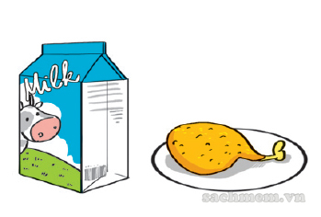
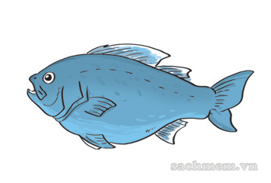
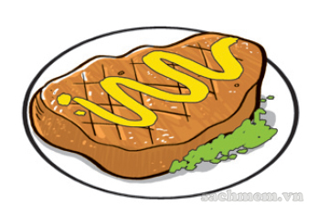
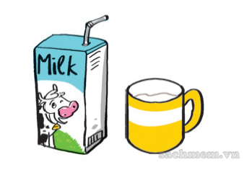
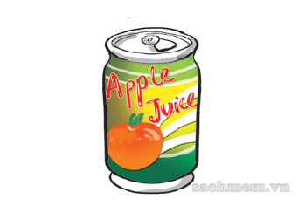
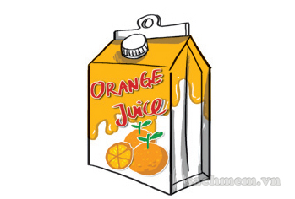
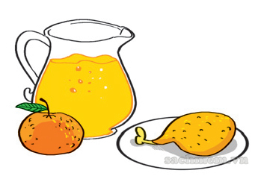
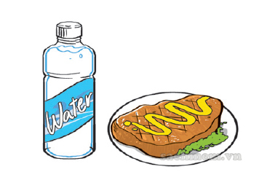
3. Listen and tick.
1. What's his favourite food?
a
b
c
✔
2. What's his favourite drink?
a
b
c
✔
3. What is her favourite food and drink?
a
b
c
✔

Slide 37
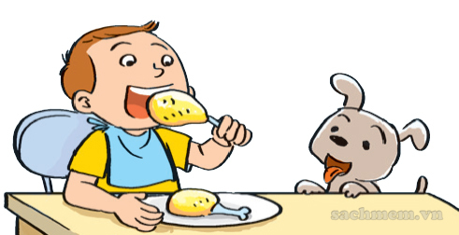
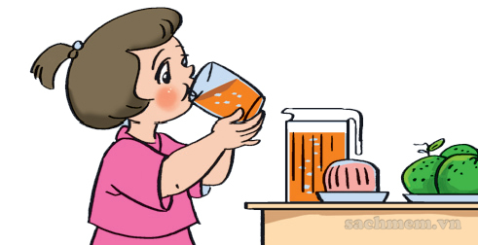
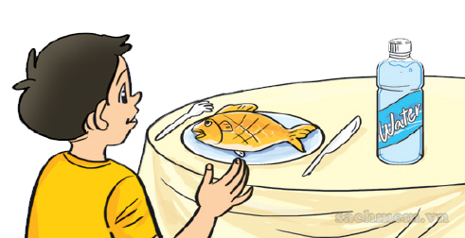
4. Look and write.
1. A: What's his favourite food?
B: _______________________.
It's chicken
2. A: What's her favourite drink?
B: _______________________.
It's orange juice
3. A: What's his favourite food and drink?
B: _______________________.
It's fish and water

Slide 38
Thursday, February 10th 2020
Unit 13: Would you like some milk?
Lesson 1
I. Words: Food beef pork chicken fish
III. Exercises:
W (2)
Q&A (p2)
Olm.vn
Drink milk orange juice water
II. Sentence patterns: What’s your favourite food / drink ? It’s pizza / milk.

Slide 39

What’s your favourite drink?
a. It’s beef.
b. It’s water.
c. It’s juice.
Next

Slide 40
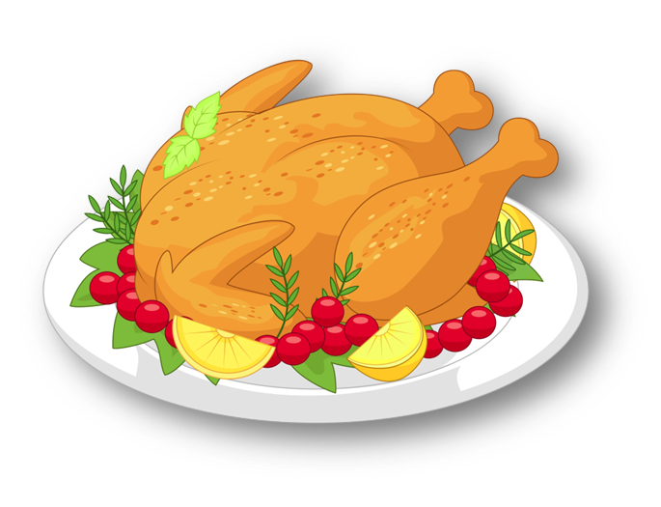
What’s your favourite food?
a. It’s chicken.
b. It’s beef.
c. It’s fish.
Next

Slide 41
What’s your favourite food?
a. It’s pork.
b. It’s fish.
c. It’s beef.
Next

Slide 42
What’s your favourite food?
a. It’s beef.
b. It’s pork.
c. It’s milk.
Next

Slide 43
What’s your favourite drink?
a. It’s chicken.
b. It’s water.
c. It’s milk.
Next

Slide 44
What’s your favourite food?
a. It’s fish.
b. It’s water.
c. It’s pork.
Next

Slide 45
What’s your favourite drink?
a. It’s orange juice.
b It’s chicken.
c. It’s milk.
Next

Slide 46
What’s your favourite food?
____________ beef.
a. I’m.
b. I
c. It’s
Next

Slide 47
What’s your favourite _____?
a. orange juice.
b. food.
c. drink.
Next

Slide 48
What’s your ______ drink?
a. favourite
b. drink
c. milk
Next

Slide 49
______ your favourite food?
It’s chicken.
a. What
b. what’s
c. What are
Next

Slide 50
What’s your favourite _____?
a. drink
b. food
c. like
Next

Slide 51
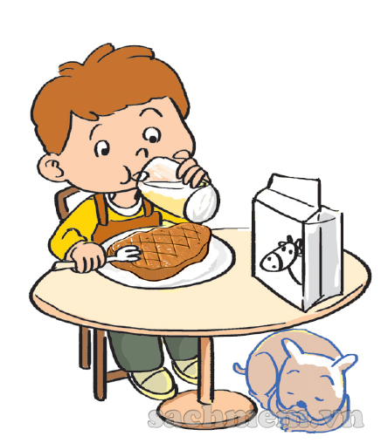
5. Let’s sing.
My favourite food and drink
What's your favourite food? What's your favourite food?
Hey ho, hey ho, my favourite food is beef.
What's your favourite drink? What's your favourite drink?
Hey ho, hey ho, my favourite drink is milk.
Beef and milk, beef and milk.
Hey ho, hey ho, they're my favourite food and drink

